Slide 1


The Rise and Fall of Cost-Effectiveness:
A state of play
Luis Salvador-Carulla
luis.salvador-carulla@canberra.edu.au

Slide 2




Cost Analysis in Mental Health
Glass NJ, Goldberg D. Cost-benefit analysis and the evaluation of psychiatric services. Psychol Med. 1977 Nov;7(4):701-7. doi: 10.1017/s0033291700006358.
Goldberg D. Cost-effectiveness studies in the treatment of schizophrenia: a review. Soc Psychiatry Psychiatr Epidemiol. 1991 May;26(3):139-42. doi: 10.1007/BF00782953.
Weisbrod BA, Test MA, Stein LI. Alternative to mental hospital treatment. II. Economic benefit-cost analysis. Arch Gen Psychiatry. 1980 Apr;37(4):400-5. doi: 10.1001/archpsyc.1980.01780170042004.
Goldman HH, Scheffler RM, Cheadle A. Demand for psychiatric services: a clinical episode model for specifying "the product". Adv Health Econ Health Serv Res. 1987;8:255-73. P
International Center of Mental Health Policy and Economics (ICMPE)
The Cost of Schizophrenia, Fondazione Giorgio Cini, Venice, October 29-31, 1990

Slide 3

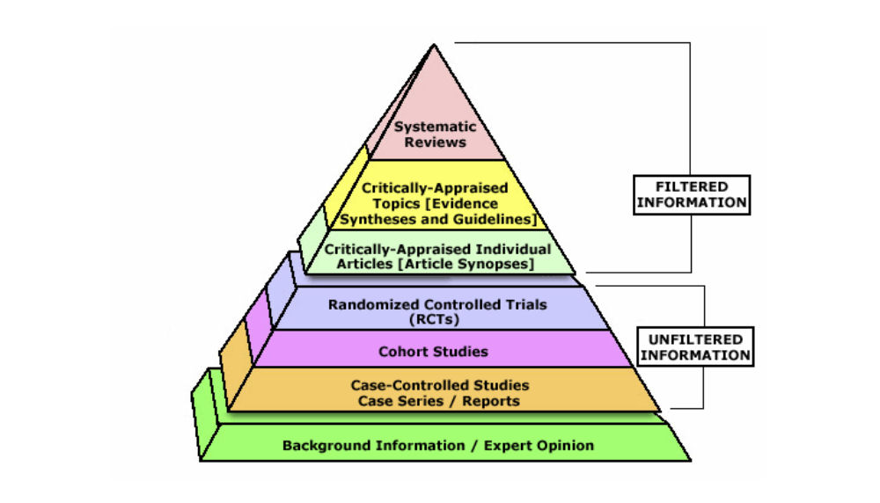
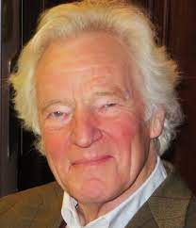

Maynard, A., Sackett, D. L., Rosenberg, W. M. C., Muir Gray, J. A., Haynes, R. B., & Richardson, S. (1996). Cost effectiveness and equity are ignored [13]. British Medical Journal, 313(7050), 170-171.
RCT
Coste como prioridad?
Importancia de efectividad relativa
Incertidumbre sobre costes

Slide 4

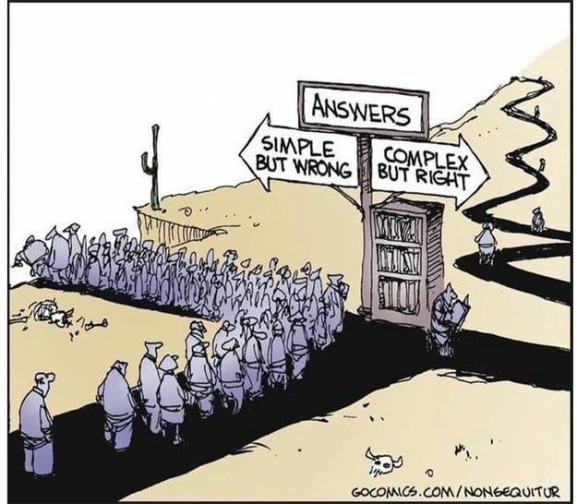
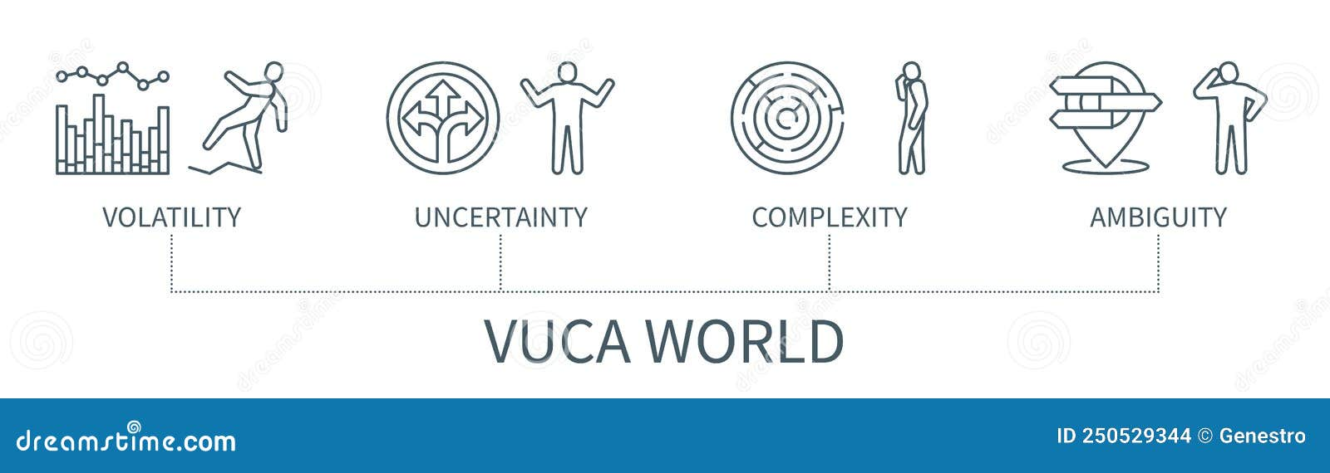
A VUCA WORLD
CEA
CER

Slide 5
Multicomponent, adaptable interventions that act independently or interdependently to change care processes and outcomes and typically require specific involvement and behaviors by patients, caregivers, and health professionals. Examples: delivery system interventions, organisational interventions, behavioral and psychological interventions, and other non-pharmacological treatments.
Complex Interventions (CHIs)
NHS (UK)
PCORI (US)
NICE (UK) Real World Evidence Framework (UK) www.nice.org.uk/corporate/ecd9
IoM (US)
Learning What Works: Infrastructure Required for Comparative Effectiveness Research: Workshop Summary. IoM, Washington, DC: The National Academies Press. 2011
Raine R, et al. Challenges, solutions and future directions in the evaluation of service innovations in health care and public health. Southampton (UK): NIHR Journals Library; 2016
Esmail LC, et al. Improving Comparative Effectiveness Research of Complex Health Interventions: Standards from the PCORI. J Gen Intern Med. 2020;35(S2):875-881.
Implementation and health service research

Slide 6
Pleotropic Drugs actions other than those for which the agent was specifically developed.
- PLG-1: Sumaglutide - it took 20 years to figure out what PLG-1 are doing
- Diabetes treatment paradigm was not prepared for the drug! RCTs did not provide useful and meaningful results
- Gut -hormone related to glucose not worked that much! Testing it in obesity at higher doses in the recent 5 years changed the perception of a drug tackling diabetes, obesity, inflammation and CVD
-The known unknown side effects - the longest trial is 40 months-
Muscle mass
Bone density
- Equality: people at need are the most unlikely to get it due to costs prescription, accessibility, etc. New approaches to understand financing, costs of multi-complex illness, long-term effects beyond diabetes (CVD, metabolic syndrome)
DIABETES
In Real World, patients with myeloma have worse treatment outcomes than in RCT: new approach is needed
ONCOLOGY

Slide 7
Intervenciones individuales complejas e intervenciones organizativas
Intervenciones transdiagnósticas en prevención primaria de TM infanto-juveniles NO RECOMENDADAS
- MYRIAD (Kuyken et al., 2022):
10 sesiones de psicoeducación y práctica de mindfulness.
6 sesiones de CBT interactivas (40 minutos).
- CLIMATE SCHOOLS (Andrews et al., 2022
8 sesiones de DBT grupal (50-60 minutos).
- WISE TEENS (Harvey et al., 2023)
Estrategias nacionales de prevención de suicidio (46 paises) NO EFECTIVAS
- NSPP (National suicide prevention strategy with specific objectives - 9 countries) (Canal-Rivero et al, in press)
Intervenciones digitales en la prevención de trastornos FALTA EVIDENCIA
- EMPOWER / eCOMPARED

Slide 8
Comparative effectiveness: eCOMPARED
CER in different mental care settings on the (cost-) effectiveness of blended internet-based treatment for depression in comparison with standard care
Prior knowledge base: Framework, Reviews (Scoping, mapping and systematic reviews),
Protocol, Barriers and Facilitators
Evaluation: including PRO and PRE, attitudes (acceptability)
Mixed Analysis: ecological momentary assessment data, multi-relational data mining / qualitative content analysis
Modelling (agent-based modelling, predictive modelling , forecasting)
Randomised non-inferiority trial
Discrete event simulation modelling of long term cost-effectiveness – extrapolation RnIT
- There are no significant differences in QALYs or societal costs between bCBT and TAU
- CBT cannot be considered cost-effective as compared to TAU.
- Caution due to high uncertanty
O'Connell et al. Discrete event simulation modelling of long term cost-effectiveness of internet-based blended cognitive behavioural therapy for major depressive disorder: Extrapolation of the E-Compared randomised controlled trial. Value in Health, 20(9), A403.

Slide 9


Slide 10
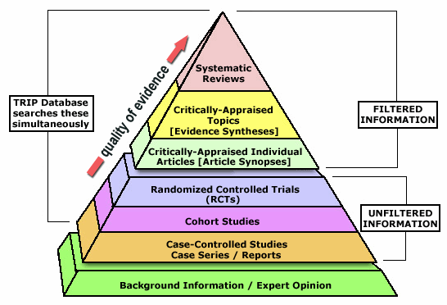
Thinking differently
From Evidence-based medicine to evidence-INFORMED policy
From the Pyramid to
the Greek Temple
Scientific Knowledge
QUANTITATIVE Evidence-based on data Mixed QUALITATIVE: Knowledge-based on expertise
Experimental
RCTs
Observational
Ecological - Cohort
Contextual
Geography,SDoH, Lifestyles
Expert Knowledge
Formal and Tacit
Experiential
Consumers, carers
Cultural
Historical, spiritual, Normative
Systematic review/meta analysis
validity
Randomised control trials
Cohort studies
Case control studies
DISCOVERY – CORROBORATION – IMPLEMENTATION
Case series/reports
Expert “opinion”
Moving from the pyramid model of scientific knowledge to the General framework: Greek temple model of scientific knowledge.
Salvador-Carulla, L., Lukersmith, S., & Sullivan, W. (2017). From the EBM pyramid to the Greek temple: a new conceptual approach to Guidelines as implementation tools in mental health. Epidemiology and Psychiatric Sciences, 26, 105-114. doi: 10.1017/S2045796016000767
REAL WORLD PROBLEMS

Slide 11

“Evidence-informed Care Policy”
‘Evidence-based health care’ has evolved into ‘evidence-informed policy’ through the addition of routine big data and local context information, and into ‘knowledge-guided policy’ through the incorporation of domain experts to the data analysis process and to the development of Decision Support Systems
Evidence-informed, rather than evidence-based, health policy acknowledges that policy-making is an inherently political process in which research evidence is only one, albeit the most important, factor that influences decision-making. Scientific evidence often has to compete with beliefs, personal interests, political considerations, traditions, past experience, and financial constraints
http://www.euro.who.int/__data/assets/pdf_file/0008/379862/who-ehr-2018-eng.pdf?ua=1

Slide 12
Ontoterminology: Taxonomies and dictionaries
Ambiguity unclarity
Mental disorders
MH Interventions
MH Services
MH Systems

Slide 13


Context
Analysis
Evidence
Implementation
Context
Expert
Knowledge

Slide 14

MENTAL HEALTH POLICY UNIT:
HEALTH ECOSYSTEM RESEARCH AND IMPACT ANALYSIS

Slide 15
Healthcare Ecosystem
Research
- Part of Implementation Sciences that incorporates systems dynamics, context analysis, health economics & knowledge discovery from data.
CONTEXT
In health care it includes all sources of evidence of the local system: geography, social and demographic factors, other environmental factors, service availability, capacity, use and costs. It also includes legislation and expertise on the milieu (e.g., the historical account current state of the art)
- Facilitates analysis of environment and context, and its knowledge translation to policy, for decreasing research waste and to guide decision making in complex questions in health care.

Slide 16
Healthcare Ecosystems Research (HER)
Context
Target
Health Ecosystem
Connections
Drivers
DSSC -EbCA

Slide 17
HER
Wellbeing
Context= Environment
Sociocultural
Physical
Individual
Context
Target
Consumers
Lifestyles
Built environment
Professionals
Human
Teams
Prevention
Health Ecosystem
Organisations
SDoH
Care
Classifications
Models
Frameworks
Connections
Drivers
Theories
Classical Stat
Dynamic modelling
GIS
Ecosystem
research
DSSC -EbCA
Organisational Learning
Methods
Impact Analysis

Slide 18
Context
Target
Ontoterminology
Financing
Health Ecosystem
Frameworks and theories
Taxonomies and Ontologies
Dictionaries and glossaries
Connections
Drivers

Slide 19
HER: Neighbourhood
characteristics
& Chronic Illness
Context
Target
Health Ecosystem
Connections
Drivers

Slide 20
HEALTHCARE ECOSYSTEM RESEARCH:
Analysis of service provision and unmet needs
Cost of Illness
Burden of Illness
Financing of Illness
Consumers
Professionals
Context
Target
Teams
Health Ecosystem
Organisations
Connections
Drivers

Slide 21
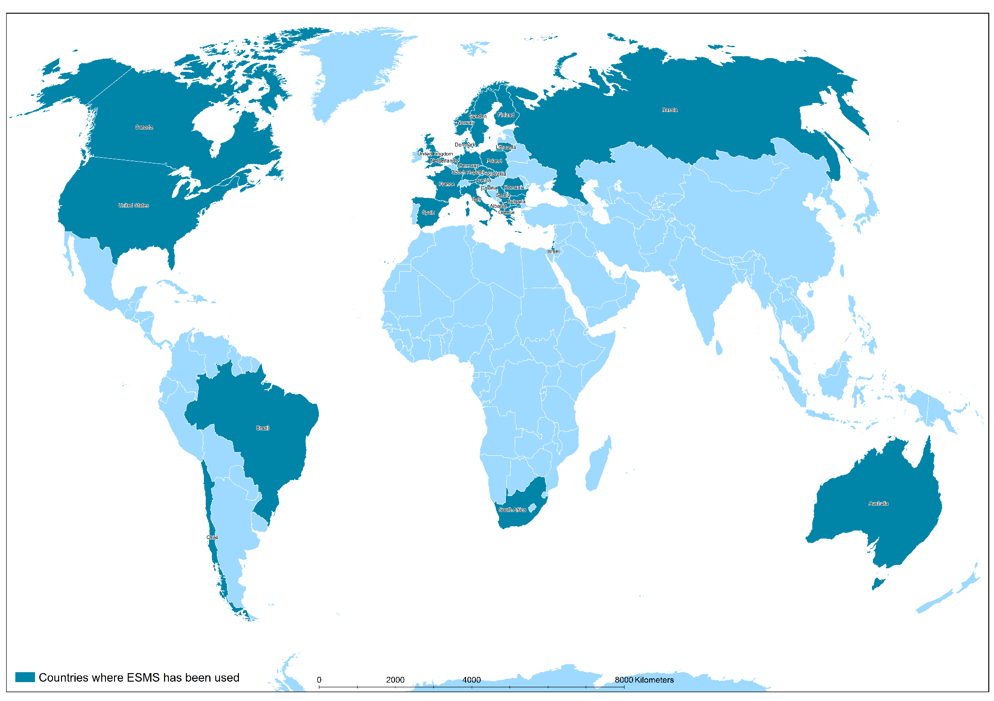
Decision Support Systems: Where?
ARTIC: comparison of remote areas
FINLAND: mapping and planning
FRANCE: Residential care units
ENGLAND: Efficiency analysis of supported accommodation services
EU (Norway, Austria, Italy, England, France, Spain, Finland): Coding, mapping, efficiency analysis, financial assessment
QATAR: Coding, mapping
WHO: Mental health services types in low and medium income countries
CHILE, BOLIVIA, MEXICO, AUSTRALIA (COALAR project): Coding, mapping
SPAIN (Basque Country, Catalonia, Madrid, Andalusia, etc.): Coding, mapping, efficiency analysis, intervention impact analysis, spatial analysis
Since 2000, 75 studies in 35 countries have used the ESMS/DESDE codification system
CHILE: Coding, mapping
Adaptable models and techniques
AUSTRALIA (WA, WS and ACT): Coding, mapping, efficiency analysis, spatial analysis, health urban determinants

Slide 22
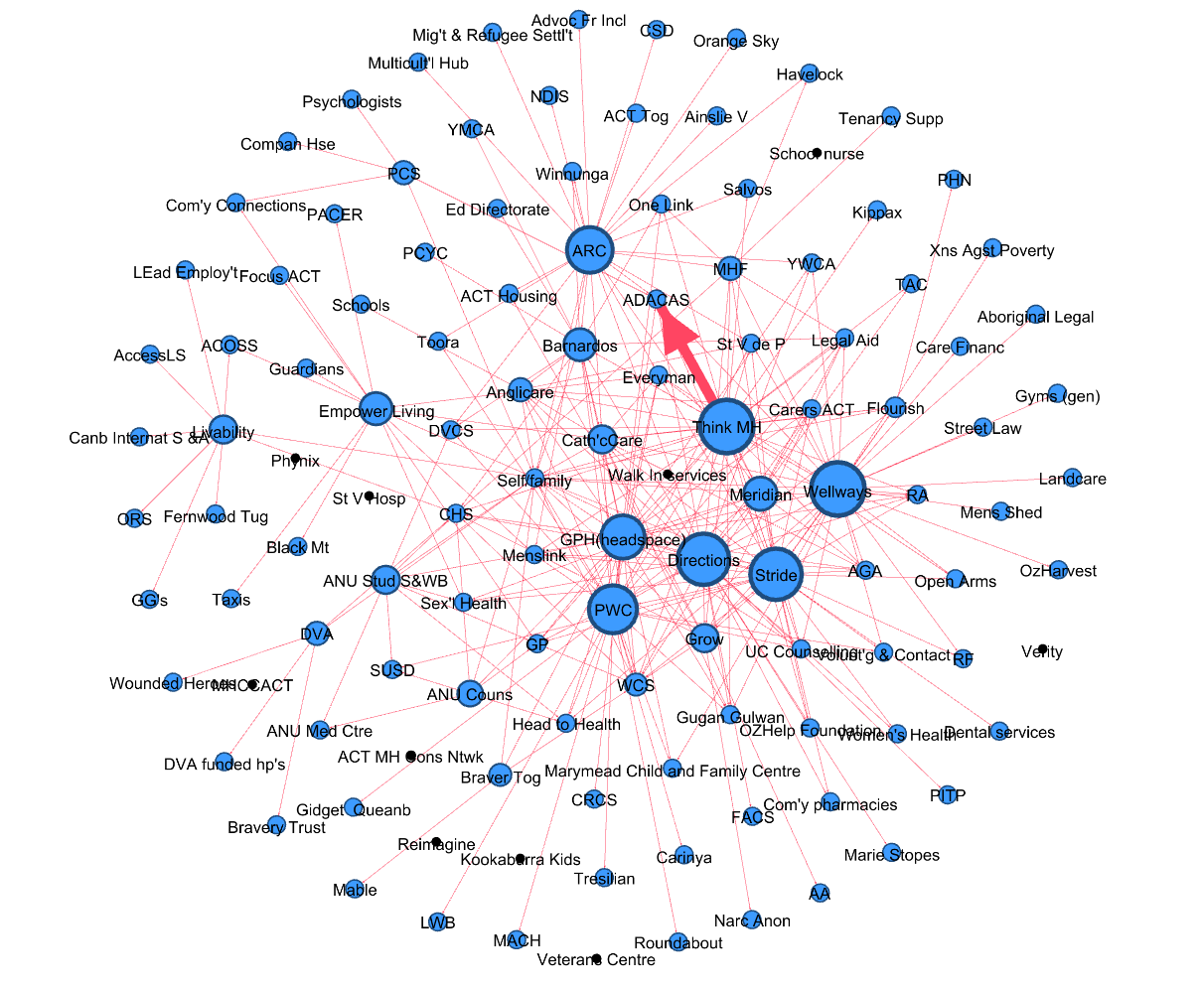
Social Network Analysis:
Reported connections with other services in the ACT
Context
Target
SNA
Health Ecosystem
Connections
Cost Consequence
Comparative effectiveness
Drivers

Slide 23
Healthcare Ecosystems Research (HER)
Context
Target
Health Ecosystem
Connections
Drivers
DSSC -EbCA

Slide 24


Designing Decision Support Systems (DSS) in complex health care ecosystems
Dealing with complexity
DSS: WHY?
Organizational change for improving MH care
DSS: HOW?
Adaptable models and techniques
DSS: WHERE?
Studies conducted in several countries with the collaboration of public agencies
Combine Health Ecosystem Research and Impact Analysis
A DSS is a health information technology that provides policy makers, planners, staff, consumers, or other stakeholders with data-driven knowledge and person and context-specific information, to help taking complex decisions under conditions of uncertainty or ambiguity

Slide 25
Decision Support Systems: Why?
Four Questions for organisational change:
Do you know how good you are? Logic/action model of reference and framing analysis.
Do you know where you stand relative to the best? List of comparators and benchmark analysis.
Do you know where the variation exists? Set of systems’ indicators and decision analytics.
Do you know the rate of improvement over time? Systems’ monitoring and comparative efficiency analysis.
Decision Support System is a “socio-technical” SYSTEM specifically designed and developed to HELP DECISION MAKERS (in health or in any decisional situation) to UNDERSTAND the ecological SYSTEM where they operate.

Slide 26


Decision Support Systems: How?
SPATIAL,
BAYESIAN,
EFFICIENCY
ANALYSIS
Knowledge
Guided Policy
SMART DECISION SUPPORT SYSTEMS
Analysis of Interventions
CER
Scenarios & Models
Burden
Financing
Cost of Illness
Service provision
Resource Utilisation
Outputs of care

Slide 27
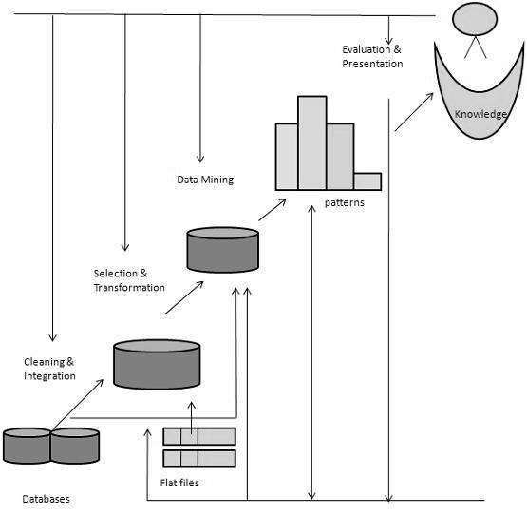
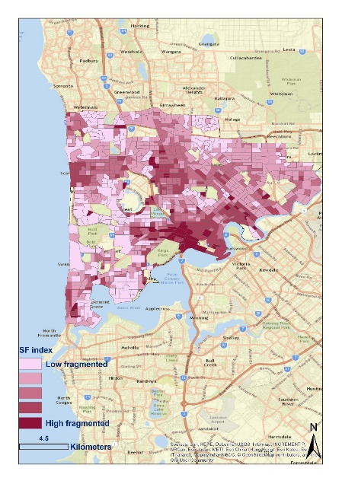
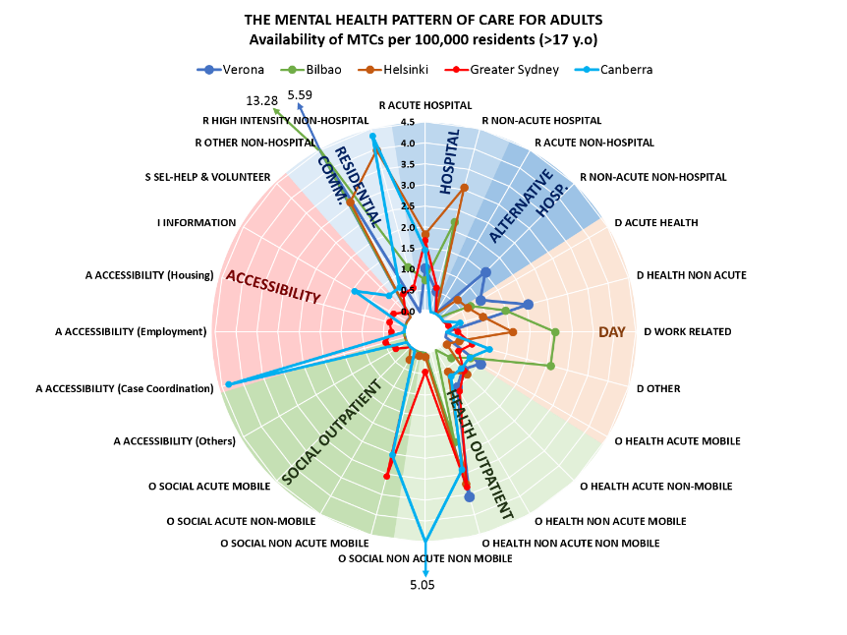
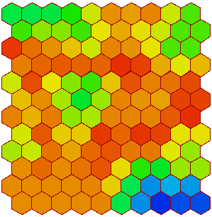
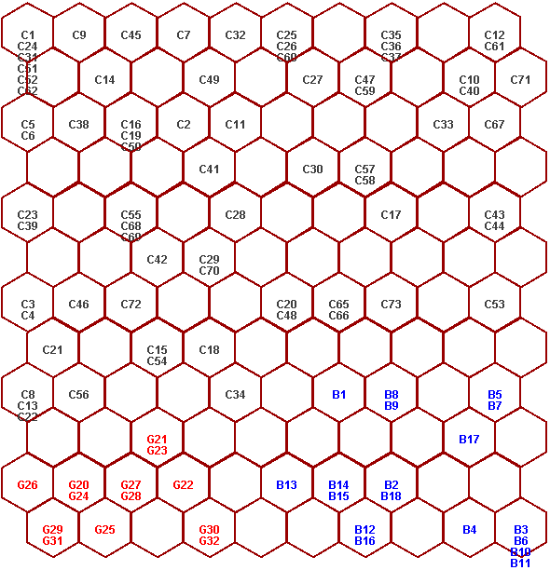

MEANING PROVIDED BY EXPERTS -EbCA
INPUT (WOF SOM)
Individual W1
TACIT
Knowledge
FORMAL
Knowledge
DECISION ANALYTICS
Quantitative benchmarking
Knowledge discovery
End-users
Experiencers
Preprocessing
Midprocessing
Postprocessing
DATA MINING
Domain
Experts
Gibert et al. Health Res Policy Syst. 2010

Slide 28
Intergovernmental Panel on Climate Change. https://www.ipcc.ch/sr15/ ISPBE.
Furst et al, 2020

Slide 29
DSS: RELATIVE TECHNICAL EFFICIENCY
Balance between inputs (resources and expenditures) consumption and outputs (outcomes directly related to the inputs) production in a set of comparable decision making units (DMU, MH services, areas, etc.).
Allows decision makers and researchers to identify potential improvements in selected DMU (health services, areas, etc.) and ecosystems (sets of DMU) as well as to carry out benchmarking processes.
Maximum 1 (the DMU is completely efficient): according to the balance of inputs/outputs of the DMU set, this DMU shows the best –it is not possible to improve it-; minimum 0 (the DMU is completely inefficient): according to the balance of inputs/outputs of the DMU set, this DMU shows the worse –it is possible to improve it-.

Slide 30
DSS: STABILITY
Sensitivity of an indicator (ie. relative technical efficiency) to variable (inputs and outputs) value variations. The direction of the indicator changes can be also assessed.
Allows decision makers to understand the sensitivity of the DMU and their ecosystems to potential changes in their organizational and managerial structures (expenditure, resource allocation, consumption, etc.) and output production.
Maximum 100% (the ecosystem is completely stable): the variable values variations do not affect the statistical distribution of the selected indicator; minimum 0% (the ecosystem is completely unstable): very small variable values variations change the statistical distribution of the selected indicators completely.

Slide 31
DSS: Shannon’s Entropy
Assesses the homogeneity vs heterogeneity levels in both the DMU and global ecosystem management.
Allows decision makers understand if the DMU and global ecosystem that they operate show a homo/heterogeneous decisional structure (ie. services and ecosystems can be managed following a non flexible/standard decisional pattern –policy- or they can be tailor-made).
Maximum 100% (the DMU or ecosystem is completely homogeneous): its input/output management follows a very strict policy; minimum 0% (the DMU or ecosystem is completely heterogeneous): its input/output management is completely tailor-made, usually trying to matching user needs.

Slide 32




AUSTRALIA - Regional
DSS in ACT (Technical Report, BUPA Foundation, 2020)
Bayesian Network Analysis (BNA) of the relationship between urban environment and health (NHMRC Ideas Grant, APP 2003853)
SPAIN - National
and regional
Evaluation of the technical efficiency of regional publicly funded mental health care system (Garcia-Alonso 2019, Almeda, 2022)
Relative Technical Efficiency of health districts
The trans-institutionalization challenge in the Helsinki-Uusimaa region (Finland): Structure and performance of the mental health ecosystem (Diaz-Milanes et al, 2023)
FINLAND - Regional
Relative Technical Efficiency of MH care in the Helsinki-Uusimaa Region
The critical factor: the role of quality in the performance of supported accommodation services for complex mental illness in England (Almeda et al, PLoS ONE 2022)
UK – NHS England
Relative Technical Efficiency of Supported Accommodation for persons with complex MH problems

Slide 33
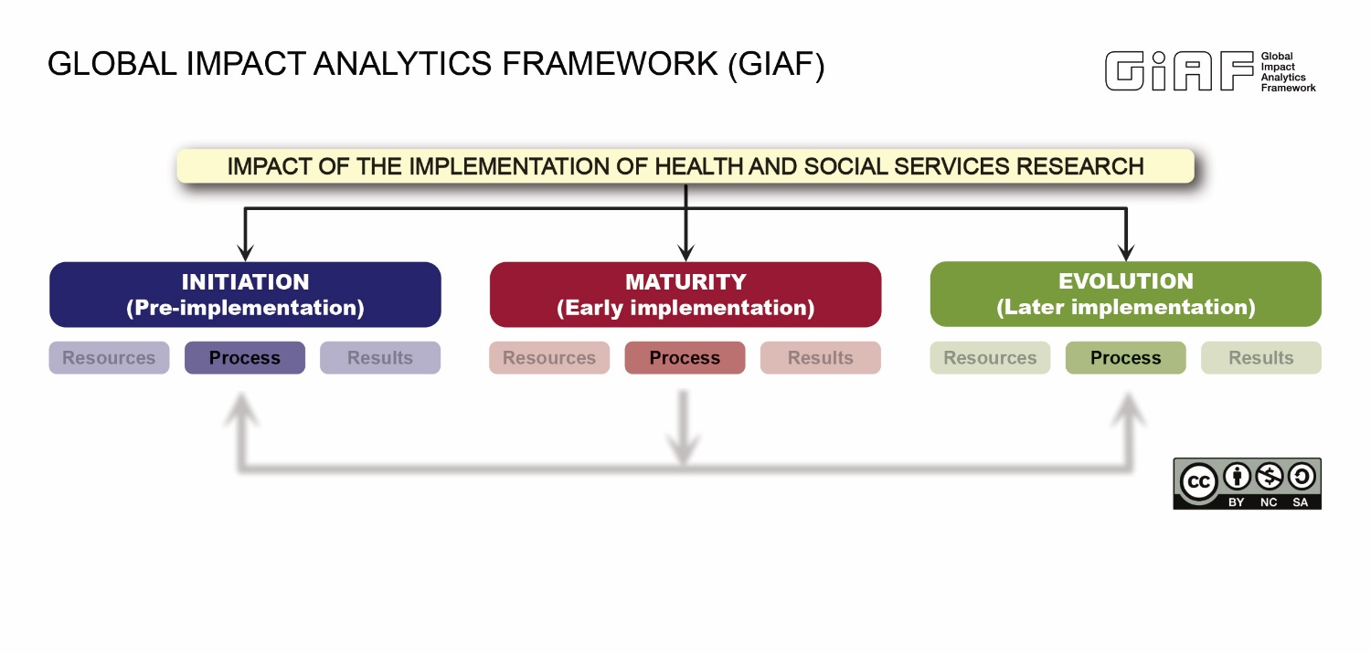
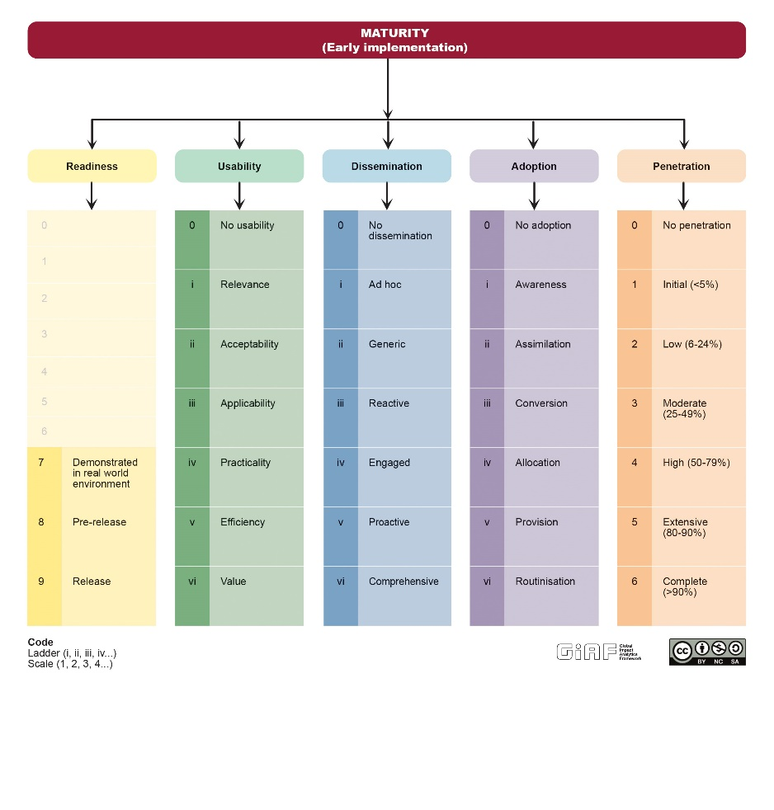
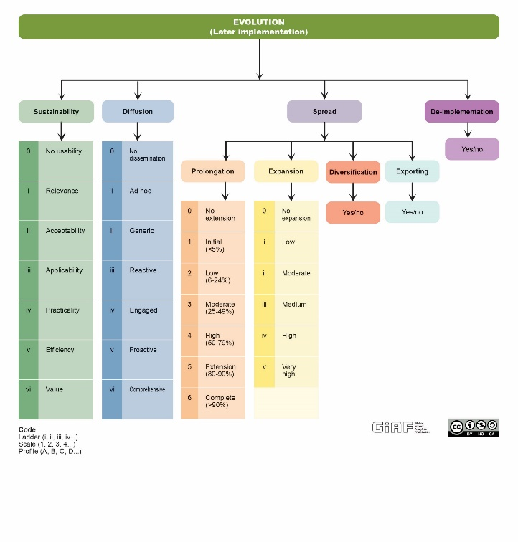
Notes:
Primary method is using the GIAF toolkit which includes a taxonomy (which provides a knowledge map of what domains to measure and how they relate to each other), the glossary (which clearly defines the components and sub-components – there are 180 terms in the glossary, and the ladders and checklists which are tools to rate EMPOWER on the ladders for the relevant domains.
We measured EMPOWER on the 8 domains in the *** initiation phase and the *** five domains in the maturity phase

Slide 34
TECHNOLOGY READINESS LEVEL (TRL)
Implement. phase | Initiation |  |  |  |  |  | Maturity (Early Implementation)
Domains of Readiness | Pre-readiness |  |  |  |  |  | Readiness
TRL context | Conceptual Stage |  |  |  | Simulated & Relevant Environment |  | Real World Environment
TRL functions | Prototyping |  |  |  | Piloting |  | Demonstration | Deployment
TRL Levels | 1 | 2 | 3 | 4 | 5 | 6 | 7 | 8 | 9
TRL description | Basic Principles | Prior knowledge base completed | Proof of Concept | Prototype | Validation of Prototype | Test in a Relevant Environment | Demonstration in Real World Environment | Pre-release | Release

Slide 35
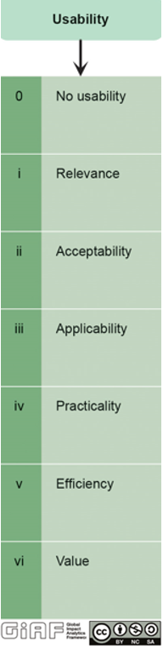
GIAF Usability Ladder
Usefulness: degree to which an intervention is found by the target audience to be beneficial, advantageous, practical and worthwhile to be applied in a real world context. The components of usefulness are relevance, acceptability, applicability, practicality, efficiency and value.
Checklist EMPOWER Project
Questions
1. The EMPOWER eHealth App (for improved mental health and wellbeing at work) is relevant, significant and meaningful for my work colleagues
2. The EMPOWER App is new, different, and/or interesting.
3. The EMPOWER App has significant potential to be used by people to promote their wellbeing, guide them on how to track their mood and adapt at work if you suffer psychological distress.
4. The EMPOWER App is acceptable to employed people. I do not have major concerns about the content of the EMPOWER App.
If you have concerns or reject the EMPOWER App, please explain why.
5. The EMPOWER App is useful to me and other employed people for their improved mental health and wellbeing at work.
6. The EMPOWER App is user friendly.
7. The instructions provided through the EMPOWER App are easy to follow.
8. The EMPOWER App is better than similar apps or tools I know of, for mental health and wellbeing at work. Please answer this question only if you know of other Apps. If not, tick the not applicable box (N/A).
9. The EMPOWER App is ‘fit for purpose’, beneficial and valuable for employed people to promote their wellbeing and reduce psychological distress, guide them on tracking their mood and adapt if they suffer psychological distress.
10. I would recommend the EMPOWER App to my work colleagues and peers.

Slide 37


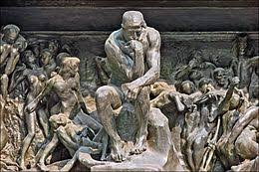
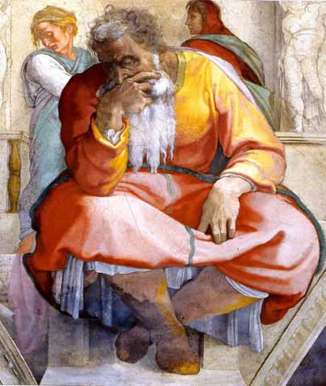

Slide 39
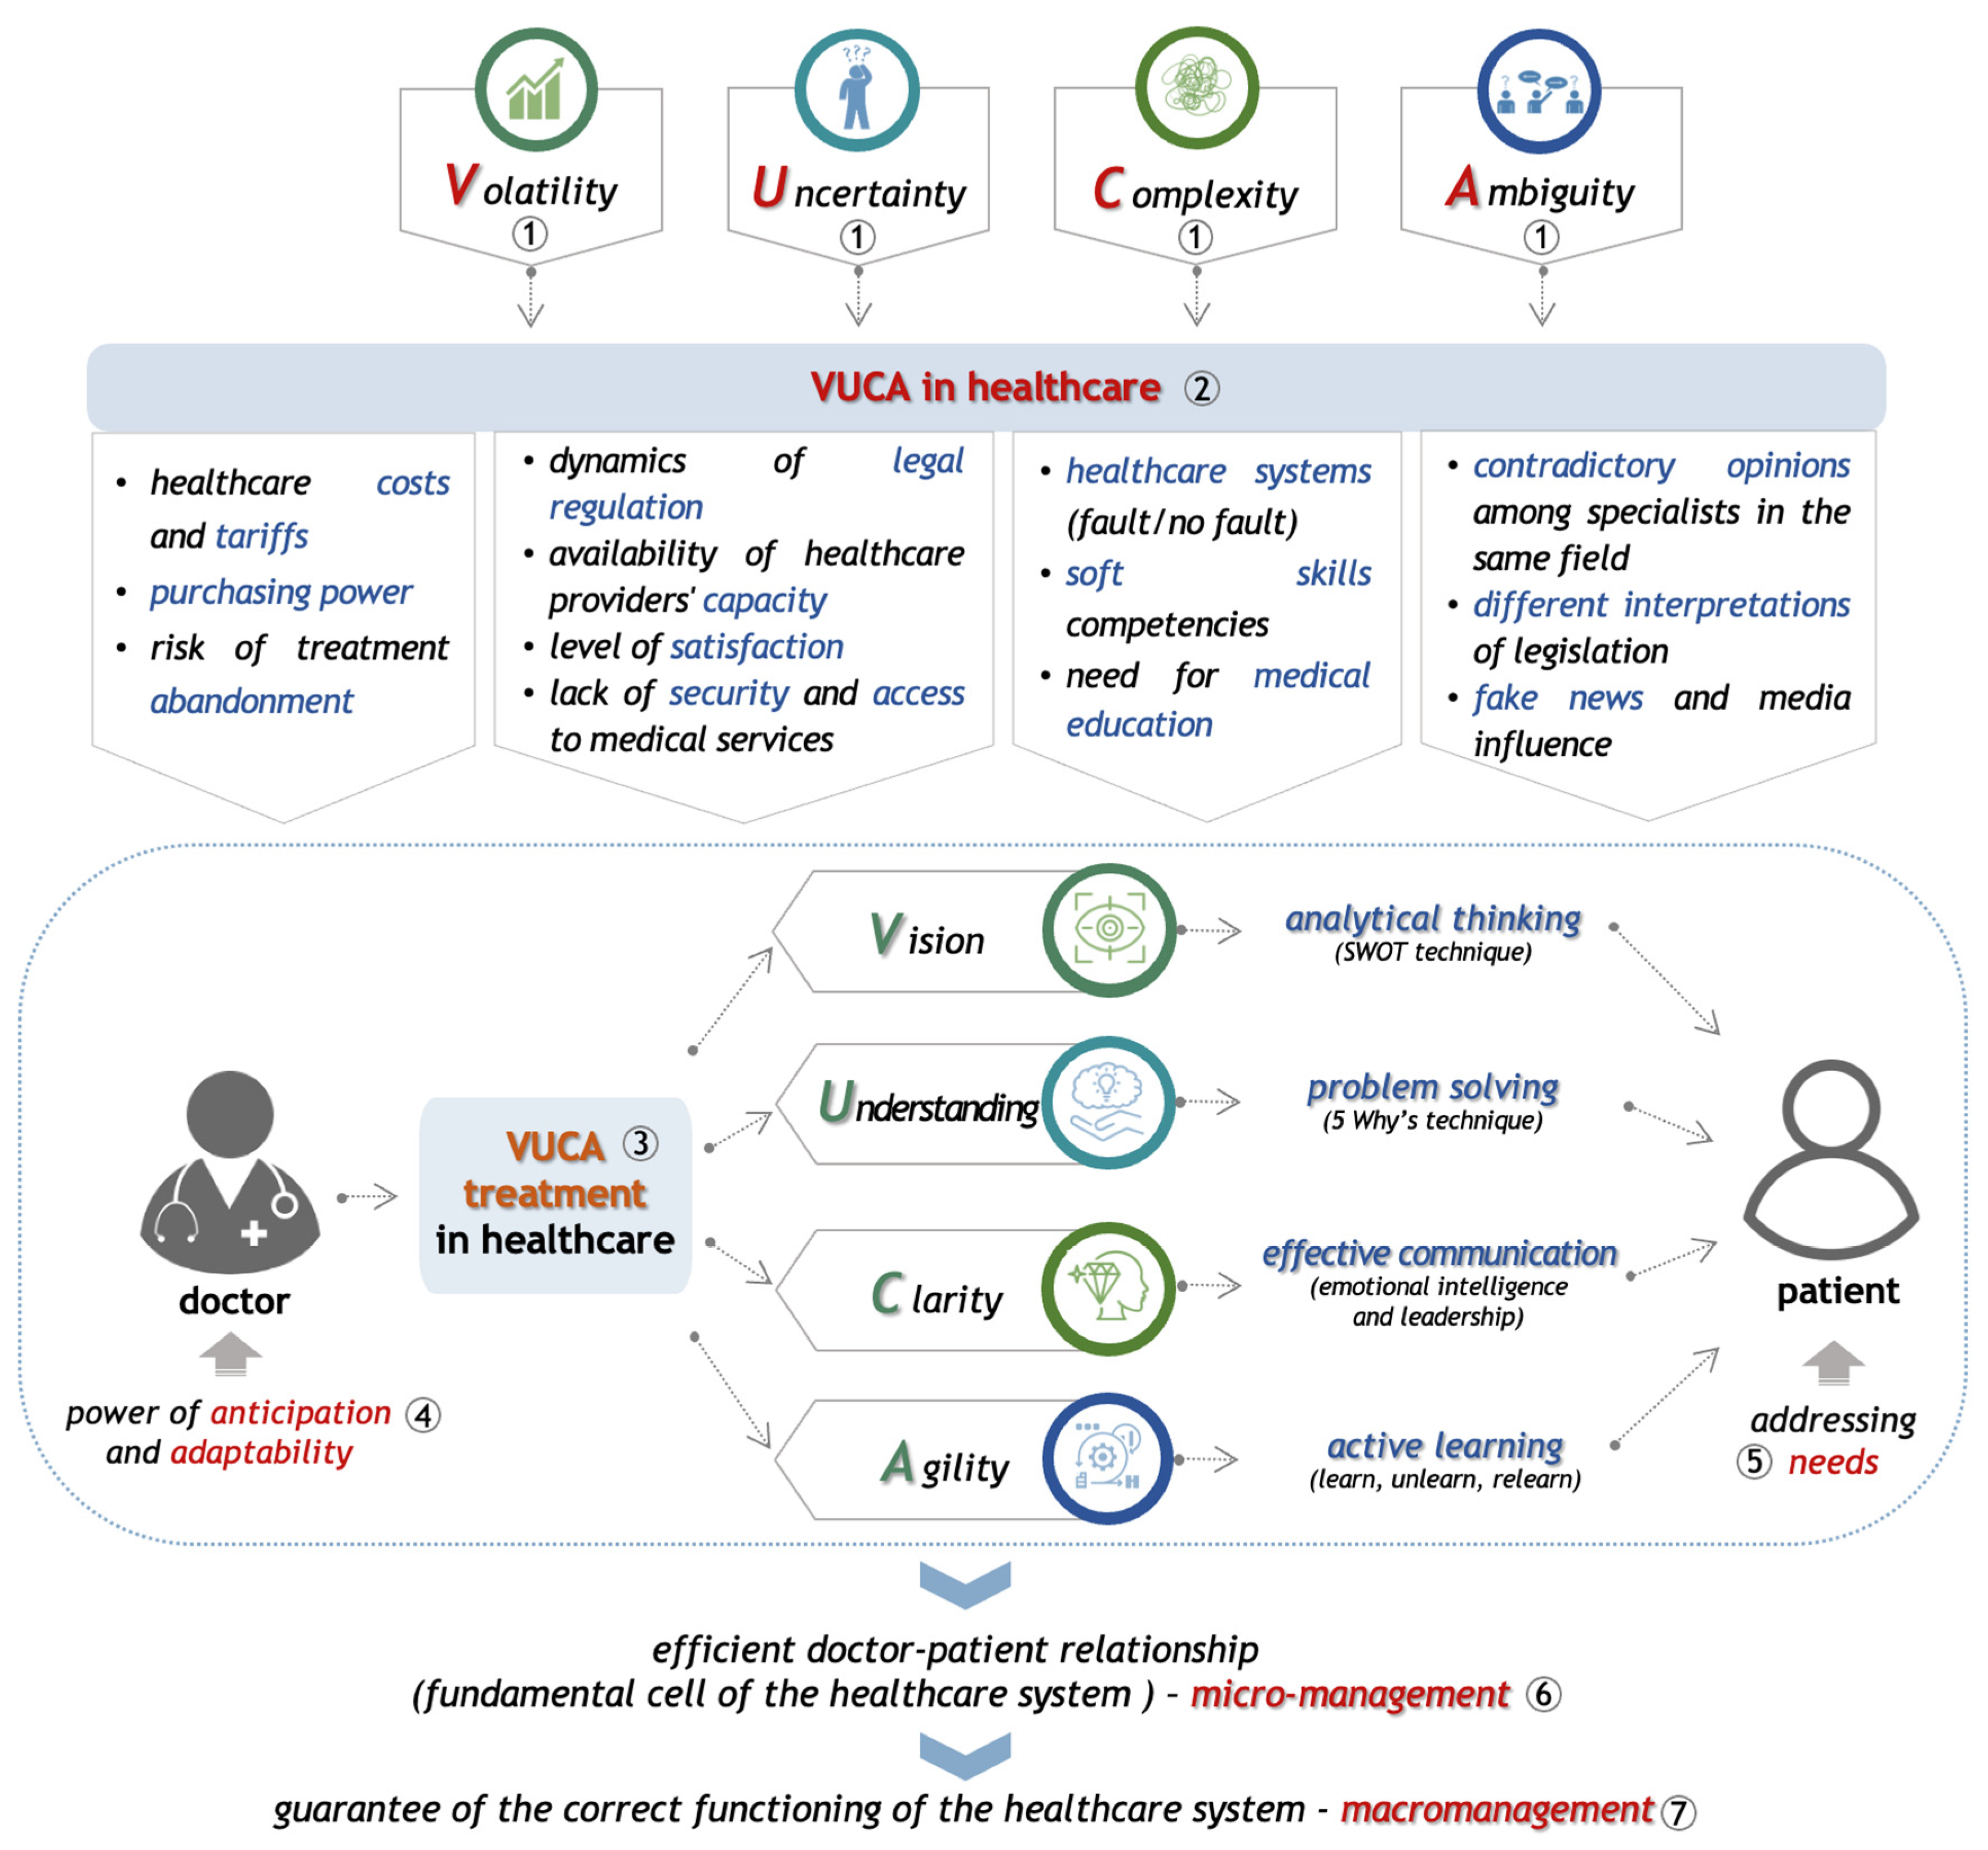
VUCA
Volatile
Uncertain
Complex
Ambiguous
Nicolescu, et al . Volatility, Uncertainty, Complexity,
and Ambiguity (VUCA) in Healthcare. Healthcare 2024, 12, 773

Slide 40
 | Randomized Clinical Trial (RCTs) | Comparative Effectiveness Research (CER)
Objective | Assesses efficacy and safety under controlled conditions | Compares different treatments in real-world settings
 |  | real-world data as data relating to patient health or experience or care delivery collected outside the context of a highly controlled clinical trial. Data can be routinely collected during the delivery of health or social care.
Study Design | Experimental design with randomization - RCT | Multiobjective with mixed methods with observational data Pragmatic trials Flexible trials
Generalizability | High internal validity, controlled conditions | High external validity, reflects real-world populations
Ethical Considerations | Strict adherence to ethical standards, including informed consent | Fewer ethical concerns, often uses existing data
Cost and Time | Typically more expensive and time-consuming | Can be cost-effective and quicker to conduct

Slide 41
Dealing with complexity
Decisional situations set
Organized complexity: randomness is dominant
DSS should be TRAINED
It is related to the amount and intensity (potential impact) of unforeseen/unpredictable events or situations
Disorganized complexity
Randomness
Organized complexity: complexity is dominant
Organized simplicity
expert knowledge
Complexity (Gegov, 2007)
Quantitative complexity
It is related to the number of variables needed to understand the behaviour of any system and to the number of relationships
Qualitative complexity
It is related to the confidence level and precision on variable values (uncertainty) and to the accuracy/clarity level on the definition of the variables (ambiguity)

Slide 42
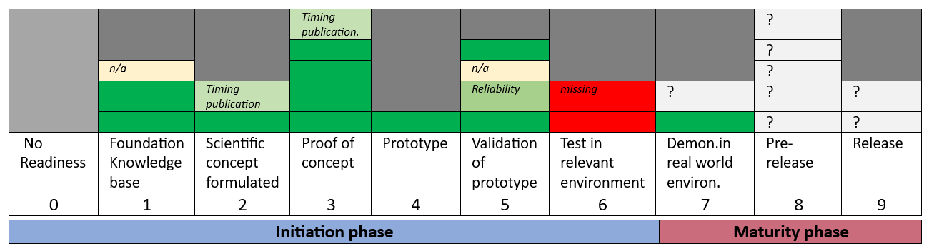
Project level Pre-readiness and readiness (TRL-HS) level – Profile
Organisational learning
GAP: Level 6 Test in relevant environment – critical (pilot tricky term)
Recruitment and usefulness may have been enhanced without technical issues and features (e.g. video/audio rather than text based

Slide 44
REFERENCES
Diaz-Milanes D, et al. Impact of the workforce allocation on the technical performance of mental health services: the collective case of Helsinki-Uusimaa (Finland). Health Res Policy Syst. 2023 Oct 23;21(1):108. doi: 10.1186/s12961-023-01061-y.
Almeda N, et al Modelling the balance of care: Impact of an evidence-informed policy on a mental health ecosystem. PLoS One. 2022 Jan 11;17(1):e0261621. doi: 10.1371/journal.pone.0261621.
Almeda N, et al. The critical factor: The role of quality in the performance of supported accommodation services for complex mental illness in England. PLoS One. 2022 Mar 17;17(3):e0265319. doi: 10.1371/journal.pone.0265319. PMID: 35298512; PMCID: PMC8929565.
García-Alonso CR, et al. A decision support system for assessing management interventions in a mental health ecosystem: The case of Bizkaia (Basque Country, Spain). PLoS One. 2019 Feb 14;14(2):e0212179. doi:10.1371/journal.pone.0212179

