Slide 1
Disinformation among older adults: analyzing the impact of fact-checking on news credibility
A joint venture between
Authors: Xavier Ramon, Aleix Martí-Danés, Reinald Besalú and Carles Pont-Sorribes
(Universitat Pompeu Fabra, Spain)

Slide 2
Introduction
Disinformation among older adults: analyzing the impact of factchecking on news credibility

Slide 3
2 research lines
Information credibility
Fact-checking
Disinformation among older adults: analyzing the impact of factchecking on news credibility

Slide 4
Age as a key factor
In all the studies elaborated by us that follow the research line of information credibility (Besalú & Pont-Sorribes, 2021; Besalú et al., 2021), the same conclusion is reached:
Age is a differential factor in the credibility given to information.
Youth are more used to new media and they are more cautious when sharing information than older people.
Older people give more credibility to all kinds of information.
Disinformation among older adults: analyzing the impact of factchecking on news credibility

Slide 5
Age as a key factor
Other previous work has also demonstrated that due to cognitive declines and lower levels of digital literacy, older people have more difficulties in discriminating between true facts and false news and therefore, are more prone to share disinformation (Braschier & Schacter, 2020; Guess et al., 2019; Valera-Ordaz et al, 2022; Hameleers & van der Meer, 2019).
Disinformation among older adults: analyzing the impact of factchecking on news credibility
Notes:
Aquí faria una d’aquestes dues coses: o bé expliquem breument què investiguen aquestes recerques que citem, o bé eliminem la diapo i deixem el títol com a frase afegida en alguna de les diapositives anteriors

Slide 6
The role of fact-checking platforms
Over the last few years, fact-checking platforms have served as critical interventions in the fight against the expansion of false and/or misleading news that threaten democratic wellbeing (Moreno-Gil et al., 2021).
Arguably, fact-checking platforms should play a critical role in bridging the digital divide and help older publics “navigate through disinformation circulating in high-choice media environments” (Kyriakidou et al. 2022, 1).
Disinformation among older adults: analyzing the impact of factchecking on news credibility

Slide 7
Methodology
Disinformation among older adults: analyzing the impact of factchecking on news credibility

Slide 8
Aim of the study and RQ
This research examines the relationship between older adults with disinformation and fact-checking platforms considering the following two research questions:
RQ 1: How do older adults evaluate the credibility of information in online press?
RQ 2: What is the impact of fact-checking platforms in the credibility that older adults give to news?
Disinformation among older adults: analyzing the impact of factchecking on news credibility

Slide 9
Method
The study is based on an experimental online survey conducted in October 2022 by YouGov Spain that drew on N=1,203 participants of +60 years.
Sample
Respondents were divided into 3 symmetrical groups considering key quota variables.
Exhibition materials
Each of the groups was exposed to four news items about current events
Disinformation among older adults: analyzing the impact of factchecking on news credibility

Slide 10
4 Topics
Immigration
(Real content)
Retirement
(Real content)
Disinformation among older adults: analyzing the impact of factchecking on news credibility

Slide 11
4 Topics
COVID-19
(False content)
Ukraine War
(False content)
Disinformation among older adults: analyzing the impact of factchecking on news credibility

Slide 12
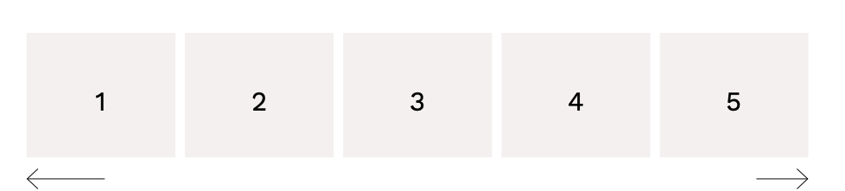
Method
To avoid any bias, all items were presented as content published by a fictitious news outlet called ‘El Independiente Digital’.
Each of the experimental groups was asked to evaluate two factors for each piece –credibility and shareability– using a Likert scale (1-5).
Disinformation among older adults: analyzing the impact of factchecking on news credibility

Slide 13
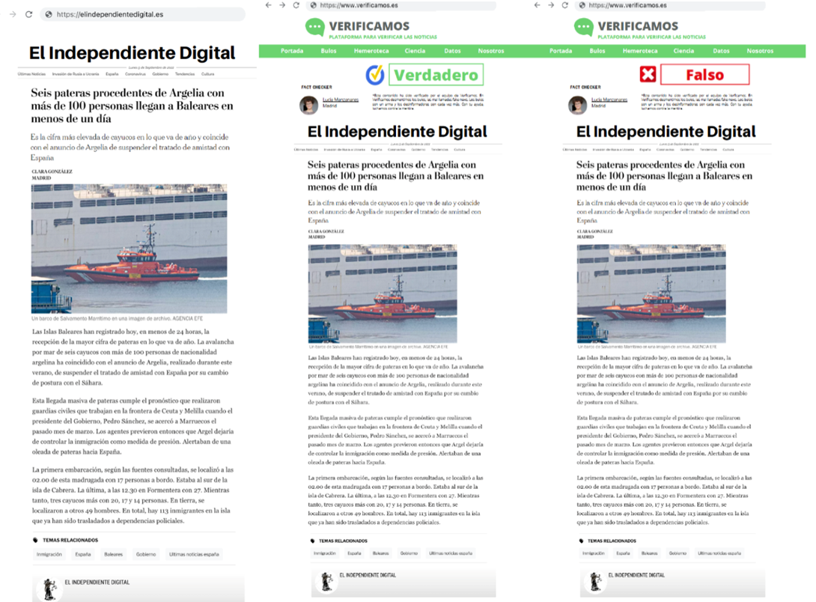
3 experimental groups
Group 1 received these items without any verification marks.
Groups 2 and 3 were respectively exposed to news that were correctly and incorrectly verified by a fictitious fact-checking platform called ‘Verificamos’.
Disinformation among older adults: analyzing the impact of factchecking on news credibility

Slide 14
03
Results
Disinformation among older adults: analyzing the impact of factchecking on news credibility

Slide 15
Results
Older adults demonstrate a good ability to identify disinformative content
Disinformation among older adults: analyzing the impact of factchecking on news credibility

Slide 16
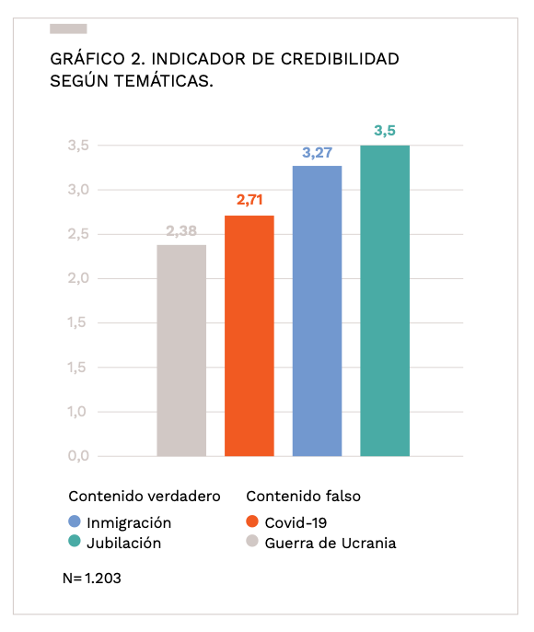
Older adults attribute a higher level of credibility to true content and a lower level of credibility to false content.
Across the three experimental groups, the news items that obtained higher levels of credibility were those focusing on retirement and immigration, both of true nature.
Disinformation among older adults: analyzing the impact of factchecking on news credibility

Slide 17
Results
2. Fact-checking has a relevant impact on older adults’ assessment of credibility
Disinformation among older adults: analyzing the impact of factchecking on news credibility

Slide 18
When respondents were presented with news items that were verified and labelled as ‘false’, their assessment of these items’ credibility was greatly diminished. In these circumstances, older adults showed greater precautions to believe and share such information.
Disinformation among older adults: analyzing the impact of factchecking on news credibility

Slide 19
Results
3. A significant part of the seniors affirm that news should be contrasted through fact-checking platforms
Disinformation among older adults: analyzing the impact of factchecking on news credibility

Slide 20
To evaluate the level of knowledge about fact-checking platforms among older adults, the experimental group 1 was asked the following question regarding sources to verify information:
“We show you a list of sources that can be used to check the authenticity of information. Of all of them, which ones would you turn to verify the news you've read before? Select a maximum of 3”.
Disinformation among older adults: analyzing the impact of factchecking on news credibility

Slide 21
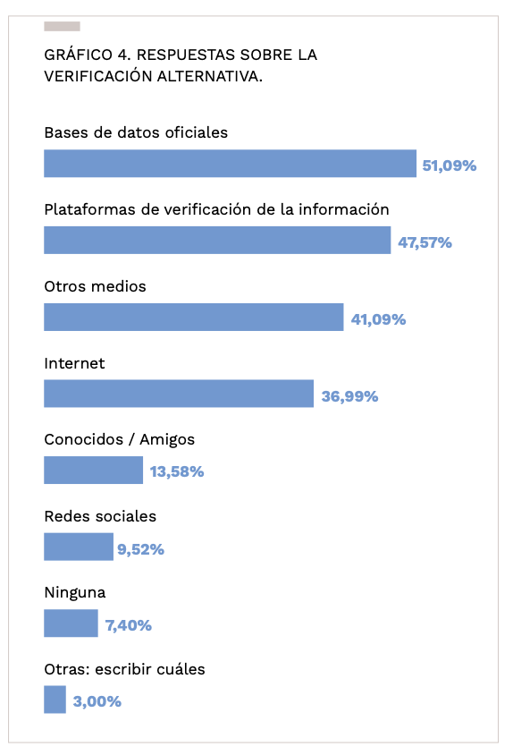
Among the different options, participants highlighted official databases and fact-checking platforms as the main sources they would use to verify news.
In contrast, friends / relatives and social media – spaces more prone to the dissemination of disinformation – were generally not considered as valuable options to verify news.
Disinformation among older adults: analyzing the impact of factchecking on news credibility

Slide 22
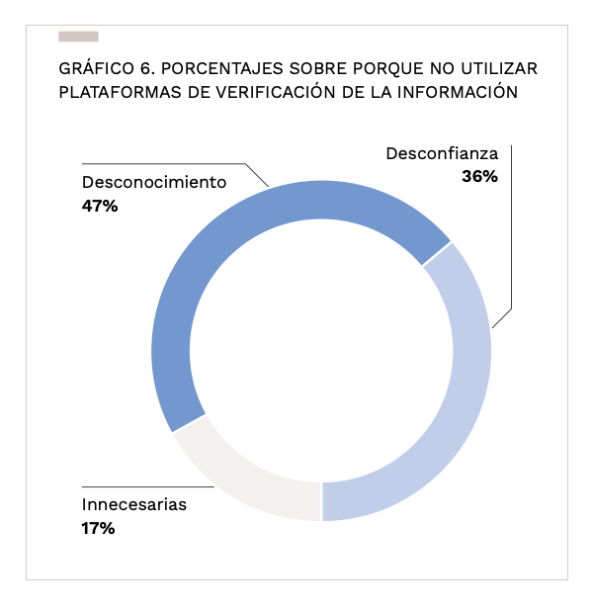
The participants that did not respond ‘fact-checking platforms’ (n=205) were faced with this second question: “For what reasons would you not use a fact-checking platform to verify the authenticity of the news you have previously read? Select 2 maximum”.
Part of the sample was not aware about the existence of these platforms, did not trust them or considered them unnecessary.
Disinformation among older adults: analyzing the impact of factchecking on news credibility

Slide 23
Results
Conclusiones
4. Gender divergences in credibility are remarkable
Disinformation among older adults: analyzing the impact of factchecking on news credibility

Slide 24
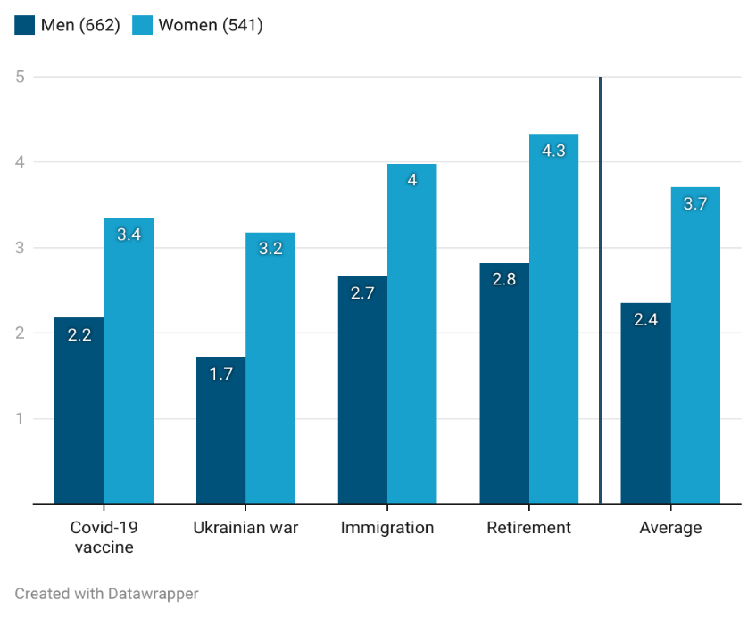
Women are those who rate the credibility of all the news more highly. This indicates a more credulous attitude on the part of female participants.
Men didn’t approve the credibility of all topics, while women did.
This gap is amplified in the age group over 70 years.
Disinformation among older adults: analyzing the impact of factchecking on news credibility

Slide 25
Results
Conclusiones
5. Political values condition the credibility of the information in each news piece
Disinformation among older adults: analyzing the impact of factchecking on news credibility

Slide 26
Depending on the vote, seniors evaluate the credibility of each news piece in a different way.
Those who did not vote in the 2019 general elections are those with the highest average credibility (3.16), followed by PP (3.08) and PSOE (2.93) voters.
The lowest credibility levels are found among UP, ERC and Junts voters.
Disinformation among older adults: analyzing the impact of factchecking on news credibility

Slide 27
Results
Conclusiones
6. Education level exposes us to a negative relationship with credibility and willingness to share the news
Disinformation among older adults: analyzing the impact of factchecking on news credibility

Slide 28
Those with less studies are the ones who give more credibility to all the news, while respondents with high levels of education show lower levels of credibility.
There is a similar relationship with education and willingness to share news.
Disinformation among older adults: analyzing the impact of factchecking on news credibility

Slide 29
Concluding remarks
Older adults demonstrate a good ability to assess the credibility of information and identify disinformation.
‘False’ warning labels play a crucial role in alerting older adults to disinformation and preventing them from believing and sharing such news items.
Fact-checkers should delve into the use of warning labels as a countermeasure to the spread of disinformation that threatens democratic wellbeing (Moreno-Gil et al., 2021).
Disinformation among older adults: analyzing the impact of factchecking on news credibility

Slide 30
Concluding remarks
Several participants would avoid using fact-checking platforms because they are not aware of them, do not trust them or think they are unnecessary. > Importance of media literacy activities.
Important sociodemographic variables: gender and education levels.
In the same vein as previous research (Hameleers & van der Meer 2020; Koch et al., 2022), political ideology is a key factor in the news credibility assessment.
Disinformation among older adults: analyzing the impact of factchecking on news credibility

Slide 31
Thank you for your attention

