Slide 1

You will receive
a salary raise next year

Slide 2

You will receive
a salary raise next year

Slide 3

I will receive
a salary raise next year

Slide 4
I will receive
a salary raise next year

Slide 5
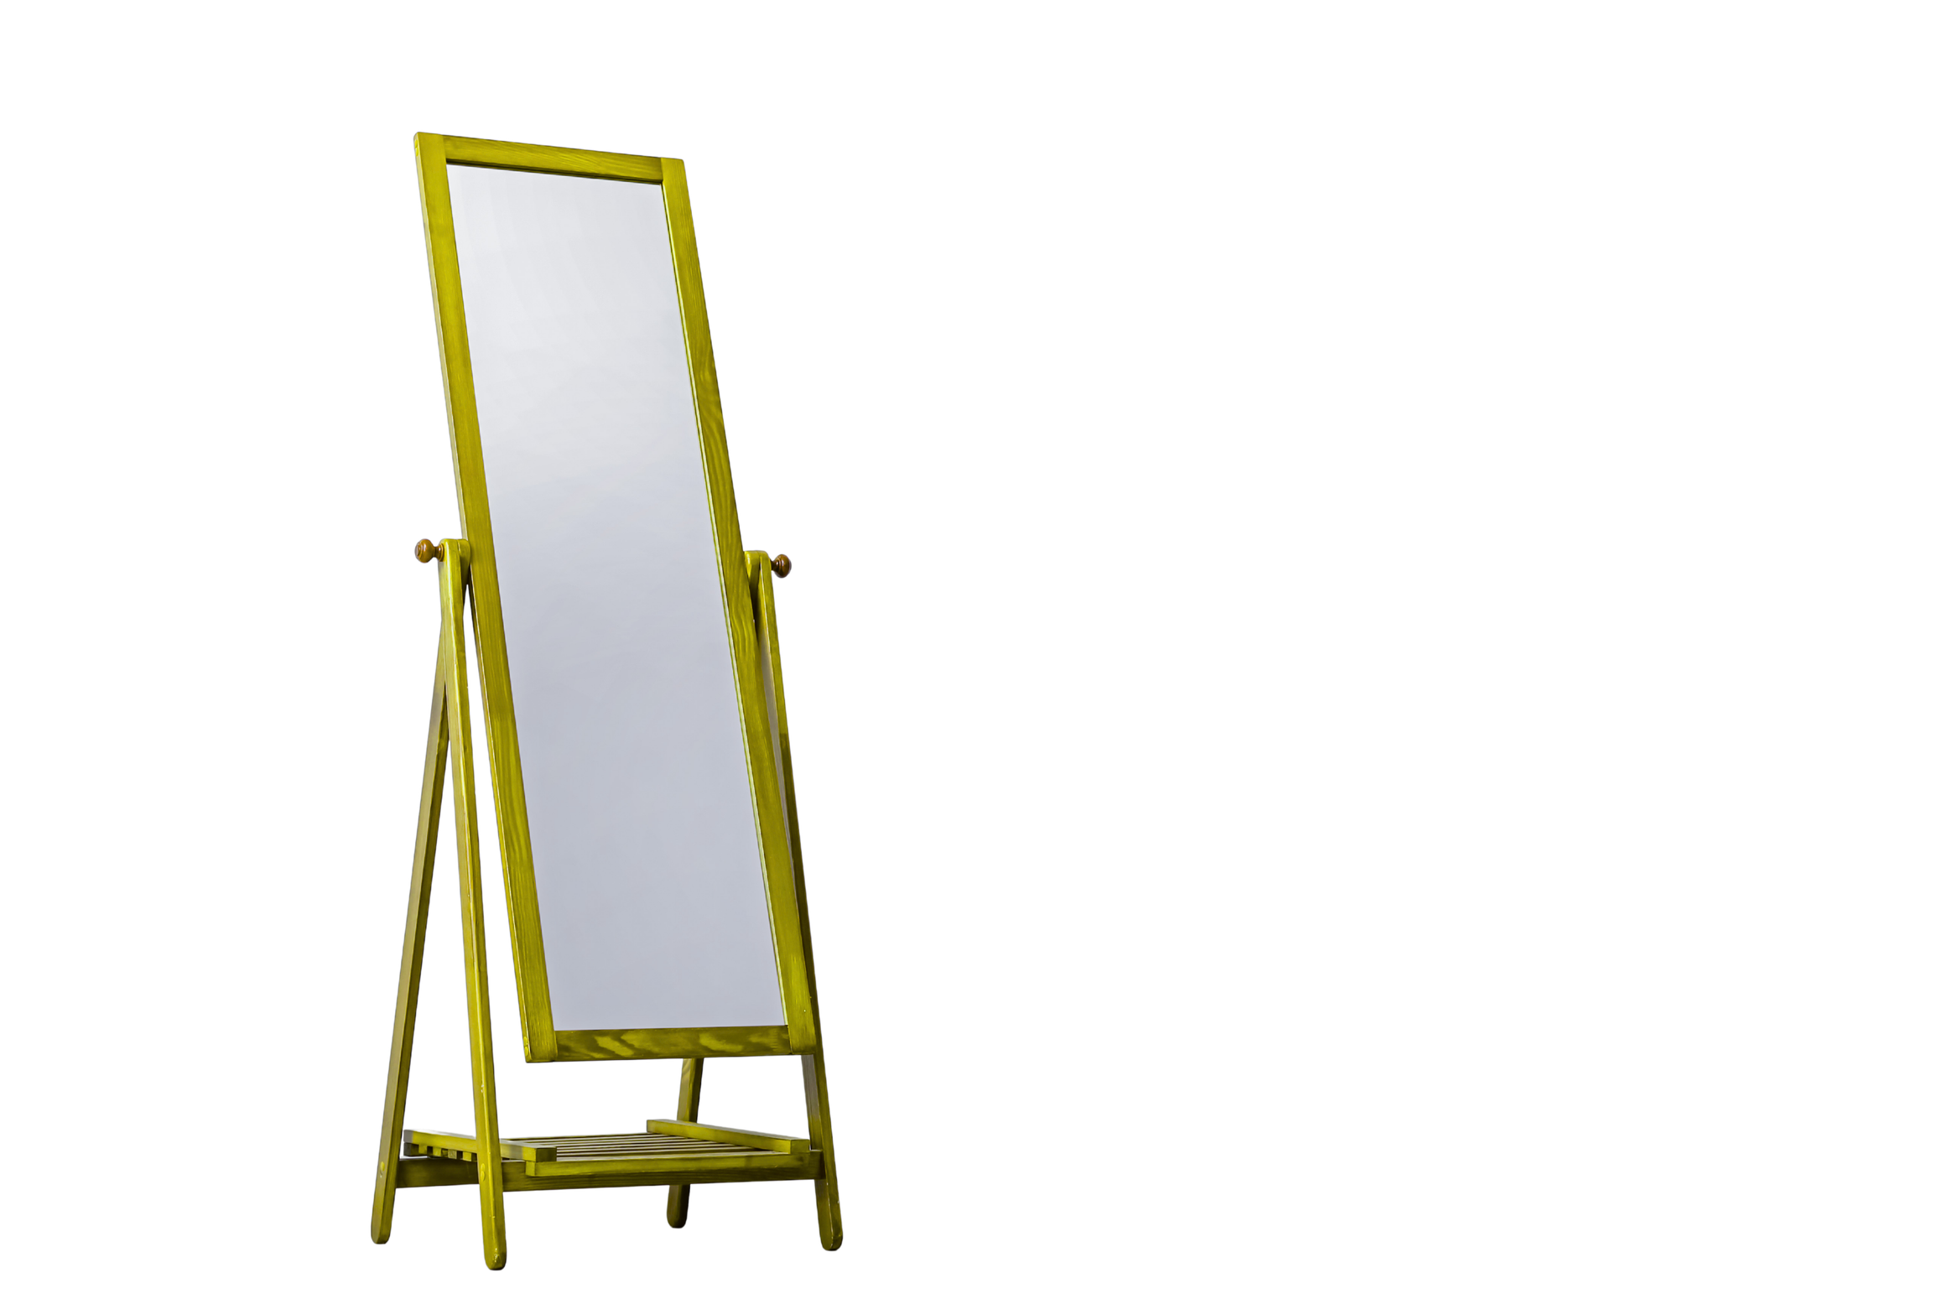
You will receive
a salary raise next year

Slide 6
You will receive
a salary raise next year

Slide 7
I will receive
a salary raise next year

Slide 8
I will receive
a salary raise next year

Slide 9


You moved into a new neighbourhood

Slide 10
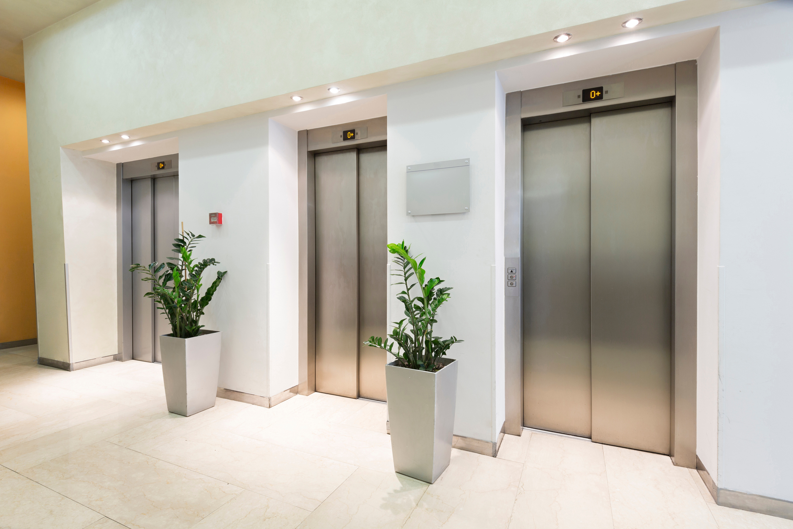


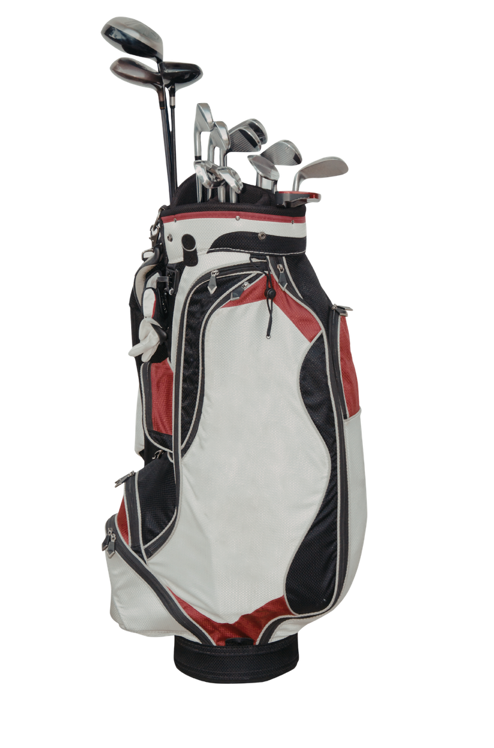
1 month later...
Your neighbours like you

Slide 11
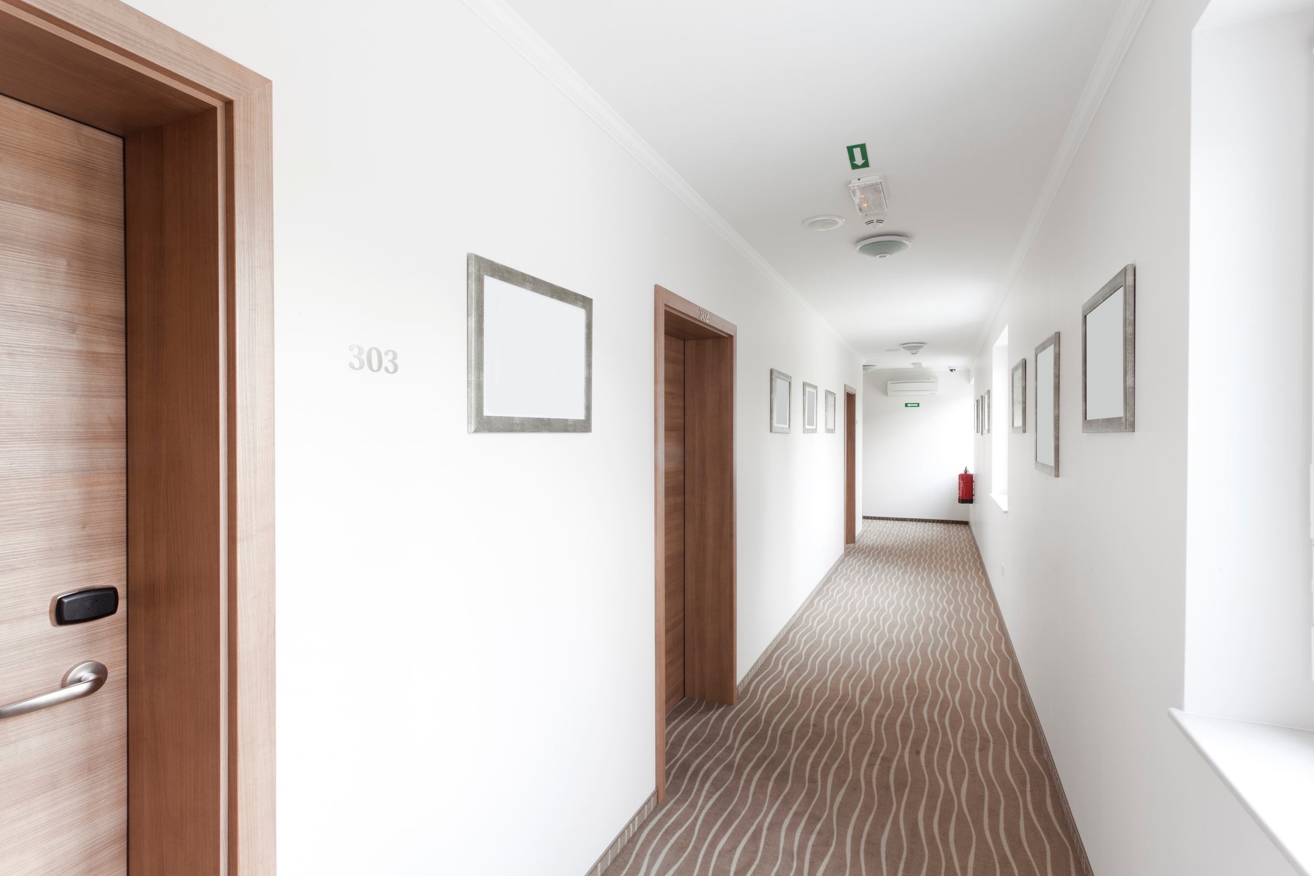

1 months later...
Your neighbours like you

Slide 12

My neighbours
like me

Slide 13
My neighbours
like me

Slide 14
Your neighbours
like you

Slide 15
Your neighbours
like you

Slide 16
My neighbours
like me

Slide 17
My neighbours
like me

Slide 18
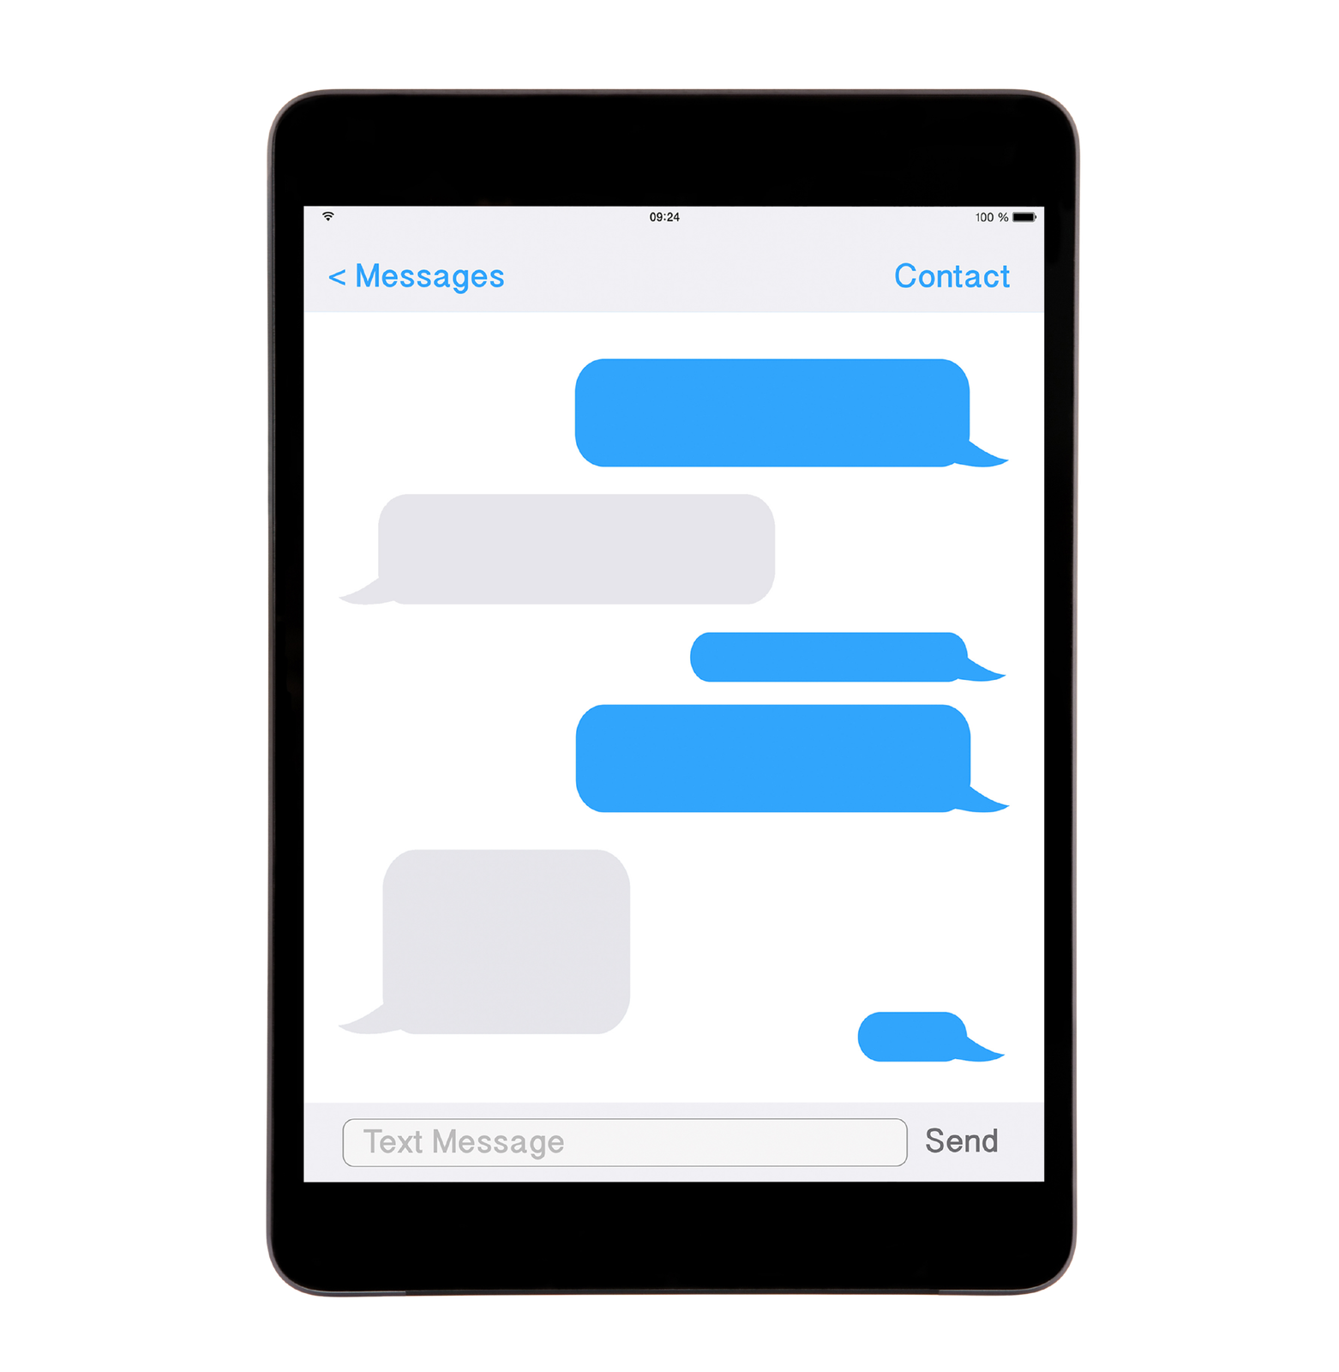

MOM
I sent you a package
??

Slide 19


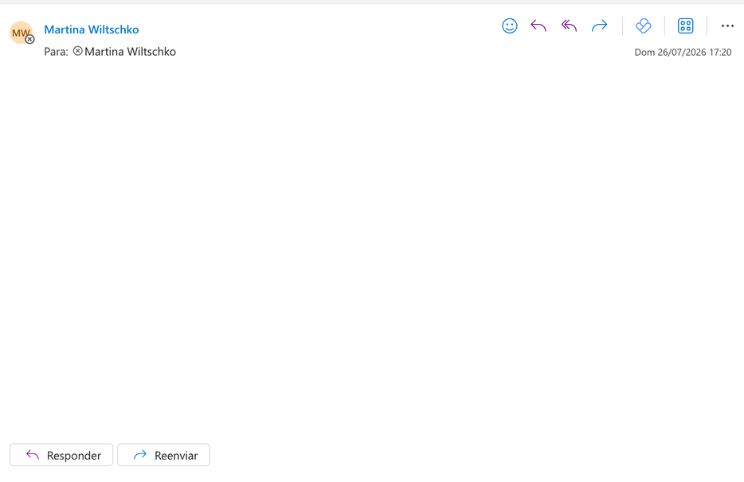
Vyntra
Your package has been sent today

Slide 20
MOM
My mom sent me a package
I sent you a package
??

Slide 21
Vyntra
Your package has been sent today
Vyntra sent
me a package

Slide 22
MOM
Your mom sent you a package
I sent you a package
??

Slide 23
Vyntra
Your package has been sent today
Vyntra sent you a package

Slide 24
MOM
My mom sent me a package
I sent you a package
??

Slide 25
Vyntra
Your package has been sent today
Vyntra sent
me a package

