Slide 1
Accessibility-precision tradeoffs in grounded referring expression choice:
Insights from monolingual and bilingual speakers
Junyi Chen, Martin Zettersten, Anne Beatty-Martínez
University of California San Diego
ESSLLI 2026
Notes:
Hi everyone. My name is Junyi, and I’m a phd student at UC San Diego.Today I'm going to talk about Accessibility-precision tradeoffs in grounded referring expression choice:
Insights from monolingual and bilingual speakers

Slide 2


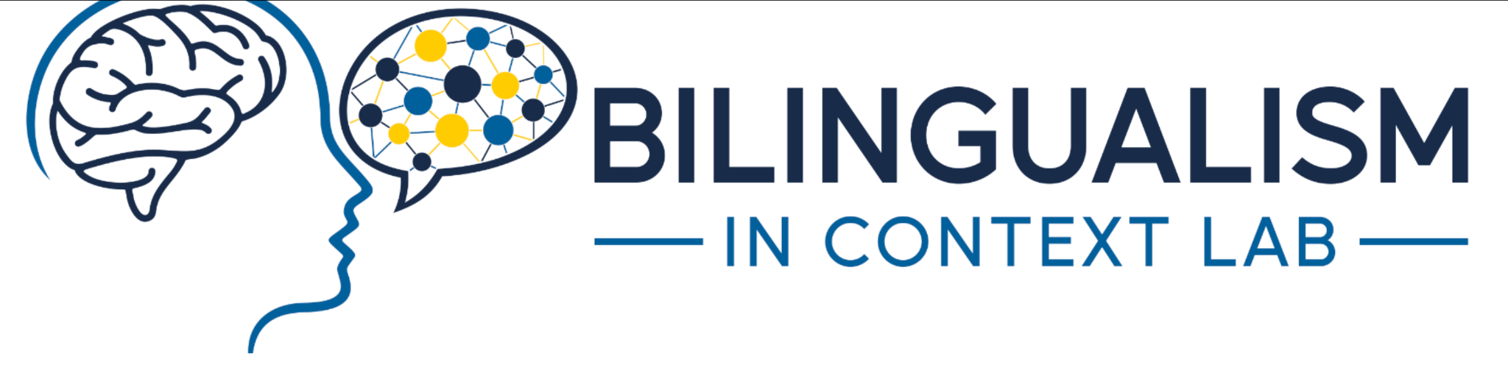

Acknowledgement
Anne Beatty-Martínez
Martin Zettersten
Notes:
Before I start, a quick thank you. This work was done with Martin Zettersten and Anne Beatty-Martínez, who advised on the design and analysis throughout. Thanks also to the members of our labs for feedback on this talk, RAs who helped run the study, and to our participants. And thank you to the organizers for having me.

Slide 3

Two ways to name the same thing
“kitten”
more precise — but rarer, harder to retrieve
“cat”
less precise — but common, comes to mind fast
Best fitting words
Vs.
Easy words
Notes:
Okay, let’s start. In everyday speech we may have more than one way to say the same thing. If you see this animal [CLICK], you could say kitten [CLICK] - that is more precise. Or you could say cat [CLICK] - a little less precise, but much more common, and it comes to mind faster.
So, there are two forces at work in word choice. [CLICK] You can say what you mean as precise as possible, picking the word that best fits the meaning you intend. [CLICK] Or, you can say what is easy. Retrieving a word from memory takes effort, and some words are much easier to get to than others - especially frequent words.

Slide 4
Speakers sometimes choose easier, but less accurate, words
Prior work finds speakers reliably choose cat over kitten (Koranda et al., 2022).
→ good-enough production speakers produce utterances that are good enough to achieve their communicative goal, while minimizing production effort
Notes:
prior work from Koranda et al. finds speakers reliably go for the easy one. They say cat.
[CLICK] That is what we call good-enough production. Speakers are not trying to be maximally precise. They are producing something good enough to achieve their communicative goal, while spending as little effort as possible.
So there is a tradeoff built into every word choice. What this talk is about is the limits of that tradeoff.

Slide 5
When retrieval gets harder,
what happens to the tradeoff?
Notes:
We know speakers trade precision for ease. What we don't know is what governs that tradeoff. If word choice is really sensitive to retrieval cost, then making retrieval harder should push speakers toward more accessible, less precise words.
To test that, we need a way to make retrieval harder.

Slide 6
Bilingualism raises retrieval cost
Weaker links
Bilinguals split usage across two languages → each word is used less often
(Gollan et al., 2008)
māo
猫
cat
Cross-language competition
Both languages stay active, so the target competes with more candidates (Green, 1998)
Notes:
Bilingualism gives us a natural way to raise retrieval cost, and there are two reasons retrieval is more effortful for a bilingual.
[CLICK] First, In everyday life, bilinguals split their usage across two languages. So for any given language, they're using it less often than a monolingual uses their one language.
[CLICK] So again take cat as an example, I speak both English and Mandarin, so I may say [CLICK] cat half of the time, and [CLICK] 猫 half of the time, and each word gets half of the practice.
[CLICK] Second, both languages stay active, so the word you want has to beat more competitors.

Slide 7
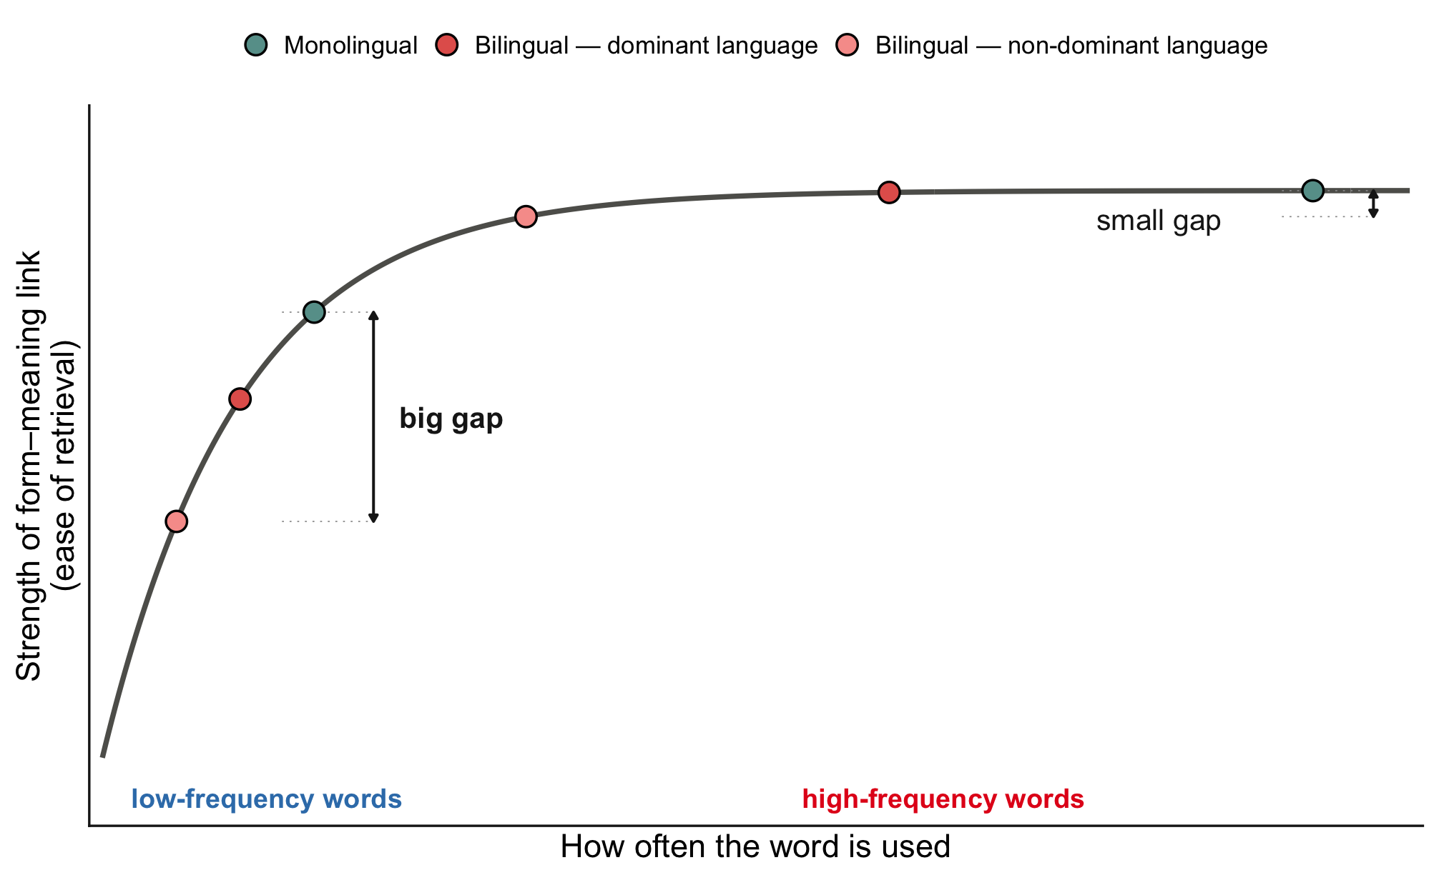
Less use hurts low-frequency words the most
Form–meaning links strengthen with use, but with diminishing returns
Notes:
However, less use hurts low-frequency words the most because word-meaning links strengthen with use with diminishing returns.
Let’s take a look at this plot. On the x-axis we have how often a word has been used, and on the y-axis we have the strength of the word meaning link.
[CLICK] Look at these two common words. Both groups have used them a lot, even if bilinguals use them only half a time, the difference between the strength of the word meaning link barely changes. Small gap.

Slide 8
Less use hurts low-frequency words the most
Form–meaning links strengthen with use, but with diminishing returns
Notes:
[CLICK] Now look at the low-frequency words. Here every use counts. So using them half as often matters a lot. Big gap.

Slide 9
Our hypotheses
H1 Both English monolinguals and English-Mandarin bilinguals will show a frequency effect.
H2 Under greater retrieval difficulty, bilinguals should show a larger frequency effect compared to monolinguals
Notes:
Putting those two pieces together, here are our hypotheses. I will come back to these at the end, so keep them in mind.
Our first hypothesis is that everyone shows good-enough word choice. High frequency words get chosen over low frequency but more precise ones. For example, people still tend to say cat when referring to a kitten.
And our second hypothesis is that Under greater retrieval difficulty, bilinguals should show a larger frequency effect compared to monolinguals

Slide 10
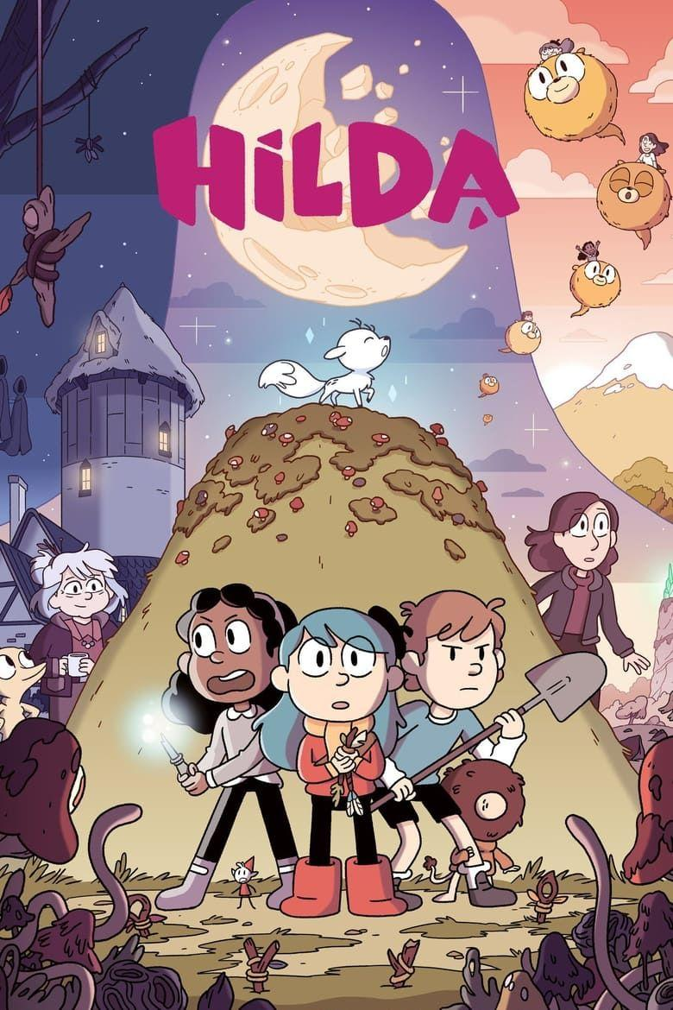
The experiment at a glance
1
2
3
Learn
→
Produce
→
Remember
8 new direction words
the word game
memory check
Background measures:
working-memory operation span task
verbal fluency task (listing words quickly — a measure of lexical access, commonly used as an objective proficiency measure)
language history questionnaire
Participants
41 monolingual English speakers
41 Mandarin–English bilinguals
Notes:
Now let’s take a look at how the experiment works. This design comes from the Koranda paper I just mentioned.
[CLICK] First, participants learn eight made-up direction words. [CLICK] Second, and this is the heart of the study, they play a game where they produce those words. [CLICK] Third, we check that they still remember the words.
After they finish the experiment [CLICK], they also complete a [CLICK] working memory operation span task, a cognitive measure to service as a control for two groups.
[CLICK] a verbal fluency task, that is listing as many words as you can in a category, quickly. It is a measure of lexical access, and it is commonly used as an objective index of proficiency, rather than relying only on self-report.
[CLICK] and a language history questionnaire to get their language background.
[CLICK] Our participants were 41 monolingual English speakers and 41 Mandarin-English bilinguals, matched on age and gender.

Slide 11
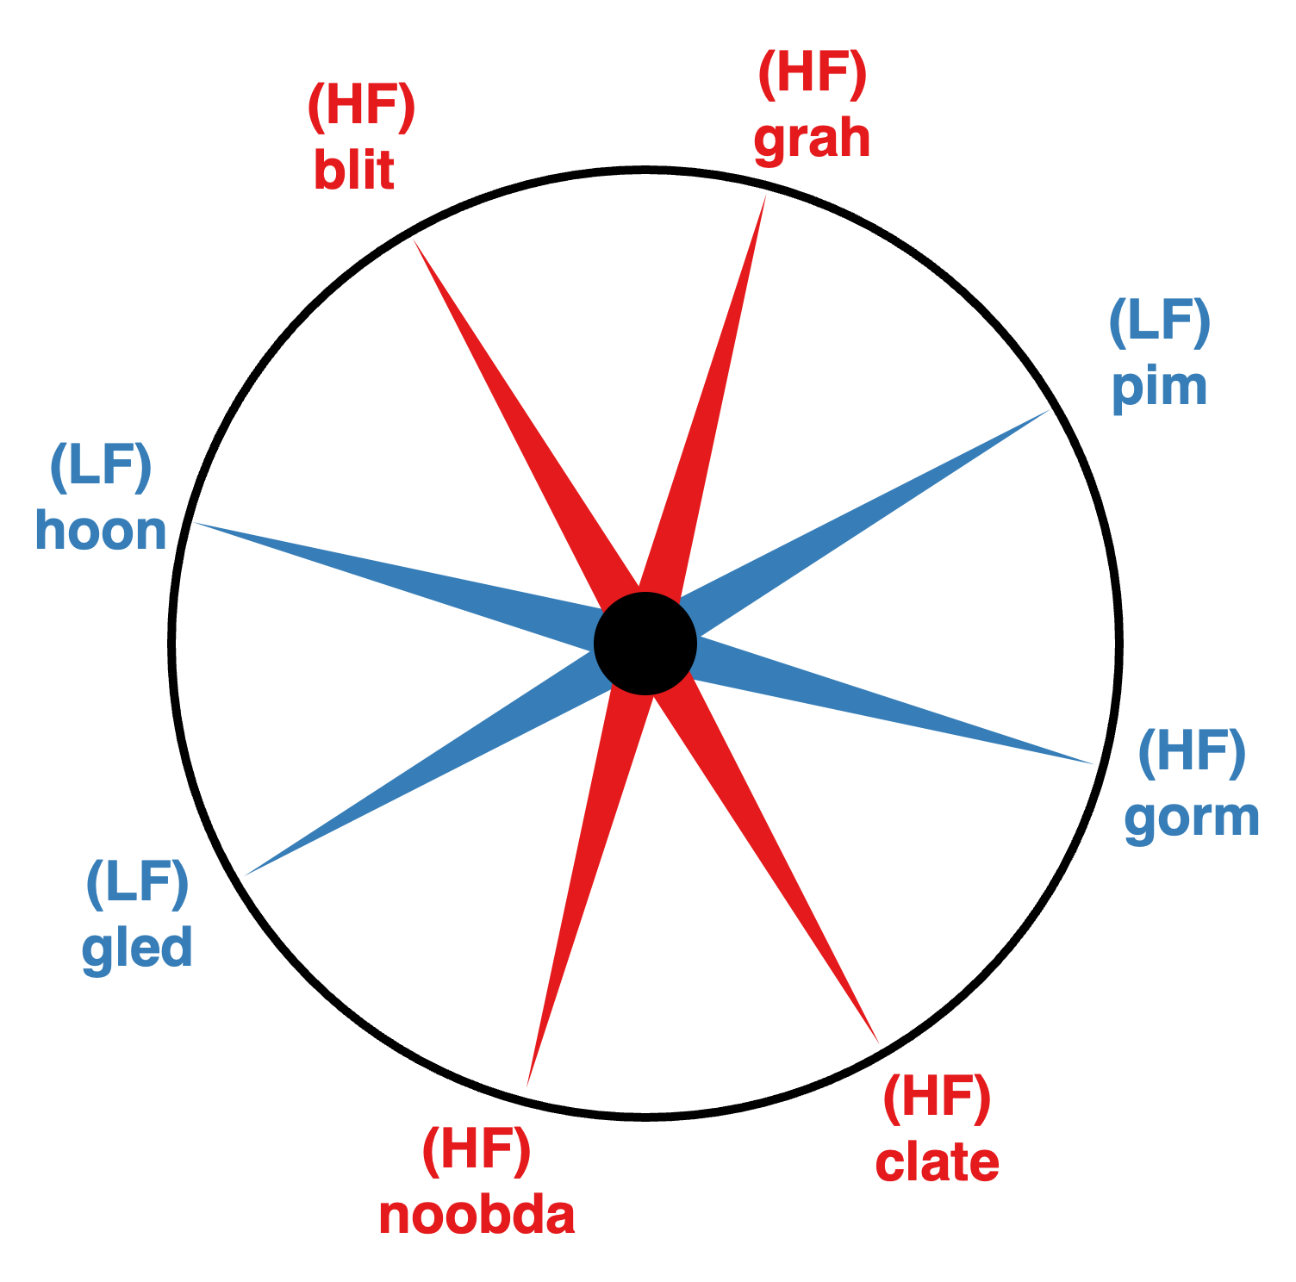
STEP 1 · LEARN
STEP 2 · PRODUCE
STEP 3 · REMEMBER
Learning 8 new direction words
8 directions, evenly spaced (45° apart)
8 made-up words (“blit”, “grah”, …), randomly assigned to directions
4 words shown 4× as often → common (“high frequency” - “HF”)
4 words shown rarely → rare (“low frequency”- “LF”)
Training repeats until 100% recall of all 8 words
Notes:
Step one. [CLICK]
[CLICK] Eight directions are evenly spaced on a compass.
[CLICK]Each gets a made-up word - blit, grah, and so on - randomly assigned for each participant.
[CLICK] Here is the key manipulation, and this is what the red and blue on the compass mean: four of the words are shown four times as often during learning - those become the common, high-frequency words, in red. [CLICK] The other four are shown rarely - the rare, low-frequency words, in blue.
[CLICK] Training repeats until every participant can recall all eight words perfectly. Everyone reaches 100 percent before moving on - so nobody is missing any words.

Slide 12
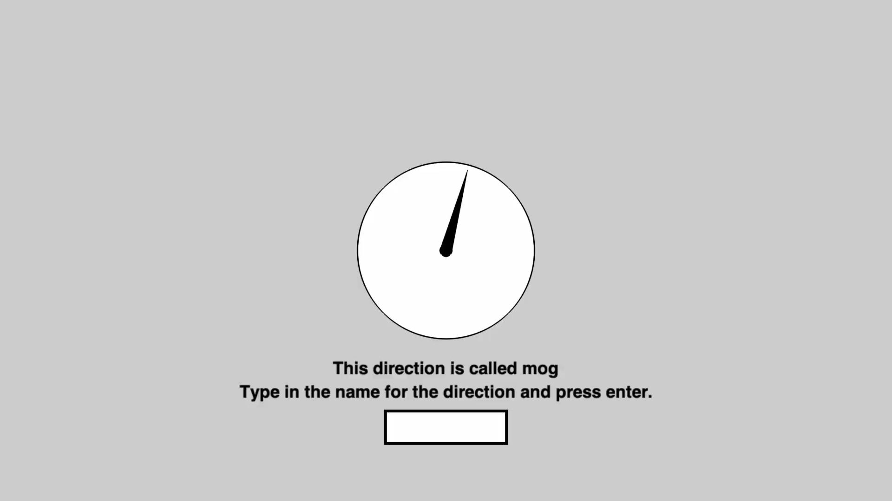
STEP 1 · LEARN
STEP 2 · PRODUCE
STEP 3 · REMEMBER
What a training trial feels like
Learn the eight words
Notes:
Let’s take a look from the participant's seat.
[CLICK] First, you see an arrow pointing at a direction, and you are prompted to type in the word. This walks you through all the eight words.

Slide 13

STEP 1 · LEARN
STEP 2 · PRODUCE
STEP 3 · REMEMBER
What a training trial feels like
Choose from two words
Notes:
[CLICK] In the next phase, two words appear - which one matches? You type your answer, and you immediately learn whether you were right.

Slide 14
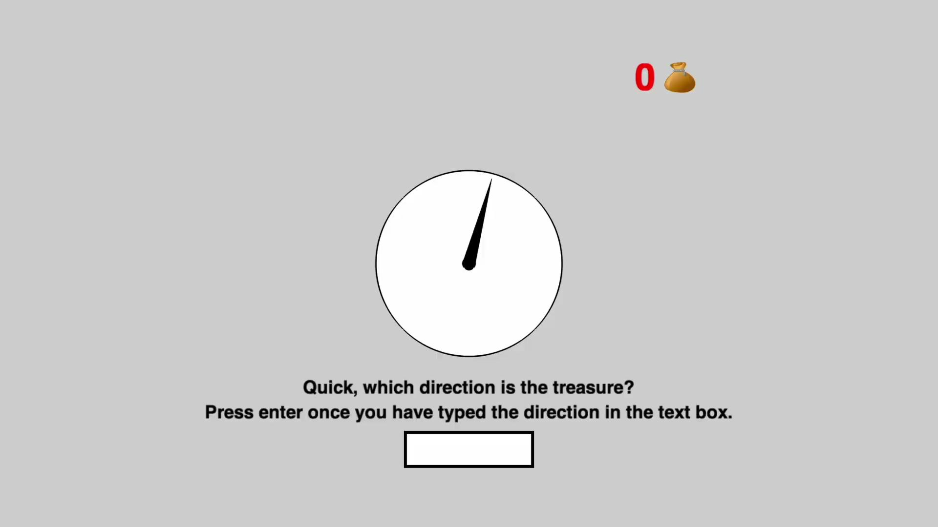
STEP 1 · LEARN
STEP 2 · PRODUCE
STEP 3 · REMEMBER
What a training trial feels like
Type the correct word from memory
Notes:
Lastly, you are asked to type the correct word from memory. If they make an error, they go back to the learning blocks. Training continues until they reach 100% accuracy on recalling all 8 words. By doing this, we make sure participants remember every word before beginning the real test.

Slide 15
STEP 1 · LEARN
STEP 2 · PRODUCE
STEP 3 · REMEMBER
The word game
You see an arrow — it can point anywhere on the circle, not just at trained directions
Notes:
Step two is the actual test - a game.
It looks like the last step of the training, but now the arrow can point anywhere on the circle, not just at the trained directions. Your job: type the best direction word for it.

Slide 16
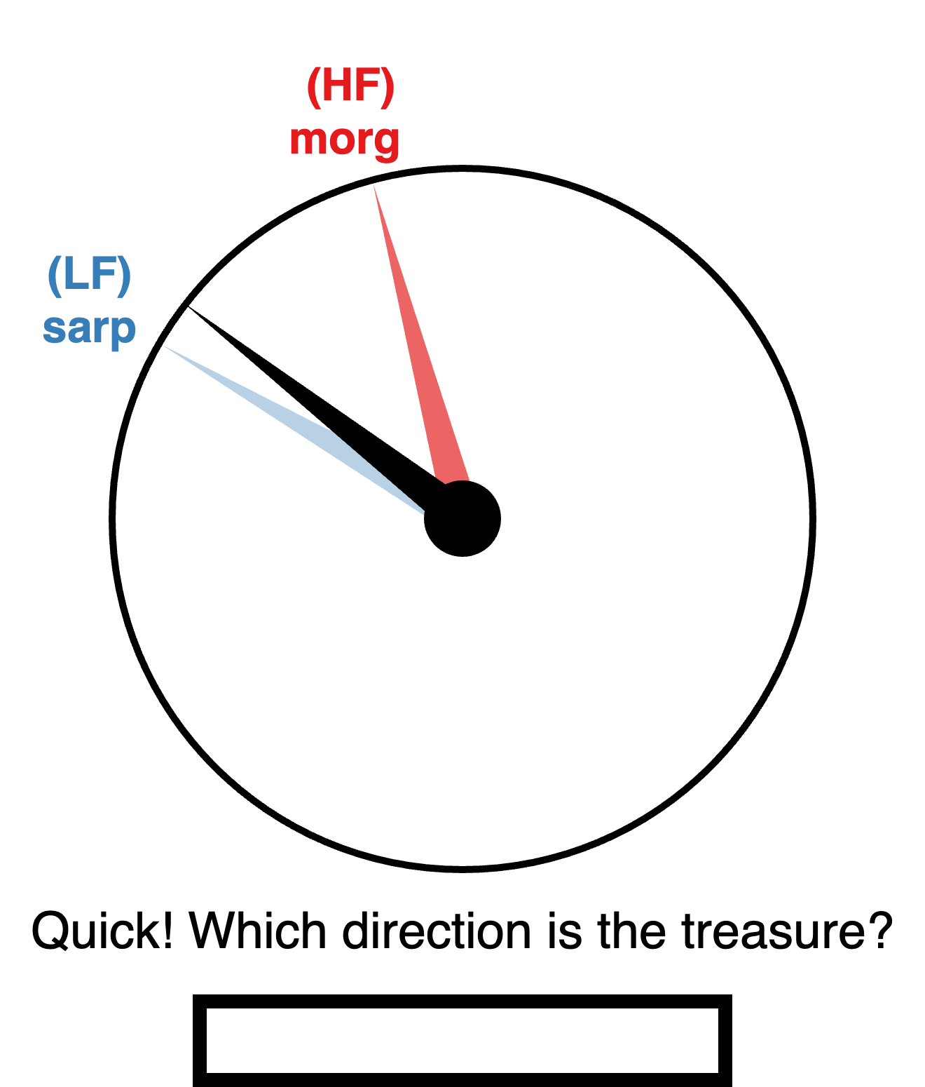
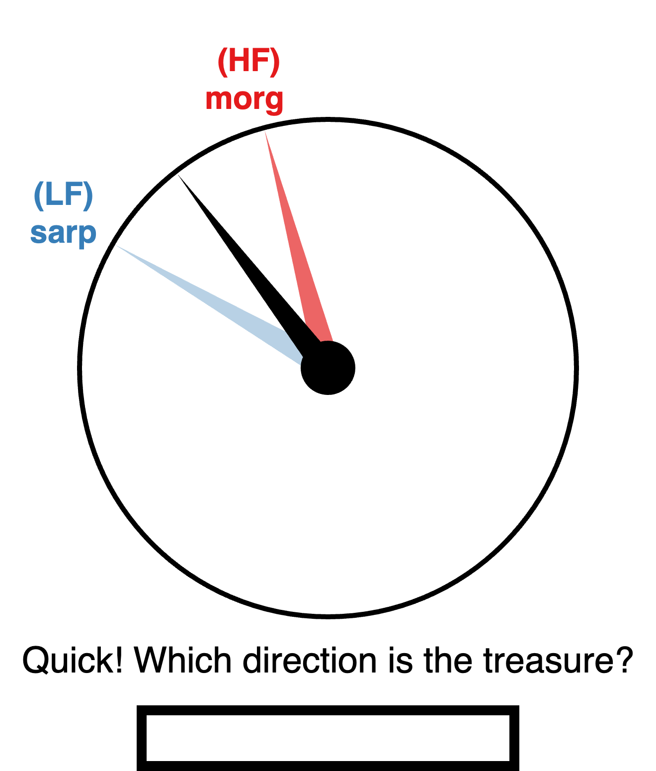
STEP 1 · LEARN
STEP 2 · PRODUCE
STEP 3 · REMEMBER
Some arrows are close to a trained compass direction;
others fall between two
A. Low Competition Trial
B. High Competition Trial
Notes:
And there are two types of test trials
[CLICK] In some trials, the arrow you see is clearly close to a direction that you just learned.
[CLICK]In some other trials, the arrow you see is kind of in the middle of two directions, and they are more ambiguous to tell which direction they are closer to.

Slide 17
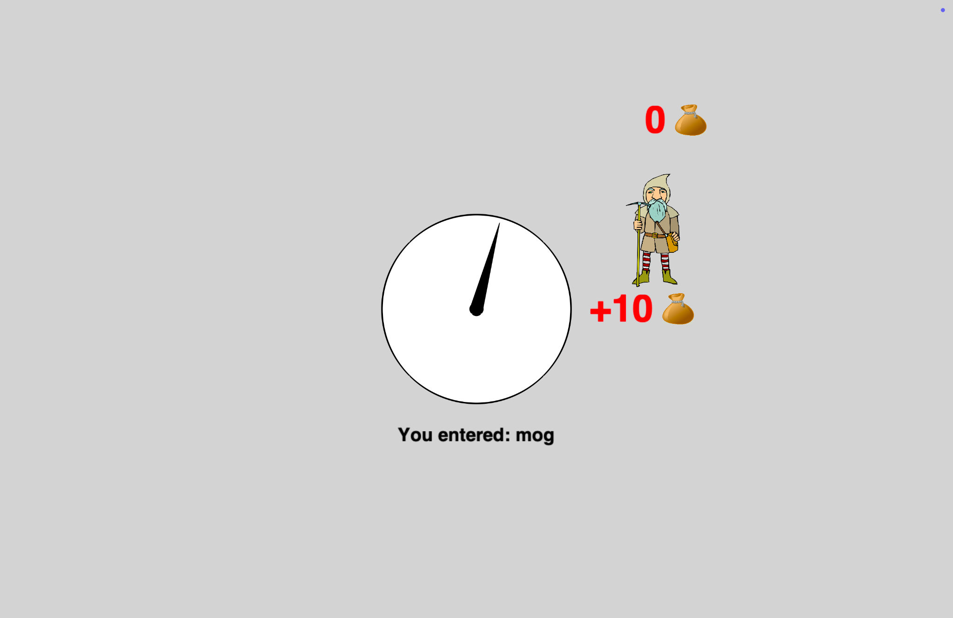
STEP 1 · LEARN
STEP 2 · PRODUCE
STEP 3 · REMEMBER
Creating conflict between precision and ease of retrieval
And you get points…
Points reward accuracy most:
the closer your word’s direction is to the arrow, the more points
And you’re under speed pressure:
5 s to start typing (or 0 points), plus a small bonus for answering fast
Notes:
[CLICK] And you get points for each trial.
There are two things about the scoring.
[CLICK] First, accuracy matters most - the closer your word's trained direction is to the arrow, the more points you get. So people are incentivized to be as precise as possible.
[CLICK] Second, you are under speed pressure. you have five seconds to start typing or the trial is worth nothing, and faster answers earn a small bonus.
So the game rewards precision, but time pressure makes ease of retrieval matter. That is exactly the conflict from the cat and kitten example, now under experimental control.

Slide 18
STEP 1 · LEARN
STEP 2 · PRODUCE
STEP 3 · REMEMBER
Memory check
Recall eight words again
↳ Make sure they remember all the words
Notes:
After the game, participants recall all eight words again. Again, we want to make sure they choose to not use the low frequency words but not that they forgot them.

Slide 19
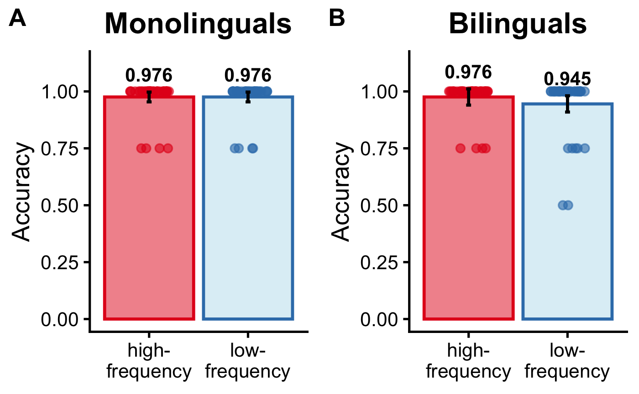
Everyone learned and remembered the words
So game choices reflect selection — not forgetting.
Notes:
Quick sanity results before the main event. Recall accuracy for the eight words, after the game.
Everything is high.
[CLICK] So everyone knew the words, and still knew them at the end.

Slide 20
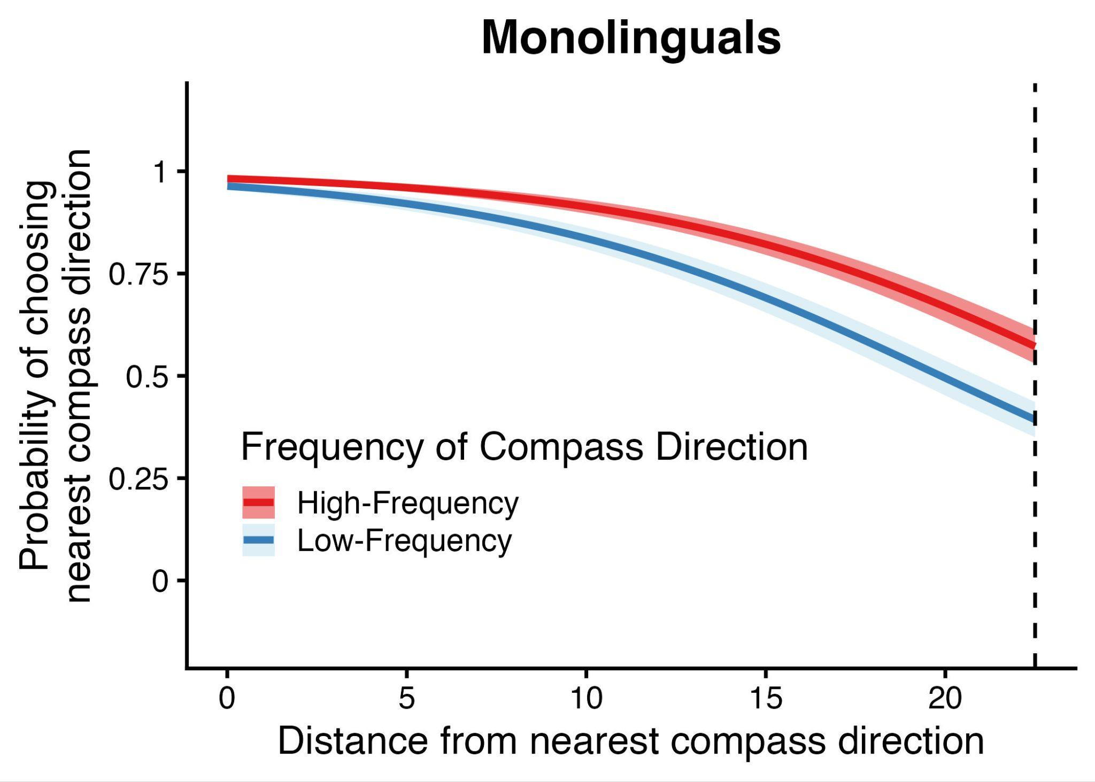
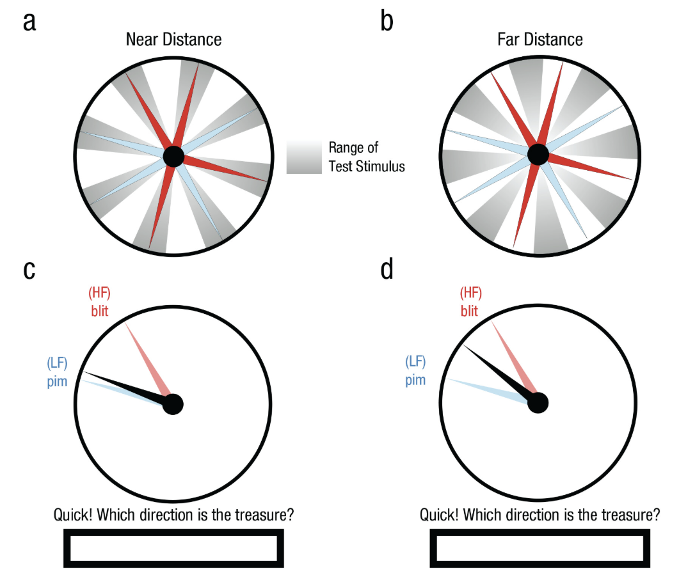
RESULTS
Monolinguals show a frequency effect
Notes:
Now let’s go on to our main results.
Let’s look at what monolinguals do first.
[CLICK] The x axis shows how far the arrow is from a word's trained direction. Zero means the arrow points exactly at that word's direction. [CLICK] 22.5 degrees is the maximum - the arrow is exactly between two words.
On the y axis is the probability that people choose that nearest word.

Slide 21
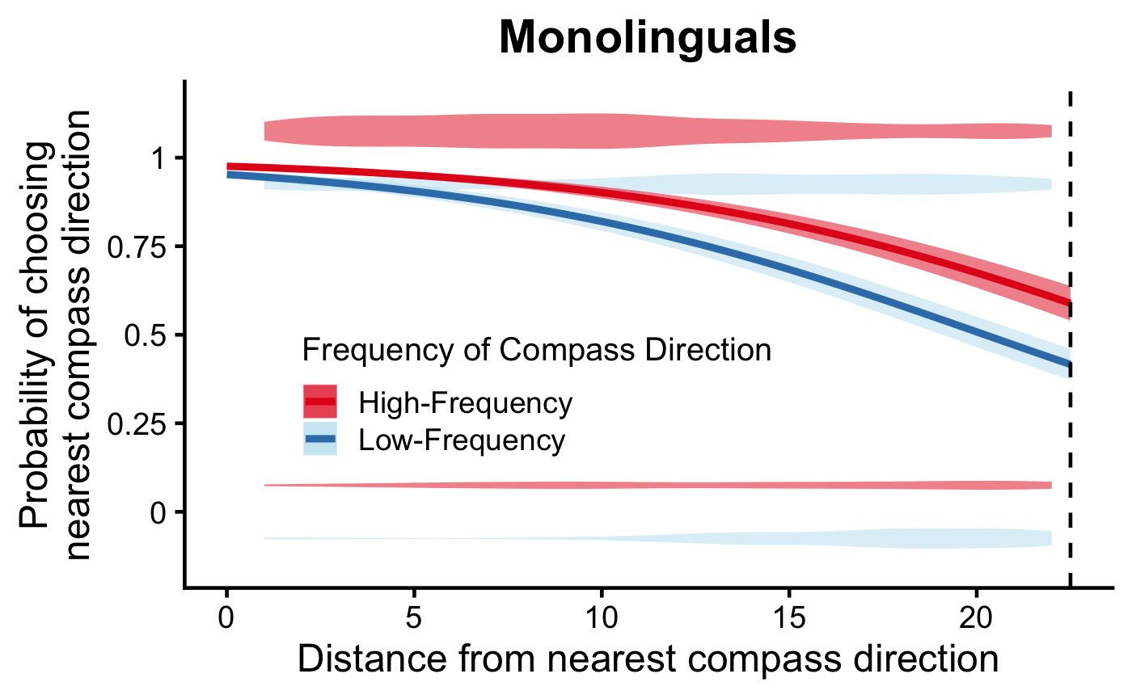
RESULTS
Monolinguals show a frequency effect
At the same distance, the high-frequency word is chosen more often than the low-frequency one — H1 ✓
Notes:
The curves are the model fit, with confidence bands. Red is high frequency words, blue is low frequency.
At zero, both curves start at the ceiling — if the arrow points at a word's direction, everyone uses it.
But as the arrow moves away, the two curves come apart. People stick with the high-frequency word even as it becomes less and less precise. And they abandon the low-frequency word at much shorter distances — they switch over to a high-frequency alternative earlier.
That is the tradeoff we started with

Slide 22
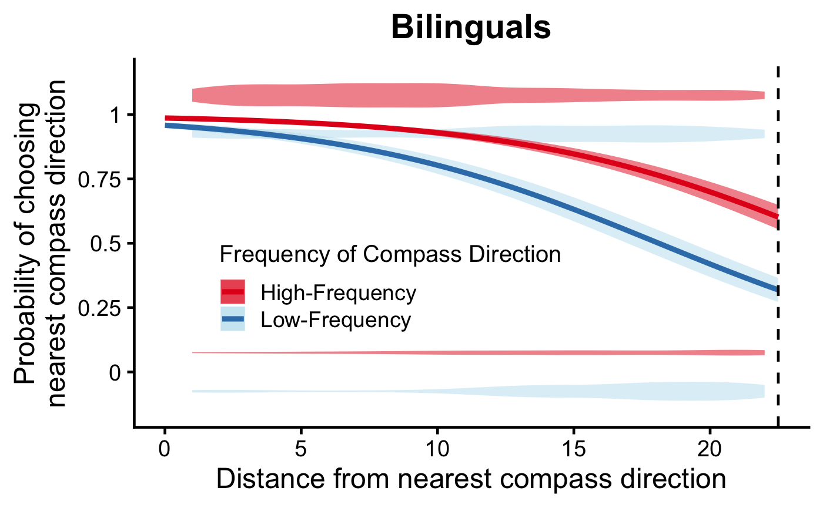
RESULTS
Bilinguals: same pattern, numerically larger
Again, the high-frequency word is chosen more often than the low-frequency one — H1 ✓
Notes:
Now bilinguals, same plot.
The same pattern.

Slide 23
RESULTS
…but the group difference is not significant
Frequency × group: p = .13
Notes:
Here are the two groups side by side. The red-blue gap here is somewhat wider in the bilingual panel - which is the direction our second hypothesis predicts. Bilinguals lean on the high frequency word a bit more. However, we did not find the interaction between the group and frequency effect to be significant.

Slide 24
Retrieval difficulty drives word choice
Bilinguals are not one group
"Bilingual" is not a categorical variable — our sample ranges from US-born speakers to recent arrivals from China, differing in dominance and retrieval cost.
Within bilinguals, dominance mattered (p = .018):
Mandarin-dominant → larger frequency effect
English-dominant → smaller frequency effect
The task was in English — so speakers working in their weaker language, where retrieval costs most, leaned hardest on high-frequency words.
Notes:
[CLICK] Moreover, our bilingual participants are not one group. Some were born and raised here in the US. Some arrived from China recently. Those are very different language histories, and they mean very different things about how dominant English is, and how much retrieval costs.
So we were also interested in whether this within group difference on retrieval cost would make a difference on participants’ performance on the task. [CLICK] And in deed we found that the more Mandarin-dominant a speaker was, the larger their frequency effect. The more English-dominant, the smaller.
[CLICK] And here is why that is the comparison that matters. The whole task was in English. So the more Mandarin-dominant speakers were working in their weaker language — the language where retrieval costs the most. And those are exactly the speakers who leaned hardest on the high-frequency words.

Slide 25
Future steps
Equal training, so this isn't about word histories. Everyone learned the same words the same number of times — differences in lifetime usage of these words can't explain the group difference.
Cross-language competition survives this control
Need naturalistic measures
real vocabulary, real usage histories, and corpus-based frequency estimates for each language.
Other populations and contexts that raise retrieval demands
Notes:
Let me be clear about what this design does and does not let us say.
[CLICK] Everyone learned the same words, the same number of times. So differences in lifetime usage of these particular words cannot be what is producing the group difference.
[CLICK] But that does not isolate a mechanism. Cross-language competition survives this control completely — multiple lexical systems are active during selection no matter how often these words were seen. So we are not in a position to separate weaker representations from increased competition.
What we can say is the thing both accounts share: when retrieval demands go up, from whatever source, lexical selection shifts toward words that are easier to access.
Two directions from here. [CLICK] One, naturalistic measures — real words with real usage histories, and frequency estimates from each speaker's actual input, rather than words we taught in an hour.
[CLICK] Two: other populations and other contexts that raise retrieval demands. Bilingualism is one way to make retrieval harder. If the account is right, we should see the same shift wherever retrieval gets costly.

Slide 26
Takeaways
H1 ✓ All participants choose easier words over more precise ones, whether you speak one language or two
H2 ? Bilinguals trend toward a stronger pull, but the difference isn’t significant
Notes:
So, back to our two hypotheses.
Our first hypothesis is clearly supported, in both groups.
Our second hypothesis is partly supported. The difference between monolinguals and bilinguals went in the predicted direction, but it did not reach significance.
But within the bilingual group, dominance predicted the size of the effect. The weaker someone's English, the harder they leaned on the high-frequency word.
So the thing that matters is not which group you belong to. It is how hard the word is to reach.
And this is all for my talk, thank you!

Slide 27
References
Koranda, M. J., Zettersten, M., & MacDonald, M. C. (2022). Good-enough production: Selecting easier words instead of more accurate ones. Psychological Science, 33(9), 1440-1451.
Gollan, T. H., Montoya, R. I., Cera, C., & Sandoval, T. C. (2008). More use almost always means a smaller frequency effect: Aging, bilingualism, and the weaker links hypothesis. Journal of memory and language, 58(3), 787-814.
Green, D. W. (1998). Mental control of the bilingual lexico-semantic system. Bilingualism: Language and cognition, 1(2), 67-81.

