Slide 1
Towards benchmarking VR sickness:
A novel methodological framework for assessing contributing factors and mitigation strategies through rapid VR sickness induction and recovery
Rouhani, R., Umatheva, N., Brockerhoff, J., Keshavarz, B., Kruijff, E., Gugenheimer, J. & Riecke, B. E. (2024). Displays, 84, 102807.
Presented by: Angela Marti Marca
November 7th, 2024

Slide 2
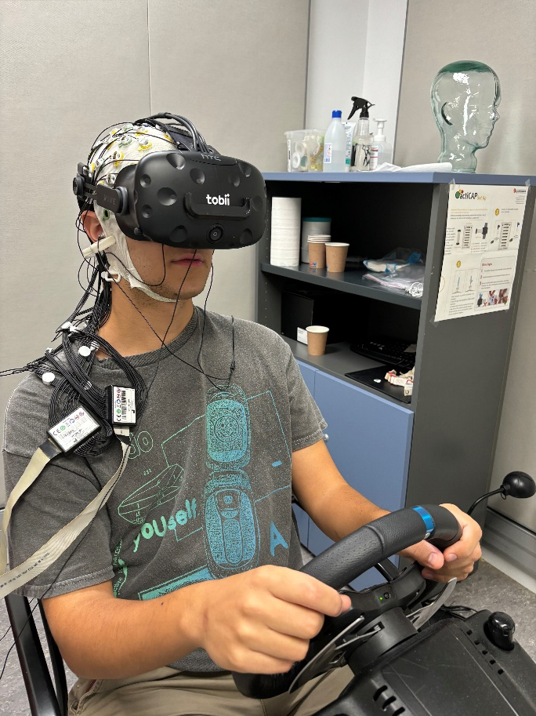
Background The Proliferation of VR
Recent years have seen a proliferation of low-cost, consumer level, head-mounted displays (HMDs)
VR applications are being used in a variety of different sectors: gaming and entertainment, advertising, virtual tourism, prototyping, medicine, scientific visualization, education, etc.
Relevant to addressing real-world challenges
Introduction | Objectives | Experiment 1 | Experiment 2 | Experiment 3 | Conclusions | Future Studies

Slide 3
Background The Reality-Virtuality Continuum
Real
environment
Augmented
reality
Augmented
virtuality
Virtual
environment
Reality-virtuality continuum
Mixed reality
Milgram & Kishino, 1994
Introduction | Objectives | Experiment 1 | Experiment 2 | Experiment 3 | Conclusions | Future Studies
Notes:
The merging of real and virtual worlds along the virtuality continuum, which connects completely real environments to completely virtual ones.
Real environment: environments that solely consist of real objects
Augmented Reality: the display of an otherwise real environment is augmented by means of virtual objects
Augmented Virtuality: that which is augmented is not a direct representation of a real scene but rather a virtual world
Virtual Environment: environments consisting of solely virtual objects

Slide 4
Background Issues in VR
Problem: There are barriers that hinder widespread VR adoption.
VR SICKNESS
A relationship between motion sickness, simulator sickness, cybersickness
Motion sickness:
Unpleasant feeling + nausea, dizziness vomiting)
Occurs when people travel in moving vehicles
Simulator sickness:
Occurs in simulators with moving platforms, discrepancies between perceived and actual motion
Cybersickness:
Affects stationary users who experience the sensation of moving in a virtual scene
Nesbitt et al., 2017; Kennedy et al., 1993; Golding et al., 1998; Hettinger et al., 1990
Introduction | Objectives | Experiment 1 | Experiment 2 | Experiment 3 | Conclusions | Future Studies
Notes:
In each case these symptoms are induced by exposure to slightly different situations, and different clusters of symptoms seem to differentiate the three conditions [12].

Slide 5

Background Issues in VR
Cobb et al., 1999; Kim et al., 2018; Keshavarz et al., 2022; Kennedy et al., 1993; LaViola, 2000; Stanney et al., 2003; Cha et al., 2021; Lassoe et al., 2023; Nesbitt et al., 2017
VR SICKNESS (CYBERSICKNESS)
General discomfort, eye strain, stomach awareness, nausea,
pallor, sweating, fatigue, drowsiness, disorientation, and more
73% experienced
increased discomfort after short VR exposure 66.7% of participants aborted experiment due to symptoms
Exposure to VR technology: HMDs, simulators and other
CAN LAST UP TO 24 HOURS
Consequences: negative user experience, reduced performance and use, shortened duration of VR exposure, diminished overall enjoyment, lower likelihood of repeat use
Introduction | Objectives | Experiment 1 | Experiment 2 | Experiment 3 | Conclusions | Future Studies
Notes:
Participants can experience a range of unpleasant physical responses when subject to virtual environments [11], [12], [13].
While for most people the effects are minor, some estimates for the percentage of the population affected during exposure are as high as 60–80% [11], [15].
Furthermore, post-training effects can impact on individuals, with effects such as drowsiness or postural instability occurring immediately after training or even many hours later [17]

Slide 6
Background Developing a VR Benchmark
Methodological inconsistencies and limitations hinder cross-study comparisons; absence of a VR sickness benchmark
Efficient and rapid VR sickness induction
Evoke and manage VR sickness
Participants can abort the session when a VR sickness threshold is reached
Evaluation of mitigation techniques and contributing factors
Goal of creating a standardized tool for assessment, comparison and refinement
The design of the benchmark is based on the existing VR sickness literature
Introduction | Objectives | Experiment 1 | Experiment 2 | Experiment 3 | Conclusions | Future Studies

Slide 7
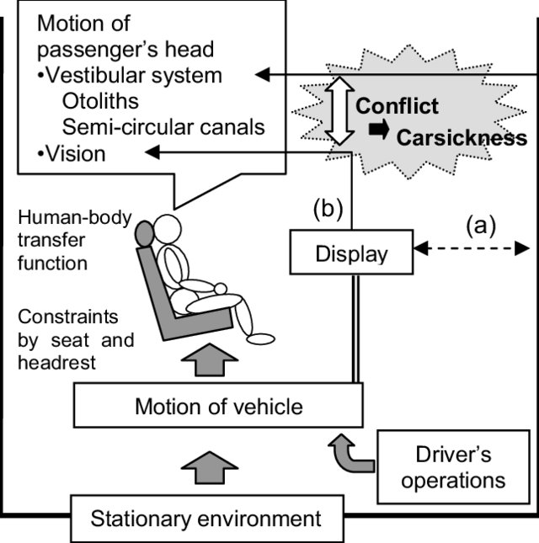
Background VR Sickness Theories
Reason et al., 1978; Oman et al., 1990; Bles et al., 1998; Bos et al., 2008; Figure from: Kato & Kitazaki
What causes VR sickness?
Severity increases with amount of mismatch
SENSORY CONFLICT THEORY
Sensory input mismatch (visual, vestibular and proprioceptive systems)
Visual cues suggest motion, other two do not detect physical movement → leads to discomfort and sickness
Expected and actual sensory signals differ
Introduction | Objectives | Experiment 1 | Experiment 2 | Experiment 3 | Conclusions | Future Studies
Notes:
SCT is the most popular and widely accepted theory
The brain’s internal model, which predicts motion and sensory patterns based on incoming signals and past experiences, is disrupted when the expected and actual sensory signals significantly differ.
All of these propositions may be pertinent to different situations and may even reinforce one another, providing a more comprehensive understanding of VR sickness

Slide 8
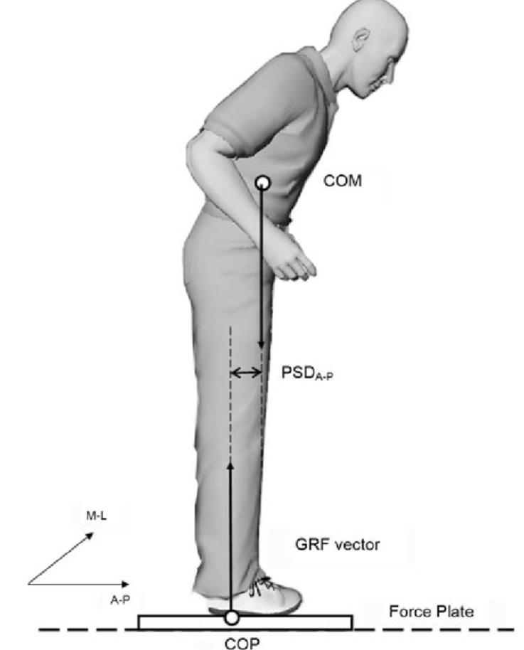
Background VR Sickness Theories
But maybe not caused by a conflict in sensory information
POSTURAL INSTABILITY THEORY
VR sickness results due to reduced postural control and is preceded by the loss of maintaining postural steadiness
Conflict between visual motion perception and body’s physical stability (control of) leading to sickness
Riccio & Stoffregen, 1991; Figure from Lee & Park 2008
Introduction | Objectives | Experiment 1 | Experiment 2 | Experiment 3 | Conclusions | Future Studies

Slide 9
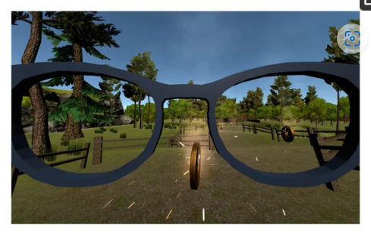
Background VR Sickness Theories
Maybe a cognitive conflict as opposed to a sensory one
REST FRAME HYPOTHESIS
Sickness due to discrepancies in the ’rest-frames’ of visual cues; need a stable
reference point
Use of a natural and stable reference point,
(ex. opaque metal net, artificial
horizon, target reticule, or a virtual nose)
Prothero & Parker, 2003; Prothero, et al., 1999; Figure from Somrak et al., 2021
Introduction | Objectives | Experiment 1 | Experiment 2 | Experiment 3 | Conclusions | Future Studies
Notes:
Users tend to underestimate distances in virtual reality (VR), and several efforts have been directed toward finding the causes and developing tools that mitigate this phenomenon. One hypothesis that stands out in the field of spatial perception is the rest frame hypothesis (RFH), which states that visual frames of reference (RFs), defined as fixed reference points of view in a virtual environment (VE), contribute to minimizing sensory mismatch. RFs have been shown to promote better eye-gaze stability and focus, reduce VR sickness, and improve visual search, along with other benefits. However, their effect on distance perception in VEs has not been evaluated. In this paper, we use a blind walking task to explore the effect of three head-centric RFs (mesh mask, nose, and hat) on egocentric distance estimation. We found that at near and mid-field distances, certain RFs can improve the user’s distance estimation accuracy and reduce distance underestimation. These findings mean that the addition of head-centric RFs, a simple avatar augmentation method, can lead to meaningful improvements in distance judgments, user experience, and task performance in VR.
the nervous system can establish any number of “reference frames” in which to track events. During any task with multiple reference frames, the brain selects one to be the “rest-frame”—that is, the reference frame that is “stationary.” For example, when riding in a car on the freeway, you might have three reference frames: the interior of the vehicle, the landscape outside your window, and a passing truck. If you were to awake from a nap and mistake the passing truck for a stationary object, you’d experience a possibly panicky moment of vertigo because it would briefly seem like your car was suddenly rolling slowly backward down the freeway.

Slide 10
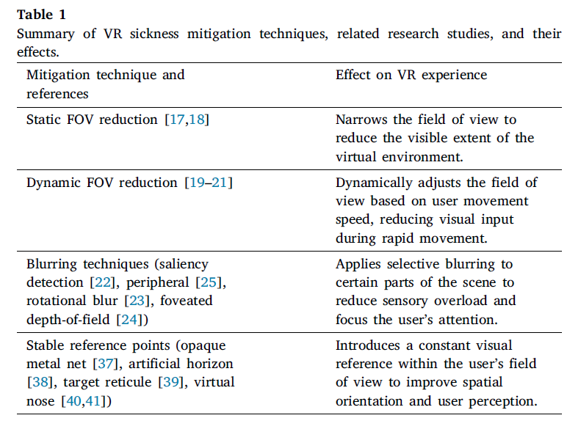
Background VR Sickness Countermeasures
Table from Rouhani et al.,2024 .
Introduction | Objectives | Experiment 1 | Experiment 2 | Experiment 3 | Conclusions | Future Studies

Slide 11
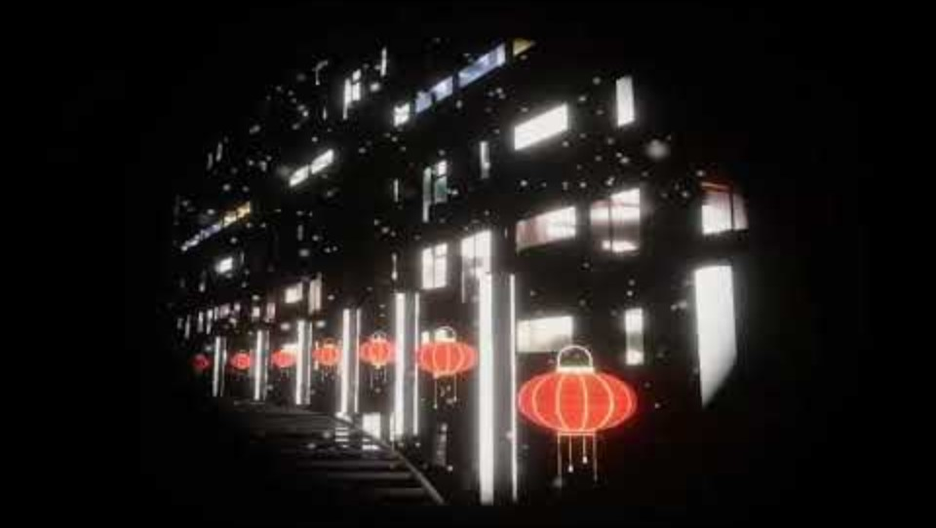
Background Static FOV Reduction
To see an example: VR Sickness Benchmark: Large Environment (Static FOV Reduction)
Introduction | Objectives | Experiment 1 | Experiment 2 | Experiment 3 | Conclusions | Future Studies
Notes:
Among these is the static FOV reduction, which narrows the users’ FOV to diminish the extent of the virtual environment seen [17,18].

Slide 12
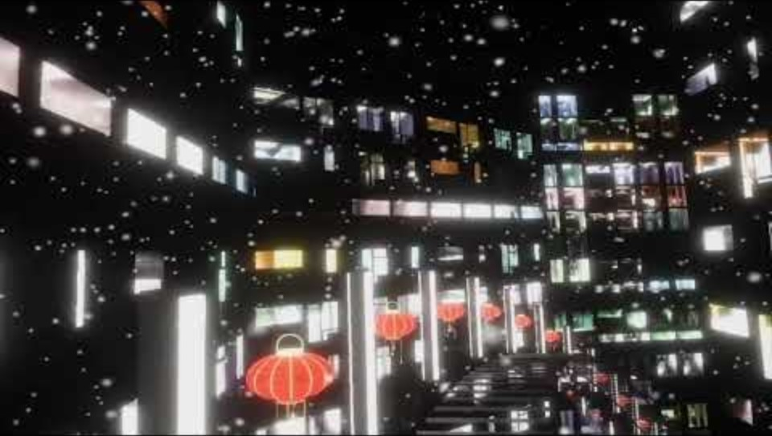
Background Dynamic FOV Reduction
To see an example: VR Sickness Benchmark: Large Environment (Dynamic FOV Reduction)
Introduction | Objectives | Experiment 1 | Experiment 2 | Experiment 3 | Conclusions | Future Studies
Notes:
Another similar strategy involves dynamically adjusting the FOV based on the user’s movement speed within the virtual scene, reducing the FOV at higher velocities, limiting the visual information available [19–21].
Overall, studies have found that reducing FOV correlates with lower VR sickness scores, indicating a negative relationship between FOV size and VR sickness. However, previous studies have also indicated that a more narrow FOV may degrade the sense of presence and enjoyment in virtual environments [17,18].

Slide 13
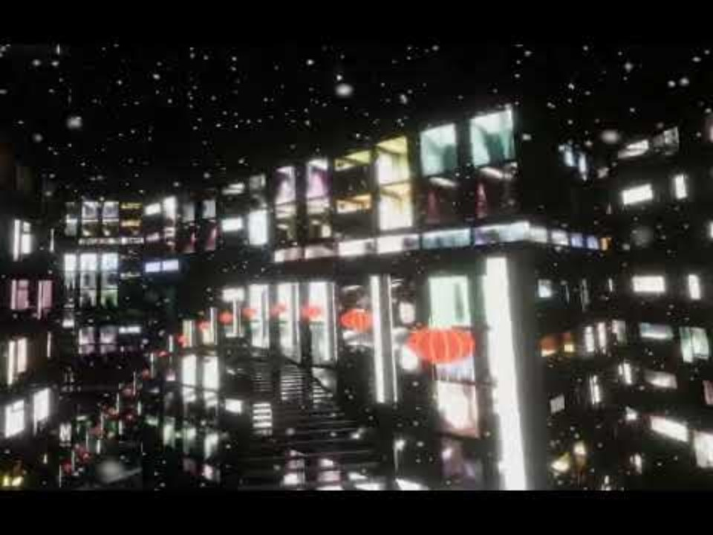
Background Rotational Blur
To see an example: VR Sickness Benchmark: Large Environment (Blur)
Introduction | Objectives | Experiment 1 | Experiment 2 | Experiment 3 | Conclusions | Future Studies
Notes:
Studies have also explored multiple blurring techniques to reduce discomfort in virtual reality. These include dynamical blurring based on saliency detection [22], peripheral blurring [25], rotation blur in response to rotational movements [23], and foveated depth-of-field blur [24]. All of these methods have shown promising results in reducing discomfort levels and enhancing user experience

Slide 14
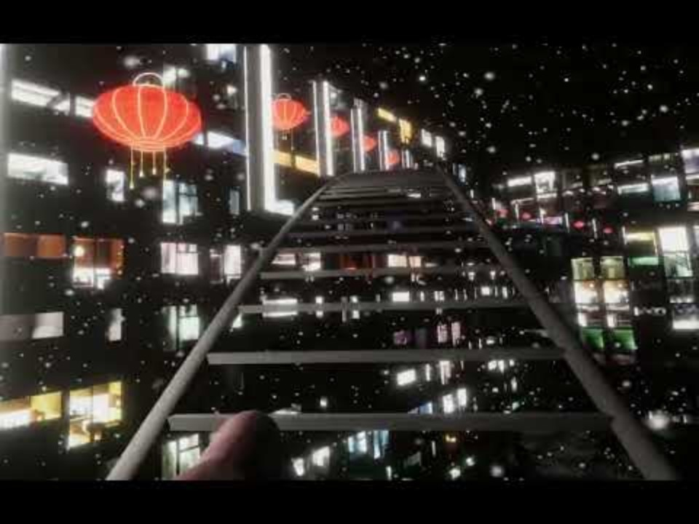
Background Virtual Nose Model
To see an example: VR Sickness Benchmark: Large Environment (Virtual Nose)
Introduction | Objectives | Experiment 1 | Experiment 2 | Experiment 3 | Conclusions | Future Studies
Notes:
Some studies have adapted this theory by providing a natural and stable reference point, such as a virtual nose model to the users’ line of sight [40,41] for improved spatial orientation and perception in VR, and have shown to mitigate VR sickness.

Slide 15
Background Need for a Standardized Benchmark
Why do we need them?
To standardize the evaluation of user experience in VR
Motion Sickness Incidence model (MSI) (O’Hanlon & McCauley, 1974) and the Vomiting Incidence (VI) model (Lawther & Griffin, 1987) used to predict motion sickness based on variables like acceleration and exposure duration
Cybersickness Dose Value (CSDV) attempts to quantify cybersickness potential using display, task and subject-related scaling factors along with spatial velocity metrics (So, 1999)
Predictive models for VR sickness in real-time based on
(1) eye-tracking and in-game character movement data (Wang et al. 2022)
(2) trajectory compression rate during game play (Monteiro et al. 2021)
BUT adoption and standardization are limited
O'Hanlon & McCauley, 1974; Lawther & Griffin, 1987; So, 1999-, Wang et al., 2022; Monteiro et al., 2021
Introduction | Objectives | Experiment 1 | Experiment 2 | Experiment 3 | Conclusion | Future Studies

Slide 16
Background Goals
The benchmark will be designed to:
Reliably induce short-term, controlled VR sickness
Provide a standardized environment that reliably induces VR sickness
Evaluate contributing factors to VR sickness (VR hardware, diverse locomotion interfaces, broader environmental, technical, and participant-related factors in the VR experience)
Equip researchers and developers with a reliable tool and methodological framework for evaluating the effectiveness of different VR mitigation strategies by providing a controlled setting for comparison and improvement
Introduction | Objectives | Experiment 1 | Experiment 2 | Experiment 3 | Conclusions | Future Studies

Slide 17
Background Framework Design
Design element | Theoretical background
Figure-eight track and roller coaster movements | Roller coaster dynamics known to induce VR sickness Figure-eight design; repetitive linear and rotational acceleration contribute to VR sickness
Passive movement | Elimination of user control over movement increases VR sickness
Movement profiles (horizontal, vertical, rotational) | Acceleration changes in sinusoidal manner complemented by lower-frequency rotational changes créate a gradual rotational sense that synergizes with the translational speed pattern
Optic flow enhancement | Visual elements (snowflakes, neon lights) intensify self-motion; greater optic flow more VR sickness
VR sickness rating | A percentage-based scale allowing real-time self-report of VR sickness adapted from FMS tool
Developed in Unity 3D URP
Consists of two VR environments one ‘small’ laboratory size and one ‘large’ scaled up version
See Table 2 in Rouhani, 2024 for original table + references
Introduction | Objectives | Experiment 1 | Experiment 2 | Experiment 3 | Conclusions | Future Studies
Notes:
VR Sickness Benchmark: Small Environment (No Sickness Reduction Technique Added)
VR Sickness Benchmark: Large Environment (No Sickness Reduction Technique Added)
Roller-coaster like tracks (emotional and motivational component)
Environments incorporate naturalistic elements: buildings, trees, and grass
The benchmark allows researchers to play with environmental factors such as lighting or time of day
A figure-eight racing track (repetitive linear and rotational acceleration, vertical and horizontal movement, that contributes to VR sickness) with roller-coaster like tracks (emotional component)
Roller coaster simulations have also been shown to effectively provoke cybersickness
Environments incorporate naturalistic elements: buildings, trees, and grass
Surrounding track is adorned with red lanterns and neon white lights, creating a visually engaging environment
Strong optic flow and slowly drifting snowflakes intensify self-motion
The benchmark allows researchers to play with environmental factors such as lighting or time of day
The large environment: scaled up version of the small environment

Slide 18
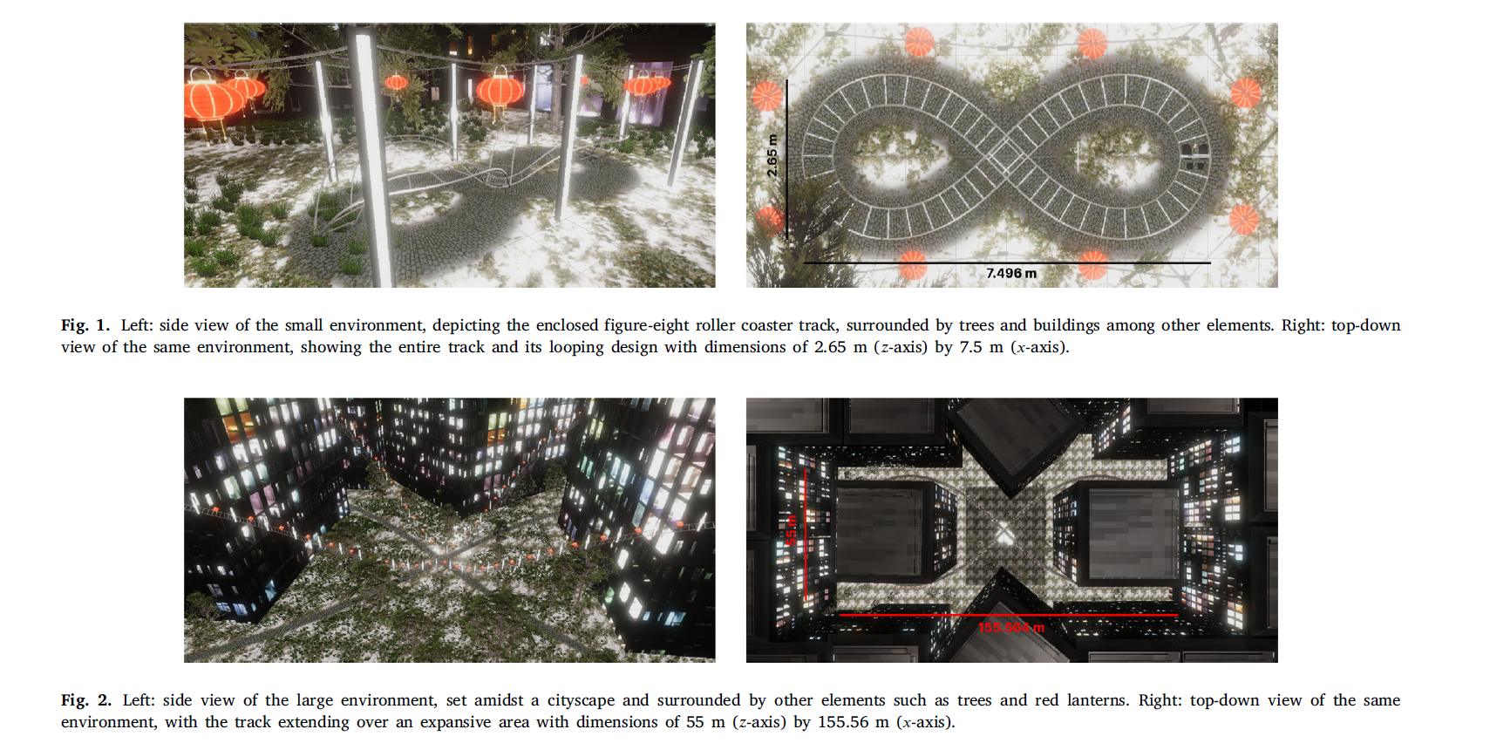
Background Framework Design
Figure from Rouhani, 2024
Introduction | Objectives | Experiment 1 | Experiment 2 | Experiment 3 | Conclusions | Future Studies

Slide 19
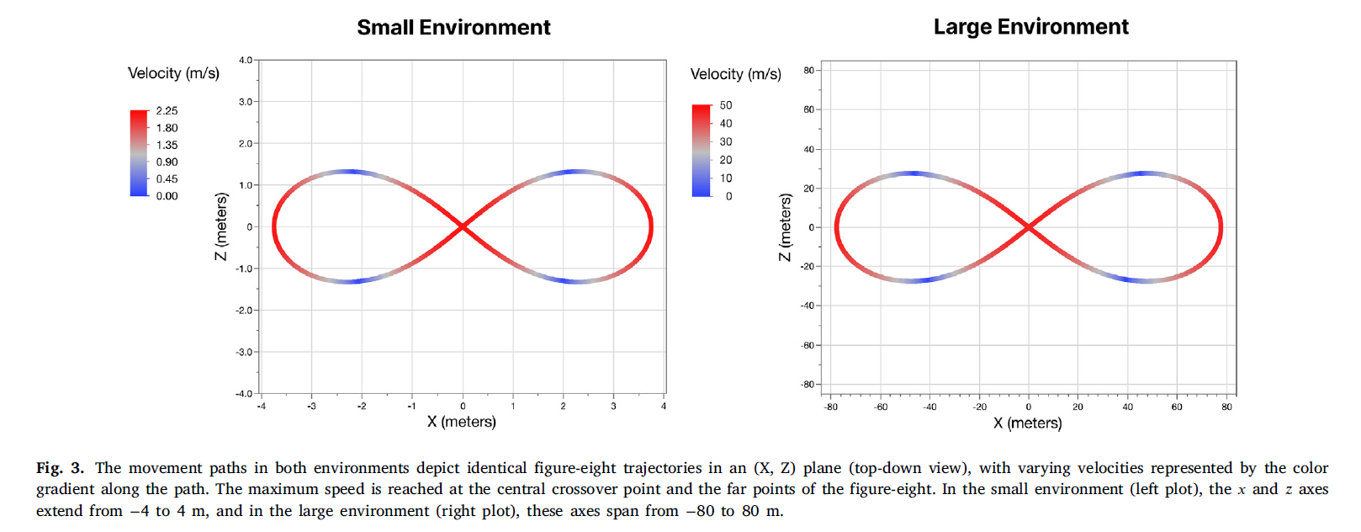
Background Framework Design
Figure from Rouhani, 2024
Introduction | Objectives | Experiment 1 | Experiment 2 | Experiment 3 | Conclusions | Future Studies

Slide 20
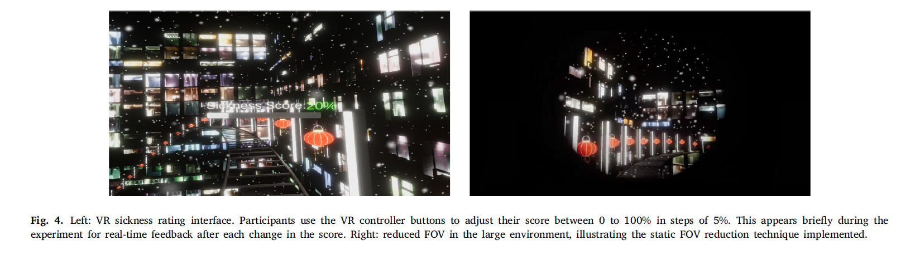
Background Framework Design
Figure from Rouhani, 2024
Introduction | Objectives | Experiment 1 | Experiment 2 | Experiment 3 | Conclusions | Future Studies
Notes:
Appears for 2s after each adjustment
This VR sickness rating interface is inspired by Keshavarz & Hecht’s Fast Motion Sickness Scale (FMS), a validated single-item, 21-point scale for assessing VR sickness [67].
During stimulus presentation, observers gave verbal ratings of experienced MS on a 20point scale (FMS) ranging from 0 (no sickness at all) to 20 (frank sickness) every minute. Participants were informed to focus on nausea, general discomfort, and stomach problems and to take these parameters into account when making their judgments. They were asked to ignore other possible distorting effects, such as nervousness, boredom, or fatigue. We are aware that participants might have had difficulties in following the instruction to ignore the irrelevant sensations, and we cannot be entirely certain that the FMS measure is free of symptoms related to but different from nausea proper. However, we believe that the participants were instructed efficiently enough to provide the necessary focus on the relevant symptoms.

Slide 21
Main Objective
To validate the effectiveness of the benchmark system and evaluate four VR sickness mitigation techniques through two experiments
Introduction | Objectives | Experiment 1 | Experiment 2 | Experiment 3 | Conclusions | Future Studies

Slide 22
Experiments
Evaluate and compare VR sickness mitigation techniques (blur, virtual nose, dynamic FOV reduction) in alleviating VR sickness, only large scale
Experiment 1
01
03
01
02
To assess the benchmark system’s capacity to induce controlled and moderate levels or VR sickness and test static FOV reduction to alleviate VR sickness at small and large scales
02
Experiment 2
Introduction | Objectives | Experiment 1 | Experiment 2 | Experiment 3 | Conclusions | Future Studies

Slide 23
Experiment 1 Research Questions
Experiment 1
RESEARCH QUESTIONS:
How does environmental size influence VR sickness reduction?
  Do small and large environments elicit different levels of VR sickness?
  How does the size of the environment alongside movement speed and height changes affect the severity and symptoms of VR sickness?
HYPOTHESIS: Authors do not make a specific hypothesis
01
01
To assess the benchmark system’s capacity to induce controlled and moderate levels or VR sickness and test static FOV reduction to alleviate VR sickness at small and large scales
Introduction | Objectives | Experiment 1 | Experiment 2 | Experiment 3 | Conclusions | Future Studies

Slide 24
Experiment 1 Research Questions
Experiment 1
RESEARCH QUESTIONS:
2. How does static FOV reduction influence VR sickness and presence and does this effect vary with environmental size?
  Does this technique actually alleviate VR sickness? Does it have an effect on presence?
HYPOTHESIS: Prior research would indicate the efficacy of this technique in alleviating VR sickness and enhancing participant comfort in VR environments (Lin et al., 2002; Seay et al., 2001)
01
01
To assess the benchmark system’s capacity to induce controlled and moderate levels or VR sickness and test static FOV reduction to alleviate VR sickness at small and large scales
Introduction | Objectives | Experiment 1 | Experiment 2 | Experiment 3 | Conclusions | Future Studies

Slide 25
Experiment 1 Research Questions
Experiment 1
RESEARCH QUESTIONS:
3. What is the time course of VR sickness within the benchmark system? How rapidly does VR sickness escalate to peak intensity and how long is the recovery period after movement cessation and how does this affect VR sickness in subsequent trials (carry-over effects)?
  Objective: ascertain the system’s capability to induce a moderate level of VR sickness quickly and confirm the short-term nature of VR sickness
HYPOTHESIS: VR sickness should be short-lived
01
01
To assess the benchmark system’s capacity to induce controlled and moderate levels or VR sickness and test static FOV reduction to alleviate VR sickness at small and large scales
Introduction | Objectives | Experiment 1 | Experiment 2 | Experiment 3 | Conclusions | Future Studies

Slide 26
Method: Experiment 1 Participants and Paradigm
40 participants
12 males, 27 females, 1 undisclosed
22.32 +- 3.81 [18-42] years old
Experimental design:
  9 participants excluded: technical issues (survey, 4, controller, 5), no VR sickness (needed to indicate at least a 5% increase in VR sickness in at least one condition, 1), excessive VR sickness (3)
Experimental design:
  Two-way within subjects design
  Small and large environment: Impact of spatial scale on experience and mitigation technique effectiveness (FOV reduction)
  Latin square design to control for order effects
Stimuli:
  FOV: 60 degrees (based on Duh et al. (2001) and pilot study results)
Introduction | Objectives | Experiment 1 | Experiment 2 | Experiment 3 | Conclusions | Future Studies
Notes:
All had normal or corrected to normal vision and no defects in depth perception

Slide 27
Method: Experiment 1 Participants and Paradigm
Equipment:
90 Hz refresh rate; Omnicept HMD with eye tracking and heart rate sensor
Response measures:
Real-time measures (VR symptoms, position coordinates, velocities, acceleration, distance/s, FOV)
Postural sway and physiology (Nintendo Wii Balance Board and Microsoft Kinect v2 for body sway and postural control as well as full body motion)
Questionnaires: Pre-study questionnaire (gender, age, vision condition, familiarity with VR devices, frequency of VR use and experience with 3D video games, susceptibility to real-world motion sickness and VR-induced sickness + Simulator Sickness Questionnare (nausea, oculomotor and disorientation) and Post-trial questionnaire (SSQ, I felt sick and I felt dizzy on a scale of 1 to 10, also assessed sense of presence, finally post-study questionnaire (comfort level, comfort in relation to environment size, perception of VR sickness and frustration level)
Interview
Introduction | Objectives | Experiment 1 | Experiment 2 | Experiment 3 | Conclusions | Future Studies

Slide 28
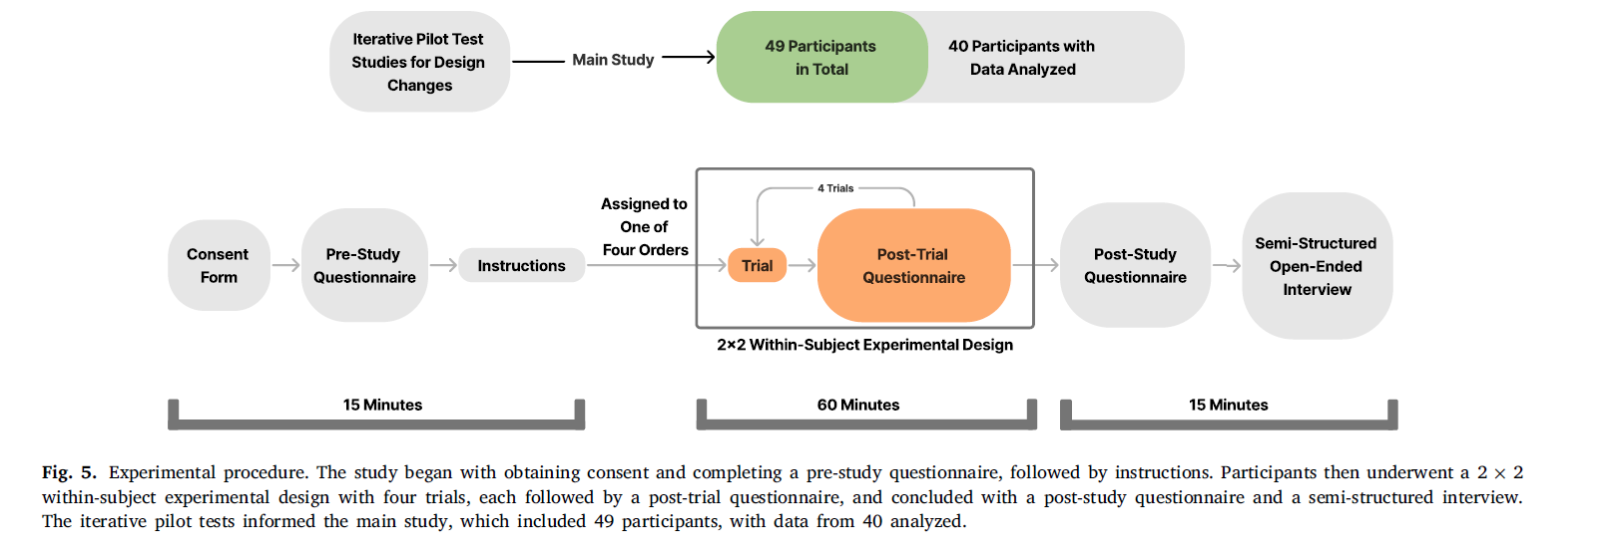
Method: Experiment 1 Procedure
Figure from Rouhani, 2024
75-90 minute duration; each trial about 5-15 minutes long
Each trial had a different combination of environment size and VR sickness reduction
Introduction | Objectives | Experiment 1 | Experiment 2 | Experiment 3 | Conclusions | Future Studies
Notes:
No recent concussions, severe fear of heights, diagnosed vestibular disorders, major musculoskeletal disorders, and other health issues relevant to the study

Slide 29
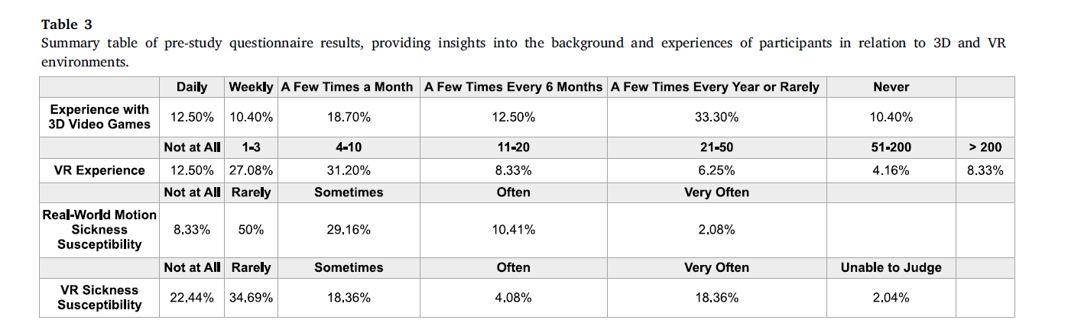
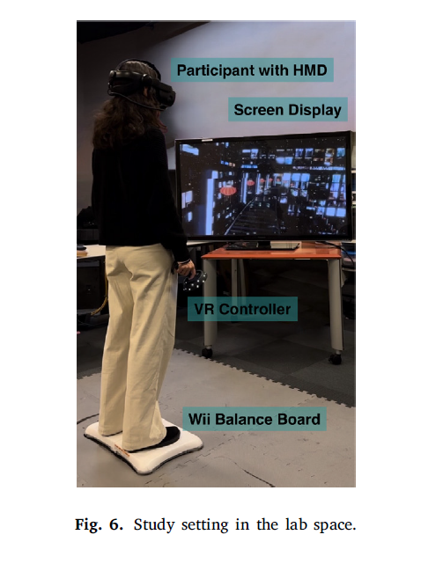
Method: Experiment 1 Procedure
Participants stood on Wii board force plate, arms down and close to their body, maintain gaze ahead and stand comfortably
Right virtual VR controller used to initiate virtual movement and rate their VR sickness; Left controller was inactive (used for symmetry)
Collected baseline body sway measurements
Continued movement until either 50% VR sickness score was met (moderate VR sickness) or same VR sickness level for >2 minutes
Baseline measure and equipment removed (once zero or request)
Figure from Rouhani, 2024
Introduction | Objectives | Experiment 1 | Experiment 2 | Experiment 3 | Conclusions | Future Studies
Notes:
Then baseline measures again and equipment removed once score reached zero or upon request (continue to adjust outside of VR)

Slide 30
Results: Experiment 1
If normality was violated used Aligned Rank Transform test
If normal 2 (size: small, large) x2 (VR sickness mitigation technique: none, static FOV reduction) repeated measures ANOVA
Introduction | Objectives | Experiment 1 | Experiment 2 | Experiment 3 | Conclusions | Future Studies

Slide 31
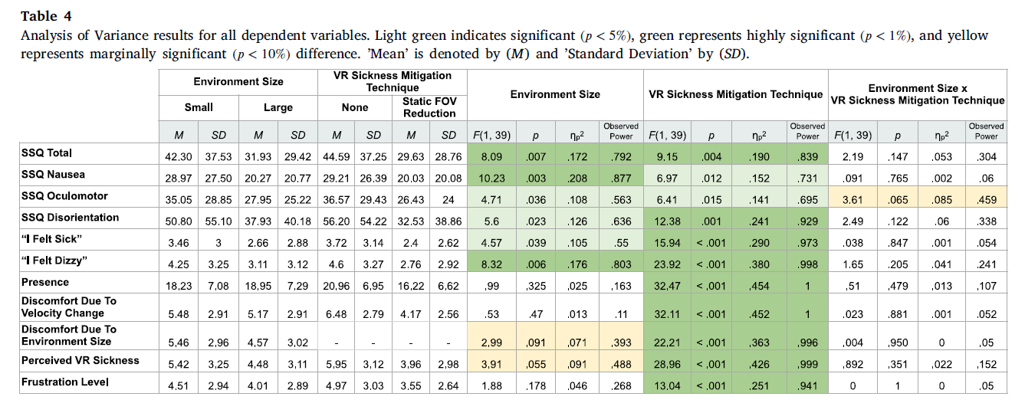
Results: Experiment 1
Figure from Rouhani, 2024
Introduction | Objectives | Experiment 1 | Experiment 2 | Experiment 3 | Conclusions | Future Studies
Notes:
Descriptive and inferential results are summarized in Table 4 for the quantitative measures

Slide 32
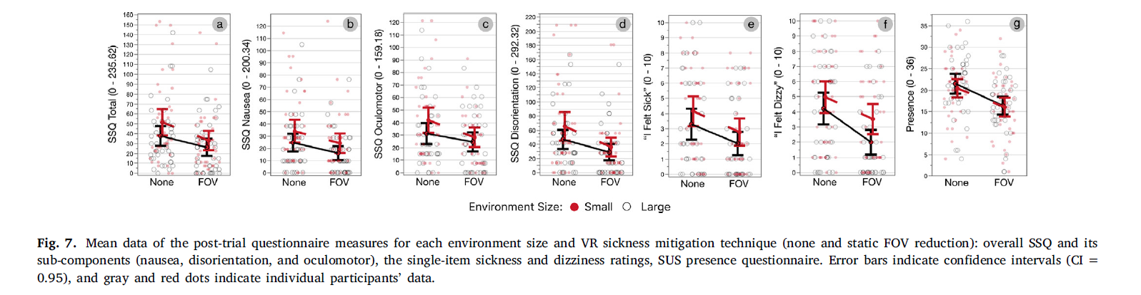
Results: Experiment 1 Post-Trial Questionnaire
Higher VR sickness scores in the small environment (SSQ Total, SSQ Nausea and Dizziness)
Application of the static FOV reduction led to a decrease in VR sickness scores (SSQ, sickness, dizziness) BUT decreased presence ratings
Figure from Rouhani, 2024
Introduction | Objectives | Experiment 1 | Experiment 2 | Experiment 3 | Conclusions | Future Studies

Slide 33
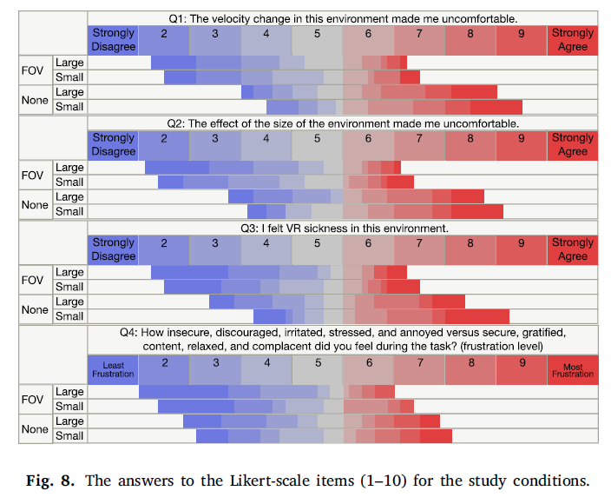
Results: Experiment 1 Post-Trial Questionnaire
In the large environment, a trend towards reduced frustration, discomfort and sickness (BUT NOT SIGNIFICANT)
Reducing FOV significantly reduces perceived discomfort, sickness and frustration
No significant interactions
Figure from Rouhani, 2024
Introduction | Objectives | Experiment 1 | Experiment 2 | Experiment 3 | Conclusions | Future Studies

Slide 34
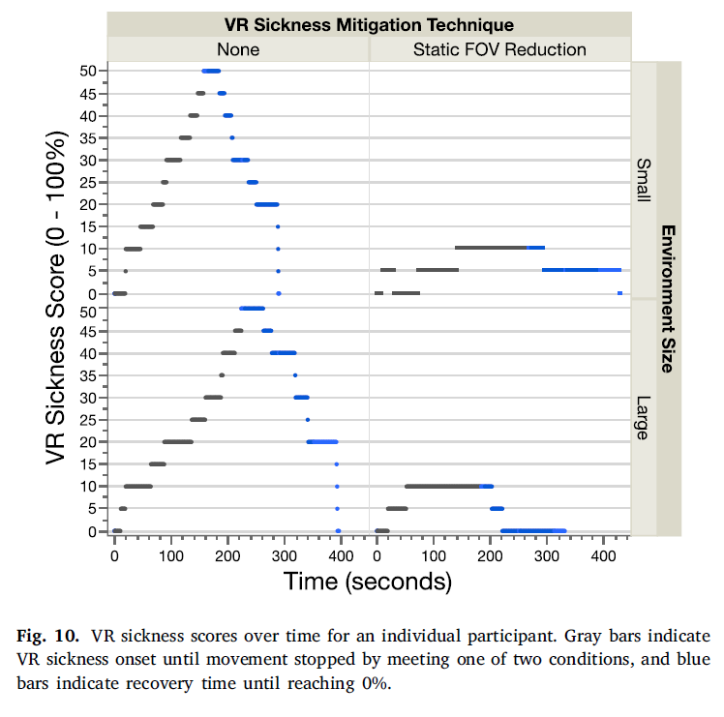
Results: Experiment 1 Post-Trial Questionnaire
Participants experienced rapid onset of VR sickness (average of 3.7 min)
Recovery times were relatively quick (peak VR sickness to baseline) across small and large environments was relatively quick (average of 2.9 min)
Minimal effects of trial order
Figure from Rouhani, 2024
Introduction | Objectives | Experiment 1 | Experiment 2 | Experiment 3 | Conclusions | Future Studies

Slide 35
Results: Experiment 1 Interview Results
In small environments without static FOV reduction:
Intense symptoms of VR sickness (dizziness, disorientation and nausea)
Attributed to velocity changes, confined space, sharp, and abrupt turns
Large environments:
Milder symptoms (dizziness, headaches and disorientation)
Attributed to velocity changes, steep track slopes
25/27 participantes found the static FOV reduction method useful
Introduction | Objectives | Experiment 1 | Experiment 2 | Experiment 3 | Conclusions | Future Studies

Slide 36

Discussion: Experiment 1
Reliable VR sickness induction in the environments, participants frequently mention speed changes as being particularly nauseating. In small environments, VR sickness appears to be worse probably due to constrained space and sharp, abrupt turns and yaw rotation
Reduction in VR sickness due to static FOV reduction in both environments (more effective in small). This is important as it shows that environmental design factors can influence VR sickness mitigation techniques
FOV reduction also reduced the sense of presence
Rapid onset/recovery allows for repeated trials within a single session with minimal carry-over effects. Severity of VR sickness does not predict longer recovery.
Introduction | Objectives | Experiment 1 | Experiment 2 | Experiment 3 | Conclusions | Future Studies

Slide 37
Experiments
Evaluate and compare VR sickness mitigation techniques (blur, virtual nose, dynamic FOV reduction) in alleviating VR sickness, only large scale
Experiment 1
Modifications:
Increase the participant pool
Assess a broader range of VR mitigation techniques
Only the large environment was used due to its relevance to practical applications
Otherwise, identical methods and procedures
01
03
01
02
To assess the benchmark system’s capacity to induce controlled and moderate levels or VR sickness and test static FOV reduction to alleviate VR sickness at small and large scales
02
Experiment 2
Introduction | Objectives | Experiment 1 | Experiment 2 | Experiment 3 | Conclusions | Future Studies

Slide 38
Experiment 2 Objective and Hypothesis
Evaluate and compare VR sickness mitigation techniques (blur, virtual nose, dynamic FOV reduction) in alleviating VR sickness, only large scale
RESEARCH QUESTIONS :
1. How do the three VR sickness mitigation techniques in the large environment influence the experience of VR sickness and presence?
HYPOTHESIS: These three VR sickness mitigation techniques have been previously demonstrated to reduce VR sickness (blur: Budhiraja, 2017; virtual nose: Whittinghill et al., 2015; Wienrich et al., 2018; dynamic FOV: Fernandes et al., 2016. Teixeira et al., 2021, Adhanom et al., 2021).
02
02
Experiment 2
Introduction | Objectives | Experiment 1 | Experiment 2 | Experiment 3 | Conclusions | Future Studies
Notes:
blur [23], virtual nose [40,41], and dynamic FOV reduction [19–21].

Slide 39
Experiment 2 Objective and Hypothesis
Evaluate and compare VR sickness mitigation techniques (blur, virtual nose, dynamic FOV reduction) in alleviating VR sickness, only large scale
RESEARCH QUESTIONS :
2. What is the progression time course of VR sickness within the benchmark system (large environment)? How rapidly does VR sickness escalate to peak intensity? How long does it last after movement cessation and are there carry-over effects?
HYPOTHESIS: VR sickness should be short-lived
02
02
Experiment 2
Introduction | Objectives | Experiment 1 | Experiment 2 | Experiment 3 | Conclusions | Future Studies

Slide 40
Method: Experiment 2 Participants and Paradigm
32 participants
18 males, 14 females
21.78 +- 2.89 [18-32] years old
Experimental design:
  2 participants excluded: no VR sickness (needed to indicate at least a 5% increase in VR sickness in at least one condition, 2)
Experimental design:
  One-factorial within-subjects design with four levels of the factor (VR sickness mitigation technique: none, blur, virtual nose, dynamic FOV reduction)
  Latin square design to prevent order effects
Introduction | Objectives | Experiment 1 | Experiment 2 | Experiment 3 | Conclusions | Future Studies
Notes:
All had normal or corrected to normal vision and no defects in depth perception

Slide 41
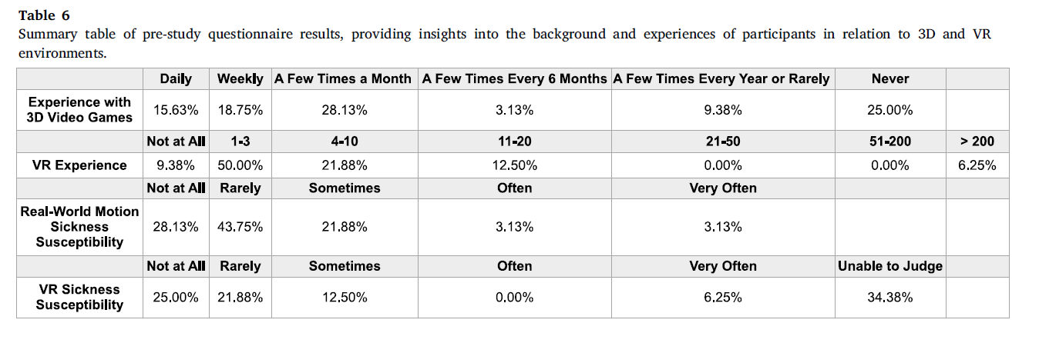
Method: Experiment 2 Pre-Study Questionnaire
Figure from Rouhani, 2024
Introduction | Objectives | Experiment 1 | Experiment 2 | Experiment 3 | Conclusions | Future Studies
Notes:
Participants stood on Wii board force plate, arms down and close to their body, maintain gaze ahead and stand comfortably (adapted from previous studies)

Slide 42
Results: Experiment 2
A 1x4 repeated measures ANOVA was used to assess the dependent variable across the conditions
Greenhouse-Geisser correction when the sphericity assumption was violated
Non-parametric related samples Friedman ANOVA when Shapiro-Wilkes test of normality was violated
Tukey post-hoc tests for pairwise comparisons
Introduction | Objectives | Experiment 1 | Experiment 2 | Experiment 3 | Conclusions | Future Studies

Slide 43
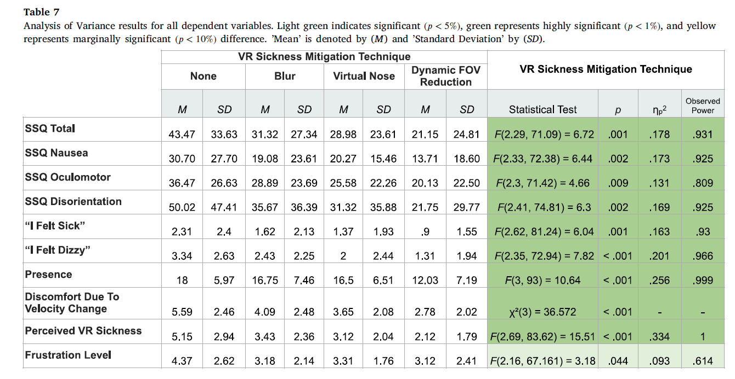
Results: Experiment 2
Figure from Rouhani, 2024
Introduction | Objectives | Experiment 1 | Experiment 2 | Experiment 3 | Conclusions | Future Studies
Notes:
Descriptive and inferential results are summarized in Table 4 for the quantitative measures

Slide 44
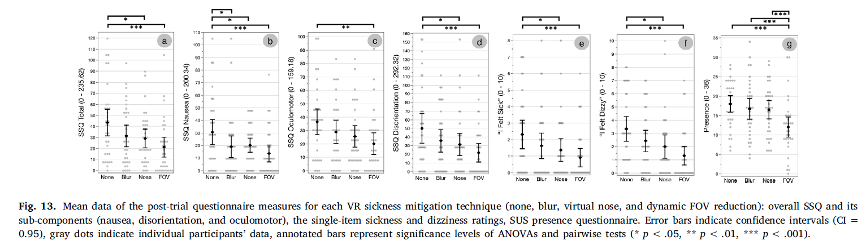
Results: Experiment 2 Post-Trial Questionnaire
Main effects of the VR sickness mitigation technique (all SSQ measures, sickness and dizziness, presence)
Specifically, dynamic FOV showed significant differences compared to baseline across all VR sickness measures and also presence; virtual nose was similar (except SSQ oculomotor), blur had trends but only significant for SSQ nausea
Figure from Rouhani, 2024
Introduction | Objectives | Experiment 1 | Experiment 2 | Experiment 3 | Conclusions | Future Studies

Slide 45
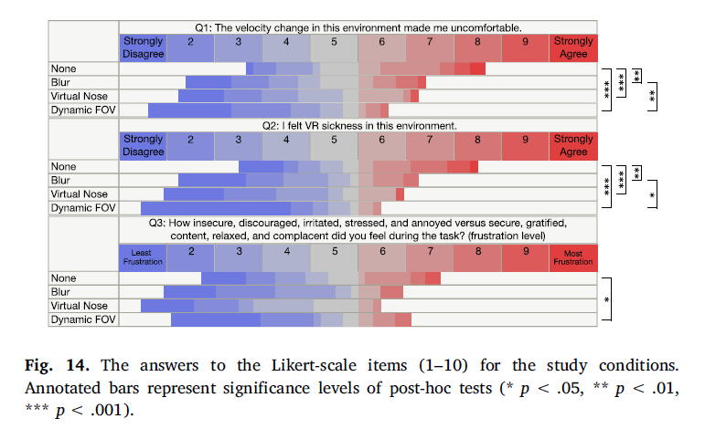
Results: Experiment 2 Post-Study Questionnaire
All three VR sickness mitigation techniques significantly reduced discomfort and VR sickness compared to baseline but only
Dynamic FOV reduction significantly lowered frustration levels among participants
Figure from Rouhani, 2024
Introduction | Objectives | Experiment 1 | Experiment 2 | Experiment 3 | Conclusions | Future Studies

Slide 46
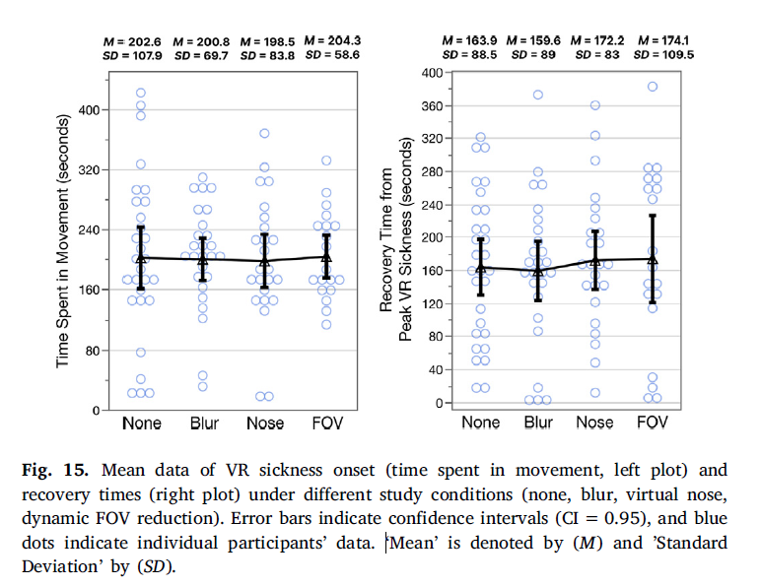
Results: Experiment 2 Recovery Time
Participants experienced rapid onset of VR sickness (average of 3.3 min)
Recovery times were relatively quick (peak VR sickness to baseline; average of 2.7 min)
Minimal effects of trial order
Figure from Rouhani, 2024
Introduction | Objectives | Experiment 1 | Experiment 2 | Experiment 3 | Conclusions | Future Studies

Slide 47
Results: Experiment 2 Interview Results
Participants mentioned increased discomfort due to velocity changes, vertical up and down movements and visual elements
Dynamic FOV reduction was the highly preferred method among many participants due to limiting motion visibility (15/24 preferred this method)
The virtual nose had mixed reactions, some found it helpful (6/24), 3 participants said it increased symptoms such as dizziness
Blur was effective for a few participants (4/24) but led to increased discomfort for others (7/24)
Basline was the least preferred condition
Most participants (19/24) reported full recovery before initiating the next trial whereas 5/24 reported residual effects with a more gradual recovery (mostly discomfort such as eye strain and a slight headache)
Introduction | Objectives | Experiment 1 | Experiment 2 | Experiment 3 | Conclusions | Future Studies

Slide 48
Discussion: Experiment 2
Reduction in VR sickness with the three techniques Dynamic FOV reduction very effective, which is consistent with the literature. Virtual nose had more mixed results but suggests stabilization of balance and orientation. There are mixed results for this technique in the literature. Blur less pronounced effect
There is a critical trade-off between balancing VR sickness mitigation while maintaining an immersive user experience
Rapid onset/recovery allows for repeated trials within a single session with minimal carry-over effects. Severity of VR sickness does not predict longer recovery
Introduction | Objectives | Experiment 1 | Experiment 2 | Experiment 3 | Conclusions | Future Studies

Slide 49
Limitations
Participant demographic mostly made up of younger adults (students)
There was an imbalance in terms of biological sex across studies
Repetitive nature of stimulation may have led to participant fatigue or adaptation, possibly altering responses to the virtual environment
Constrained scope to collect recovery times from peak VR sickness
Introduction | Objectives | Experiment 1 | Experiment 2 | Experiment 3 | Conclusions | Future Studies

Slide 50
General Discussion
The benchmark system effectively induced moderate VR sickness in a relatively short amount of time across baseline conditions in both studies (as judged by a threshold over or close to 40)
The inability to move heightened VR sickness symptoms, so did the figure eight tracks, with speed and height fluctuations and dynamic optic flow, which intensified the sense of self-motion and VR sickness
Participants started each trial relatively free from residual VR symptoms with slight effect observed between trial 1 and trial 2 – a practice trial could help remove this
Dynamic FOV reduction appears to be the most potent technique, followed by static FOV reduction, virtual nose and blur but there is significant between-subject variability
The most effective VR sickness mitigation methods also had the most negative impact on presence
Introduction | Objectives | Experiment 1 | Experiment 2 | Experiment 3 | Conclusions | Future Studies

Slide 51
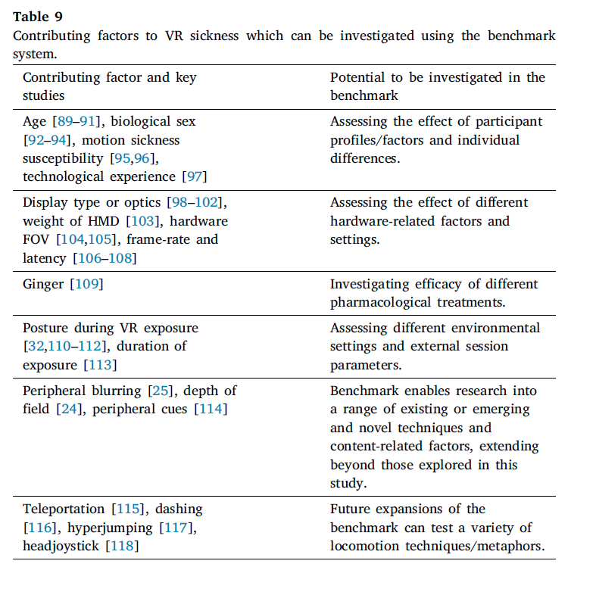
General Discussion
Figure from Rouhani, 2024
Introduction | Objectives | Experiment 1 | Experiment 2 | Experiment 3 | Conclusions | Future Studies

Slide 52
Future Studies
All of the sources and code are open source and available on Github:
VRSickness_Benchmark/README.md at main · BernhardRiecke/VRSickness_Benchmark · GitHub
Direct implementation: Directly integrate your own mitigation strategies into the benchmark system, utilizing its built-in features for inducing VR sickness
Reproduction in different engines: Allows for the benchmark system to be reconstructed in similar environments
Introduction | Objectives | Experiment 1 | Experiment 2 | Experiment 3 | Conclusions | Future Studies

Slide 53
References
Adhanom, I. B., Al-Zayer, M., Macneilage, P., & Folmer, E. (2021). Field-of-view restriction to reduce VR sickness does not impede spatial learning in women. ACM Transactions on Applied Perception (TAP), 18(2), 1-17.
Bles, W., Bos, J. E., De Graaf, B., Groen, E., & Wertheim, A. H. (1998). Motion sickness: only one provocative conflict?. Brain research bulletin, 47(5), 481-487.
Bos, J. E., Bles, W., & Groen, E. L. (2008). A theory on visually induced motion sickness. Displays, 29(2), 47-57.
Budhiraja, P., Miller, M. R., Modi, A. K., & Forsyth, D. (2017). Rotation blurring: use of artificial blurring to reduce cybersickness in virtual reality first person shooters. arXiv preprint arXiv:1710.02599.
Cha, Y. H., Golding, J. F., Keshavarz, B., Furman, J., Kim, J.S., Lopez, J. A., Escamez, Magnusson, M., Yates, B. J., & Lawson, B. D., Advisors:, Motion sickness diagnostic criteria: Consensus document of the classification committee of the Bárány Society, J. Vestib. Res., Equilib. Orientat. 31 (5) (2021) 327–344, http://dx.doi.org/10.3233/VES-200005.
Cobb, S. V., Nichols, S., Ramsey, A., & Wilson, J. R. (1999). Virtual reality-induced symptoms and effects (VRISE). Presence: Teleoperators & Virtual Environments, 8(2), 169-186.
Duh, H. L., Lin, J. W., Kenyon, R. V., Parker, D. E., & Furness, T. A. (2001, March). Effects of field of view on balance in an immersive environment. In Proceedings IEEE Virtual Reality 2001 (pp. 235-240). IEEE.
Fernandes, A. S., & Feiner, S. K. (2016, March). Combating VR sickness through subtle dynamic field-of-view modification. In 2016 IEEE symposium on 3D user interfaces (3DUI) (pp. 201-210). IEEE.
Golding, J. F. (1998). Motion sickness susceptibility questionnaire revised and its relationship to other forms of sickness. Brain research bulletin, 47(5), 507-516.
Hettinger, L. J., Berbaum, K. S., Kennedy, R. S., Dunlap, W. P., & Nolan, M. D. (1990). Vection and simulator sickness. Military psychology, 2(3), 171-181.
Kato, K. and Kitazaki, S. (2006), A study forunderstanding carsickness based on the sensoryconflict theory, SAE Technical Paper 2006-01-0096.

Slide 54
References
Kennedy, R. S., Lane, N. E., Berbaum, K. S., & Lilienthal, M. G. (1993). Simulator sickness questionnaire: An enhanced method for quantifying simulator sickness. The international journal of aviation psychology, 3(3), 203-220.
Keshavarz, B., & Golding, J. F. (2022). Motion sickness: current concepts and management. Current opinion in neurology, 35(1), 107-112.
Kim, H. K., Park, J., Choi, Y., & Choe, M. (2018). Virtual reality sickness questionnaire (VRSQ): Motion sickness measurement index in a virtual reality environment. Applied ergonomics, 69, 66-73.
Læssøe, U., Abrahamsen, S., Zepernick, S., Raunsbaek, A. & Stensen, C. Motion sickness and cybersickness– Sensory mismatch, Physiol. Behav. 258 (2023) 114015, http://dx.doi.org/10.1016/j.physbeh.2022.114015, URL https://www.sciencedirect.com/science/article/pii/S0031938422003201.
LaViola Jr., J. J., A discussion of cybersickness in virtual environments, ACM SIGCHI Bull. 32 (2000) 47–56, http://dx.doi.org/10.1145/333329.333344.
Lawther, A., & Griffin, M. J. (1987). Prediction of the incidence of motion sickness from the magnitude, frequency, and duration of vertical oscillation. The Journal of the Acoustical Society of America, 82(3), 957-966.
Lee, G., & Park, A. E. (2008). Development of a more robust tool for postural stability analysis of laparoscopic surgeons. Surgical endoscopy, 22, 1087-1092.
Lin, J. W., Duh, H. B. L., Parker, D. E., Abi-Rached, H., & Furness, T. A. (2002, March). Effects of field of view on presence, enjoyment, memory, and simulator sickness in a virtual environment. In Proceedings ieee virtual reality 2002 (pp. 164-171). IEEE.
Milgram, P., & Kishino, F. (1994). A taxonomy of mixed reality visual displays. IEICE TRANSACTIONS on Information and Systems, 77(12), 1321-1329.
Monteiro, D., Liang, H.-N., Tang, X. & Irani, P. (2021). Using trajectory compression rate to predict changes in cybersickness in virtual reality games, in: 2021 IEEE International Symposium on Mixed and Augmented Reality, ISMAR, IEEE, pp. 138–146.
Nesbitt, K., Davis, S., Blackmore, K., & Nalivaiko, E. (2017). Correlating reaction time and nausea measures with traditional measures of cybersickness. Displays, 48, 1-8.
O’Hanlon, J. & McCauley, M. (1974). Motion sickness incidence as a function of vertical sinusoidal motion, Aerospace Med. 45, 366–369.

Slide 55
References
Oman, C. M. (1990). Motion sickness: a synthesis and evaluation of the sensory conflict theory. Canadian journal of physiology and pharmacology, 68(2), 294-303.
Prothero, J. D., Draper, M. H., Furness 3rd, T. A., Parker, D. E., & Wells, M. J. (1999). The use of an independent visual background to reduce simulator side-effects. Aviation, space, and environmental medicine, 70(3 Pt 1), 277-283.
Prothero, J. D., & Parker, D. E. (2003). A unified approach to presence and motion sickness. In Virtual and adaptive environments (pp. 47-66). CRC Press.
Reason, J. T. (1978). Motion sickness adaptation: a neural mismatch model. Journal of the royal society of medicine, 71(11), 819-829.
Riccio, G. E., & Stoffregen, T. A. (1991). An ecological theory of motion sickness and postural instability. Ecological psychology, 3(3), 195-240.
Rouhani, R., Umatheva, N., Brockerhoff, J., Keshavarz, B., Kruijff, E., Gugenheimer, J., & Riecke, B. E. (2024). Towards benchmarking VR sickness: A novel methodological framework for assessing contributing factors and mitigation strategies through rapid VR sickness induction and recovery. Displays, 84, 102807.
Seay, A. F., Krum, D. M., Hodges, L., & Ribarsky, W. (2001, March). Simulator sickness and presence in a high FOV virtual environment. In Proceedings IEEE virtual reality 2001 (pp. 299-300). IEEE.
Somrak, A., Pogačnik, M., & Guna, J. (2021). Impact of different types of head-centric rest-frames on vrise and user experience in virtual environments. Applied Sciences, 11(4), 1593.
So, R. H., (1999). The search for a cybersickness dose value, in: Proceedings of HCI In ternational (the 8th International Conference on Human-Computer Interaction) on Human-Computer Interaction: Ergonomics and User Interfaces-Volume I Volume I, L. Erlbaum Associates Inc., USA, pp. 152–156.
Stanney, K. M., Hale, K. S., Nahmens, I., & Kennedy, R. S. (2003). What to expect from immersive virtual environment exposure: Influences of gender, body mass index, and past experience. Human factors, 45(3), 504-520.
Teixeira, J., & Palmisano, S. (2021). Effects of dynamic field-of-view restriction on cybersickness and presence in HMD-based virtual reality. Virtual Reality, 25(2), 433-445.

Slide 56
References
Wang, J., Liang, H.-N., Monteiro, D., Xu, W. & Xiao, J. (2022). Real-time prediction of simulator sickness in virtual reality games, IEEE Trans. Games 15 (2), 252–261.
Whittinghill, D.M.,Ziegler, B., Case, T., Moore, B. (2015). Nasum virtualis: A simple technique for reducing simulator sickness, in: Games Developers Conference, Vol. 74, GDC.
Wienrich, C., Weidner, C.K., Schatto, C., Obremski, D., Israel, J.H. (2018). A virtual nose as a rest-frame- the impact on simulator sickness and game experience, in: 2018 10th International Conference on Virtual Worlds and Games for Serious
Applications, VS-Games, IEEE, 2018, pp. 1–8, http://dx.doi.org/10.1109/VS
Games.2018.8493408.

