Slide 1
UPF presentation
March 2024

Slide 2
A young university
UPF is a public, international and research-intensive university. Founded in 1990, it has quickly earned a place for itself among the best universities in Europe

Slide 3
A quality university
Ranking Times Higher Education (2023):
18th best young university in the world
U-Multirank (promoted by the EC, 2022):
1st Spanish university and 4th in Europe
U-Ranking (BBVA Foundation & Ivie, 2022):
1st Spanish university since 2013

Slide 4
Facts & Figures
(2023-2024 academic year)
Undergraduate studies: 10,115 students in 27 programmes (UPF Group: 15,063 students in 51 programmes)
Official Master's studies: 1,358 students in 33 programmes (UPF Group: 4,004 students in 69 programmes)
Doctoral studies: 1,318 students in 9 programmes
Number of teaching and research staff: 1,181 FTE (Number of permanent professors: 328)
Number of administrative and service staff: 790
2024 Budget: 173 M€
Main facilities: 3 campuses and 2 scientific research parks

Slide 5
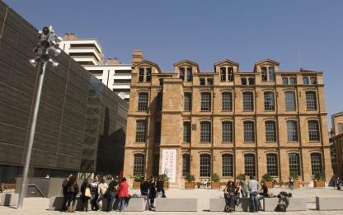
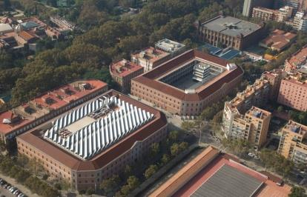
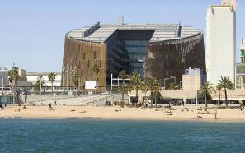
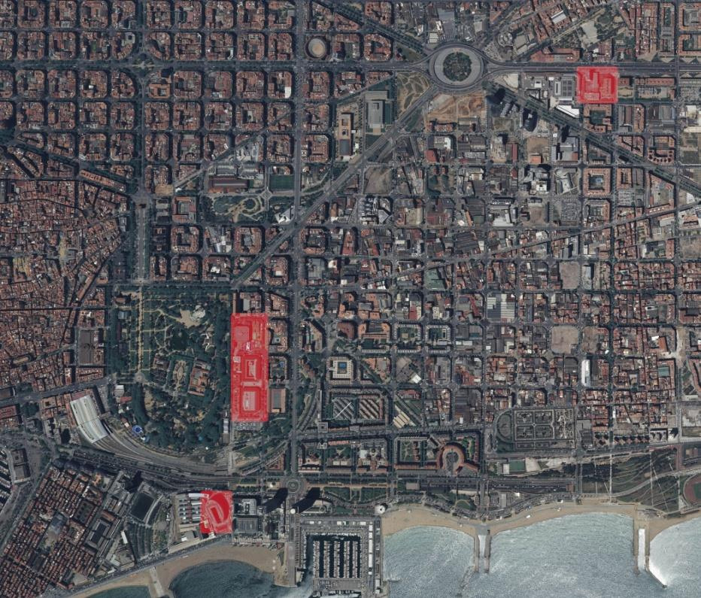
An urban university,
with three campuses at the heart of Barcelona
Communication
Engineering & ICT
Translation and Language Sciences
Poblenou Campus
Economics & Business
Humanities
Political & Social Science
Law
Ciutadella
Campus
Medicine & Life Sciences
Mar
Campus

Slide 6
The UPF model
Quality teaching
Outstanding research
International vocation

Slide 7
Quality teaching: some indicators
Access
Two applicants for available place (2023-2024 academic year)
An own teaching model
1st Spanish public university with the highest performance rate (Ministry of Universities, 2024)
Results
Graduate employment rate: 92% (AQU Catalunya, 2023)
15% of new students left secondary school with honours (2023-2024 academic year)
Graduate employment rate one year after graduation: 89% (AQU Catalunya, 2023)
Satisfaction rate: 90% of UPF's graduates would choose the same university again (AQU Catalunya, 2023)
100% of undergraduate, master’s and doctoral studies positively assessed (AQU Catalunya, 2024)
Innovative degrees: Open Bachelor’s Degree Programme, Global Studies, Bioinformatics, Double Degree in Law with King’s College London
Internship agreements with more than 1,260 companies (2022-2023 academic year)
Job satisfaction: 8/10 (AQU Catalunya, 2023)
25% of UPF graduates found a job through the university (AQU Catalunya, 2023)

Slide 8
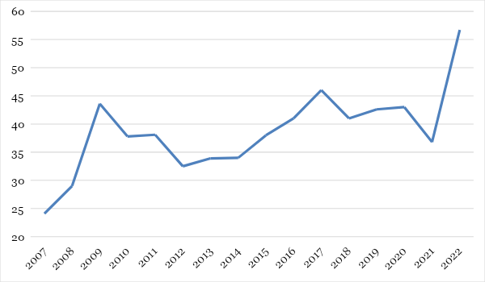
Outstanding research: success in competitive funding
Research funding evolution in M€ (2007- 2022)
Research funding by source (2022)
Highest competitiveness in EU:
1st. Spanish university in grants funded by the European Research Council (by number of professors)
Horizon Europe Results (January 2024)
61 projects and 43M€, including:
21 ERC Grants (26,6M€)
16 Marie Curie actions (3,4M€)
European administration
State administration
Regional administration
Corporations and institutions

Slide 9
Outstanding research: some indicators
Scientific production: Quality and international impact
Training capacity
1st Spanish university in FPI grants (per 100 professors) (INUE, 2023)
Innovation & knowledge transfer
UPFVentures, a startup to strengthen the university’s relations with industry
1st Spanish university in percentage of articles published in the most influential scholarly journals of the world (Leiden, 2023)
1st Spanish university in percentage of papers produced in collaboration with national institutions (Leiden, 2023)
2nd Spanish university in percentage of papers produced in collaboration with foreign institutions (Leiden, 2023)
52 industrial doctoral projects funded by the Catalan government (2013-2023)
15 active business chairs (2023)
77% of doctoral theses were written and defended in English (2022-2023 academic year)
1st Spanish university in doctoral theses read (per 100 professors) (INUE, 2023)
1st Spanish university in revenue from licenses (per 100 professors) (INUE, 2023)

Slide 10
International vocation: some indicators
International community
Innovative projects
50% of master's and doctoral students are international (2023-2024 academic year)
43% of UPF graduates have studied abroad (2023-2024 academic year)
25% of UPF faculty is international (2023)
1st Spanish public university in international outlook (THE ranking, 2023)
Agreements with 28 of the Top 50 universities in the world (THE ranking, 2023)
Public Policy Center with Johns Hopkins University (since 2013)
Barcelona Centre for European Studies (BACES), with the Jean Monnet seal
1 Erasmus Mundus in AI and 5 Erasmus Mundus joint master’s degree programmes, 9 double master’s degree programmes, and 2 double degree programmes (King’s College London and Toulouse 1 Capitole Univ)
International Programmes: Barcelona International Summer School (BISS), Barcelona Program for Interdisciplinary Studies (BaPIS) & International Business Program (IBP, alongside with ESCI)
Alliances and networks: The Guild, EUTOPIA, European University Association, A4U and Europaeum

Slide 11
International vocation: international agreements
(2022)
EUROPE (249)
France | 43 | Ireland | 3
UK | 36 | Poland | 4
Germany | 37 | Portugal | 6
Italy | 25 | Czech Republic | 3
Holland | 15 | Greece | 2
Belgium | 11 | Latvia | 2
Russia | 12 | Romania | 3
Austria | 9 | Hungary | 2
Switzerland | 9 | Croatia | 1
Sweden | 7 | Slovenia | 1
Norway | 5 | Estonia | 1
Denmark | 4 | Serbia | 2
Finland | 5 | Island | 1
NORTH AMERICA (50)
USA | 42
Canada | 8
LATIN AMERICA (80)
Brasil | 14
Mexico | 13
Argentina | 13
Chile | 10
Cuba | 6
Colombia | 6
Peru | 5
Nicaragua | 4
Uruguay | 2
Ecuador | 2
Bolivia | 1
Rep. Dominicana Costa Rica Puerto Rico | 1 1 1
Venezuela | 1
ASIA-PACIFIC (64)
China | 11
India | 8
Japan | 8
Indonesia | 7
Australia | 5
South Korea | 5
Thailand | 4
Malaysia | 3
Hong Kong | 3
Taiwan | 3
Vietnam | 3
Philippines | 1
New Zealand | 1
Singapore | 2
AFRICA & MIDDLE EAST (40)
Iran | 11 | Morocco | 1
Turkey | 7 | Tunisia | 1
Botsuana | 4 | Palestine | 1
South Africa | 3 | Arab Emirates | 1
Israel | 3 | Qatar | 1
Namibia | 2 | Nigeria | 1
Lebanon | 1 | Ethiopia | 1

