Slide 1
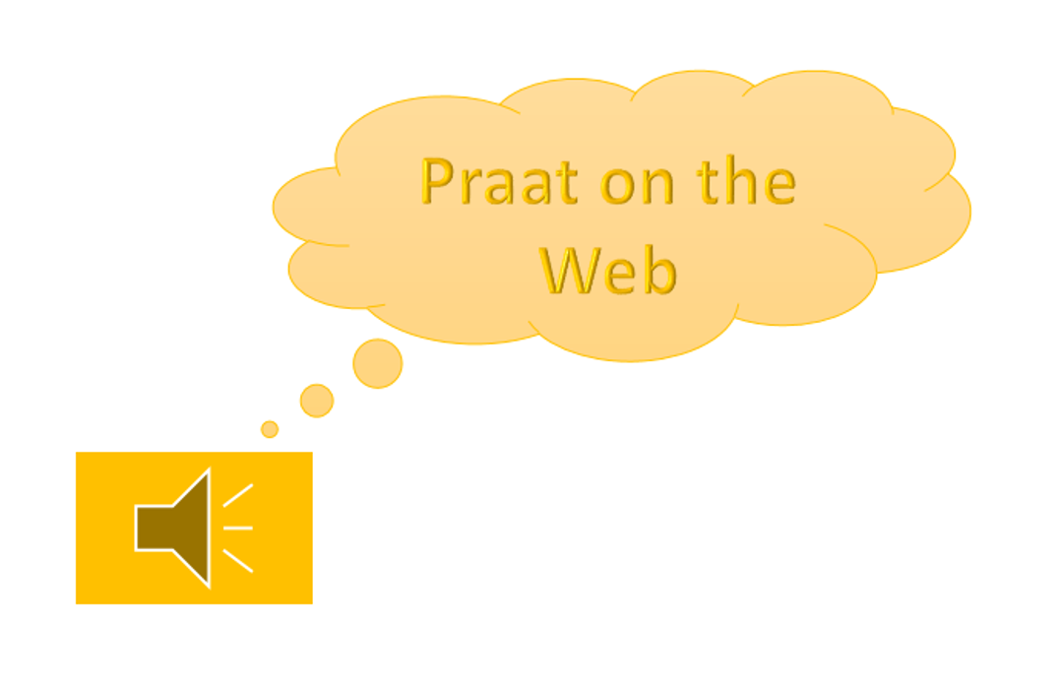
PRAAT ON THE WEB
An upgrade of praat for semi-automatic speech annotation

Slide 2
summary
Motivation
Praat Software & Format
Extended Praat
Prosody Tagger
Demo
Conclusions

Slide 3
“What’s the story behind?”
Annotation of Big Data
Prosodic Phrase
Segmentation
Prominence
Salient Word
Acoustic and Linguistic
Information
Theoretical Work:
Correlation Information Structure and Prosody
(Domínguez et al., 2014a)
Prosody as a Vectorial Representation of
Acoustic Parameters (Domínguez et al., 2014b)

Slide 4
1. Motivation (I)
Aim
Object
Focus
Tools for Annotation of Spontaneous Speech
Visualization
Scripting
Semi-Automatic Approaches
Question
How do we deal with …
…feature annotation?
…complex computational processes?

Slide 5
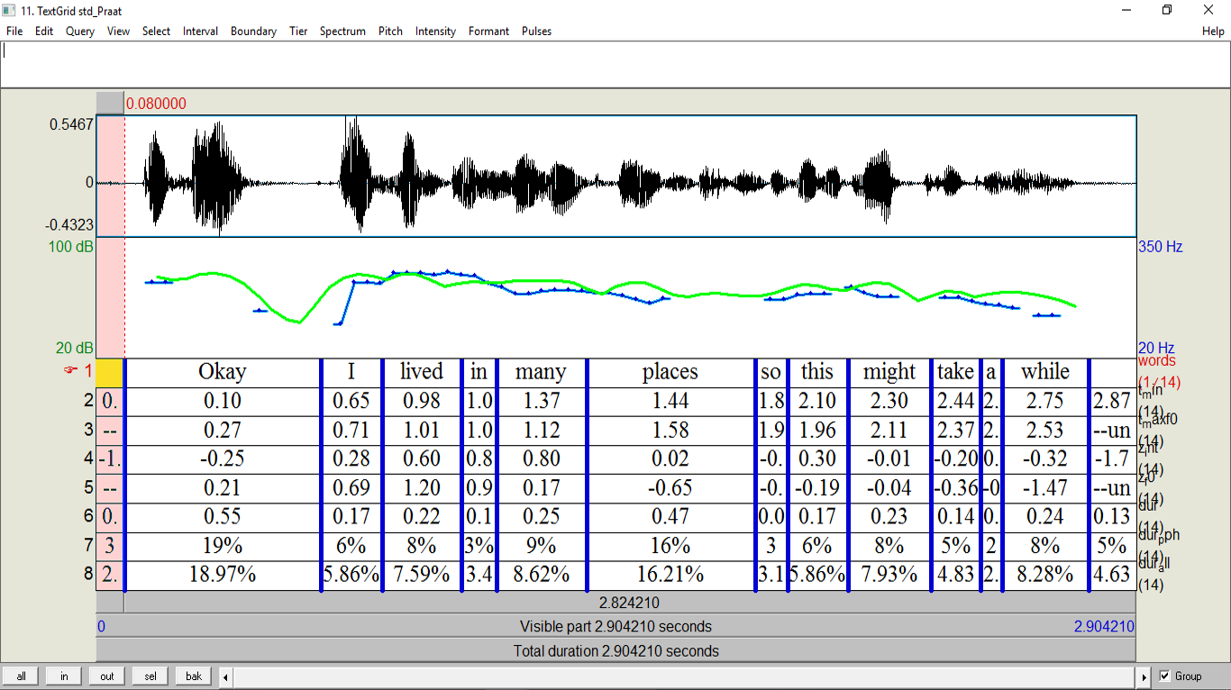
1. Motivation (II)
Feature Annotation

Slide 6
1. Motivation (III)
Scripting
.txt
TextGrid
parsers
Acoustic Data
.TextGrid
ProsodyPro (Xu, 2013)
Praaline (Christoulides, 2014)

Slide 7
2. PRAAT SOFTWARE AND FORMAT (I)
The Problem:
Labels are unparseable
Units of segmentation
TextGrid
File type
Tiers
item[n]
Interval
class/name/[n]
Point
class/name/[n]
Label
string
Start & End Time
xmin/xmax
Label
string
Point in Time
point

Slide 8
2. PRAAT SOFTWARE AND FORMAT (II)
Example Praat (Boersma, 2001) Graphical User Interface

Slide 9
2. PRAAT SOFTWARE AND FORMAT (III)
TextGrid in text editor
Sublime

Slide 10
3. EXTENDED PRAAT (I)
The Solution:
Parseable Labels
TextGrid
File type
Tiers
item[n]
Interval
class/name/[n]
Point
class/name/[n]
Label
string
Start & End Time
xmin/xmax
Label
string
Point in Time
point
Head
string
Features
[n]
Name
string
Value
string
Head
string
Features
[n]
Name
string
Value
string
SEMAFOR (Tsatsaronis et al., 2012)
http://www.cs.cmu.edu/ ark/SEMAFOR/
GATE (Cunningham et al., 2011)
https://gate.ac.uk/
Brat (Stenetorp et al., 2012)
http://brat.nlplab.org/

Slide 11
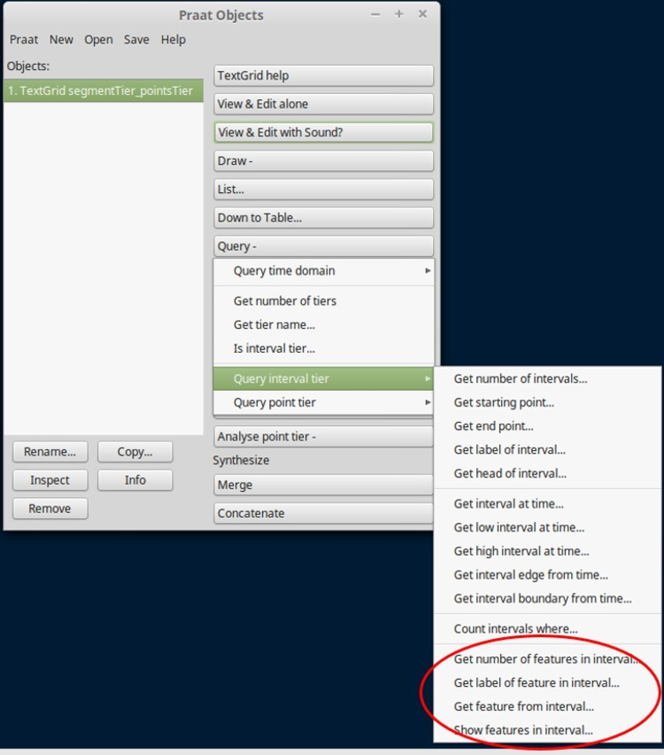
3. EXTENDED PRAAT (Ii)
Extended Praat for Feature Annotation
(Domínguez, et al. 2016d)
Local Version for Linux
https://github.com/monikaUPF
Web Version
http://kristina.taln.upf.edu/praatweb/
Tutorial
https://www.youtube.com/watch?v=sJXu15Dskjs

Slide 12
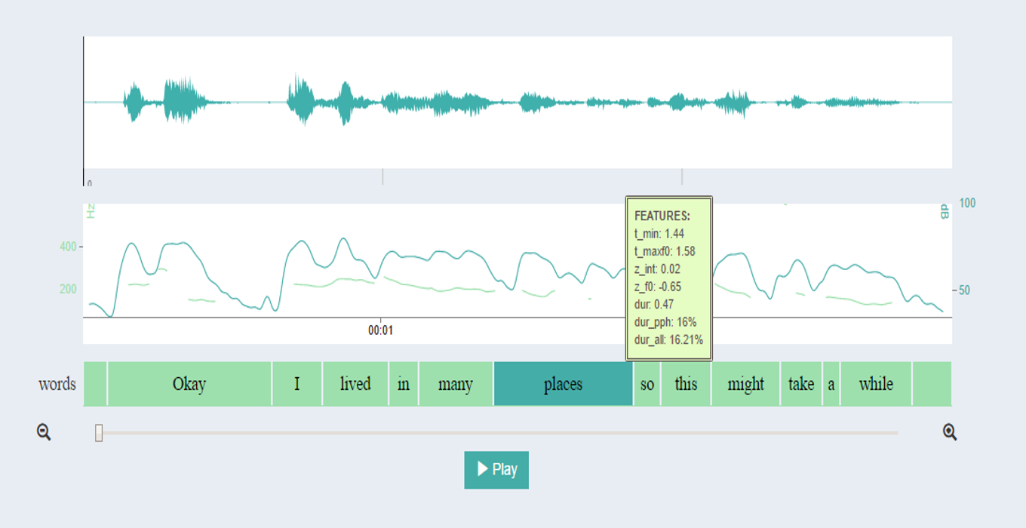
3. EXTENDED PRAAT (iiI)
Advantage 1: Visualization
Visualization Standard Praat
Visualization Praat on the Web

Slide 13
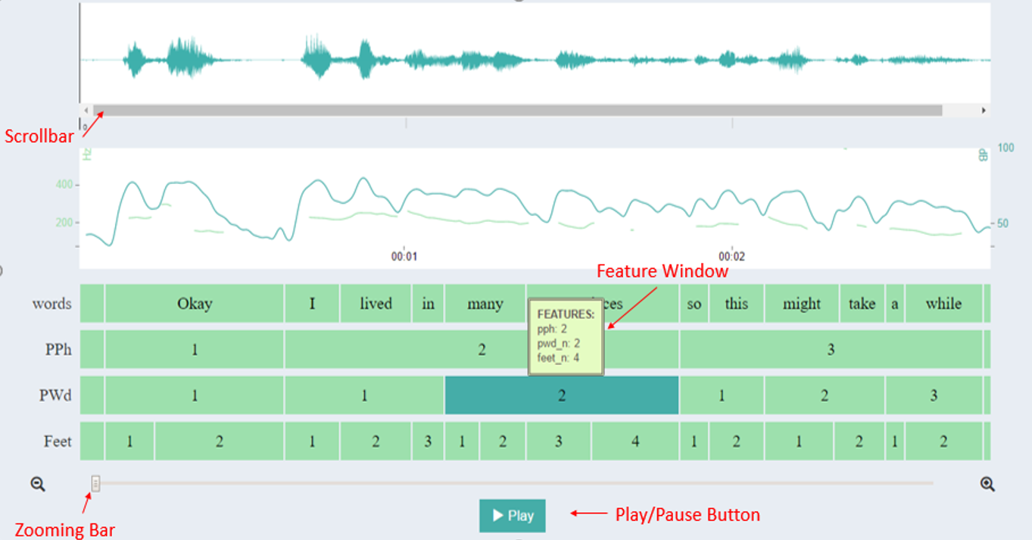
3. EXTENDED PRAAT (iiI)
Advantage 2: Intuitive GUI
Standard Praat
Keyboard Shortcuts
Zooming
Audio playback
Scrolling
Praat on the Web
Dedicated buttons

Slide 14
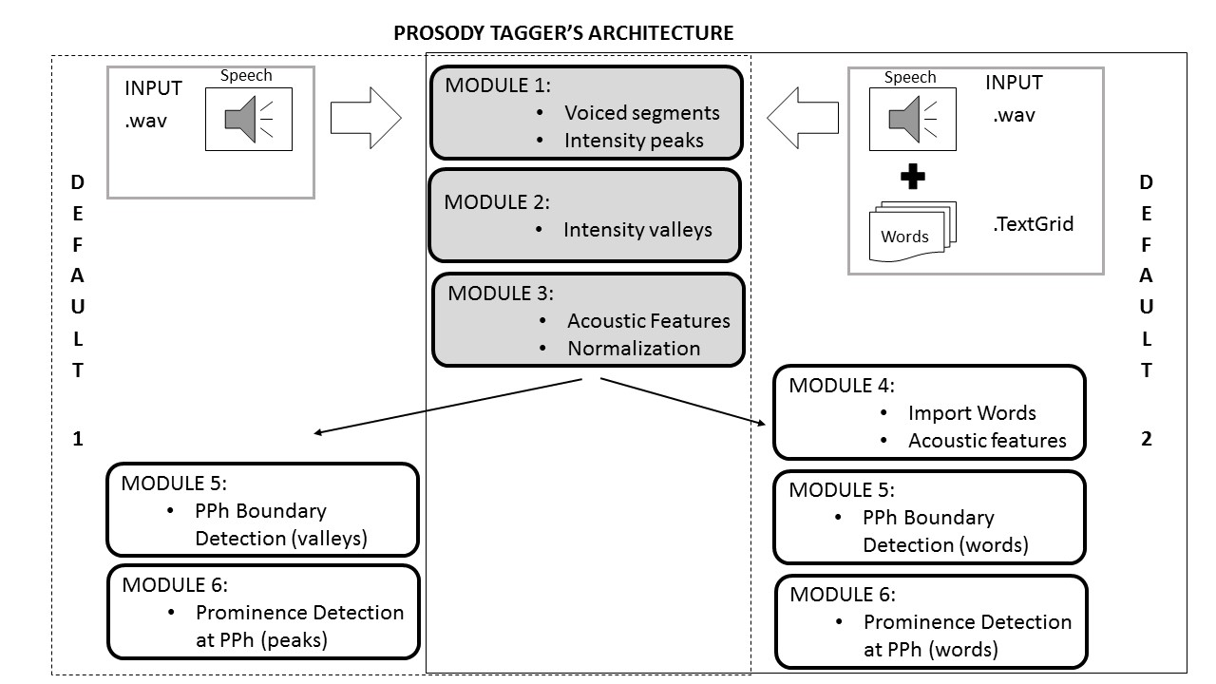
3. EXTENDED PRAAT (iV)
Advantage 3: Scripting Composition
Features allow
storing information for :
Data analysis
Retrieval for computation
at different stages
Segmentation of a complex
computational problem
into specialized / dedicated steps
Within the same Praat Environment

Slide 15
4. Prosody TAGGER (I)
Related Work
Methodology
Implementation
Evaluation
Future Work
(Domínguez, et al. 2016c)
Language and register independant
Raw input: suitable for spontaneous speech analysis
No previous installation
http://kristina-project.eu/en/
AuToBI (Rosenberg, 2010)
http://eniac.cs.qc.cuny.edu/andrew/autobi/
ANALOR (Avanzi et al., 2008)
http://www.lattice.cnrs.fr/Analor.html?lang=fr

Slide 16
4. Prosody TAGGER (Ii)
Multiple configurations

Slide 17
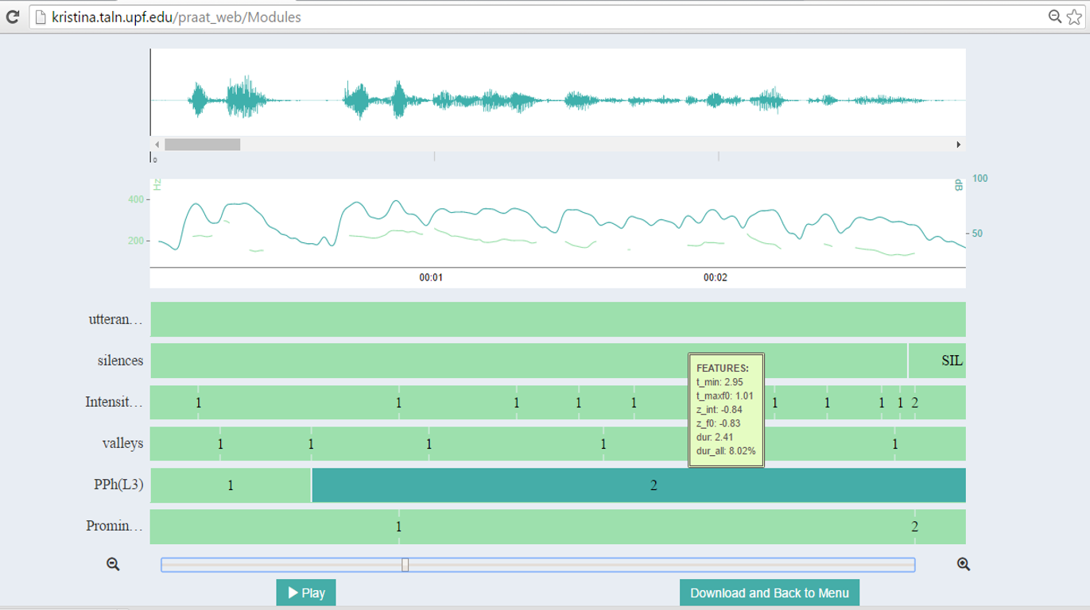
4. Prosody TAGGER (III)
Output
Praat on the Web
TextGrid for Local Use

Slide 18
5. demo

Slide 19
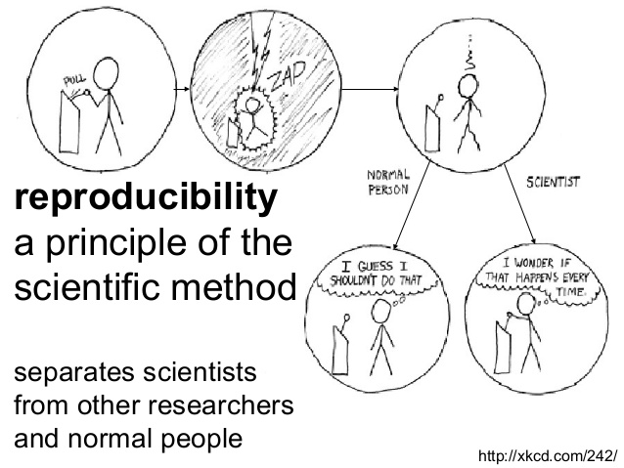
6. Conclusions (i)
Integrative and Reproducible Research
Reproducibility as a principle of the scientific method
Reproducibility separates scientists from normal people

Slide 20
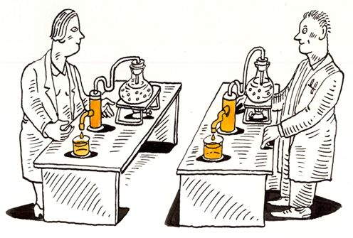
4. Conclusions (Ii)
Advantages of Specialized Modules
Testing different techniques for the same process
Different configurations
Optimization of modules
Task assignment
Library of scripts
Impact on reproducibility

Slide 21
6. Conclusions (III)
Praat on the Web
Multidimensional Feature Vector within segment labels
VISUALIZATION in a dedicated window
Web-based Implementation
Ready-to-use Interface
Operational Interface for Modular Script Composition
Modular Computational Tasks within Praat Platform

Slide 22
Thank you !
https://portal.upf.edu/web/mdm-dtic/home
Acknowledgements:
Iván Latorre
Joan Codina
Mireia Farrús
Leo Wanner
Aurelio Ruiz
Open Demopage & Source Code:
http://kristina.taln.upf.edu/praatweb/
https://github.com/monikaUPF
monica.dominguez@upf.edu
@MonikaUPF
@talnupf
@projectKRISTINA

Slide 23
references
Y. Xu. 2013. “Prosodypro a tool for large-scale systematic prosody analysis”. In Proceedings of Tools and Resources for the Analysis of Speech Prosody (TRASP), pages 7–10, Aix-en-Provence, France.
G. Christodoulides. 2014. “Praaline: Integrating tools for speech corpus research”. In Proceedings of the 9th International Conference on Language Resources and Evaluation, Reykjavik, Iceland.
P. Boersma. 2001. “Praat, a system for doing phonetics by computer”. Glot International, 5(9/10):341–345.
G. Tsatsaronis, I. Varlamis, and K. Nørvag. 2012. “Semafor: Semantic document indexing using semantic forests”. In Proceedings of the 21st ACM International Conference on Information and Knowledge Management, CIKM’12, pages 1692–1696, New York, NY, USA. ACM.
P. Stenetorp, S. Pyysalo, G. Topi´c, T. Ohta, S. Ananiadou, and J. Tsujii. 2012. “Brat: A web-based Tool for NLP-assisted Text Annotation”. In Proceedings of the Demonstrations at the 13th Conference of the European Chapter of the Association for Computational Linguistics, EACL ’12, pages 102–107, Stroudsburg, PA, USA. Association for Computational Linguistics.
H. Cunningham, D. Maynard, K. Bontcheva, V. Tablan, N. Aswani, I. Roberts, G. Gorrell, A. Funk, A. Roberts, D. Damljanovic, T. Heitz, M. A. Greenwood, H. Saggion, v Petrak, Y. Li, and W. Peters. 2011. Text Processing with GATE (Version 6).
M. Domínguez, M. Farrús, A. Burga, and L. Wanner. 2016a. “Using hierarchical information structure for prosody prediction in content-to-speech applications”. In Proceedings of the 8th International Conference on Speech Prosody, pages 1019–1023, Boston, USA.
M. Domínguez, M. Farrús, and L. Wanner. 2016b. “Combining acoustic and linguistic features in phrase-oriented prosody prediction”. In Proceedings of the 8th International Conference on Speech Prosody, pages 796–800, Boston, USA.
M. Domínguez, M. Farrús, and L. Wanner. 2016c. “An automatic prosody tagger for spontaneous speech”. Accepted in COLING 2016, Osaka, Japan.
M. Domínguez, M. Farrús, and L. Wanner. 2016c. “Praat on the Web: An Upgrade of Praat for Semi-Automatic Speech Annotation”. Accepted in COLING 2016, Osaka, Japan.

