Slide 1
Is tracking all that it takes? Exploring the validity of news media exposure measurements created with metered data
o.bosch-jover@lse.ac.uk
orioljbosch
https://orioljbosch.com/
Oriol J. Bosch | Department of Methodology, LSE & RECSM - UPF
Melanie Revilla | RECSM - UPF
Acknowledgements: I would like to thank Patrick Sturgis and Jouni Kuha
Funding: This project has received funding from the European Research Council (ERC) under the European Unions Horizon 2020 research and innovation programme (grant agreement No 849165; PI: Melanie Revilla); the Spanish Ministry of Science and Innovation under the "R+D+i projects" programme (grant number PID2019-106867RB-I00 /AEI/10.13039/501100011033 (2020-2024), PI: Mariano Torcal); and the BBVA foundation under their grant scheme to scientific research teams in economy and digital society, 2019 (PI: Mariano Torcal).

Slide 2
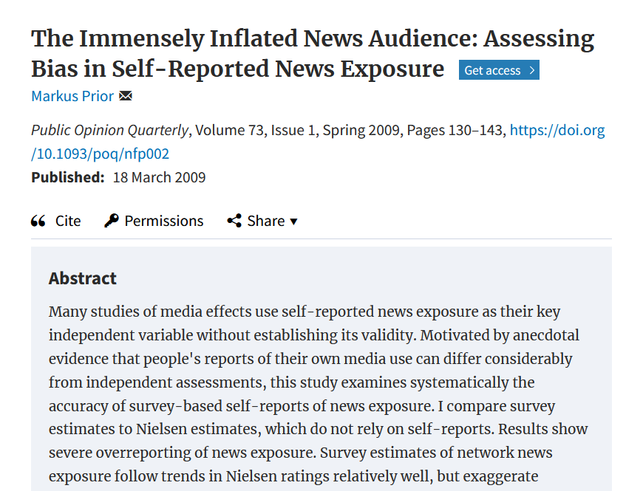
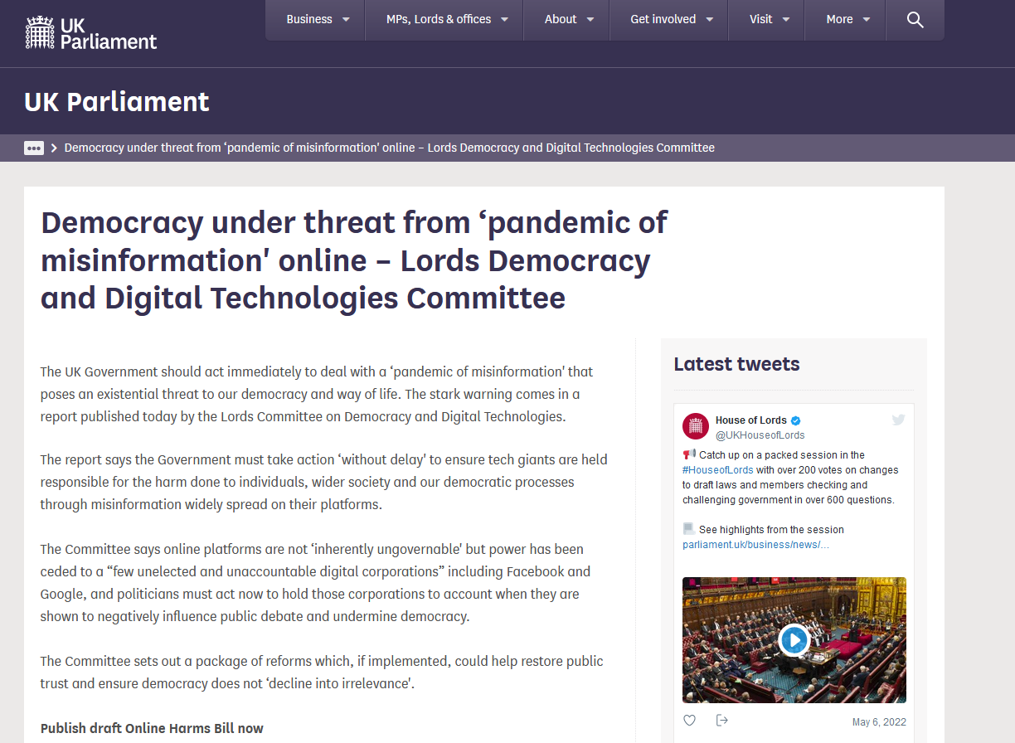
The rise of metered data to understand online media exposure
OBTAINIG HIGH-QUALITY DATA ABOUT ONLINE BEHAVIOURS
Two parallel trends:
Increasing importance of understanding what kind of media people are exposed to;
Concerns about the data quality of self-reported exposure to media

Slide 3
The rise of metered data to understand online media exposure
OBTAINIG HIGH-QUALITY DATA ABOUT ONLINE BEHAVIOURS
Two parallel trends:
Increasing importance of understanding what kind of media people are exposed to;
Concerns about the data quality of self-reported exposure to media
Alternative: directly observe what people do online using digital tracking solutions, or meters.
Group of tracking technologies
Installed on participants devices.
Collect traces left by participants when interacting with their devices online: e.g. URLs or apps visited
We call the resulting data: metered data +60 papers published using metered data since 2016

Slide 4
Measuring online media exposure with metered data
OBTAINIG HIGH-QUALITY DATA ABOUT ONLINE BEHAVIOURS
Concept of interest Measurement

Slide 5
Measuring online media exposure with metered data
OBTAINIG HIGH-QUALITY DATA ABOUT ONLINE BEHAVIOURS
Measurements: pieces of information from the participants’ tracked online behaviour that are combined, and sometimes transformed, to compute a specific variable.
Concept of interest Measurement

Slide 6
Measuring online media exposure with metered data
OBTAINIG HIGH-QUALITY DATA ABOUT ONLINE BEHAVIOURS
Measurements: pieces of information from the participants’ tracked online behaviour that are combined, and sometimes transformed, to compute a specific variable.
The time stamps of all visited URLs defined as news media articles
Concept of interest Measurement

Slide 7
Measuring online media exposure with metered data
OBTAINIG HIGH-QUALITY DATA ABOUT ONLINE BEHAVIOURS
Measurements: pieces of information from the participants’ tracked online behaviour that are combined, and sometimes transformed, to compute a specific variable.
The time stamps of all visited URLs defined as news media articles
Concept of interest Measurement
Concept of interest Measurement
Validity
Most research seems to expect this relationship
to be perfect, but there is no evidence

Slide 8
Many unclear questions to answer
OBTAINIG HIGH-QUALITY DATA ABOUT ONLINE BEHAVIOURS
Online news media exposure
Define the list of URLs that can be defined as “online news media”
Select a list of online news media domains → no complete one, which one to choose?
Select which domains to use within those lists → all? The most visited? How many?
Is all the information from the domain relevant, or only some specific URLs should be considered?
Define what is considered as being “exposed”
Should all visits to an URL/App be considered? Only those complying with a specific rule?
Should visits be counted? Or the time of those visits?
Should information from all devices be used? Or only from specific devices?
Define the time frame used to compute the variables
How many days of tracking should be used?
Should information be from before the survey, from after the survey, or from both before and after the survey (in case a survey is used).

Slide 9
This study

Slide 10
Research questions
OUR STUDY
Does the convergent validity of online news media exposure measured with metered data fluctuate across design choices? (RQ1.1)?
Does the predictive validity of online news media exposure measured with meted data fluctuate across design choices? (RQ1.2)
What design choices have a higher impact on predictive validity? (RQ2.1)
To what extent do different design choices affect the predictive validity of metered data measures? (RQ2.2)

Slide 11
Data
OUR STUDY
TRI-POL project - Overview
Three wave survey combined with metered data at the individual level
Spain, Portugal, Italy + Argentina and Chile
Netquest metered panels – Cross-quotas about gender, age, education and region
Sample size: 993 (Spain), 842 (Italy), 818 (Portugal)
Fieldwork: September 21 – April 22

Slide 12
Design choices identified
DESIGN CHOICES
Online news media exposure
Characteristics | Our choices
List | Own, Tranco, Alexa, Cisco, Majestic
Top | 10, 20, 50, 100, 200, All
Information | All domain level, subdomains defined as political
Exposure | 1 second, 30 seconds, 120 seconds
Level | Visits, Time
Devices | Mobile & PC, PC only, Mobile only
Days of tracking | 2, 5, 10, 15, 31
Survey period | Before, After, Before and After
3,573 potential combinations
Which ones should be preferred?
Which ones should be avoided?
Does it even matter?

Slide 13
Assessing whether validity fluctuates across design choices
THIS STUDY
First, we study convergent validity across the three countries (RQ1.1)
“Convergent validity describes the fit between independent measures of the same underlying concept” (Prior, 2013).
Essentially, if all variables were measuring the same concept, they should highly correlate with each other

Slide 14
Assessing whether validity fluctuates across design choices
THIS STUDY
First, we study convergent validity across the three countries (RQ1.1)
“Convergent validity describes the fit between independent measures of the same underlying concept” (Prior, 2013).
We computed one correlation for each potential pair of variables 6,349,266 unique correlations
Essentially, if all variables were measuring the same concept, they should highly correlate with each other

Slide 15
Assessing whether validity fluctuates across design choices
THIS STUDY
First, we study convergent validity across the three countries (RQ1.1)
“Convergent validity describes the fit between independent measures of the same underlying concept” (Prior, 2013).
We computed one correlation for each potential pair of variables 6,349,266 unique correlations
Essentially, if all variables were measuring the same concept, they should highly correlate with each other
RQ1.1: To what extent do these correlations fluctuate?

Slide 16
Assessing whether validity fluctuates across design choices
THIS STUDY
Second, we study predictive validity across the three countries (RQ1.2)
“Predictive validity refers to the degree to which scores on a test or assessment are related to performance on a criterion or gold standard assessment” (Frey, 2018).
Measures closer to the theorised true relationship should be preferred. In practice, since the true value is unknown, people assume that higher is better.

Slide 17
Assessing whether validity fluctuates across design choices
THIS STUDY
Second, we study predictive validity across the three countries (RQ1.2)
“Predictive validity refers to the degree to which scores on a test or assessment are related to performance on a criterion or gold standard assessment” (Frey, 2018).
Political knowledge has been used as the most common gold standard when assessing the predictive validity of news media exposure.
Measures closer to the theorised true relationship should be preferred. In practice, since the true value is unknown, people assume that higher is better.
Smith B, Clifford S, Jerit J. TRENDS: How Internet Search Undermines the Validity of Political Knowledge Measures. Political Research Quarterly. 2020;73(1):141-155. doi:10.1177/1065912919882101
Dilliplane, S., Goldman, S. K., & Mutz, D. C. (2013). Televised exposure to politics: New measures for a fragmented media environment. American Journal of Political Science, 57(1), 236-248.
Prior, M. (2009). Improving media effects research through better measurement of news exposure. The Journal of Politics, 71(3), 893-908.

Slide 18
Assessing whether validity fluctuates across design choices
THIS STUDY
Second, we study predictive validity across the three countries (RQ1.2)
“Predictive validity refers to the degree to which scores on a test or assessment are related to performance on a criterion or gold standard assessment” (Frey, 2018).
Political knowledge has been used as the most common gold standard when assessing the predictive validity of news media exposure.
Political knowledge was measured by asking 4 knowledge questions about politics.
The questions covered basic knowledge about the political system, and knowledge about the current cabinets in each country.
The final variable is a sum of all correct answers, hence, it ranges from 0 to 4.
Measures closer to the theorised true relationship should be preferred. In practice, since the true value is unknown, people assume that higher is better.
Smith B, Clifford S, Jerit J. TRENDS: How Internet Search Undermines the Validity of Political Knowledge Measures. Political Research Quarterly. 2020;73(1):141-155. doi:10.1177/1065912919882101
Dilliplane, S., Goldman, S. K., & Mutz, D. C. (2013). Televised exposure to politics: New measures for a fragmented media environment. American Journal of Political Science, 57(1), 236-248.
Prior, M. (2009). Improving media effects research through better measurement of news exposure. The Journal of Politics, 71(3), 893-908.

Slide 19
Assessing whether validity fluctuates across design choices
THIS STUDY
Second, we study predictive validity across the three countries (RQ1.2)
“Predictive validity refers to the degree to which scores on a test or assessment are related to performance on a criterion or gold standard assessment” (Frey, 2018).
Political knowledge has been used as the most common gold standard when assessing the predictive validity of news media exposure.
For each variable, we ran a regression model with political knowledge as the dependant variable, and several common control variables.
3,573 unique coefficients
Measures closer to the theorised true relationship should be preferred. In practice, since the true value is unknown, people assume that higher is better.

Slide 20
Assessing whether validity fluctuates across design choices
THIS STUDY
Second, we study predictive validity across the three countries (RQ1.2)
“Predictive validity refers to the degree to which scores on a test or assessment are related to performance on a criterion or gold standard assessment” (Frey, 2018).
Political knowledge has been used as the most common gold standard when assessing the predictive validity of news media exposure.
For each variable, we ran a regression model with political knowledge as the dependant variable, and several common control variables.
3,573 unique coefficients
Measures closer to the theorised true relationship should be preferred. In practice, since the true value is unknown, people assume that higher is better.
RQ1.2: To what extent do these coefficients fluctuate?

Slide 21
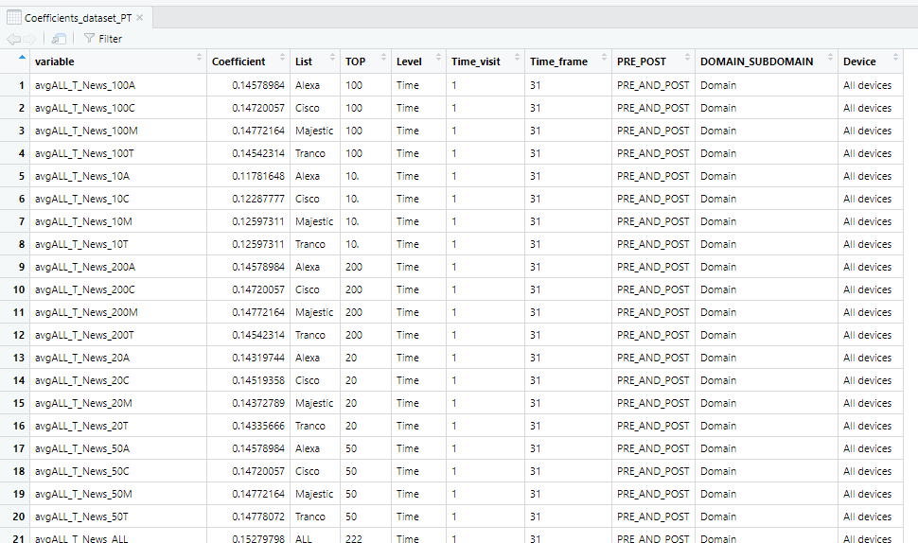
The impact of each design choice on predictive validity (RQ3)
THIS STUDY
The variables were used as the observations, their associated regression coefficients as the dependant variable, and the characteristics of the variable as the predictors
Similar approach as for the Survey Quality Predictor (SQP)
http://sqp.upf.edu/

Slide 22
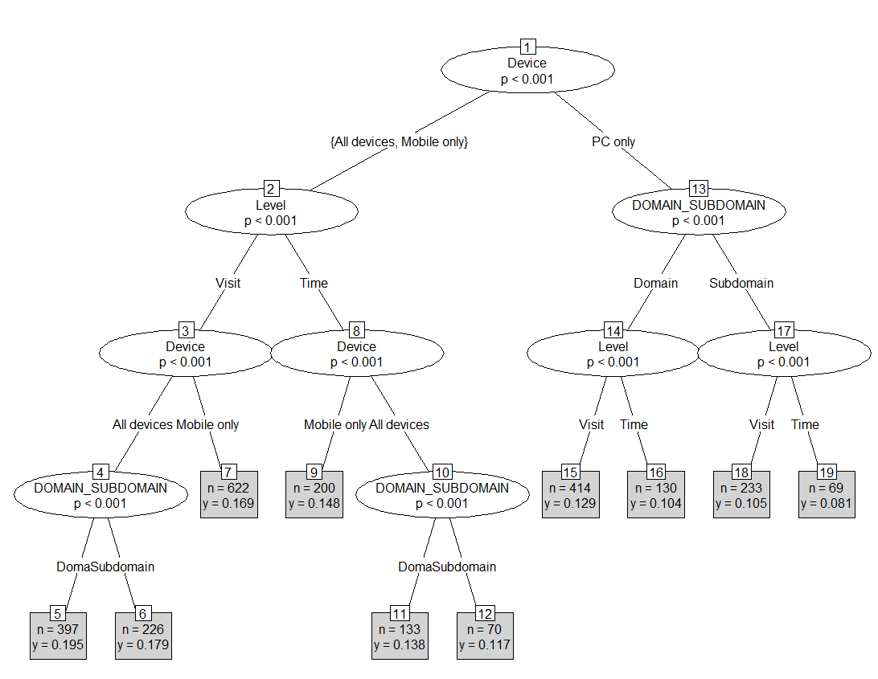
The impact of each design choice (RQ2)
THIS STUDY
To predict the impact of each design choice, we used random forests of regression trees* (randomForest R package).
Why?
Non-linearity
Correlated features
Feature importance
Ensemble learning
We extract the following information:
The variable importance: % increase of MSE (RQ2.1)
And the marginal effect of each choice (RQ2.2)
* Ntree: 500 | Mtry: 6 | Node size: 3 | Sample fraction: 80%

Slide 23
The impact of each design choice (RQ2)
THIS STUDY
To predict the impact of each design choice, we used random forests of regression trees* (randomForest R package).
Why?
Non-linearity
Correlated features
Feature importance
Ensemble learning
We extract the following information:
The variable importance: % increase of MSE (RQ2.1)
And the marginal effect of each choice (RQ2.2)
* Ntree: 500 | Mtry: 6 | Node size: 3 | Sample fraction: 80%

Slide 24
Does the validity of online news media exposure measured with metered data fluctuate across design choices? (RQ1)

Slide 25
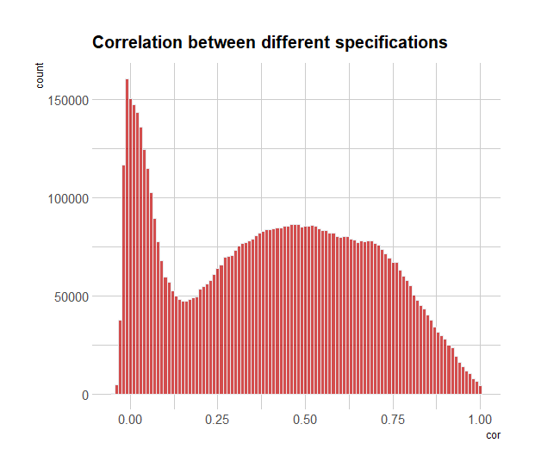
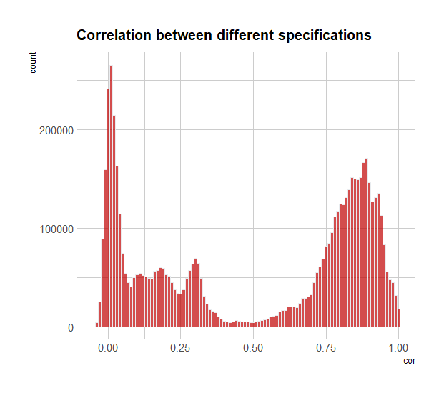
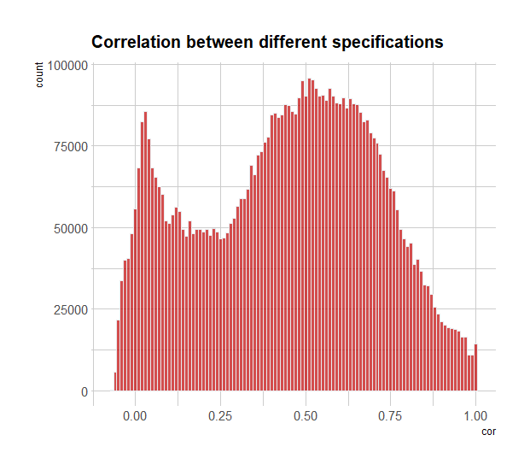
Convergent validity
RESULTS
Correlation between different specifications
SPAIN
ITALY
PORTUGAL
Mean: .40
Media: .41
1st Quart: .15
3rd Quart: .63
Mean: .51
Media: .69
1st Quart: .10
3rd Quart: .85
Mean: .45
Media: .47
1st Quart: .24
3rd Quart: .64

Slide 26
Convergent validity
RESULTS
Correlation between different specifications
SPAIN
ITALY
PORTUGAL
On average the correlation between measurements is below what should be desired.
Small proportion beyond the .70-.80 mark desired
High fluctuation
Mean: .40
Media: .41
1st Quart: .15
3rd Quart: .63
Mean: .51
Media: .69
1st Quart: .10
3rd Quart: .85
Mean: .45
Media: .47
1st Quart: .24
3rd Quart: .64

Slide 27
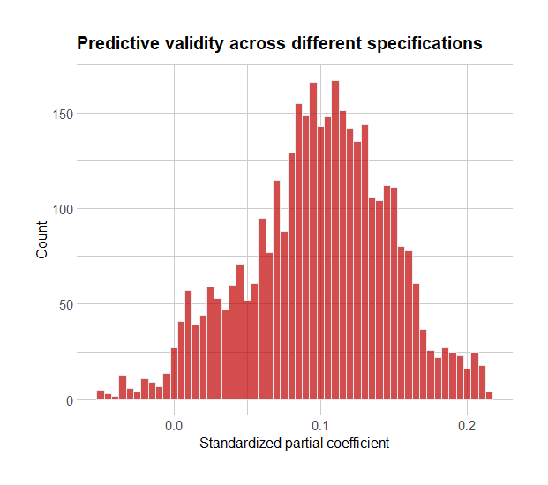
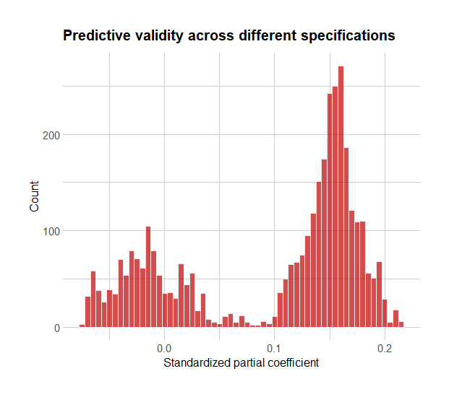
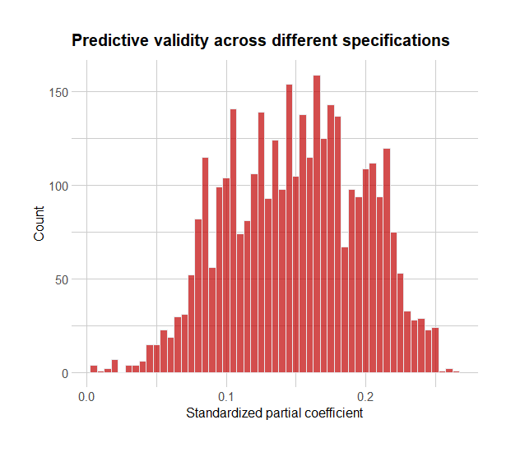
Predictive validity
RESULTS
Association with political knowledge across different specifications
SPAIN
ITALY
PORTUGAL
Mean: .099
Media: .102
1st Quart: .069
3rd Quart: .132
Mean: .098
Media: .140
1st Quart: .098
3rd Quart: .160
Mean: .150
Media: .152
1st Quart: .113
3rd Quart: .188

Slide 28
Predictive validity
RESULTS
Association with political knowledge across different specifications
SPAIN
ITALY
PORTUGAL
High fluctuation
Differences not that far of what can be seen between survey questions
Mean: .099
Media: .102
1st Quart: .069
3rd Quart: .132
Mean: .098
Media: .140
1st Quart: .098
3rd Quart: .160
Mean: .150
Media: .152
1st Quart: .113
3rd Quart: .188

Slide 29
What design choices have a higher impact on predictive validity? (RQ2.1) To what extent do different design choices affect the predictive validity of metered data measures? (RQ2.2)

Slide 30
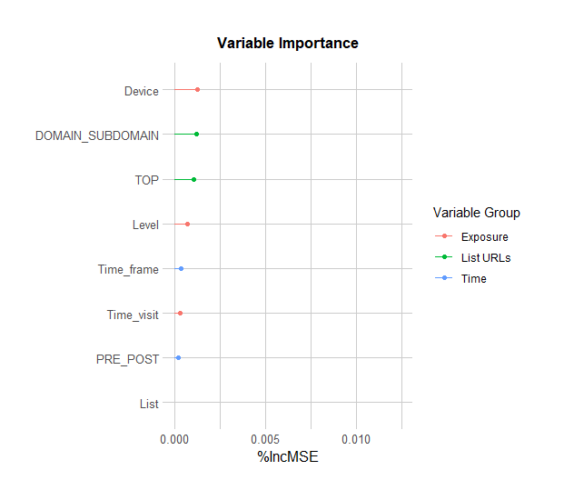
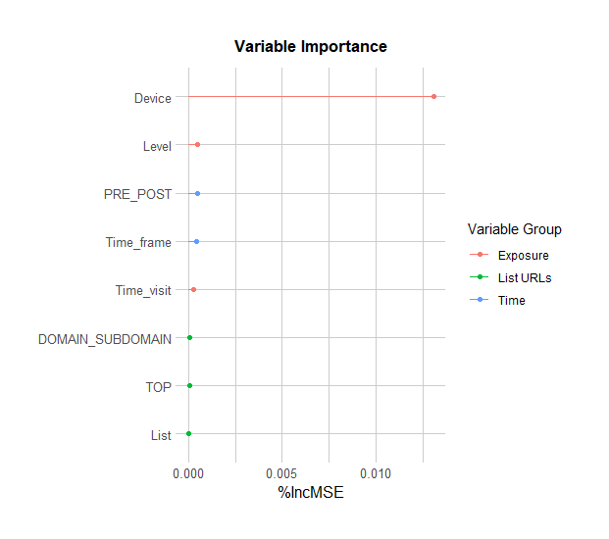
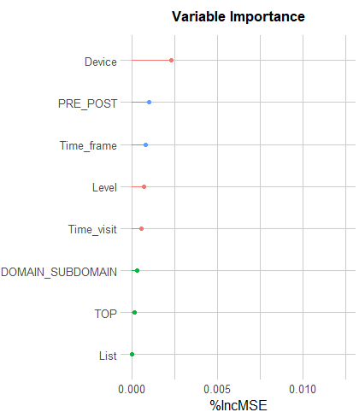
The importance of each design choice
RESULTS
SPAIN
ITALY
PORTUGAL
* These results agree with the conditional (unbiased) important measures from cforest

Slide 31
The importance of each design choice
RESULTS
SPAIN
ITALY
PORTUGAL
The device information used is the most important variable across countries

Slide 32
The importance of each design choice
RESULTS
SPAIN
ITALY
PORTUGAL
The ranking list used is the less important variable across countries

Slide 33
The importance of each design choice
RESULTS
SPAIN
ITALY
PORTUGAL
Spain has specific characteristic that could explain its differential importance
More richness in the subdomain information
Regional outlets (more) important in their own regions

Slide 34
The importance of each design choice
RESULTS
SPAIN
ITALY
PORTUGAL
The level (visit or time) and the time frame (number of days tracked) seem to be somewhat relevant across all countries

Slide 35
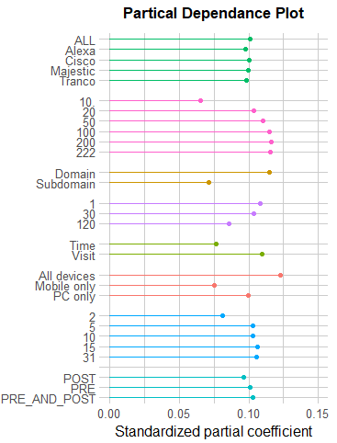
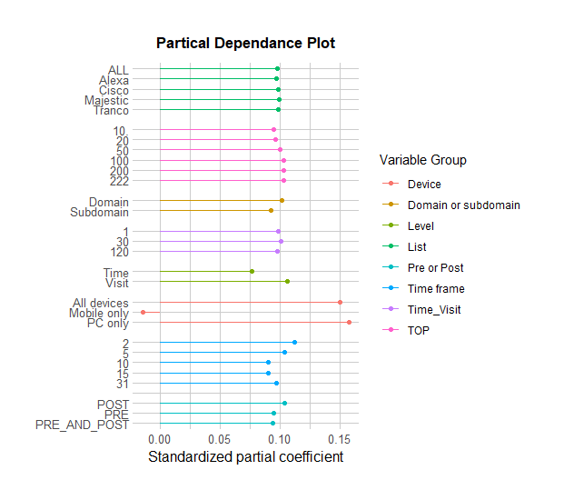
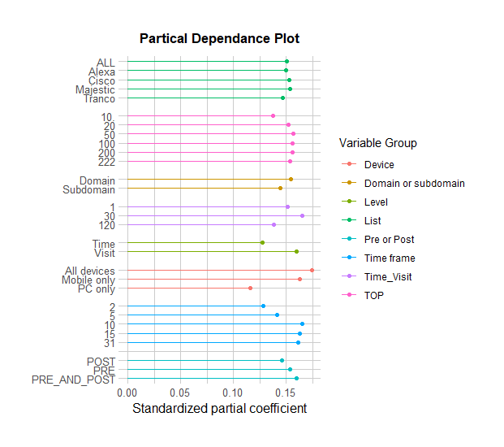
Marginal effect of each specification
RESULTS
SPAIN
ITALY
PORTUGAL

Slide 36
Marginal effect of each specification
RESULTS
SPAIN
ITALY
PORTUGAL
Almost no fluctuation across the different ranking lists

Slide 37
Marginal effect of each specification
RESULTS
SPAIN
ITALY
PORTUGAL
Apart from Spain, little fluctuation. The top 50-100 outlets seem to work fine

Slide 38
Marginal effect of each specification
RESULTS
SPAIN
ITALY
PORTUGAL
Using domain information yields higher predictive power

Slide 39
Marginal effect of each specification
RESULTS
SPAIN
ITALY
PORTUGAL
Slight but inconsistent fluctuation. The 120s always the lowest

Slide 40
Marginal effect of each specification
RESULTS
SPAIN
ITALY
PORTUGAL
Counting visits always leads to higher predictive power

Slide 41
Marginal effect of each specification
RESULTS
SPAIN
ITALY
PORTUGAL
Although inconsistent across countries, using information from both devices seems as the most stable option

Slide 42
Marginal effect of each specification
RESULTS
SPAIN
ITALY
PORTUGAL
The coefficients fluctuate across tracking periods. Italy behaves differently.
10 to 15 days seems to yield the highest predictive power.

Slide 43
Marginal effect of each specification
RESULTS
SPAIN
ITALY
PORTUGAL
Little fluctuation. Apart from Italy, using information from after the survey seems to yield lower predictive power.

Slide 44
CONCLUSIONS

Slide 45
Take-home messages
CONCLUSIONS
Many different design choices need to be made when measuring online news media exposure with metered data
The average-to-low convergent validity + the fluctuation of predictive validity asks for more research…like with surveys!
Some practical tips
Making inferences using only PCs and Mobile devices should be avoided
Using the 50 most visited news media outlets from any of the most common ranking lists should work fine.
10 to 15 days of tracking before the survey seems to be a sensible choice

Slide 46
Thanks!
Questions?
Oriol J. Bosch|PhD Candidate, The London School of Economics
ORIOL J. BOSCH | THE LONDON SCHOOL OF ECONOMICS / RECSM-UPF
o.bosch-jover@lse.ac.uk
orioljbosch
https://orioljbosch.com/

Slide 47
Predictive validity
Appendix
Measurements generating the highest associations
Spain: Pre | 15 days | PC & Mobile | Visit | 1 second | All news outlets
Italy: Pre | 2 days | PC | Visit | 30 seconds | Top 50 | Cisco
Portugal: Post | 10 days | Mobile | Time | 1 second | Top 50 | Tranco

