Slide 1
Track me but not really: Tracking undercoverage in metered data collection
o.bosch-jover@lse.ac.uk
orioljbosch
https://orioljbosch.com/
Oriol J. Bosch| Department of Methodology, LSE
Patrick Sturgis| Department of Methodology, LSE
Jouni Kuha| Department of Methodology, LSE
Acknowledgements: I would like to thank Melanie Revilla for her always insightful comments
Funding: This project has received funding from the European Research Council (ERC) under the European Unions Horizon 2020 research and innovation programme (grant agreement No 849165; PI: Melanie Revilla); the Spanish Ministry of Science and Innovation under the "R+D+i projects" programme (grant number PID2019-106867RB-I00 /AEI/10.13039/501100011033 (2020-2024), PI: Mariano Torcal); and the BBVA foundation under their grant scheme to scientific research teams in economy and digital society, 2019 (PI: Mariano Torcal).

Slide 2
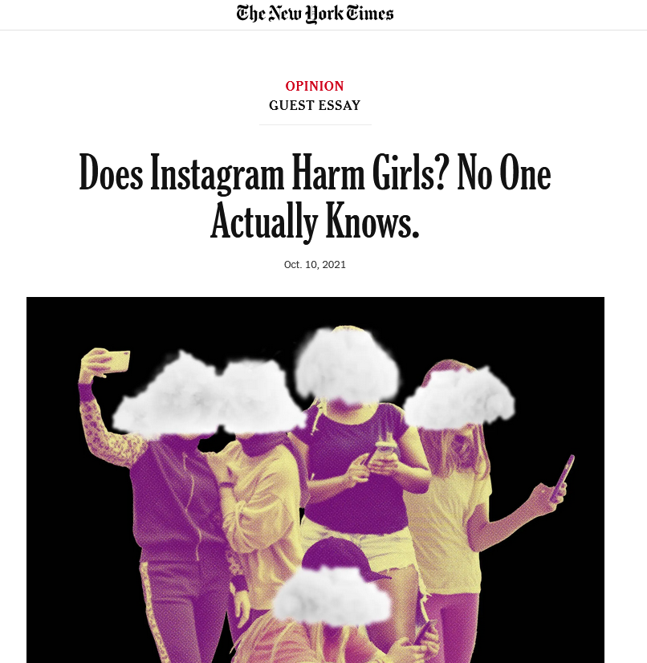
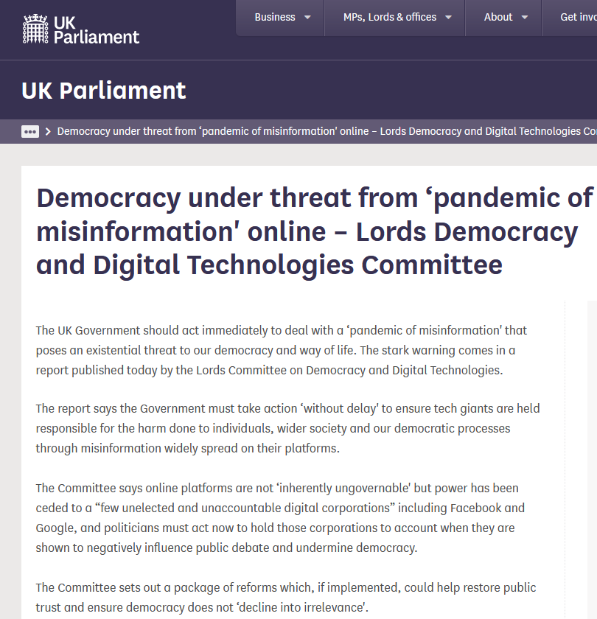
The rise of metered data
OBTAINIG HIGH-QUALITY DATA ABOUT ONLINE BEHAVIOURS
It is becoming vital to better understand what people do online and what impact this has on online and offline phenomena.

Slide 3
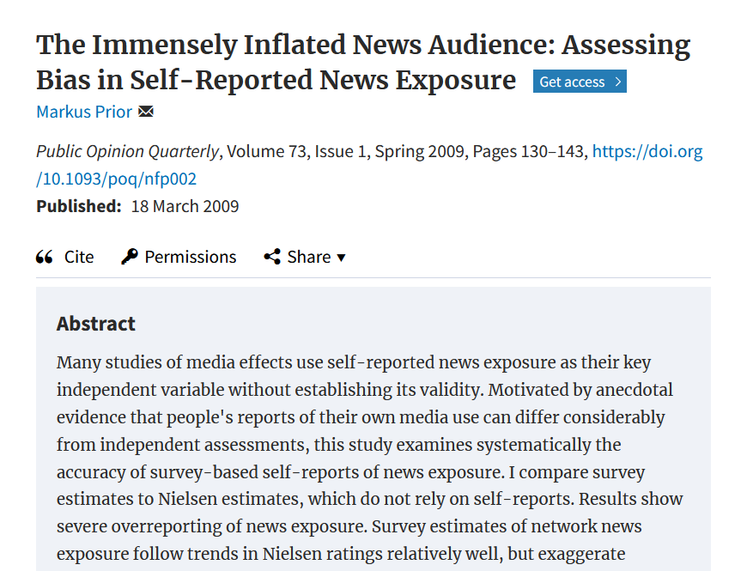
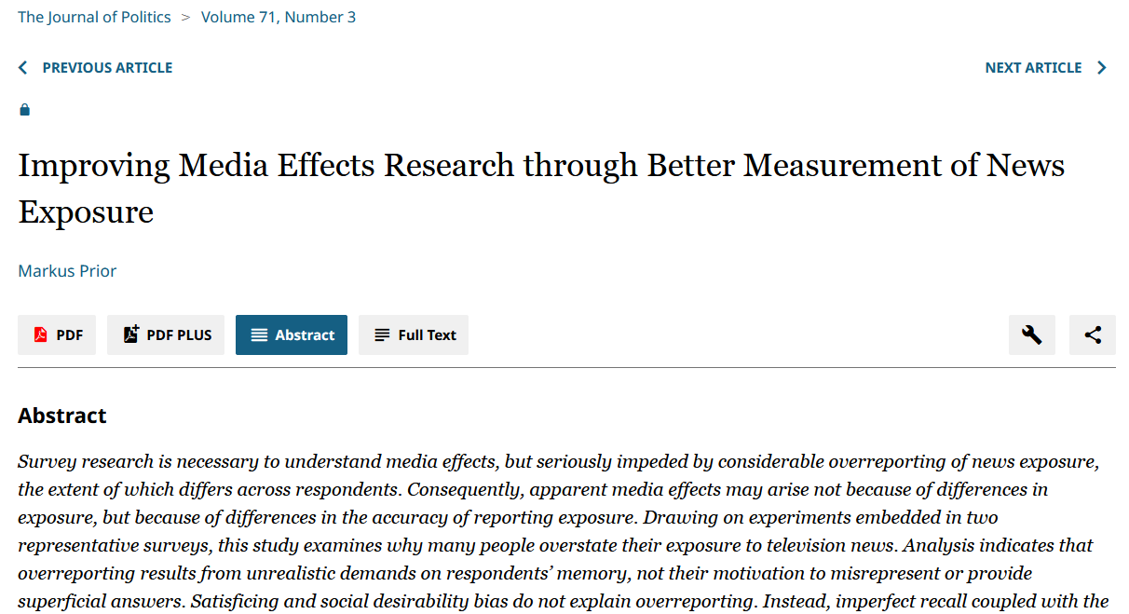
The rise of metered data
OBTAINIG HIGH-QUALITY DATA ABOUT ONLINE BEHAVIOURS
It is becoming vital to better understand what people do online and what impact this has on online and offline phenomena.
Self-reports might not be best suited for this

Slide 4
The rise of metered data
OBTAINIG HIGH-QUALITY DATA ABOUT ONLINE BEHAVIOURS
It is becoming vital to better understand what people do online and what impact this has on online and offline phenomena.
Self-reports might not be best suited for this
Alternative: directly observe what people do online using digital tracking solutions, or meters.
Group of tracking technologies
Installed on participants devices.
Collect traces left by participants when interacting with their devices online: e.g. URLs or apps visited
We call the resulting data: metered data.

Slide 5
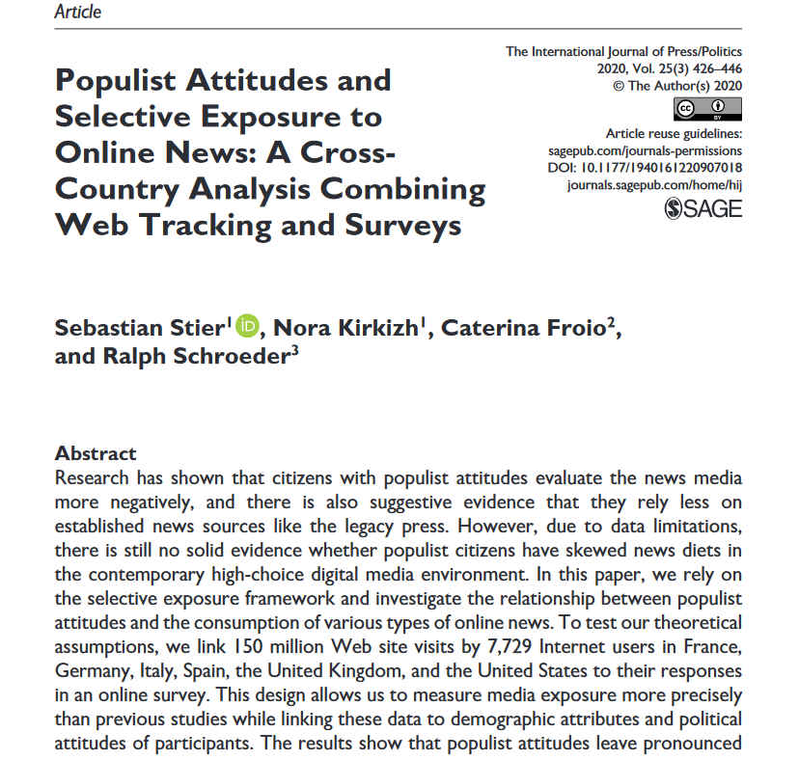
The rise of metered data
OBTAINIG HIGH-QUALITY DATA ABOUT ONLINE BEHAVIOURS
Since 2016, more than 60 papers published using metered data

Slide 6
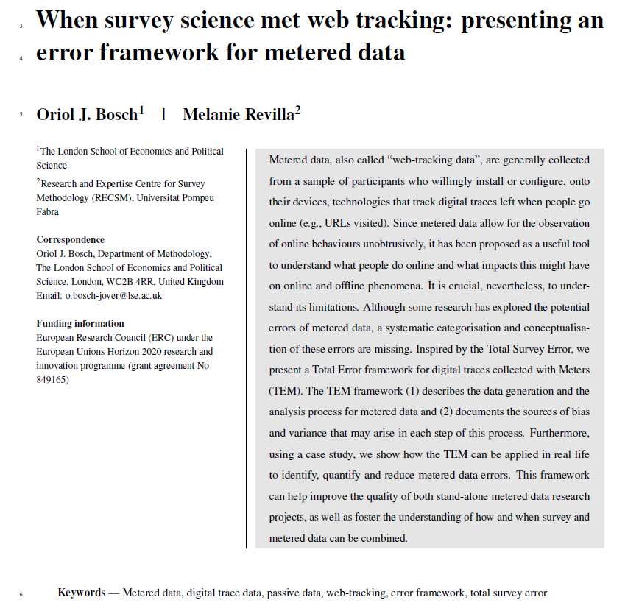
The rise of metered data
OBTAINIG HIGH-QUALITY DATA ABOUT ONLINE BEHAVIOURS
Since 2016, more than 60 papers published using metered data
The benefits seem clear…but should we assume that metered data is unbiased?

Slide 7
TRACKING UNDERCOVERAGE

Slide 8
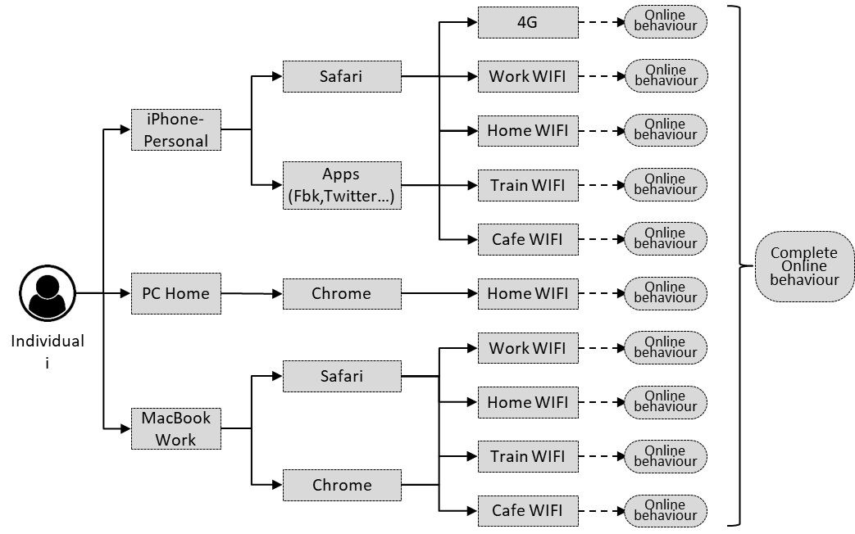
What do we mean by tracking undercoverage?
TRACKING UNDERCOVERAGE
Objective: measuring individuals’ behaviours
Reality: vector of those behaviours that individuals’ do through all their targets

Slide 9
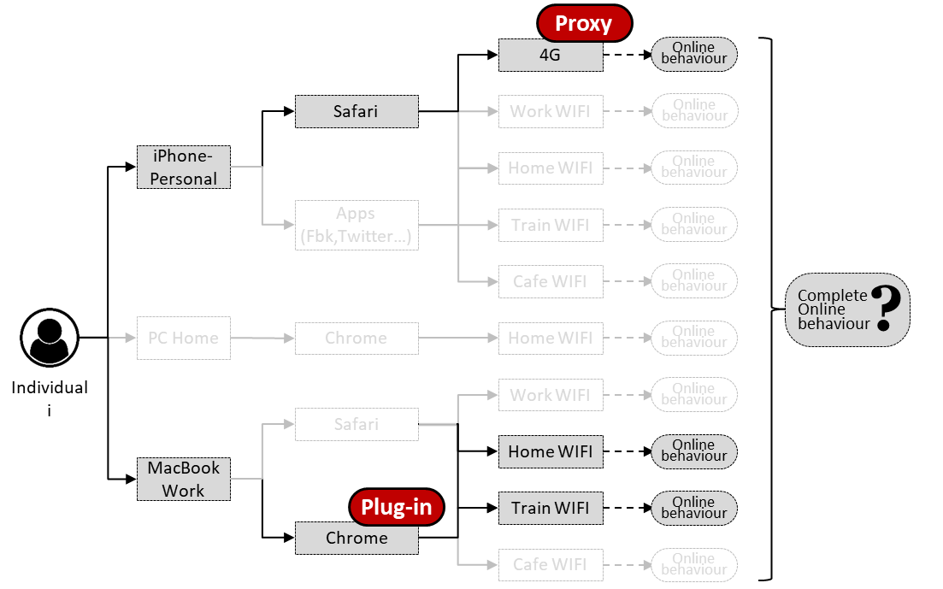
What do we mean by tracking undercoverage?
TRACKING UNDERCOVERAGE
Undercoverage can prevent tracking a participant’s complete online behaviour.
Different reasons:
Non-trackable targets
Meter not installed
Meter uninstalled
New non-tracked target

Slide 10
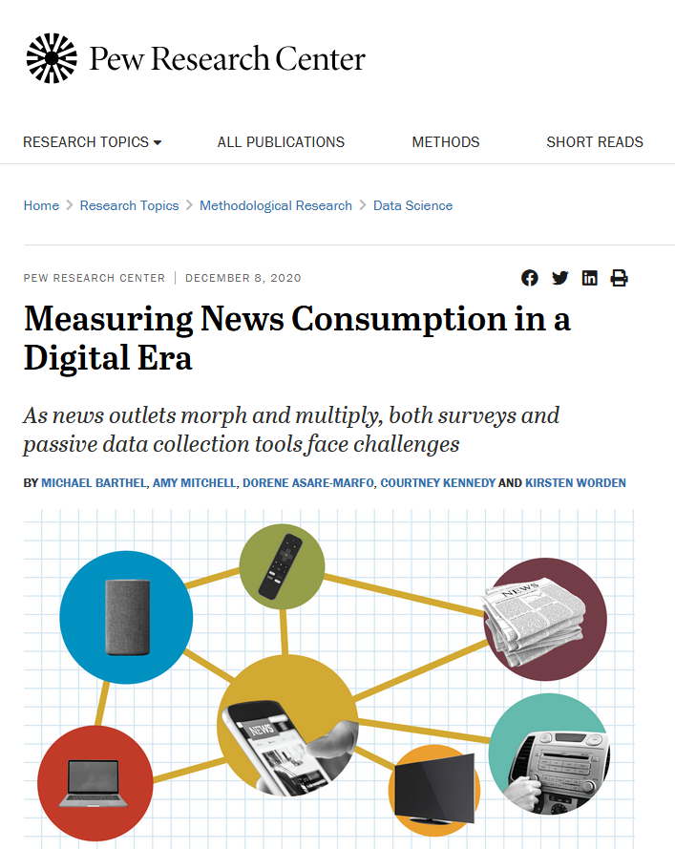
What do we mean by tracking undercoverage?
TRACKING UNDERCOVERAGE
Undercoverage can prevent tracking a participant’s complete online behaviour.
Different reasons:
Non-trackable targets
Meter not installed
Meter uninstalled
New non-tracked target

Slide 11
The consequences of tracking undercoverage
TRACKING UNDERCOVERAGE
Partial observation
Partial observations can introduce measurement errors
Can lead to underestimation of univariate estimates
Biased multivariate estimates
APP
PC Home
Chrome
Home WIFI
5 minutes
Work WIFI
6 minutes
Time spent visiting news articles
Individual i
Safari
Home WIFI
7 minutes
Iphone
Train WIFI
3 minutes
True: 23m
Observed: 5m
Apps (Fbk,Twitter…)
Cafe WIFI
2 minutes
Non-tracked device

Slide 12
OUR STUDY

Slide 13
Research questions
OUR STUDY
What is the percentage of participants being undercovered in general (RQ 1.1) and in terms of their devices and browsers? (RQ 1.2)
Which types of devices are not covered? (RQ 2)
To what extent does undercoverage introduce bias to univariate (RQ 3.1) and multivariate estimates based on metered data? (RQ 3.2)

Slide 14
Data
OUR STUDY
TRI-POL project - Overview
Three wave survey combined with metered data at the individual level
Spain, Portugal, Italy + Argentina and Chile
Netquest metered panels – Cross-quotas about gender, age, education and region

Slide 15
Data
OUR STUDY
TRI-POL project - Overview
Three wave survey combined with metered data at the individual level
Spain, Portugal, Italy + Argentina and Chile
Netquest metered panels – Cross-quotas about gender, age, education and region
Survey part | Metered part
Questions: polarization, political trust, political communication… | Devices: Windows PC, MAC, iOS & Android mobile devices
Time: ≈30 minutes | Technologies: plug-in, apps and proxies
Fieldwork: September 21 – April 22 | Time frame: 15 days before participants started the survey, 16 after starting
Sample Size: 1,289 (Spain), 1,231 (Italy), 1,028 (Portugal) | Sample size: 993 (Spain), 842 (Italy), 818 (Portugal)*
* Inverse probability weights computed using the random forest relative frequency method by Buskirk and Kolenikov (2015)

Slide 16
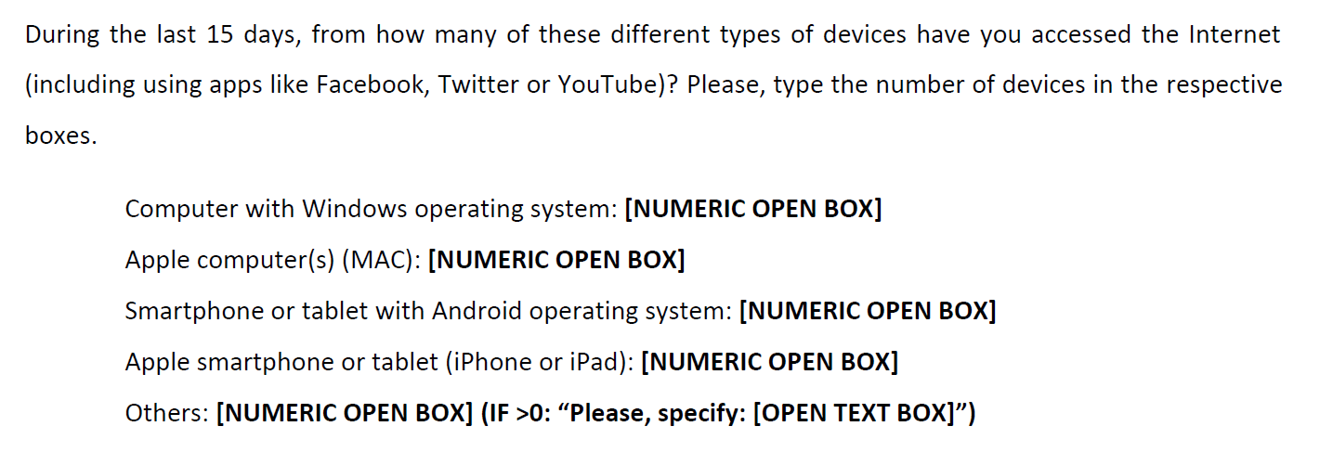
To measure undercoverage, we need to identify it
OUR STUDY
Our approach: combining survey and paradata

Slide 17
To measure undercoverage, we need to identify it
OUR STUDY
Our approach: combining survey and paradata
RQ 1 & RQ2
This approach can be used to compute the proportion of participants undercovered, in general and for each kind of device / browser

Slide 18
Simulating undercoverage bias (RQ3)
OUR STUDY
Knowing who is fully covered allows also to simulate bias for them

Slide 19
Simulating undercoverage bias (RQ3)
OUR STUDY
Knowing who is fully covered allows also to simulate bias for them
We can treat those subsamples as our “population” of fully covered participants*
Full sample
Fully covered sample
* Inverse probability weights computed using the random forest relative frequency method by Buskirk and Kolenikov (2015)

Slide 20
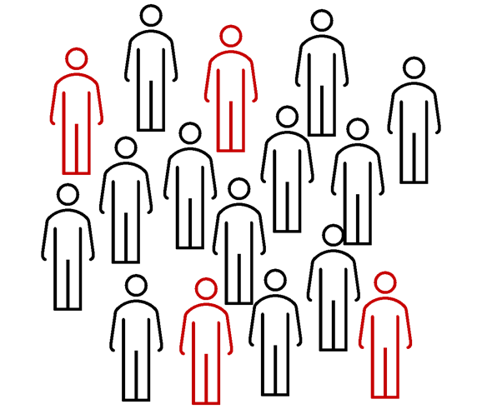
Simulating undercoverage bias (RQ3)
OUR STUDY
Simulation approach
We can estimate the true estimates of this fully covered subsamples…
Under | Minutes mobile | Minutes PC | Total
Yes | 20 | 4 | 24
No | 10 | 6 | 16
Yes | 5 | 14 | 19
Yes | 26 | 9 | 35
No | 3 | 32 | 35
Yes | 14 | 3 | 17
No | 17 | 6 | 23
Complete coverage True value: 40 minutes

Slide 21
Simulating undercoverage bias (RQ3)
OUR STUDY
Simulation approach
…to then simulate how their estimates would change if some of their information was lost
Under | Minutes mobile | Minutes PC | Total
Yes | 0 | 4 | 4
No | 10 | 6 | 16
Yes | 0 | 14 | 14
Yes | 0 | 9 | 9
No | 3 | 32 | 35
Yes | 0 | 3 | 3
No | 17 | 6 | 23
Simulated undercoverage Biased value: 18 minutes
Difference: 18 minutes = bias

Slide 22
Simulating undercoverage bias (RQ3)
OUR STUDY
Simulating scenarios
3 different computer undercoverage scenarios:
25%
50%
75%
3 different mobile undercoverage scenarios:
25%
50%
75%
With no computer covered
With no mobile covered
* In our samples % with no PC covered: 34.1 (Spain), 38.1 (Italy) , 27 (Portugal) | % with no mobile: 23.8 (Spain), 28.3 (Italy), 37.7 (Portugal)

Slide 23
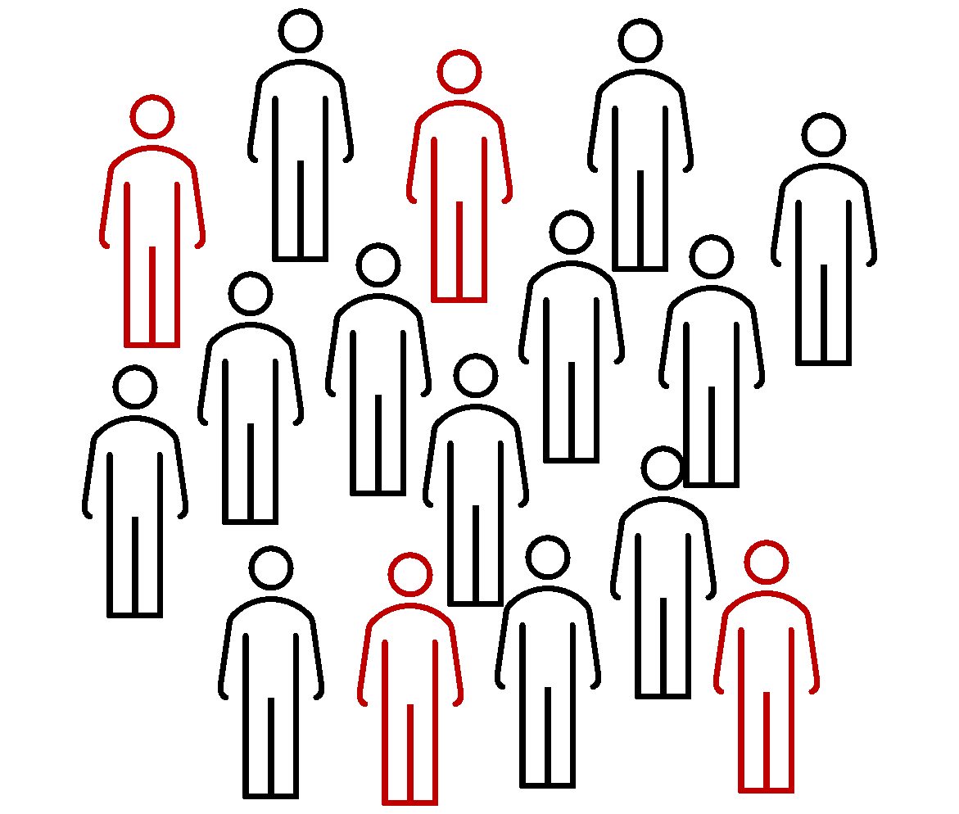
Simulating undercoverage bias (RQ3)
OUR STUDY
Montecarlo simulations
For each scenario, we ran 1,000 random simulations.
e.g. 25% with no computer covered 0.25 probability of being undercovered

Slide 24
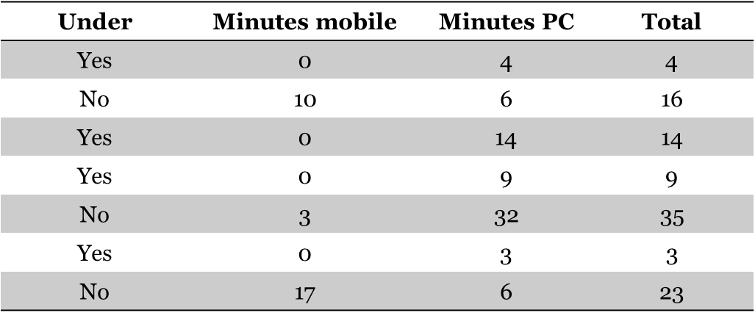
Simulating undercoverage bias (RQ3)
OUR STUDY
Computing the bias
We then computed the average estimate of all 1,000 simulations.
Avg. undercovered estimate: 22 minutes
True estimate: 40 minutes
Difference: 18 minutes bias

Slide 25
Simulating undercoverage bias (RQ3)
OUR STUDY
Simulation approach
We ran simulations for a variety of estimates
Univariate estimates:
Average time spent on the Internet
Average time spent on Social Network Sites (SNS)
Proportion of participants visiting online news media outlets
Multivariate estimates
Correlation between average time spent on SNS and trust in SNS
Association between average number of visits to online news media outlets and political knowledge (OLS regression with controls*)
* Age, gender and education

Slide 26
PREVALENCE (RQ 1 & 2)

Slide 27
Proportion undercovered (RQ1)
PREVALENCE
 | Spain | Italy | Portugal
Overall | 80.5 | 83.1 | 85.7
Device* | 69.7 | 76.1 | 77.5
Browser | 35.1 | 26.8 | 39.3
Very high prevalence, with differences between device and browser
* 68% in the Pew Research Centre report, in the USA, using a probability-based panel and a different tracking provider

Slide 28
Is undercoverage evenly distributed across devices? (RQ2)
PREVALENCE
Proportion of users who use a specific type of device and not all of them are tracked
 | Spain | Italy | Portugal
Windows PC | 50.5 | 54.0 | 49.2
MAC | 69.3 | 78.2 | 67.2
Android | 44.7 | 47.8 | 53.1
iOS | 93.4 | 80.9 | 95.4
Apple devices present a substantially higher prevalence

Slide 29
SIMULATING BIAS (RQ3)

Slide 30
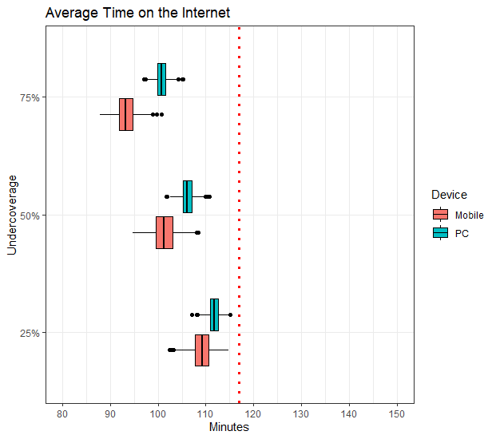
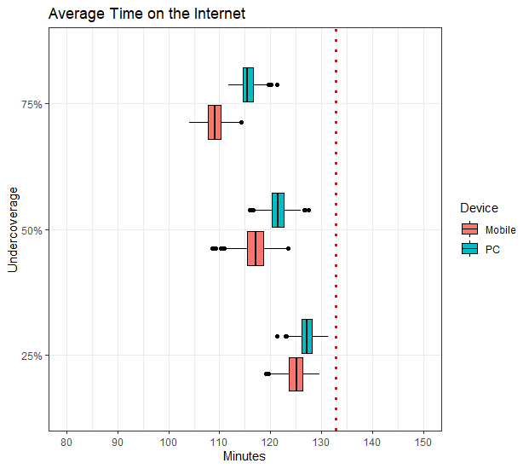
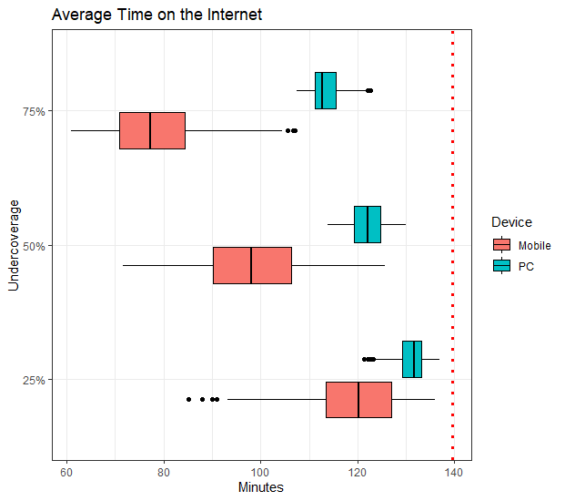
Average time spent on the Internet
SIMULATING BIAS
SPAIN
ITALY
PORTUGAL
N: 295 N: 201 N: 192
Avg. bias: 5 – 38 minutes 5 – 23 minutes 5 – 24 minutes

Slide 31
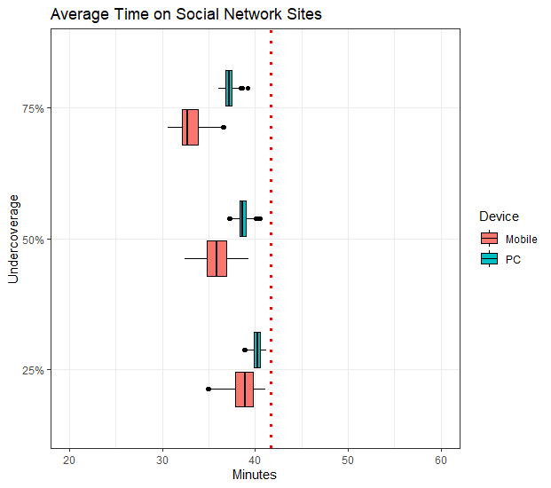
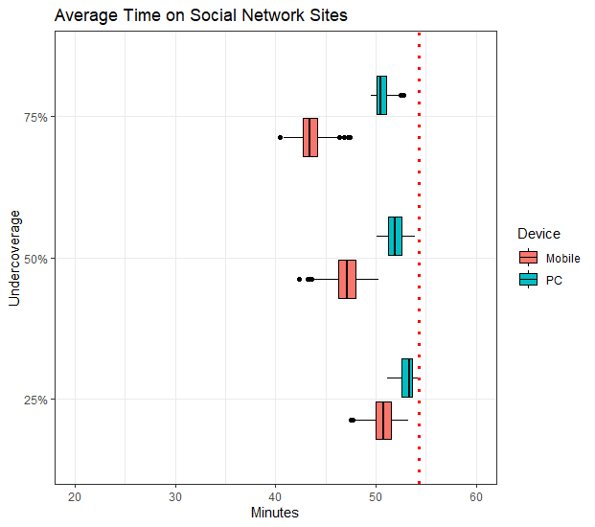
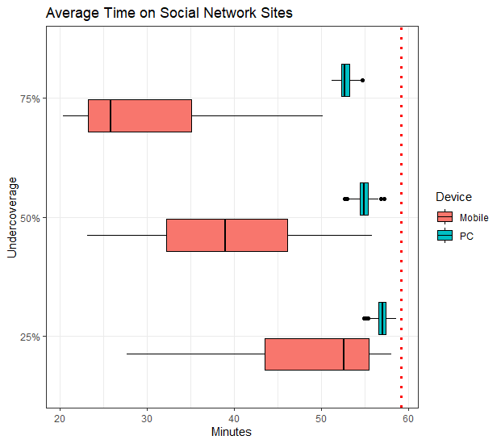
Average time spent on social network sites
SIMULATING BIAS
SPAIN
ITALY
PORTUGAL
N: 295 N: 201 N: 192
Avg. bias: 1 – 15 minutes 1 – 11 minutes 1 – 8 minutes

Slide 32
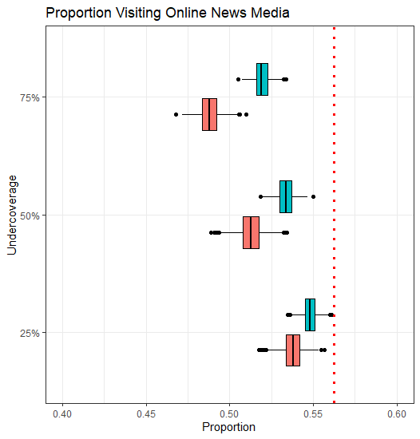
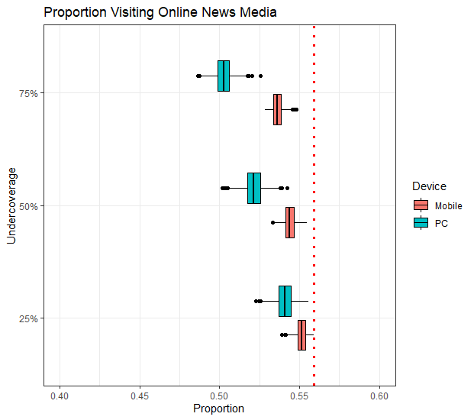
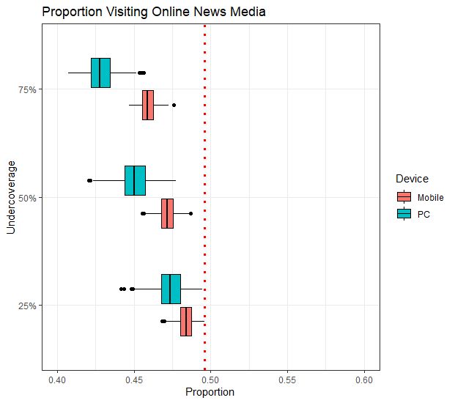
Proportion visiting online news media
SIMULATING BIAS
SPAIN
ITALY
PORTUGAL
N: 295 N: 201 N: 192
Avg. bias: 1 – 8 % point 1 – 6 % point 1 – 7 % point

Slide 33
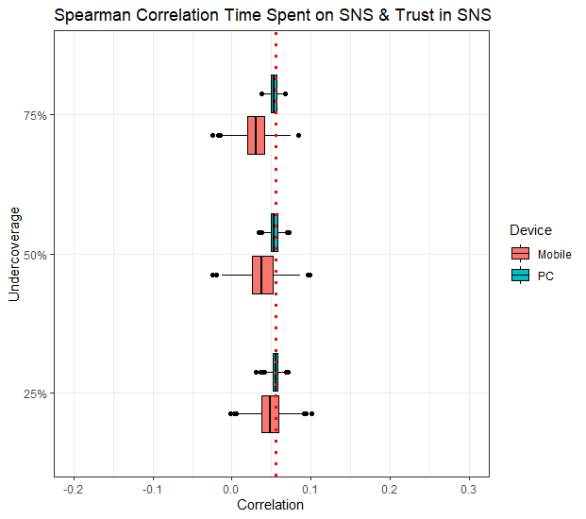
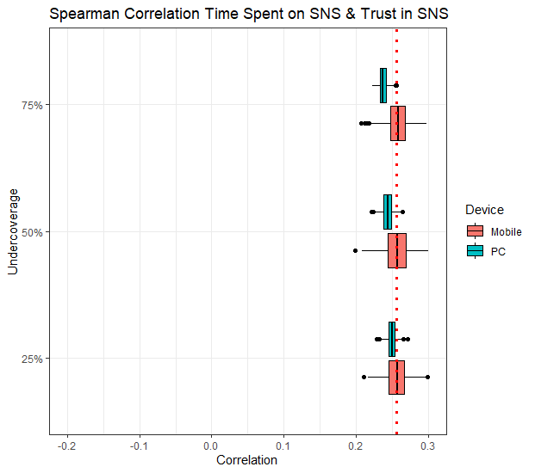
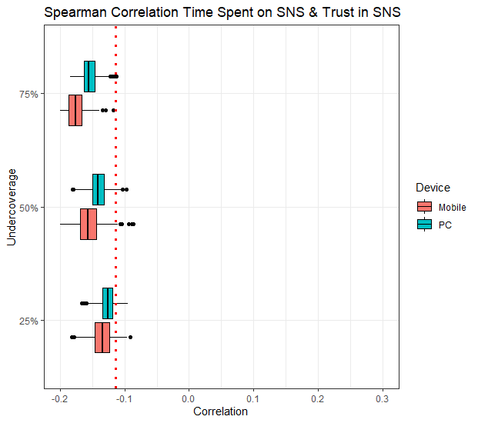
Correlation between time spent on SNS and trust in SNS
SIMULATING BIAS
SPAIN
ITALY
PORTUGAL
N: 295 N: 201 N: 192
Avg. bias: 0.0 - 0.02 0.0 - 0.02 0.02 - 0.06

Slide 34
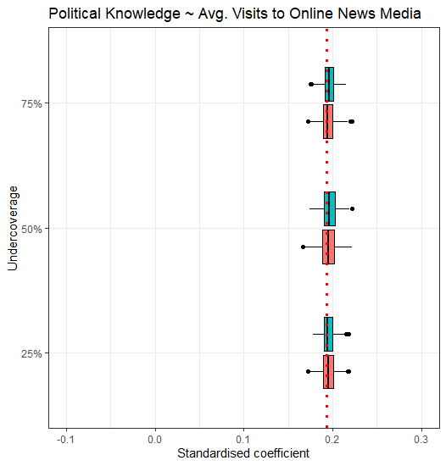
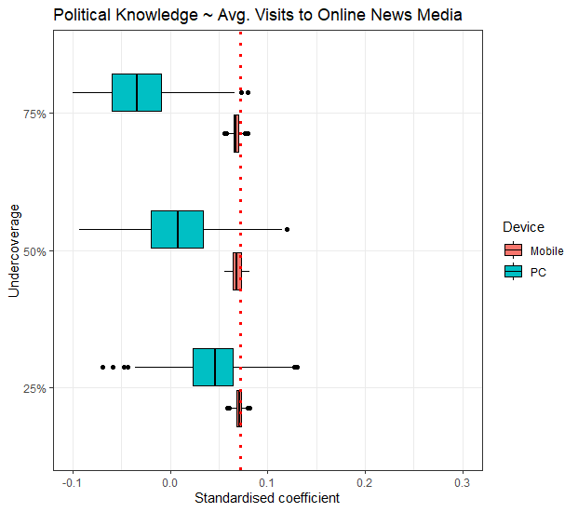
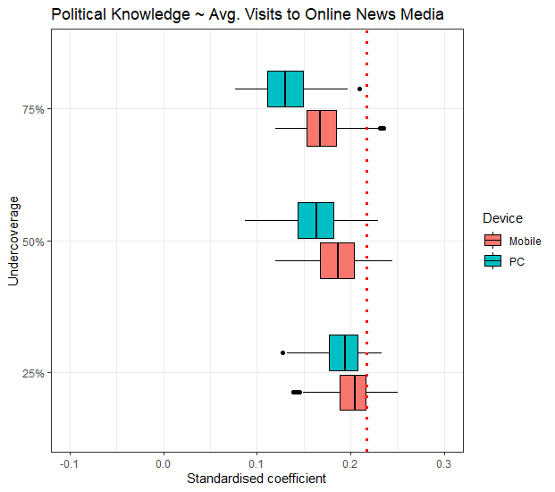
OLS coefficient: Political Knowledge ~ Nº visits to online news
SIMULATING BIAS
SPAIN
ITALY
PORTUGAL
N: 295 N: 201 N: 192
Avg. bias: 0.002 -0.003 0.00 – 0.11 0.01 – 0.09
* Control variables: age, gender, tertiary education

Slide 35
CONCLUSIONS

Slide 36
Take-home messages
CONCLUSIONS
The prevalence of tracking undercoverage is high, mostly driven by device undercoverage (RQ1)
Apple devices are more likely to be undercovered, specially iPhones and iPads (RQ2)
Tracking undercoverage can bias both univariate and multivariate estimates (RQ3)
Higher undercoverage leads to higher bias
The extent varies across topics, as well as devices undercovered.

Slide 37
Take-home messages
CONCLUSIONS
The prevalence of tracking undercoverage is high, mostly driven by device undercoverage (RQ1)
Apple devices are more likely to be undercovered, specially iPhones and iPads (RQ2)
Tracking undercoverage can bias both univariate and multivariate estimates (RQ3)
Higher undercoverage leads to higher bias
The extent varies across topics, as well as devices undercovered.
This can be extrapolated to other device-dependant digital trace data

Slide 38
Thanks!
Questions?
Oriol J. Bosch|Department of Methodology, LSE
ORIOL J. BOSCH | THE LONDON SCHOOL OF ECONOMICS / RECSM-UPF
o.bosch-jover@lse.ac.uk
orioljbosch
https://orioljbosch.com/

