Slide 1
The challenges of using metered data to study online behaviours
Oriol J. Bosch | THE LONDON SCHOOL OF ECONOMICS / RECSM-UPF
ORIOL J. BOSCH | THE LONDON SCHOOL OF ECONOMICS / RECSM-UPF
o.bosch-jover@lse.ac.uk
orioljbosch
https://orioljbosch.com/
This project has received funding from the European Research Council (ERC) under the European Union’s Horizon 2020 research and innovation programme (grant agreement No849165), PI: Melanie Revilla

Slide 2
What this talk is about
INTRODUCTION
Practical experience designing the (potentially) first cross-national online panel survey combined with metered data.

Slide 3
What this talk is about
INTRODUCTION
Practical experience designing the (potentially) first cross-national online panel survey combined with metered data.
+ Theoretical knowledge from our Total Error Framework

Slide 4
What this talk is about
INTRODUCTION
Practical experience designing the (potentially) first cross-national online panel survey combined with metered data.
+ Theoretical knowledge from our Total Error Framework
Sadly, we still don’t have data (yet)

Slide 5
Tracking online behaviours using a meter
INTRODUCTION
Definition
Metered data is obtained from a meter willingly installed or configured by a sample of participants on their devices (PCs, tablets and/or smartphones).
A meter refers to a heterogeneous group of tracking technologies that allow to passively track, at least, information about the URLs of the web pages visited by the participants.

Slide 6
Tracking online behaviours using a meter
INTRODUCTION
Definition
Metered data is obtained from a meter willingly installed or configured by a sample of participants on their devices (PCs, tablets and/or smartphones).
A meter refers to a heterogeneous group of tracking technologies that allow to passively track, at least, information about the URLs of the web pages visited by the participants.

Slide 7
TRI-POL project
THIS STUDY
Combination of surveys and metered data at the individual level
3 survey waves, 15 days of tracking prior & posterior of each wave
Netquest metered panels
Spain, Italy, Portugal, Argentina and Chile
Questionnaire about polarization, political trust and political communication
Metered data dataset focused on consumption of news, political information and social media
Important considerations:
Sample of already metered individuals.
Not access to raw data
The dataset is gonna be open-access!

Slide 8
Challenges when using metered data to make inferences for finite populations
RESULTS
How to create metered data variables

Slide 9
Challenges when using metered data to make inferences for finite populations
RESULTS
How to create metered data variables
Mostly we will measure behavioural concepts with behavioural data…it should be very straightforward

Slide 10
Challenges when using metered data to make inferences for finite populations
RESULTS
How to create metered data variables
Mostly we will measure behavioural concepts with behavioural data…it should be very straightforward
Concept: average hours of consumption of online political news

Slide 11
Challenges when using metered data to make inferences for finite populations
RESULTS
How to create metered data variables
Mostly we will measure behavioural concepts with behavioural data…it should be very straightforward
Concept: average hours of consumption of online political news
Measure: average time recorded of the visits to online news media outlets’ political URLs.

Slide 12
Challenges when using metered data to make inferences for finite populations
RESULTS
How to create metered data variables
Mostly we will measure behavioural concepts with behavioural data…it should be very straightforward
Concept: average hours of consumption of online political news
Measure: average time recorded of the visits to online news media outlets’ political URLs.
Which online news media outlets?

Slide 13
Challenges when using metered data to make inferences for finite populations
RESULTS
How to create metered data variables
Mostly we will measure behavioural concepts with behavioural data…it should be very straightforward
Concept: average hours of consumption of online political news
Measure: average time recorded of the visits to online news media outlets’ political URLs.
Which online news media outlets?
What is political?

Slide 14
Challenges when using metered data to make inferences for finite populations
RESULTS
How to create metered data variables
Mostly we will measure behavioural concepts with behavioural data…it should be very straightforward
Concept: average hours of consumption of online political news
Measure: average time recorded of the visits to online news media outlets’ political URLs.
Which online news media outlets?
What is political?
What do we consider as a visit?

Slide 15
Challenges when using metered data to make inferences for finite populations
RESULTS
How to create metered data variables
Mostly we will measure behavioural concepts with behavioural data…it should be very straightforward
Concept: average hours of consumption of online political news
Measure: average time recorded of the visits to online news media outlets’ political URLs.
Which online news media outlets?
What is political?
What do we consider as a visit?
What time frame to use to compute an average?

Slide 16
Challenges when using metered data to make inferences for finite populations
RESULTS
Which news media outlets to track? – Our experience
Past approaches:

Slide 17
Challenges when using metered data to make inferences for finite populations
RESULTS
Which news media outlets to track? – Our experience
Past approaches:
Already available lists created by researchers? (Domains shared on Facebook, Guess, 2021)

Slide 18
Challenges when using metered data to make inferences for finite populations
RESULTS
Which news media outlets to track? – Our experience
Past approaches:
Already available lists created by researchers? (Domains shared on Facebook, Guess, 2021)
Not available in our countries
What is the validity of these lists?

Slide 19
Challenges when using metered data to make inferences for finite populations
RESULTS
Which news media outlets to track? – Our experience
Past approaches:
Already available lists created by researchers? (Facebook blabla Guess et al.)
Top X list by some ranking web site? (TOP 50 Alexa, Cardenal et al., 2019)

Slide 20
Challenges when using metered data to make inferences for finite populations
RESULTS
Which news media outlets to track? – Our experience
Past approaches:
Already available lists created by researchers? (Facebook blabla Guess et al.)
Top X list by some ranking web site? (TOP 50 Alexa, Cardenal et al., 2019)
Which ranking site to use?

Slide 21
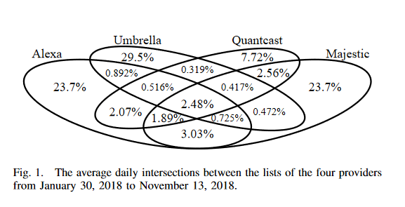
Challenges when using metered data to make inferences for finite populations
RESULTS
Which news media outlets to track? – Our experience
Past approaches:
Already available lists created by researchers? (Domains shared on Facebook, Guess, 2021)
Top X list by some ranking web site? (TOP 50 Alexa, Cardenal et al., 2019)
Which ranking site to use?
Pochat, V. L., Van Goethem, T., Tajalizadehkhoob, S., Korczyński, M., & Joosen, W. (2018). Tranco: A research-oriented top sites ranking hardened against manipulation. arXiv preprint arXiv:1806.01156.

Slide 22
Challenges when using metered data to make inferences for finite populations
RESULTS
Which news media outlets to track? – Our experience
Past approaches:
Already available lists created by researchers? (Domains shared on Facebook, Guess, 2021)
Top X list by some ranking web site? (TOP 50 Alexa, Cardenal et al., 2019)
Which ranking site to use?
Which Nº to use? 20? 50? 100?

Slide 23
Challenges when using metered data to make inferences for finite populations
RESULTS
Which news media outlets to track? – Our experience
Past approaches:
Already available lists created by researchers? (Domains shared on Facebook, Guess, 2021)
Top X list by some ranking web site? (TOP 50 Alexa, Cardenal et al., 2019)
A complete list of all news media outlets? (Germany, Mangold et al., 2021)

Slide 24
Challenges when using metered data to make inferences for finite populations
RESULTS
Which news media outlets to track? – Our experience
Past approaches:
Already available lists created by researchers? (Domains shared on Facebook, Guess, 2021)
Top X list by some ranking web site? (TOP 50 Alexa, Cardenal et al., 2019)
A complete list of all news media outlets? (Germany, Mangold et al., 2021)
Not available in our countries

Slide 25
Challenges when using metered data to make inferences for finite populations
RESULTS
Which news media outlets to track? – Our experience
Our approach is a combination of all of them:
Step 1: Build a comprehensive list of “all” news media domain outlets in the country

Slide 26
Challenges when using metered data to make inferences for finite populations
RESULTS
Which news media outlets to track? – Our experience
Our approach is a combination of all of them:
Step 1: Build a comprehensive list of “all” news media domain outlets in the country
Step 2: Create different lists of most visited news media outlets, using different rankings and numbers: All news outlets, top 200, top 100, top 50, top 20, top 10 * Tranco, Alexa, Cisco, Majestic.

Slide 27
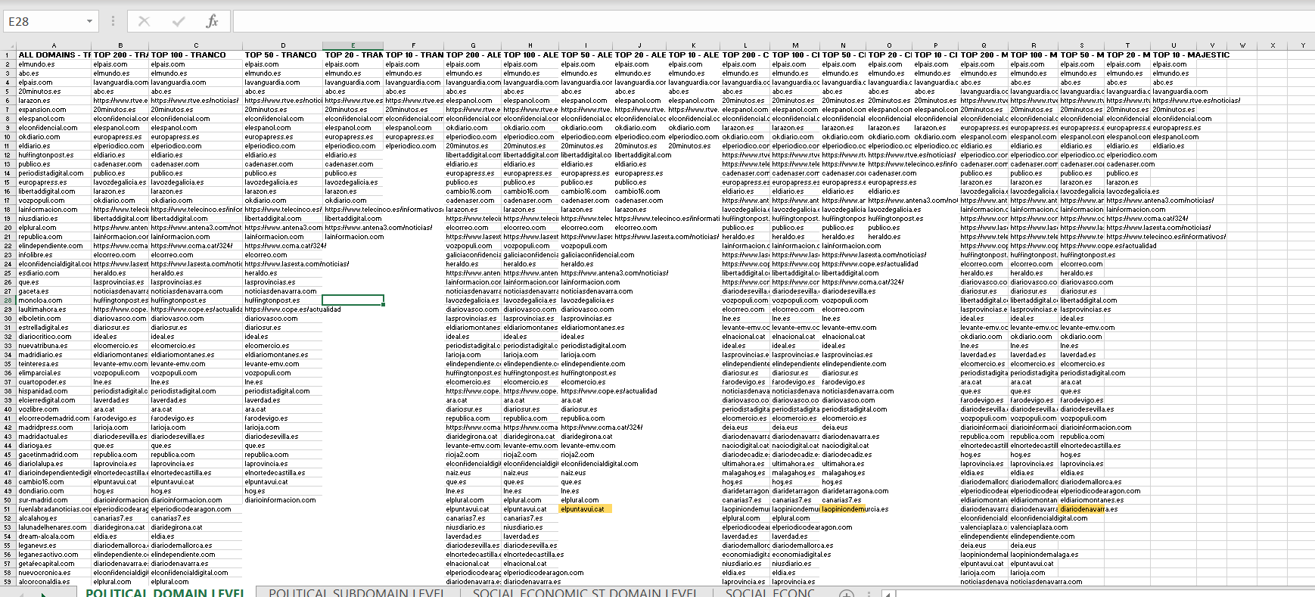
Challenges when using metered data to make inferences for finite populations
RESULTS
How to create metered data variables
Our approach is a combination of all of them:
Step 1: Build a comprehensive list of “all” news media domain outlets in the country
Step 2: Create different lists of most visited news media outlets, using different rankings and numbers

Slide 28
Challenges when using metered data to make inferences for finite populations
RESULTS
But what is political? – Our experience

Slide 29
Challenges when using metered data to make inferences for finite populations
RESULTS
But what is political? – Our experience
Everything is political

Slide 30
Challenges when using metered data to make inferences for finite populations
RESULTS
But what is political? – Our experience
Everything is political

Slide 31
Challenges when using metered data to make inferences for finite populations
RESULTS
But what is political? – Our experience
Everything is political

Slide 32
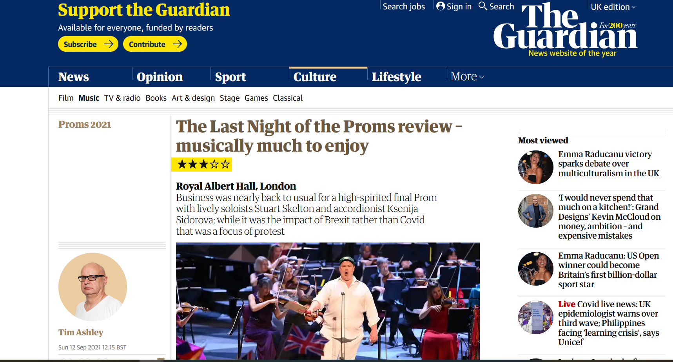
Challenges when using metered data to make inferences for finite populations
RESULTS
But what is political? – Our experience
Everything is political

Slide 33
Challenges when using metered data to make inferences for finite populations
RESULTS
But what is political? – Our experience
Everything is political
Only some articles are political

Slide 34
Challenges when using metered data to make inferences for finite populations
RESULTS
But what is political? – Our experience
Everything is political
Only some articles are political
Manual selection What criteria to use?
Machine learning selection How accurate can it be?

Slide 35
Challenges when using metered data to make inferences for finite populations
RESULTS
But what is political? – Our experience
Everything is political
Only some articles are political
Manual selection What criteria to use?
Machine learning selection How accurate can it be?

Slide 36
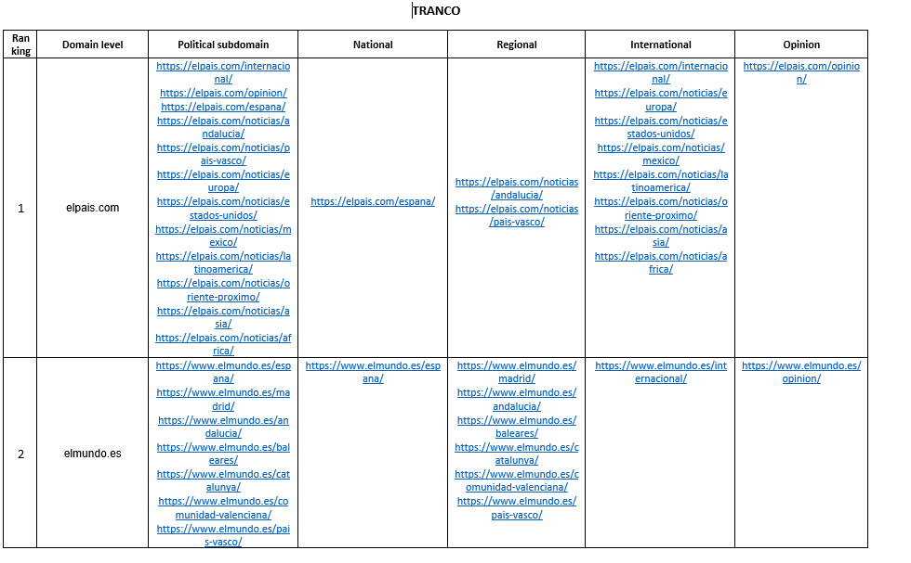
Challenges when using metered data to make inferences for finite populations
RESULTS
But what is political? – Our experience
But what is political?
Everything is political
Only some articles are political
Manual selection What criteria to use?
Machine learning selection How accurate can it be?

Slide 37
Challenges when using metered data to make inferences for finite populations
RESULTS
But what is political? – Our experience
Our approach is a combination of all of them:
Step 1: Build a comprehensive list of “all” news media domain outlets in the country
Step 2: Create different lists of most visited news media outlets, using different rankings and numbers: All news outlets, top 200, top 100, top 50, top 20, top 10 * Tranco, Alexa, Cisco, Alexa.
Step 3: Selecting the political subdomains for each (Top 50) list.

Slide 38
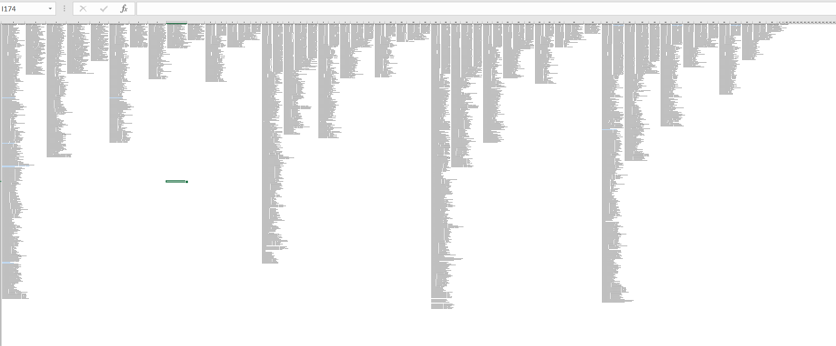
Challenges when using metered data to make inferences for finite populations
RESULTS
How to create metered data variables – Our experience
Our approach is a combination of all of them:
Step 1: Build a comprehensive list of “all” news media domain outlets in the country
Step 2: Create different lists of most visited news media outlets, using different rankings and numbers
Step 3: Selecting the subdomains for each (Top 50) list.

Slide 39
Challenges when using metered data to make inferences for finite populations
RESULTS
What do we consider as a visit? – Our experience

Slide 40
Challenges when using metered data to make inferences for finite populations
RESULTS
What do we consider as a visit? – Our experience
In general, panel companies consider any visit taking around 1-3 seconds as a visit. They also have their own rules to consider what a new visit is (e.g. refreshing, after a given amount of time, etc.).

Slide 41
Challenges when using metered data to make inferences for finite populations
RESULTS
What do we consider as a visit? – Our experience
In general, panel companies consider any visit taking around 1-3 seconds as a visit. They also have their own rules to consider what a new visit is (e.g. refreshing, after a given amount of time, etc.).
Is this too liberal to be considered as a visit

Slide 42
Challenges when using metered data to make inferences for finite populations
RESULTS
What do we consider as a visit? – Our experience
In general, panel companies consider any visit taking around 1-3 seconds as a visit. They also have their own rules to consider what a new visit is (e.g. refreshing, after a given amount of time, etc.).
Depending on what we are measuring, we might want to consider alternatives.

Slide 43
Challenges when using metered data to make inferences for finite populations
RESULTS
What do we consider as a visit? – Our experience
In general, panel companies consider any visit taking around 1-3 seconds as a visit. They also have their own rules to consider what a new visit is (e.g. refreshing, after a given amount of time, etc.).
Depending on what we are measuring, we might want to consider alternatives.
Do we want to infer if they have read all or part of the article?

Slide 44
Challenges when using metered data to make inferences for finite populations
RESULTS
What do we consider as a visit? – Our experience
In general, panel companies consider any visit taking around 1-3 seconds as a visit. They also have their own rules to consider what a new visit is (e.g. refreshing, after a given amount of time, etc.).
Depending on what we are measuring, we might want to consider alternatives.
Do we want to infer if they have read all or part of the article?
How many seconds is that?

Slide 45
Challenges when using metered data to make inferences for finite populations
RESULTS
What do we consider as a visit? – Our experience
In general, panel companies consider any visit taking around 1-3 seconds as a visit. They also have their own rules to consider what a new visit is (e.g. refreshing, after a given amount of time, etc.).
Depending on what we are measuring, we might want to consider alternatives.
Do we want to infer if they have read all or part of the article?
Do we want to measure if they were interested enough to open it?
How many seconds is that?

Slide 46
Challenges when using metered data to make inferences for finite populations
RESULTS
What do we consider as a visit? – Our experience
In general, panel companies consider any visit taking around 1-3 seconds as a visit. They also have their own rules to consider what a new visit is (e.g. refreshing, after a given amount of time, etc.).
Depending on what we are measuring, we might want to consider alternatives.
Do we want to infer if they have read all or part of the article?
Do we want to measure if they were interested enough to open it?
How many seconds is that?
How do we avoid “false positives”?

Slide 47
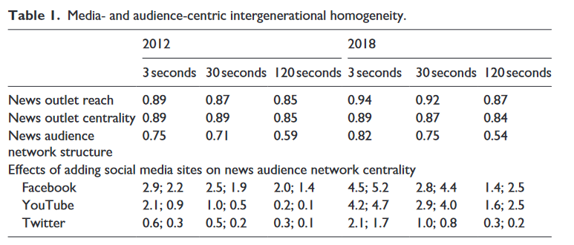
Challenges when using metered data to make inferences for finite populations
RESULTS
What do we consider as a visit? – Our experience
In general, panel companies consider any visit taking around 1-3 seconds as a visit. They also have their own rules to consider what a new visit is (e.g. refreshing, after a given amount of time, etc.).
Mangold, F., Stier, S., Breuer, J., & Scharkow, M. (2021). The overstated generational gap in online news use? A consolidated infrastructural perspective. new media & society, 1461444821989972.

Slide 48
Challenges when using metered data to make inferences for finite populations
RESULTS
What do we consider as a visit? – Our experience
In general, panel companies consider any visit taking around 1-3 seconds as a visit. They also have their own rules to consider what a new visit is (e.g. refreshing, after a given amount of time, etc.).
Mangold, F., Stier, S., Breuer, J., & Scharkow, M. (2021). The overstated generational gap in online news use? A consolidated infrastructural perspective. new media & society, 1461444821989972.

Slide 49
Challenges when using metered data to make inferences for finite populations
RESULTS
What do we consider as a visit? – Our experience
We measure everything with different approaches:
Netquest criteria: 1 second. New visit after 30 minutes. New visit if refreshed.
Alternative criteria 1: 30 seconds. No new visits after given minutes or refreshing.
Alternative criteria 2: 120 seconds. No new visits after given minutes or refreshing.

Slide 50
Challenges when using metered data to make inferences for finite populations
RESULTS
What time frame to use to compute an average?– Our experience
Two main considerations:
How much time do we need to properly measure a “typical” behaviour?
Also, time is money…specially with metered data.

Slide 51
Challenges when using metered data to make inferences for finite populations
RESULTS
What time frame to use to compute an average?– Our experience
We measure everything with different time frames:
30 days
15 Days
10 Days
7 Days
3 Days

Slide 52
Challenges when using metered data to make inferences for finite populations
RESULTS
How to create metered data variables
Concept: average hours of consumption of online political news
Measure: average time recorded of the visits to online political outlets’ URLs.

Slide 53
Challenges when using metered data to make inferences for finite populations
RESULTS
How to create metered data variables
Concept: average hours of consumption of online political news
Measure: average time recorded of the visits to online political outlets’ URLs.
News media outlets: All news outlets & top 200, top 100, top 50, top 20, top 10 * Tranco, Alexa, Cisco, Alexa
Political: All URLs, Specific subdomains
Visit: Netquest criteria, Alternative criteria 1, Alternative Criteria 2
Time frame: 30, 15, 10, 7, 3 days

Slide 54
Challenges when using metered data to make inferences for finite populations
RESULTS
How to create metered data variables
Concept: average hours of consumption of online political news
Measure: average time recorded of the visits to online political outlets’ URLs.
News media outlets: All news outlets & top 200, top 100, top 50, top 20, top 10 * Tranco, Alexa, Cisco, Alexa
Political: All URLs, Specific subdomains
Visit: Netquest criteria, Alternative criteria 1, Alternative Criteria 2
Time frame: 30, 15, 10, 7, 3 days
What was supposed to be 1 variable now can be computed in 540 different ways!

Slide 55
Challenges when using metered data to make inferences for finite populations
RESULTS
A multiverse of measurement instruments – Our approach
What was supposed to be 1 variable now can be computed in 540 different ways!

Slide 56
Challenges when using metered data to make inferences for finite populations
RESULTS
A multiverse of measurement instruments – Our approach
What was supposed to be 1 variable now can be computed in 540 different ways!
We are used to measure questions with one or few questions…

Slide 57
Challenges when using metered data to make inferences for finite populations
RESULTS
A multiverse of measurement instruments – Our approach
What was supposed to be 1 variable now can be computed in 540 different ways!
We are used to measure questions with one or few questions…
…but why constraining ourselves when using Big Data?

Slide 58
Challenges when using metered data to make inferences for finite populations
RESULTS
A multiverse of measurement instruments – Our approach
What was supposed to be 1 variable now can be computed in 540 different ways!
We are used to measure questions with one or few questions…
…but why constraining ourselves when using Big Data?
We do not know which combination of specifications is better
Why not testing the robustness of our analyses?

Slide 59
Challenges when using metered data to make inferences for finite populations
RESULTS
How to identify and deal with device & browser undercoverage?

Slide 60
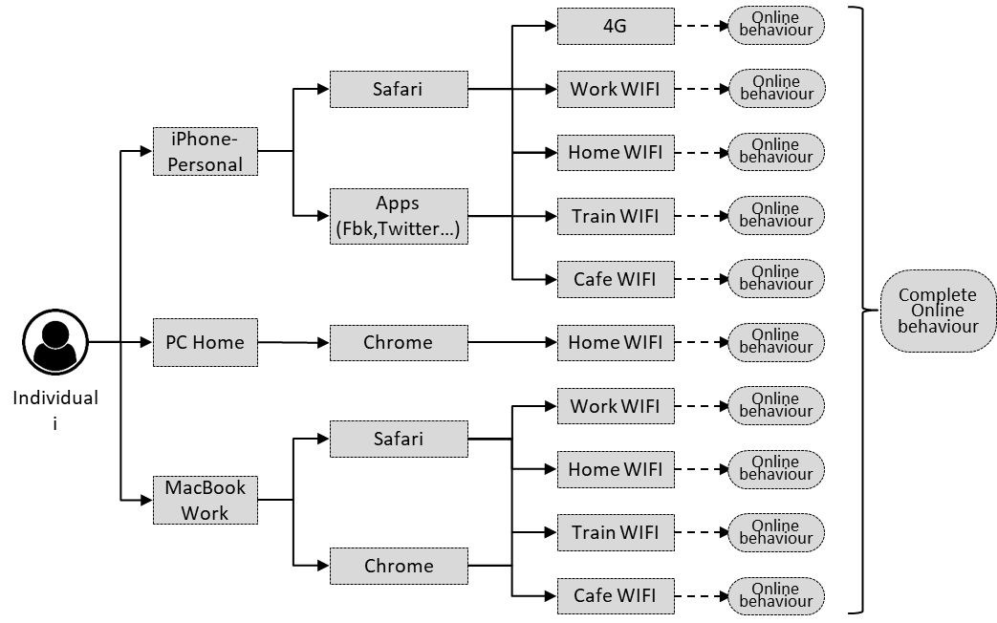
Challenges when using metered data to make inferences for finite populations
RESULTS
How to identify and deal with device & browser undercoverage?

Slide 61
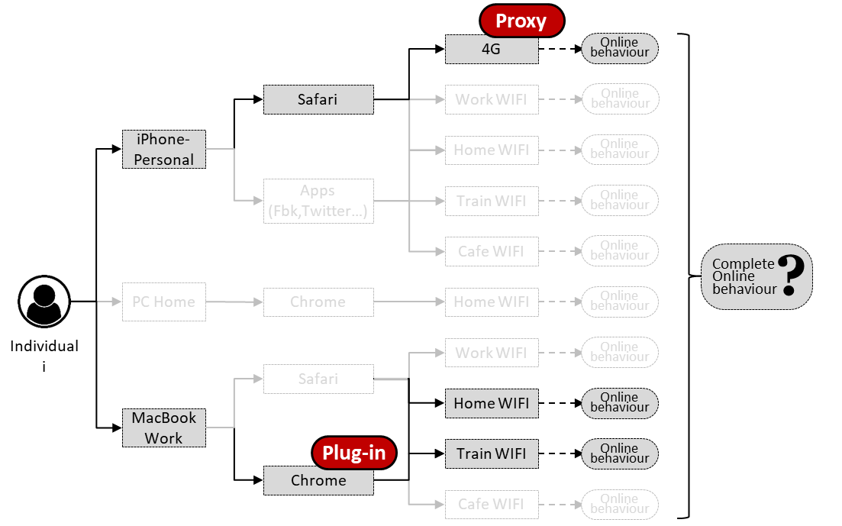
Challenges when using metered data to make inferences for finite populations
RESULTS
How to identify and deal with device & browser undercoverage?

Slide 62
Challenges when using metered data to make inferences for finite populations
RESULTS
How to identify and deal with device & browser undercoverage?
Undercoverage can prevent tracking the complete online behaviour.
Different levels:
Device: at least one device used by a participant is not tracked
Browser: at least one web-browser used by a participant is not tracked
In-app: the behaviours happening inside apps are not tracked.
Network: at least one network from which a participant connect to the Internet is not tracked

Slide 63
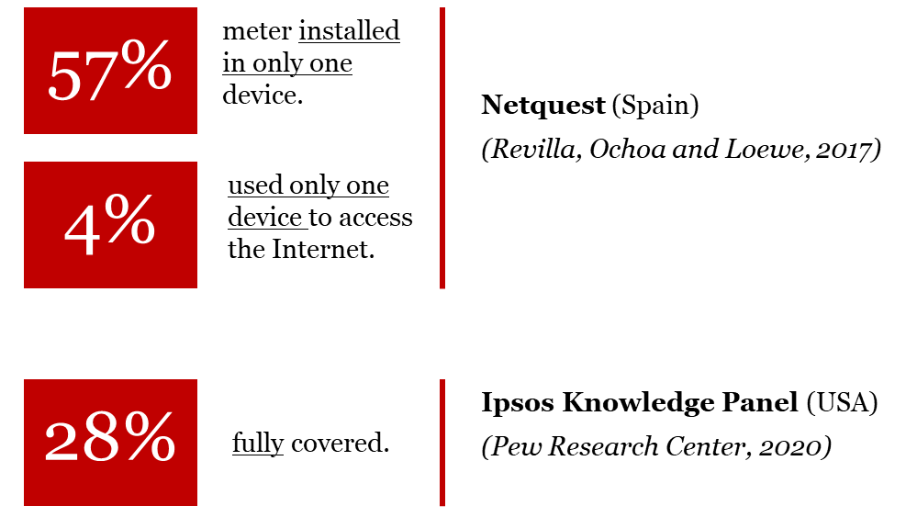
Challenges when using metered data to make inferences for finite populations
RESULTS
How to identify and deal with device & browser undercoverage?

Slide 64
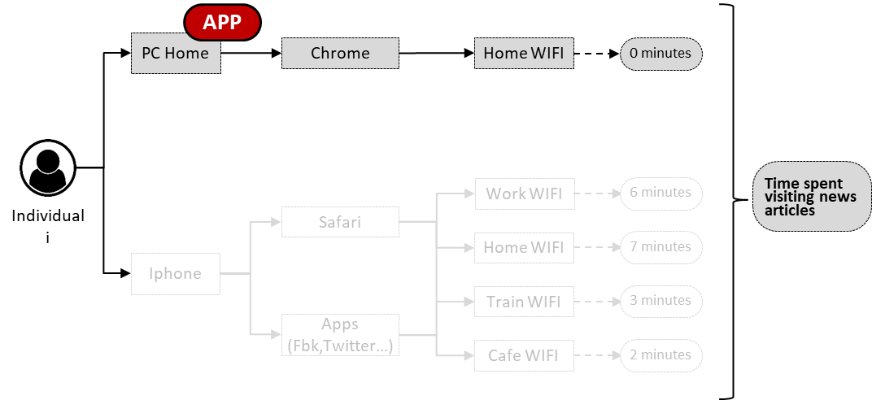
Practical recommendations
RESULTS
How to identify and deal with device & browser undercoverage?

Slide 65
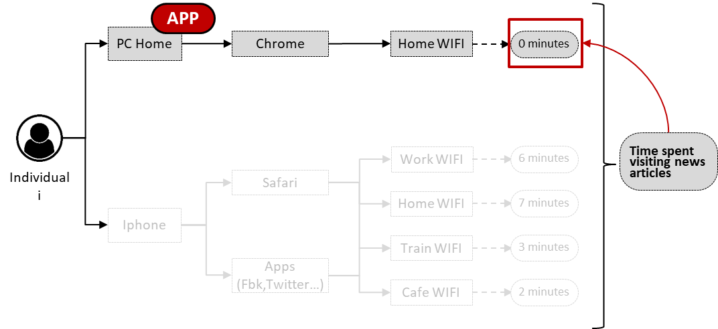
Practical recommendations
RESULTS
How to identify and deal with device & browser undercoverage?

Slide 66
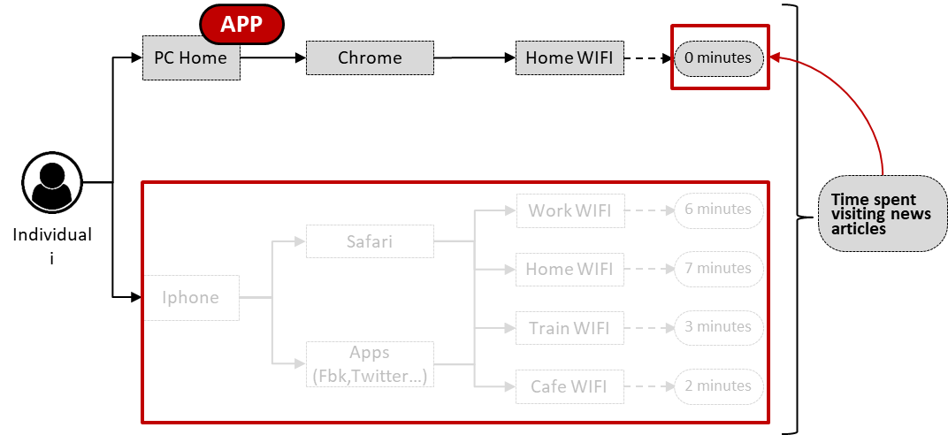
Practical recommendations
RESULTS
How to identify and deal with device & browser undercoverage?

Slide 67
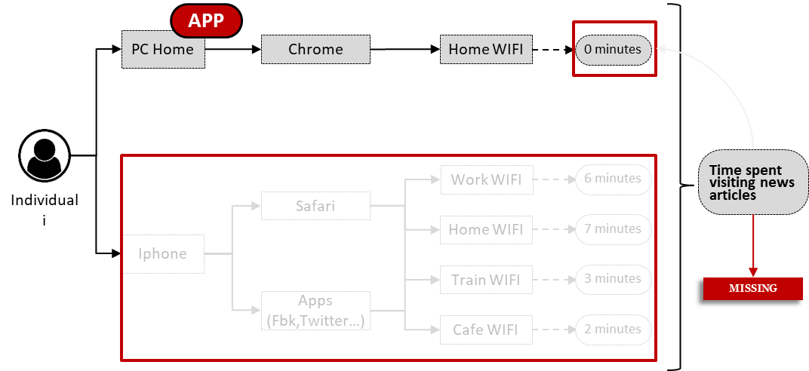
Practical recommendations
RESULTS
How to identify and deal with device & browser undercoverage?

Slide 68
Challenges when using metered data to make inferences for finite populations
RESULTS
Identifying undercoverage – Our approach
Combining survey & paradata

Slide 69
Challenges when using metered data to make inferences for finite populations
RESULTS
Identifying undercoverage – Our approach
Combining survey & paradata

Slide 70
Challenges when using metered data to make inferences for finite populations
RESULTS
Identifying undercoverage – Our approach
Combining survey & paradata

Slide 71
Challenges when using metered data to make inferences for finite populations
RESULTS
Identifying undercoverage – Our approach
Combining survey & paradata

Slide 72
Challenges when using metered data to make inferences for finite populations
RESULTS
Identifying undercoverage – Our approach
Combining survey & paradata
We can compute the proportion of people being undercovered, and how.
We can be transparent reporting it, and explore how this might be affecting our analyses.

Slide 73
Practical recommendations
RESULTS
Deal with undercoverage – Our approach

Slide 74
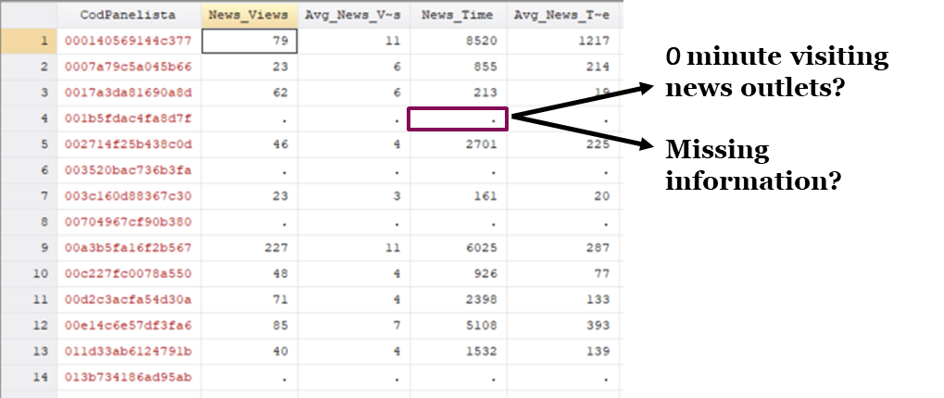
Practical recommendations
RESULTS
Deal with undercoverage – Our approach

Slide 75
Practical recommendations
RESULTS
Deal with undercoverage – Our approach
For those completely covered, we can be quite certain that a lack of behaviour should be considered as 0.
For those partially undercovered, it is still not clear what to do

Slide 76
Practical recommendations
RESULTS
Deal with undercoverage – Our approach
For those completely covered, we can be quite certain that a lack of behaviour should be considered as 0.
For those partially undercovered, it is still not clear what to do
We need more data

Slide 77
Practical recommendations
RESULTS
Deal with undercoverage – Our approach

Slide 78
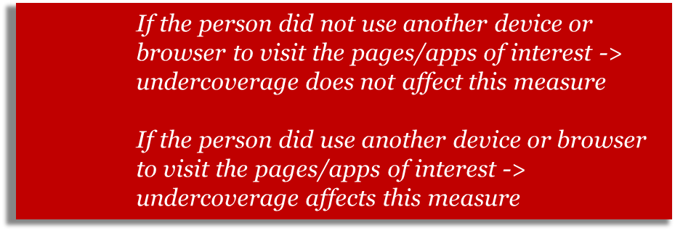
Practical recommendations
RESULTS
Deal with undercoverage – Our approach

Slide 79
Practical recommendations
RESULTS
Deal with undercoverage – Our approach
Most likely cannot be done for every web page/app of interest

Slide 80
CONCLUSIONS
Take-home messages
Using metered data is complex and many decisions must be taken.
Reporting these decisions and conducting robustness checks is necessary.
More empirical research is needed.
This framework can help on all these aspects.

Slide 81
Thanks!
Questions?
Oriol J. Bosch
ORIOL J. BOSCH | THE LONDON SCHOOL OF ECONOMICS / RECSM-UPF
o.bosch-jover@lse.ac.uk
orioljbosch
https://orioljbosch.com/
This project has received funding from the European Research Council (ERC) under the European Union’s Horizon 2020 research and innovation programme (grant agreement No849165), PI: Melanie Revilla

