Slide 1
Surveys or digital trace data, which one should we use? Using MultiTrait-MultiMethod models to simultaneously estimate the measurement quality of surveys and digital trace data.
Oriol J. Bosch| Department of Methodology, LSE & RECSM
Melanie Revilla |Institut Estudis Barcelona Internacional (IBEI)
Patrick Sturgis| Department of Methodology, LSE
Jouni Kuha| Department of Methodology, LSE
o.bosch-jover@lse.ac.uk
orioljbosch
https://orioljbosch.com/
Acknowledgements: I would like to thank Melanie Revilla, Mariano Torcal, Patrick Sturgis and Jouni Kuha
Funding: This project has received funding from the European Research Council (ERC) under the European Unions Horizon 2020 research and innovation programme (grant agreement No 849165; PI: Melanie Revilla); the Spanish Ministry of Science and Innovation under the "R+D+i projects" programme (grant number PID2019-106867RB-I00 /AEI/10.13039/501100011033 (2020-2024), PI: Mariano Torcal); and the BBVA foundation under their grant scheme to scientific research teams in economy and digital society, 2019 (PI: Mariano Torcal).

Slide 2
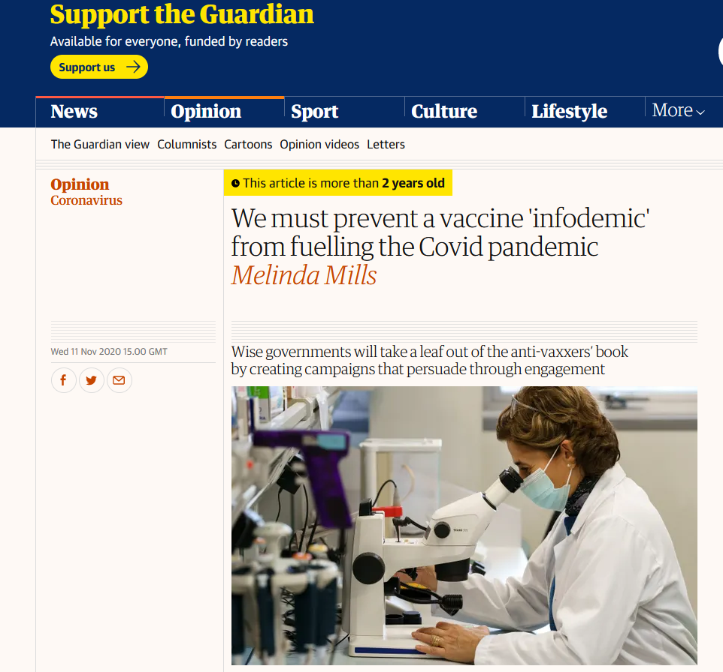
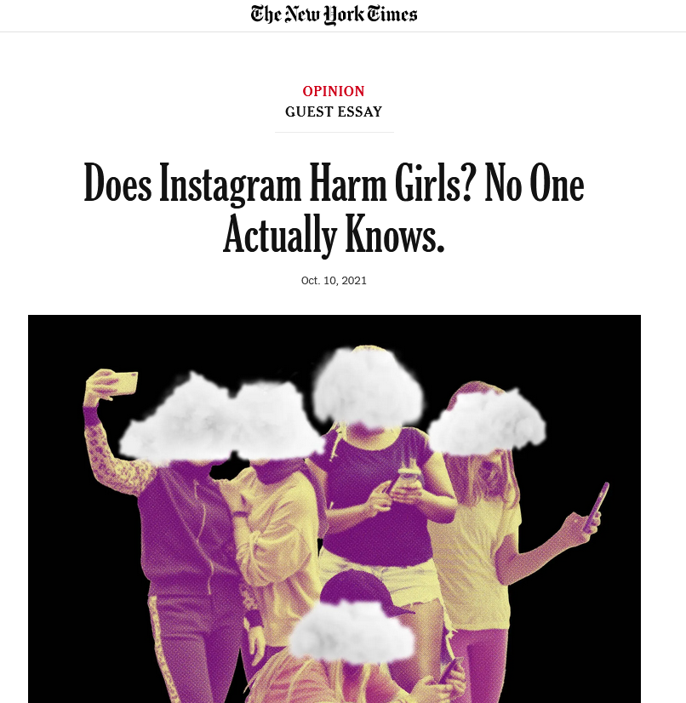
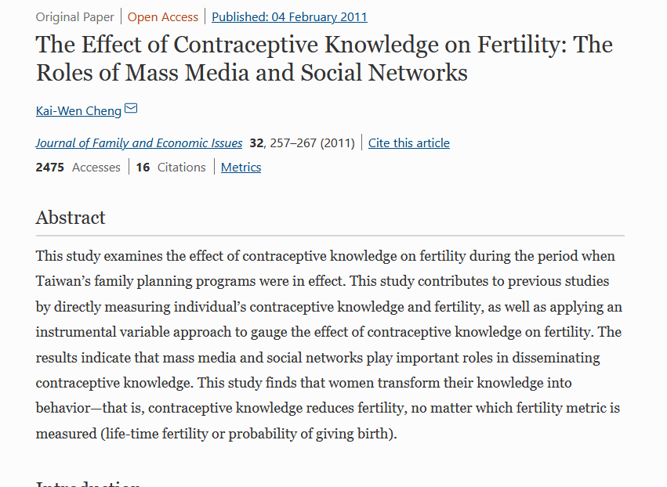
The importance of measuring what people do online
MEASURING WHAT PEOPLE DO ONLINE WITH DIGITAL TARCES
Increased importance of understanding the extent and the type of media/content people are exposed to
As well as its effect on how people think, feel, and behave

Slide 3
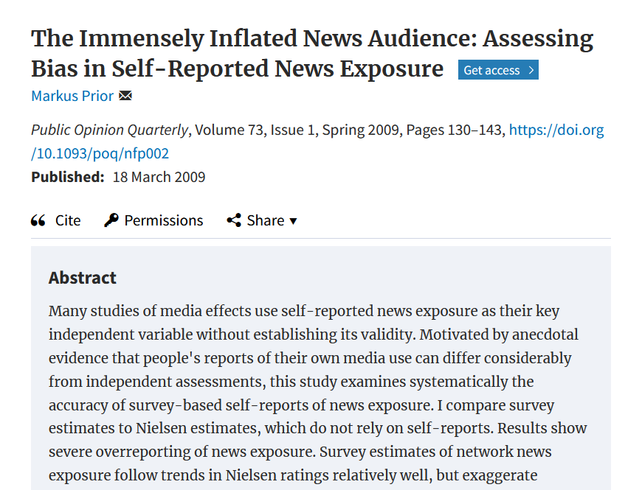
Digital trace data to understand online behaviours
MEASURING WHAT PEOPLE DO ONLINE WITH DIGITAL TARCES
Survey self-reports are still the most common approach

Slide 4
Digital trace data to understand online behaviours
MEASURING WHAT PEOPLE DO ONLINE WITH DIGITAL TARCES
Survey self-reports are still the most common approach
More and more availability of digital traces to directly observe media exposure

Slide 5
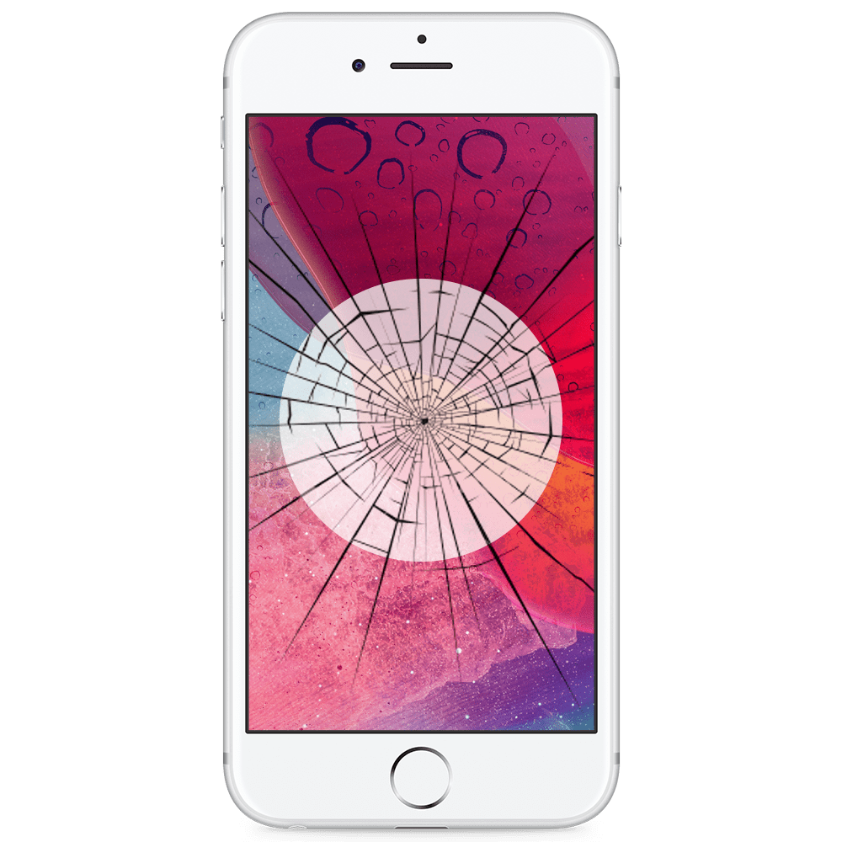
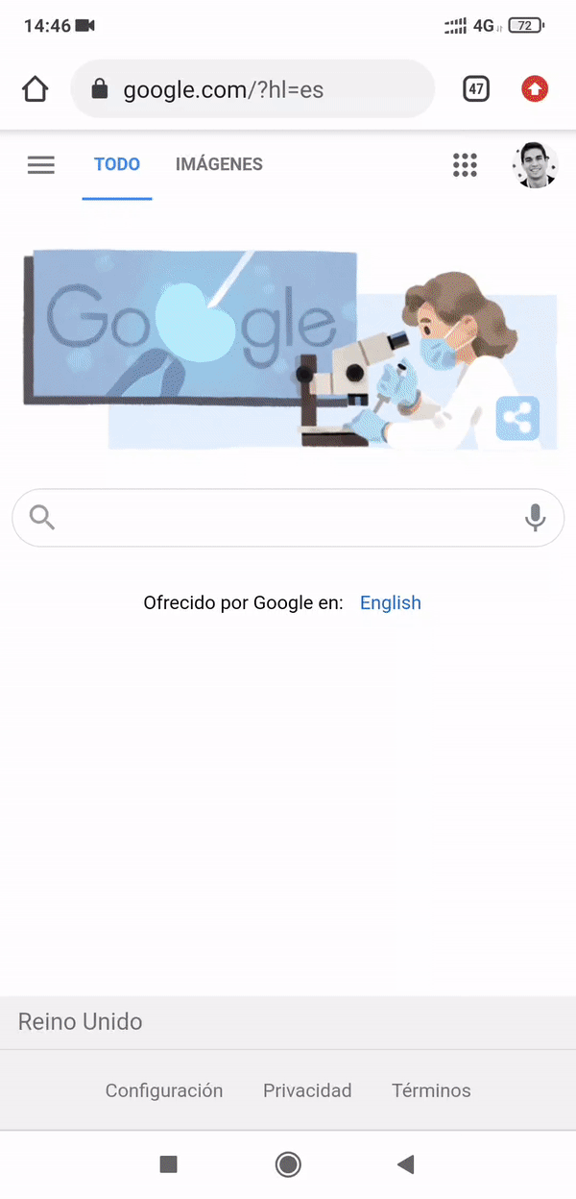
Individual-level approach: web trackers
MEASURING WHAT PEOPLE DO ONLINE WITH DIGITAL TARCES
Direct observations of online behaviours using tracking solutions, or meters.
Group of tracking technologies (plug-ins, apps, proxies, etc)
Installed on participants devices
Collect traces left by participants when interacting with their devices online: URLs, apps visited, cookies…
Great, we will get unbiased measures!

Slide 6
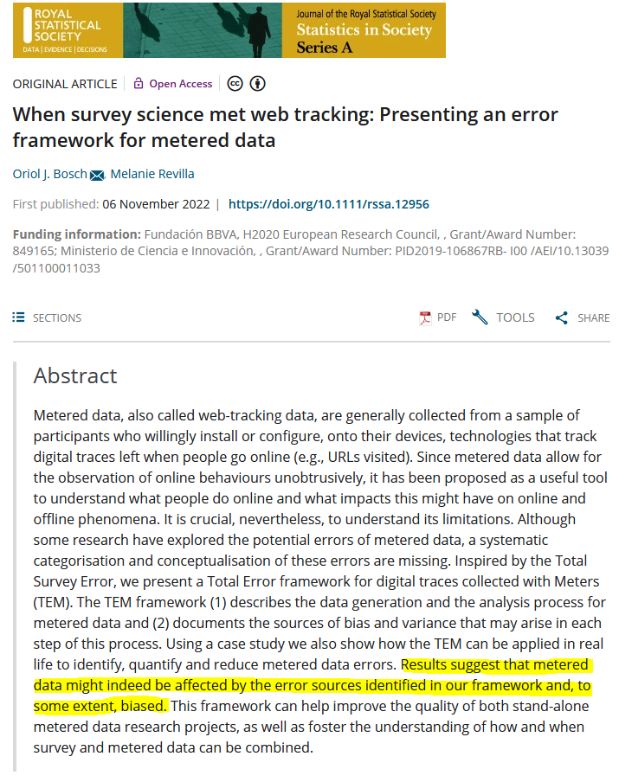
Is web tracking data actually unbiased?
MEASURING WHAT PEOPLE DO ONLINE WITH DIGITAL TARCES
Little but growing evidence that web tracking data is affected by errors

Slide 7
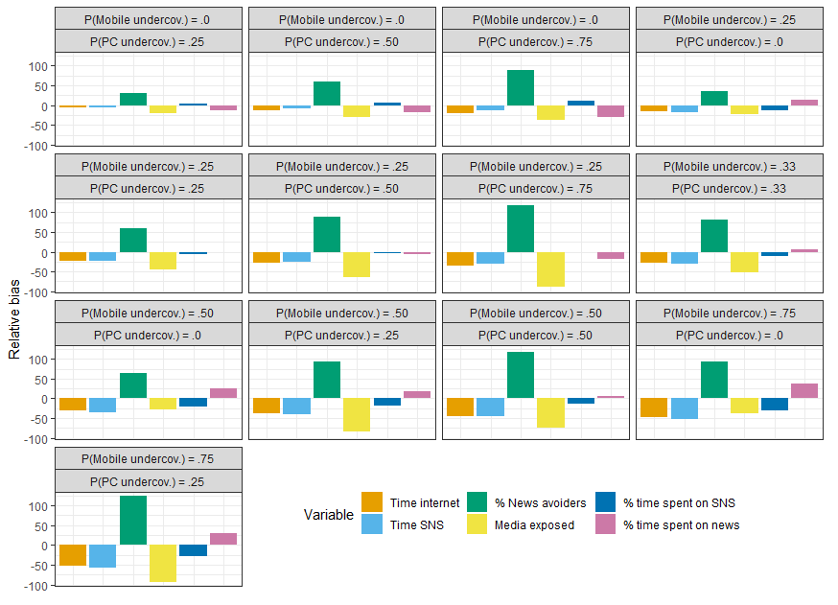
Is web tracking data actually unbiased?
MEASURING WHAT PEOPLE DO ONLINE WITH DIGITAL TARCES
Little but growing evidence that web tracking data is affected by errors
We know that these errors can introduce measurement errors of a considerable size

Slide 8
Is web tracking data actually unbiased?
MEASURING WHAT PEOPLE DO ONLINE WITH DIGITAL TARCES
Little but growing evidence that web tracking data is affected by errors
We know that these errors can introduce measurement errors of a considerable size
But still not near what we know about surveys!

Slide 9
Is web tracking data actually unbiased?
MEASURING WHAT PEOPLE DO ONLINE WITH DIGITAL TARCES
Little but growing evidence that web tracking data is affected by errors
We know that these errors can introduce measurement errors of a considerable size
But still not near what we know about surveys!
My pitch: adapt decades of knowledge in psychometrics and survey methodology to improve how we use digital trace data

Slide 10
Simultaneously estimating the measurement quality of digital trace data and surveys using MultiTrait-MultiMethod (MTMM) models

Slide 11
Measurement quality
SIMULTANEOUSLY ESTIMATING THE MEASUREMENT QUALITY OF DIGITAL TRACE DATA AND SURVEYS USING MULTITRAIT-MULTIMETHOD (MTMM) MODELS
Quality = part of variance explained by the latent concept of interest
→ complement of measurement errors
Quality = reliability x measurement validity
Validity coefficient
Reliability coefficient
Quality = strength of the relationship between the latent concept of interest and the observed answers

Slide 12
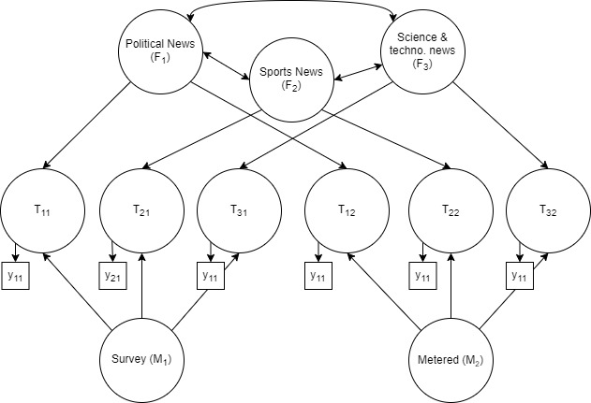
The model
SIMULTANEOUSLY ESTIMATING THE MEASUREMENT QUALITY OF DIGITAL TRACE DATA AND SURVEYS USING MULTITRAIT-MULTIMETHOD (MTMM) MODELS
Residuals are not shown for ease of reading

Slide 13
The model
SIMULTANEOUSLY ESTIMATING THE MEASUREMENT QUALITY OF DIGITAL TRACE DATA AND SURVEYS USING MULTITRAIT-MULTIMETHOD (MTMM) MODELS
Three similar traits
Residuals are not shown for ease of reading

Slide 14
The model
SIMULTANEOUSLY ESTIMATING THE MEASUREMENT QUALITY OF DIGITAL TRACE DATA AND SURVEYS USING MULTITRAIT-MULTIMETHOD (MTMM) MODELS
Three similar traits
Two methods to measure these traits
Residuals are not shown for ease of reading

Slide 15
The model
SIMULTANEOUSLY ESTIMATING THE MEASUREMENT QUALITY OF DIGITAL TRACE DATA AND SURVEYS USING MULTITRAIT-MULTIMETHOD (MTMM) MODELS
Three similar traits
Validity
Reliability
Method effect
Two methods to measure these traits
Residuals are not shown for ease of reading

Slide 16
The model
SIMULTANEOUSLY ESTIMATING THE MEASUREMENT QUALITY OF DIGITAL TRACE DATA AND SURVEYS USING MULTITRAIT-MULTIMETHOD (MTMM) MODELS
Three similar traits
Validity
Others have already considered similar (but different) approaches like this. For example, Oberski and colleagues, for admin & survey data. Or more recently Cernat and colleagues for digital trace data & surveys.
Reliability
Method effect
Two methods to measure these traits
Residuals are not shown for ease of reading

Slide 17
This study

Slide 18
Research questions
THIS STUDY
What is the overall reliability (RQ 1.1) and validity (RQ 1.2) of digital news media exposure measures created using digital traces?
Does the reliability (RQ 2.1) and validity (RQ 2.2) of the digital news media exposure measures fluctuate across design choices?
What design choices have a higher impact on reliability and validity? (RQ 3.1)
To what extent do different design choices affect the reliability and validity of metered data measures? (RQ 3.2)

Slide 19
Research questions
THIS STUDY
What is the overall validity, reliability, method effect and measurement quality of several measurements computed with digital trace data? (RQ.1)
And how do these compare with the quality estimates from equivalent survey questions? (RQ.2)
Does the validity (RQ 2.1) and reliability (RQ 2.2) of the news media exposure measures fluctuate across different measurements?
What design choices increase the validity (RQ 3.1) and reliability (RQ 3.2) of web tracking measures?

Slide 20
Data
THIS STUDY
Survey combined with web tracking data at the individual level
Netquest metered panel in Spain
Cross-quotas: gender, age, and education
Sample size: 1,200
Fieldwork: Late May – Early June 2023
Tracking technologies installed in both mobile and desktop devices
Part of the ERC project WEB DATA OPP

Slide 21
Three differ groups of traits of interest
THIS STUDY
1. News exposure traits
Exposure to news about politics
Exposure to news about sports
Exposure to news about science and technology
2. Communication traits:
Use of social media
Use of instant messaging
Use of e-mails
3. Entertainment traits:
Use of video platforms (YouTube, Vimeo, Twitch)
Use of audio streaming (Spotify, Audible, Apple podcast)
Use of TV/Movie streaming (Netflix, BBC online)

Slide 22
The measurements
THIS STUDY
Survey questions
More specifically, on average, how much time per day do you spend on the Internet reading news and articles...
MC4_1. ... about politics and current affairs?
MC4_1_HH. Hours: [SMALL NUMERIC OPEN BOX] MC4_1_MM. Minutes: [SMALL NUMERIC OPEN]

Slide 23
The measurements
THIS STUDY
Survey questions
Web tracking data
Characteristics | My choices
Metric | Minutes
List of traces
List of media | Tranco
Top media | All
Information | Those identified as specific concept
Exposure
Time threshold | 1 second
Devices | All devices (with or without app)
Tracking period | 31 days

Slide 24
The measurements
THIS STUDY
Survey questions
Web tracking data
I use the log of these measures

Slide 25
Results

Slide 26
Correlation matrix
RESULTS
Web tracking: | Politics | Sports | Science | Social Media | Messages | Emails | Videos | Audio | TV
Survey:
Politics | .17
Sports |  | .33
Science |  |  | .07
Social Media |  |  |  | .41
Messages |  |  |  |  | .14
Emails |  |  |  |  |  | .11
Video |  |  |  |  |  |  | .17
Audio |  |  |  |  |  |  |  | .29
TV |  |  |  |  |  |  |  |  | .34

Slide 27
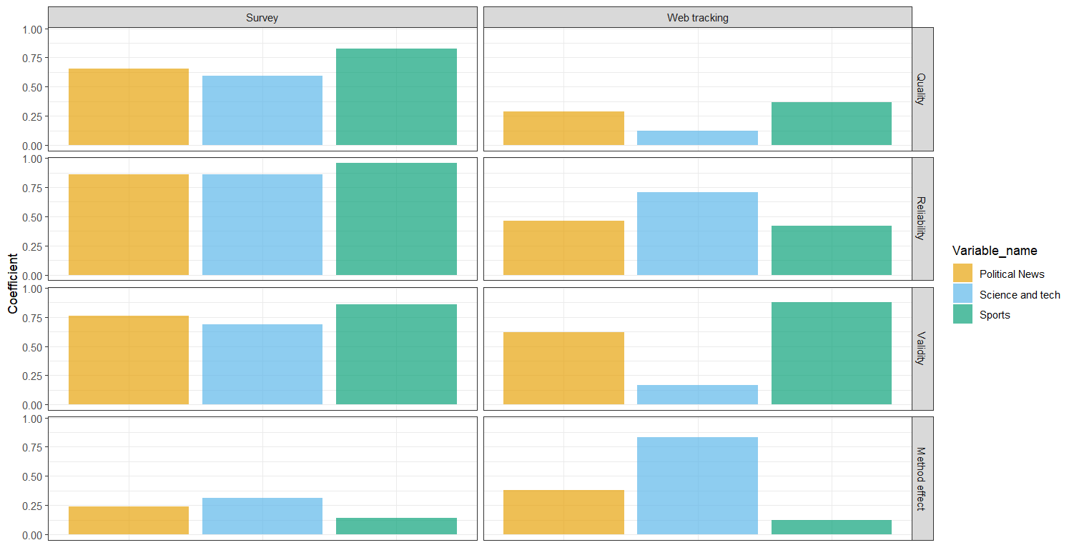
#1 News: quality estimates
RESULTS
.65
.59
.82
.28
.12
.36
.86
.86
.96
.46
.71
.42
.76
.69
.86
.88
.62
.17
.83
.24
.31
.38
.14
.12

Slide 28
#1 News: quality estimates
RESULTS
Faulty identification strategy?
.65
.59
.82
.28
.12
.36
.86
.86
.96
.46
.71
.42
.76
.69
.86
.88
.62
.17
.83
.24
.31
.38
.14
.12

Slide 29
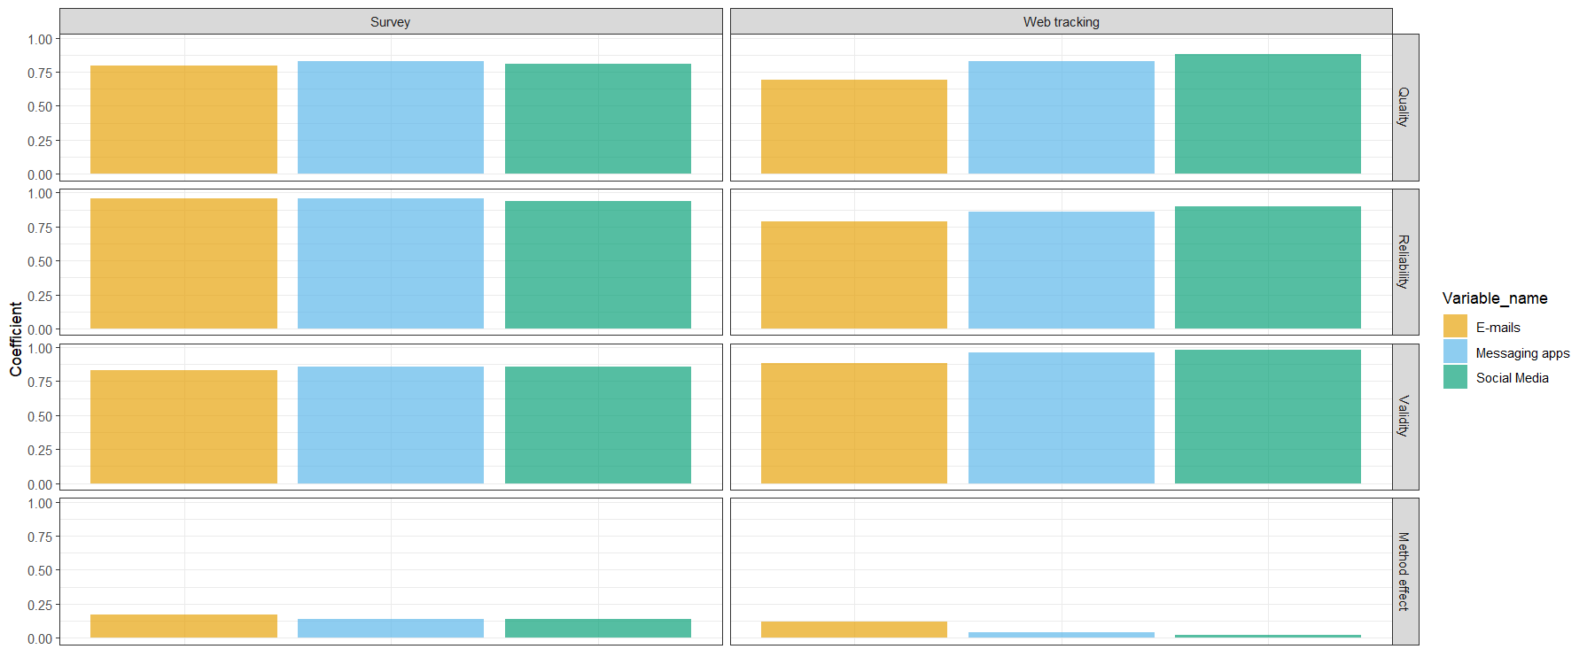
#2 Communication: quality estimates
RESULTS
.80
.83
.81
.83
.88
.70
.96
.96
.94
.79
.90
.86
.83
.86
.86
.88
.96
.98
.83

Slide 30
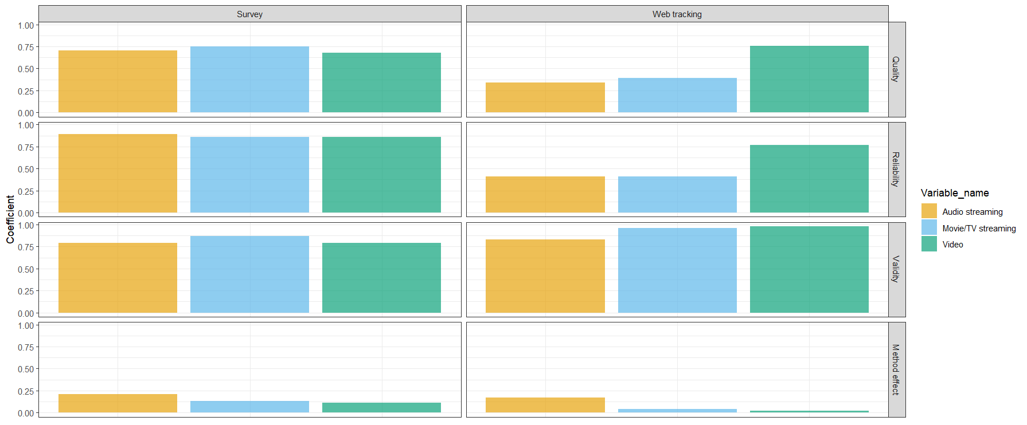
#3 Entertainment: quality estimates
RESULTS
.70
.75
.68
.75
.34
.39
.89
.86
.86
.41
.77
.41
.79
.87
.79
.83
.96
.98
.83

Slide 31
#3 Entertainment: quality estimates
RESULTS
Run background
Untrackable devices
.70
.75
.68
.75
.34
.39
.89
.86
.86
.41
.77
.41
.79
.87
.79
.83
.96
.98
.83

Slide 32
CONCLUSIONS

Slide 33
Take-home messages
CONCLUSIONS
Results put into question the measurement quality of web tracking measurements
Some concepts are measures very accurately: communication and video streaming
While others are extremely off: news media exposure and some entertainment
All in all
Some practical tips
Making inferences using only PCs and Mobile devices should be avoided
Using the 50 most visited news media outlets from any of the most common ranking lists should work fine
Variance explained by trait: +/- 80%
Variance explained by trait: 12-39% !!!

Slide 34
Take-home messages
CONCLUSIONS
Results put into question the measurement quality of web tracking measurements
Some concepts are measures very accurately: communication and video streaming
While others are extremely off: news media exposure and some entertainment
All in all
Some practical tips
Making inferences using only PCs and Mobile devices should be avoided
Using the 50 most visited news media outlets from any of the most common ranking lists should work fine
Variance explained by trait: +/- 80%
Variance explained by trait: 12-39% !!!
Surveys, on the other hand, perform acceptably well. They also struggle more with news, but their quality is never below .50 and generally around .70 (agrees w/ Alwin)

Slide 35
Take-home messages
CONCLUSIONS
Results put into question the measurement quality of web tracking measurements
Some concepts are measures very accurately: communication and video streaming
While others are extremely off: news media exposure and some entertainment
All in all
Some practical tips
Making inferences using only PCs and Mobile devices should be avoided
Using the 50 most visited news media outlets from any of the most common ranking lists should work fine
Even if surprising, some of these results make logical sense when we think about the theory of the potential error causes of web tracking data!
Variance explained by trait: +/- 80%
Variance explained by trait: 12-39% !!!
Surveys, on the other hand, perform acceptably well. They also struggle more with news, but their quality is never below .50 and generally around .70 (agrees w/ Alwin)

Slide 36
The limits of this approach
CONCLUSIONS
VERY preliminary results…take with a pinch of salt
We need to think much more about the MTMM models used, how to fine tune them, and their limitations
Is it biased towards surveys?
Is it of any value if surveys and web tracking do not measure the same to start with?
True score model??
Differential measurement errors!
A world of unexplored opportunities, we can improve how we study:
Digital inequalities
Digital wellbeing
Fertility
The relationship between misinformation and health outcomes
Questionnaire design is complex, and it needs to be evidence-based…same with web tracking data!

Slide 37
Thanks!
Questions?
Oriol J. Bosch| PhD Candidate, The London School of Economics
ORIOL J. BOSCH | THE LONDON SCHOOL OF ECONOMICS / RECSM-UPF
o.bosch-jover@lse.ac.uk
orioljbosch
https://orioljbosch.com/

