Slide 1
Are media exposure measures created with digital trace data any good? An approach to assess and predict the true-score reliability of web tracking data.
o.bosch-jover@lse.ac.uk
orioljbosch
https://orioljbosch.com/
Oriol J. Bosch | Department of Methodology, LSE
Acknowledgements: I would like to thank Melanie Revilla, Mariano Torcal, Patrick Sturgis and Jouni Kuha
Funding: This project has received funding from the European Research Council (ERC) under the European Unions Horizon 2020 research and innovation programme (grant agreement No 849165; PI: Melanie Revilla); the Spanish Ministry of Science and Innovation under the "R+D+i projects" programme (grant number PID2019-106867RB-I00 /AEI/10.13039/501100011033 (2020-2024), PI: Mariano Torcal); and the BBVA foundation under their grant scheme to scientific research teams in economy and digital society, 2019 (PI: Mariano Torcal).

Slide 2
The importance of media exposure
MEASURING MEDIA EXPOSURE WITH DIGITAL TARCES
Increased importance of understanding the extent and the type of media/content people are exposed to
As well as its effect on how people think, feel, and behave

Slide 3
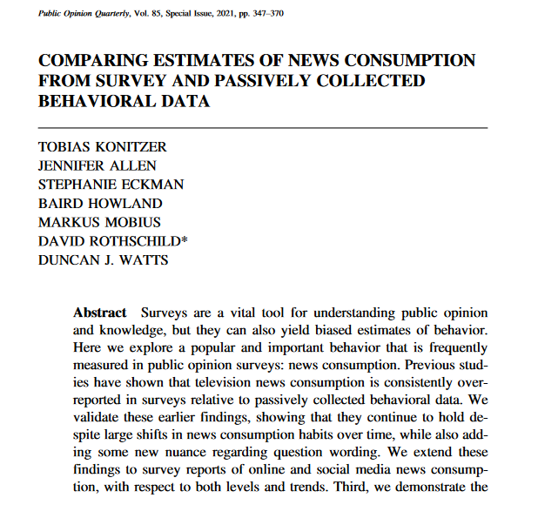
The importance of media exposure
MEASURING MEDIA EXPOSURE WITH DIGITAL TARCES
Increased importance of understanding the extent and the type of media/content people are exposed to
As well as its effect on how people think, feel, and behave
We can now measure this with digital trace data

Slide 4
Individual-level approach: web trackers
MEASURING MEDIA EXPOSURE WITH DIGITAL TARCES
Direct observations of online behaviours using tracking solutions, or meters.
Group of tracking technologies (plug-ins, apps, proxies, etc)
Installed on participants devices
Collect traces left by participants when interacting with their devices online: URLs, apps visited, cookies…
Great, we will get unbiased measures!

Slide 5
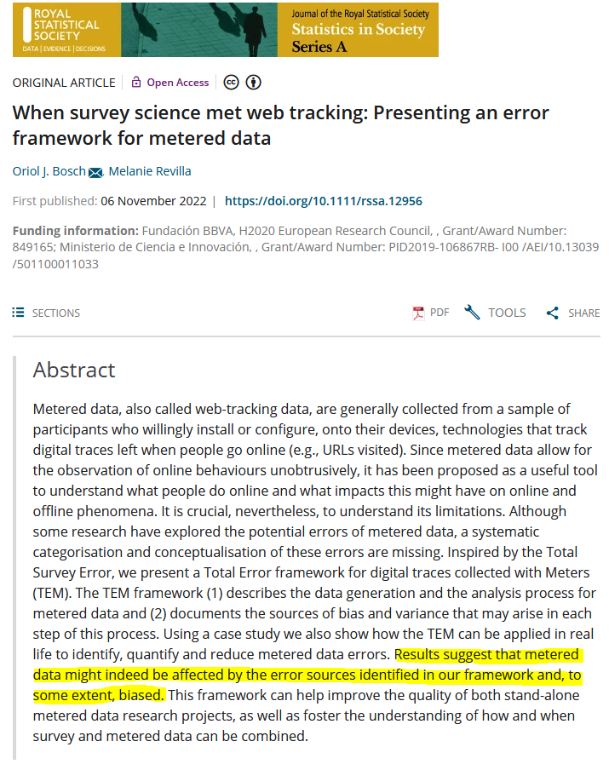
Is web tracking data actually unbiased?
MEASURING MEDIA EXPOSURE WITH DIGITAL TARCES
Little but growing evidence that web tracking data is affected by errors
But still not near what we know about surveys!
My pitch: adapt decades of knowledge in psychometrics and survey methodology to improve how we use digital trace data

Slide 6
Understanding the reliability of web tracking measures

Slide 7
Reliability
RELIABILITY OF MEDIA EXPOSURE MEASRUES CREATED WITH DIGITAL TARCES
Regardless of how valid a measure is, does the observed values reflects the hypothetical true value of our measurement?
True value Observed value
Reliability
Hypothetical value: 5 minutes exposed to misinformation
Observed value: 3 minutes exposed to misinformation

Slide 8
Reliability
RELIABILITY OF MEDIA EXPOSURE MEASRUES CREATED WITH DIGITAL TARCES
Regardless of how valid a measure is, does the observed values reflects the hypothetical true value of our measurement?
True value Observed value
Reliability
Hypothetical value: 5 minutes exposed to misinformation
Observed value: 3 minutes exposed to misinformation
Measurement error
2 minutes of underestimation

Slide 9
This study

Slide 10
Research questions
THIS STUDY
What is the overall reliability of news media exposure measures created using digital traces? (RQ 1)
Does the reliability of the news media exposure measures fluctuate across different measurements? (RQ 2)
What design choices increase the reliability of web tracking measures? (RQ 3)

Slide 11
TRI-POL: the triangle of polarization
THIS STUDY
Three wave survey combined with web tracking data at the individual level (both PC and mobile data)
Netquest metered panels
Cross-quotas: gender, age, education and region
Sample size: 1,289 (Spain)
Spain, Portugal, Italy, Argentina and Chile

Slide 12
Creating the measurements
THIS STUDY
Concept: The extent to which an individual encounters written news media
Online news media exposure

Slide 13
Creating the measurements
THIS STUDY
Concept: The extent to which an individual encounters written news media
Online news media exposure
Task: operationalize this concept into a specific measurement

Slide 14
Creating the measurements
THIS STUDY
Concept: The extent to which an individual encounters written news media
Online news media exposure
Task: operationalize this concept into a specific measurement
Objective: understand the reliability of the whole universe of measurements that could be used to measure this concept, not one single arbitrary measurement
However

Slide 15
Identify the available design choices
THIS STUDY
Characteristics | My choices
List of traces
List of media | Tranco, Alexa, Cisco, Majestic
Top media | 10, 20, 50, 100, 200, All
Information | All URLs, only those identified as political
Exposure
Time threshold | 1 second, 30 seconds, 120 seconds
Devices | PC only, Mobile only, All, All without apps
Tracking period | 2, 5, 10, 15, 31 days

Slide 16
Identify the available design choices
THIS STUDY
Metric: what can best express variation in the “extent”?
Characteristics | My choices
Metric | Visits, Seconds, Days, Media
List of traces
List of media | Tranco, Alexa, Cisco, Majestic
Top media | 10, 20, 50, 100, 200, All
Information | All URLs, only those identified as political
Exposure
Time threshold | 1 second, 30 seconds, 120 seconds
Devices | PC only, Mobile only, All, All without apps
Tracking period | 2, 5, 10, 15, 31 days
In surveys, the reliability is higher for days or media, is it the same for web tracking?

Slide 17
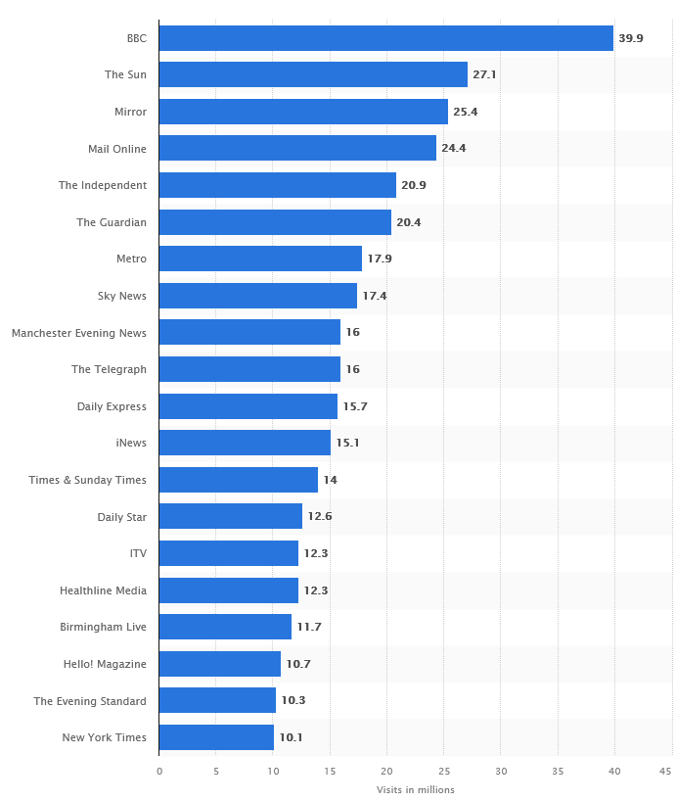
Identify the available design choices
THIS STUDY
List of traces: what is defined as “written news media”?
Characteristics | My choices
Metric | Visits, Seconds, Days, Media
List of traces
List of media | Tranco, Alexa, Cisco, Majestic
Top media | 10, 20, 50, 100, 200, All
Exposure
Time threshold | 1 second, 30 seconds, 120 seconds
Devices | PC only, Mobile only, All, All without apps
Tracking period | 2, 5, 10, 15, 31 days

Slide 18
Identify the available design choices
THIS STUDY
List of traces: what is defined as “written news media”?
Characteristics | My choices
Metric | Visits, Seconds, Days, Media
List of traces
List of media | Tranco, Alexa, Cisco, Majestic
Top media | 10, 20, 50, 100, 200, All
Information | All URLs, only those identified as political
Exposure
Time threshold | 1 second, 30 seconds, 120 seconds
Devices | PC only, Mobile only, All, All without apps
Tracking period | 2, 5, 10, 15, 31 days

Slide 19
Identify the available design choices
THIS STUDY
Exposure: what events can be considered as “exposed”?
Characteristics | My choices
Metric | Visits, Seconds, Days, Media
List of traces
List of media | Tranco, Alexa, Cisco, Majestic
Top media | 10, 20, 50, 100, 200, All
Information | All URLs, only those identified as political
Exposure
Time threshold | 1 second, 30 seconds, 120 seconds
Tracking period | 2, 5, 10, 15, 31 days
Exposure might mean just seeing something, or reading part / all of the article

Slide 20
Identify the available design choices
THIS STUDY
Exposure: what events can be considered as “exposed”?
Characteristics | My choices
Metric | Visits, Seconds, Days, Media
List of traces
List of media | Tranco, Alexa, Cisco, Majestic
Top media | 10, 20, 50, 100, 200, All
Information | All URLs, only those identified as political
Exposure
Time threshold | 1 second, 30 seconds, 120 seconds
Devices | PC only, Mobile only, All, All without apps
Tracking period | 2, 5, 10, 15, 31 days
Most research has focused only on behaviours through PCs, is this right?

Slide 21
Identify the available design choices
THIS STUDY
Tracking period: what time period allows to measure “normality”?
Characteristics | My choices
Metric | Visits, Seconds, Days, Media
List of traces
List of media | Tranco, Alexa, Cisco, Majestic
Top media | 10, 20, 50, 100, 200, All
Information | All URLs, only those identified as political
Exposure
Time threshold | 1 second, 30 seconds, 120 seconds
Devices | PC only, Mobile only, All, All without apps
Tracking period | 2, 5, 10, 15, 31 days
Longer tracking periods might be better, but also more expensive

Slide 22
Identify the available design choices
THIS STUDY
Characteristics | My choices
Metric | Visits, Seconds, Days, Media
List of traces
List of media | Tranco, Alexa, Cisco, Majestic
Top media | 10, 20, 50, 100, 200, All
Information | All URLs, only those identified as political
Exposure
Time threshold | 1 second, 30 seconds, 120 seconds
Devices | PC only, Mobile only, All, All without apps
Tracking period | 2, 5, 10, 15, 31 days
Number of visits, lasting 1 second or more, to the political articles in the top 50 most popular news websites according to Alexa, through PCs, during the last 15 days

Slide 23
Identify the available design choices
THIS STUDY
Characteristics | My choices
Metric | Visits, Seconds, Days, Media
List of traces
List of media | Tranco, Alexa, Cisco, Majestic
Top media | 10, 20, 50, 100, 200, All
Information | All URLs, only those identified as political
Exposure
Time threshold | 1 second, 30 seconds, 120 seconds
Devices | PC only, Mobile only, All, All without apps
Tracking period | 2, 5, 10, 15, 31 days
8,070 potential variables*
* Not 100% fully crossed. The time metric is not crossed with the 30 seconds and 120 seconds thresholds.

Slide 24
Identify the available design choices
THIS STUDY
Characteristics | My choices
Metric | Visits, Seconds, Days, Media
List of traces
List of media | Tranco, Alexa, Cisco, Majestic
Top media | 10, 20, 50, 100, 200, All
Information | All URLs, only those identified as political
Exposure
Time threshold | 1 second, 30 seconds, 120 seconds
Devices | PC only, Mobile only, All, All without apps
Tracking period | 2, 5, 10, 15, 31 days
8,070 potential variables*
I created all the potential variables
Analyses are computed for each of the 8,070
This would take years and innumerable resources to be replicated for surveys!
* Not 100% fully crossed. The time metric is not crossed with the 30 seconds and 120 seconds thresholds.

Slide 25
Analytical approach

Slide 26
Assessing the reliability and its fluctuations (RQ 1 & 2)
ANALYTICAL APPROACH
I focus on the true-score (TS) reliability

Slide 27
Assessing the reliability and its fluctuations (RQ 1 & 2)
ANALYTICAL APPROACH
I focus on the true-score (TS) reliability
Is the measure consistent across multiple observations?
If we account for the changes in the true value across waves, the true values should be stable independently of when we measure them

Slide 28
Assessing the reliability and its fluctuations (RQ 1 & 2)
ANALYTICAL APPROACH
I use the Quasi-Markov Simplex Model, which allows separating reliability from stability
E_{w1}
E_{w2}
E_{w3}
Observed value at wave i
Measurement errors at wave i
Y_{w1}
Y_{w2}
Y_{w3}
True score at wave i
T_{w1}
T_{w2}
T₃
True score change over time
Z_{w2}
Z_{w3}
Heise, D. R. (1969). Separating reliability and stability in test-retest correlation. American sociological review, 93-101.
Alwin, D. F. (2007). Margins of error: A study of reliability in survey measurement. John Wiley & Sons.

Slide 29
Assessing the reliability and its fluctuations (RQ 1 & 2)
ANALYTICAL APPROACH
I use the Quasi-Markov Simplex Model, which allows separating reliability from stability
E_{w1}
E_{w2}
E_{w3}
Observed value at wave i
Measurement errors at wave i
Y_{w1}
Y_{w2}
Y_{w3}
True score at wave i
T_{w1}
T_{w2}
T₃
True score change over time
Z_{w2}
Z_{w3}
With 3 waves change can be accounted for

Slide 30
Assessing the reliability and its fluctuations (RQ 1 & 2)
ANALYTICAL APPROACH
I use the Quasi-Markov Simplex Model, which allows separating reliability from stability
E_{w1}
E_{w2}
E_{w3}
Observed value at wave i
Measurement errors at wave i
Y_{w1}
Y_{w2}
Y_{w3}
Reliability
True score at wave i
T_{w1}
T_{w2}
T₃
True score change over time
Z_{w2}
Z_{w3}
With 3 waves change can be accounted for

Slide 31
Assessing the reliability and its fluctuations (RQ 1 & 2)
ANALYTICAL APPROACH
I use the Quasi-Markov Simplex Model, which allows separating reliability from stability
E_{w1}
E_{w2}
E_{w3}
Y_{w1}
Y_{w2}
Y_{w3}
Reliability
T_{w1}
T_{w2}
T₃
8,070 unique coefficients*
Z_{w2}
Z_{w3}
RQ1.2: What is the average?
RQ2.2: Does it fluctuate?
*Computed using Heise’s approach. Underlying correlation matrix created with using latent correlations for mixed data types,
to account for the truncated and zero inflated nature of media exposure variables

Slide 32
The impact of design choices on reliability & validity (RQ 3)
ANALYTICAL APPROACH

Slide 33
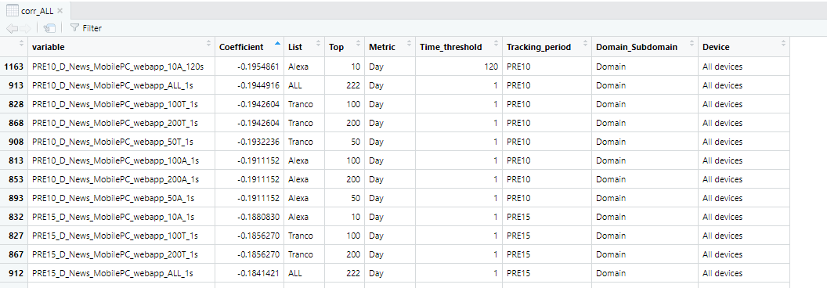
The impact of design choices on reliability & validity (RQ 3)
ANALYTICAL APPROACH
After running the reliability analyses, I created a new dataset, with the following:
Name of the variables
Associated reliability coefficient
Design choices of the specific variable, for each design characteristic

Slide 34
The impact of design choices on reliability & validity (RQ 3)
ANALYTICAL APPROACH
After running the reliability analyses, I created a new dataset, with the following:
Name of the variables
Associated reliability coefficient
Design choices of the specific variable, for each design characteristic
With this dataset it is possible to model the effect of each design choice on the estimated reliability, using the 8,070 variables as observations

Slide 35
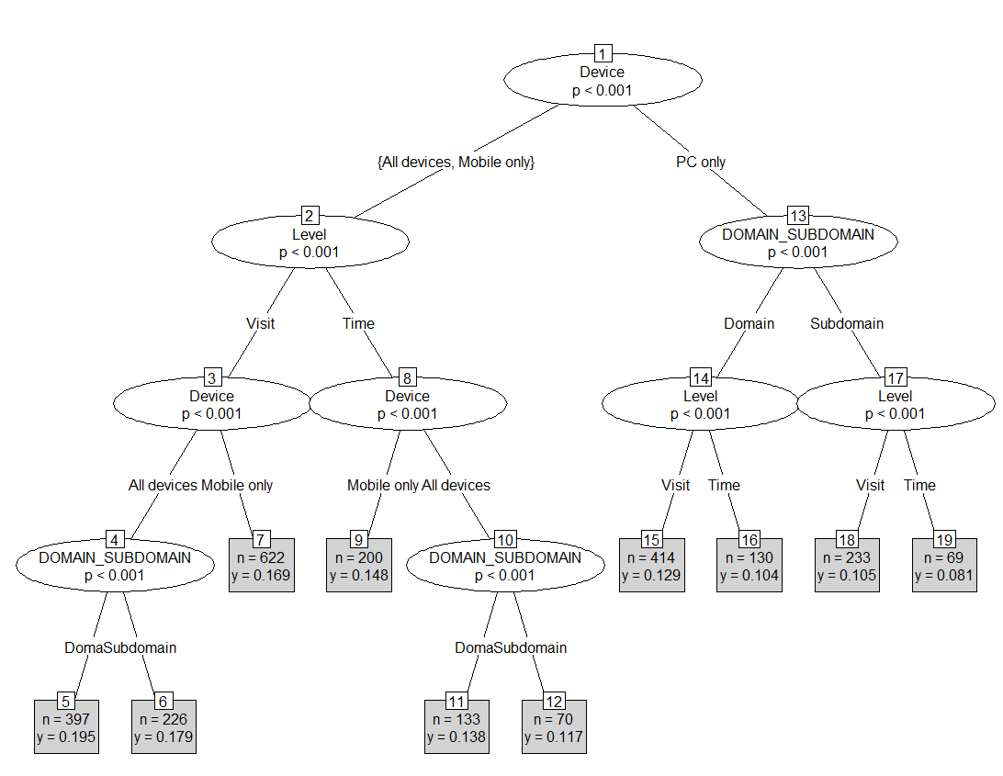
The impact of design choices on reliability & validity (RQ 3)
ANALYTICAL APPROACH
To predict the impact of each design choice, we used random forests of regression trees*
* R package randomForest: Ntree: 500 | Mtry: 4 | Node size: 3 | Sample fraction: 80%

Slide 36
The impact of design choices on reliability & validity (RQ 3)
ANALYTICAL APPROACH
To predict the impact of each design choice, we used random forests of regression trees*
I extract the following information:
The variable importance: % increase of MSE
And the marginal effect of each choice
* R package randomForest: Ntree: 500 | Mtry: 4 | Node size: 3 | Sample fraction: 80%

Slide 37
What is the overall reliability of digital news media exposure created with digital traces? (RQ1) And does it fluctuate across design choices? (RQ2)

Slide 38
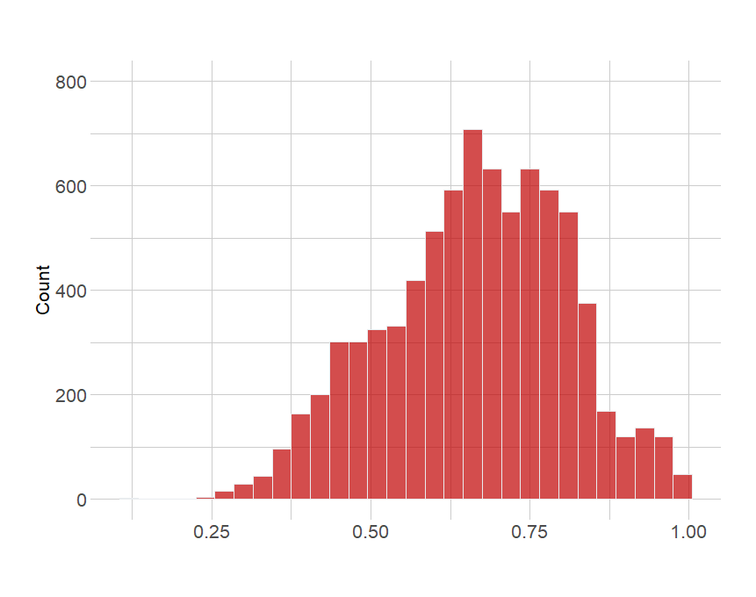
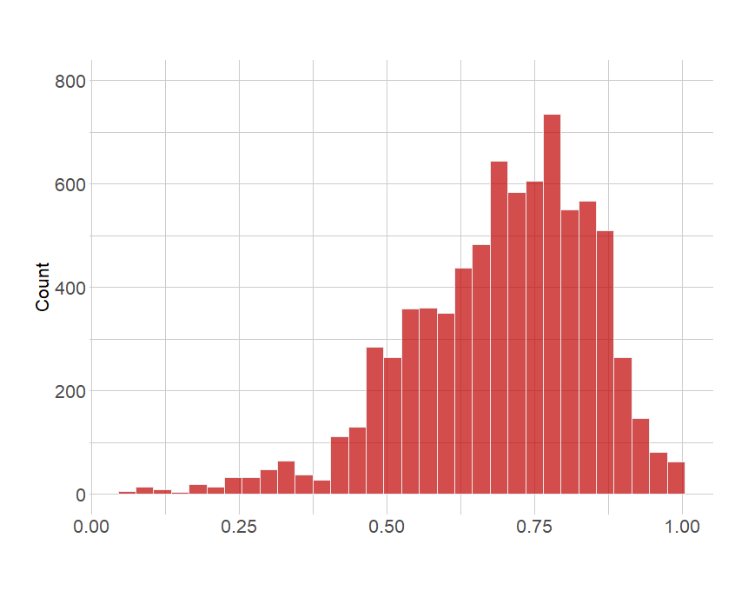
TS Reliability across different specifications
RELIABILITY
SPAIN
PORTUGAL
Self report: 0.80
Self report: 0.80
Mean: .66
Media: .67
1st Quart: .57
3rd Quart: .77
Mean: .69
Media: .71
1st Quart: .60
3rd Quart: .81

Slide 39
TS Reliability across different specifications
RELIABILITY
SPAIN
PORTUGAL
Self report: 0.80
Self report: 0.80
The reliability ranges from questionable to acceptable
On average, 31-34% of the variance of the measures are due to errors
High fluctuation, perfection can be achieved, as well as very unacceptable
Mean: .66
Media: .67
1st Quart: .57
3rd Quart: .77
Mean: .69
Media: .71
1st Quart: .60
3rd Quart: .81

Slide 40
What design choices increase the reliability of web tracking measures? (RQ 3)

Slide 41
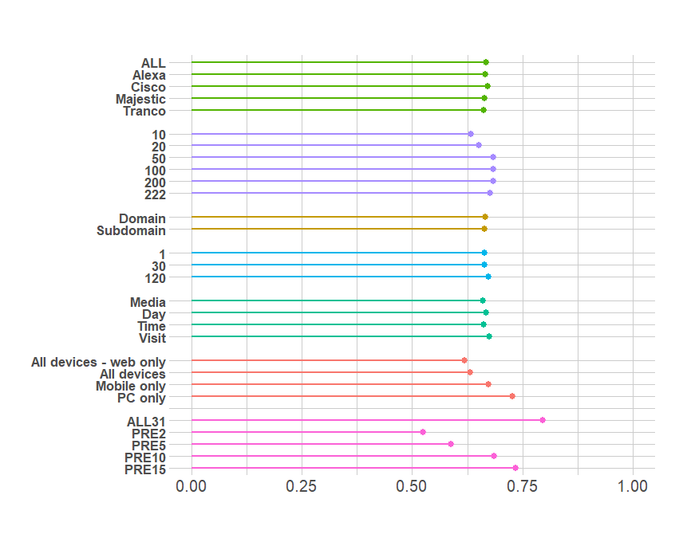
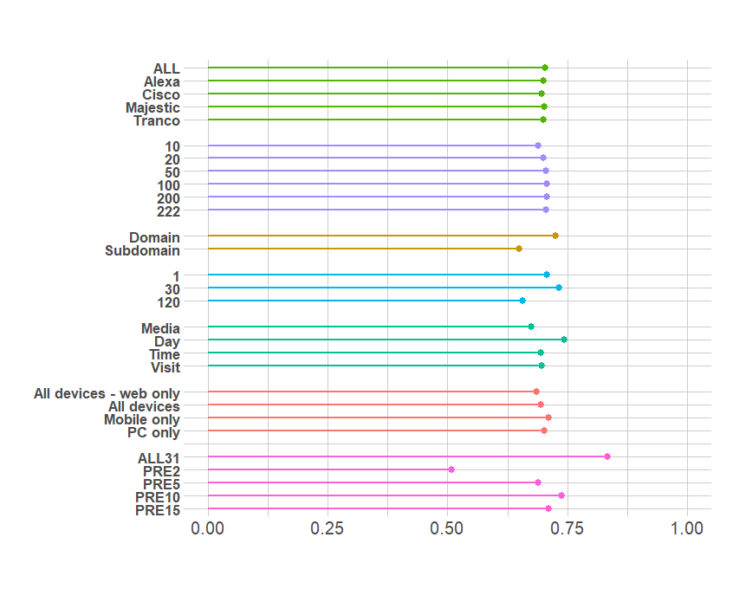
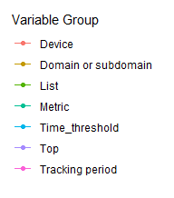
Marginal reliability for each design choice
RELIABILITY
SPAIN
PORTUGAL
Marginal TS Reliability
Marginal TS Reliability
Indicates variable with the highest % increase of Mean Squared Error when excluded from the model

Slide 42
Marginal reliability for each design choice
RELIABILITY
SPAIN
PORTUGAL
Marginal TS Reliability
Marginal TS Reliability
The more days, the more stable the measures. Normality is key across countries
Indicates variable with the highest % increase of Mean Squared Error when excluded from the model

Slide 43
Marginal reliability for each design choice
RELIABILITY
SPAIN
PORTUGAL
Marginal TS Reliability
Marginal TS Reliability
The other choices are less stable across countries. In Spain only looking at PCs is best but does not change much in Portugal. Same with the number of media outlets.
Indicates variable with the highest % increase of Mean Squared Error when excluded from the model

Slide 44
CONCLUSIONS

Slide 45
Take-home messages
CONCLUSIONS
Overall, the reliability of the measures is average (30% of the variance due to errors)
All in all
Some practical tips
Making inferences using only PCs and Mobile devices should be avoided
Using the 50 most visited news media outlets from any of the most common ranking lists should work fine.
10 to 15 days of tracking before the survey seems to be a sensible choice

Slide 46
Take-home messages
CONCLUSIONS
Overall, the reliability of the measures is average (30% of the variance due to errors)
All in all, web tracking measures of media exposure are affected by errors.
We should question its gold standard status.
Questionnaire design is complex, and it needs to be evidence-based…same with web tracking data!

Slide 47
The bigger picture
CONCLUSIONS
I am optimistic! Errors should always be expected, this does not discredit digital trace data
The paper shows that we can (1) understand these errors, (2) quantify them, and (3) identify which design decision might produce the highest reliability…
…in a faster and more efficient way than with surveys!
A world of unexplored opportunities, we can improve how we study:
Digital inequalities
Digital wellbeing
Fertility
The relationship between misinformation and health outcomes
Questionnaire design is complex, and it needs to be evidence-based…same with web tracking data!

Slide 48
The bigger picture
CONCLUSIONS
I am optimistic! Errors should always be expected, this does not discredit digital trace data
The paper shows that we can (1) understand these errors, (2) quantify them, and (3) identify which design decision might produce the highest reliability…
…in a faster and more efficient way than with surveys!
A world of unexplored opportunities, we can improve how we study:
Digital inequalities
Digital wellbeing
Fertility
The relationship between misinformation and health outcomes
Questionnaire design is complex, and it needs to be evidence-based…same with web tracking data!

Slide 49
The bigger picture
CONCLUSIONS
I am optimistic! Errors should always be expected, this does not discredit digital trace data
The paper shows that we can (1) understand these errors, (2) quantify them, and (3) identify which design decision might produce the highest reliability…
…in a faster and more efficient way than with surveys!
A world of unexplored opportunities, we can improve how we study:
Digital inequalities
Digital wellbeing
Fertility
The relationship between misinformation and health outcomes
Questionnaire design is complex, and it needs to be evidence-based…same with web tracking data!
By helping researchers use digital trace data in the best possible way, we can foster our understanding of these pressing issues

Slide 50
Thanks!
Questions?
Oriol J. Bosch| PhD Candidate, The London School of Economics
ORIOL J. BOSCH | THE LONDON SCHOOL OF ECONOMICS / RECSM-UPF
o.bosch-jover@lse.ac.uk
orioljbosch
https://orioljbosch.com/

Slide 51
Heise’s approach
APPENDIX
The (Quasi-Markov) Simplex Model
Corr(Y_{w2},Y_{w3})
Heise’s approach
$$\frac{\text{Corr}\text{(}\text{Y}\text{w}\text{1,}\text{Y}\text{w}\text{2}\text{)}∗\text{Corr}\text{(}\text{Y}\text{w}\text{2,}\text{Y}\text{w}\text{3}\text{)} }{\text{Corr}\text{(}\text{Y}\text{w}\text{1,}\text{Y}\text{w}\text{3}\text{)} }$$
Y_{w1}
Y_{w2}
Y_{w3}
Corr(Y_{w1},Y_{w2})
TS Reliability =
Corr(Y_{w1},Y_{w3})

Slide 52
Main Heise’s assumptions
APPENDIX
Measurement errors are not correlated across waves
Reliability is constant across time periods
True score change is not correlated in times 2 and 3, and not correlated with true score at time 1
Questionnaire design is complex, and it needs to be evidence-based…same with web tracking data!

Slide 53
On the breach of assumptions
APPENDIX
As discussed by Prior (2013) and Torangeau, Sun and Yan (2021) breaching the assumptions when calculating TS Reliability, if anything, should inflate the reliability estimates, not deflate.
Systematic & correlated measurement errors would inflate underlying correlation matrix

Slide 54
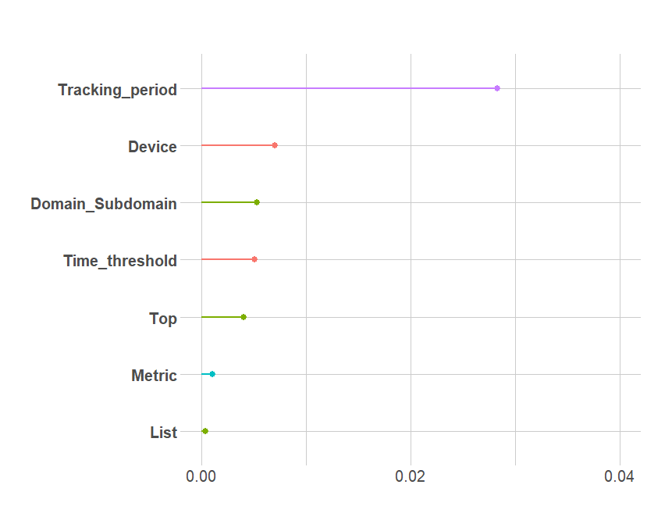
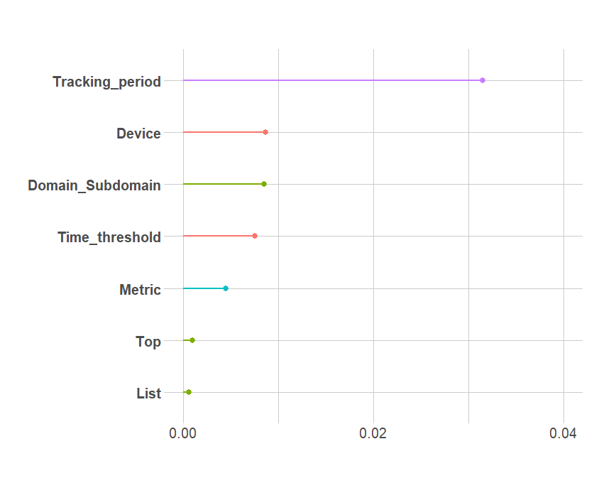
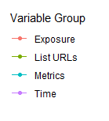
The importance of each design choice on reliability
APPENDIX
SPAIN
PORTUGAL
% increase of Mean Squared Error
% increase of Mean Squared Error
* These results agree with the conditional (unbiased) important measures from cforest

Slide 55
The importance of each design choice on reliability
APPENDIX
SPAIN
PORTUGAL
% increase of Mean Squared Error
% increase of Mean Squared Error
The number of days of information used is the best predictor, across countries

Slide 56
The importance of each design choice on reliability
APPENDIX
SPAIN
PORTUGAL
% increase of Mean Squared Error
% increase of Mean Squared Error
The device, type of information, and way of defining exposure also matter

Slide 57
Model’s performance
APPENDIX
Predictive validity
Spain:
Variance explained: 86%
Mean Squared Residuals: .0002633571
Portugal:
Variance explained: 93%
Mean Squared Residuals: .0005002027
TS Reliability
Spain:
Variance explained: 90%
Mean Squared Residuals: .001975801
Portugal:
Variance explained: 92%
Mean Squared Residuals: .002011027
Questionnaire design is complex, and it needs to be evidence-based…same with web tracking data!

