Slide 1
When survey science met online tracking: Presenting an error framework for metered data
Oriol J. Bosch | THE LONDON SCHOOL OF ECONOMICS / RECSM-UPF
Melanie Revilla | RECSM-UPF
ORIOL J. BOSCH | THE LONDON SCHOOL OF ECONOMICS / RECSM-UPF
o.bosch-jover@lse.ac.uk
orioljbosch
https://orioljbosch.com/
This project has received funding from the European Research Council (ERC) under the European Union’s Horizon 2020 research and innovation programme (grant agreement No849165), PI: Melanie Revilla

Slide 2
Tracking online behaviours using a meter
INTRODUCTION
Definition
Metered data is obtained from a meter willingly installed or configured by a sample of participants on their devices (PCs, tablets and/or smartphones).
A meter refers to a heterogeneous group of tracking technologies that allow sharing with the researchers, at least, information about the URLs of the web pages visited by the participants.

Slide 3
Tracking online behaviours using a meter
INTRODUCTION
Definition
Metered data is obtained from a meter willingly installed or configured by a sample of participants on their devices (PCs, tablets and/or smartphones).
A meter refers to a heterogeneous group of tracking technologies that allow sharing with the researchers, at least, information about the URLs of the web pages visited by the participants.

Slide 4
Tracking online behaviours using a meter
INTRODUCTION
Benefits of metered data
Objective and free of recall errors
Continuously collected in real time
Pre-designed sample of participants

Slide 5
Metered data in past research
BACKGROUND
33 papers identified, 26 since 2019
Notes:
Another lit review identified 42 papers gathering web and/or device log data with approaches that cannot be defined as metered data.

Slide 6
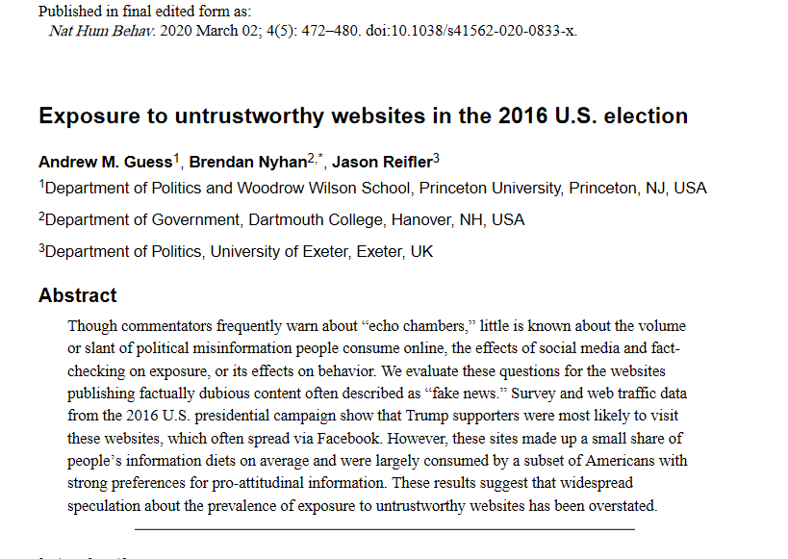
Metered data in past research
BACKGROUND
33 papers identified, 26 since 2019
Notes:
Another lit review identified 42 papers gathering web and/or device log data with approaches that cannot be defined as metered data.

Slide 7
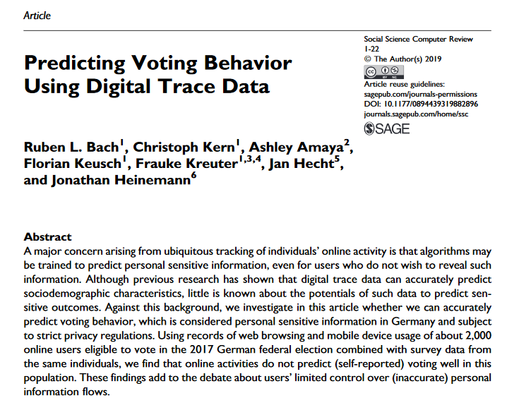
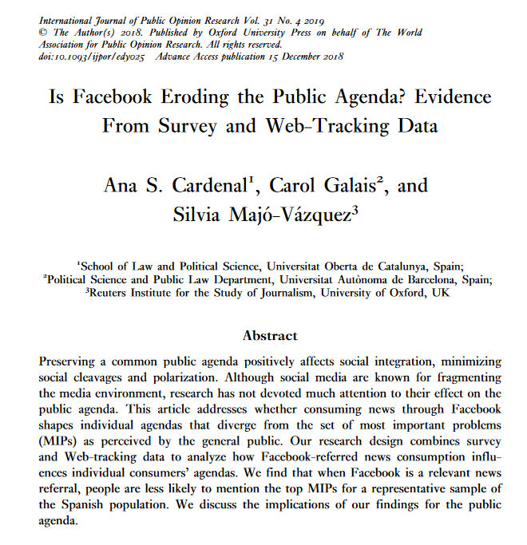
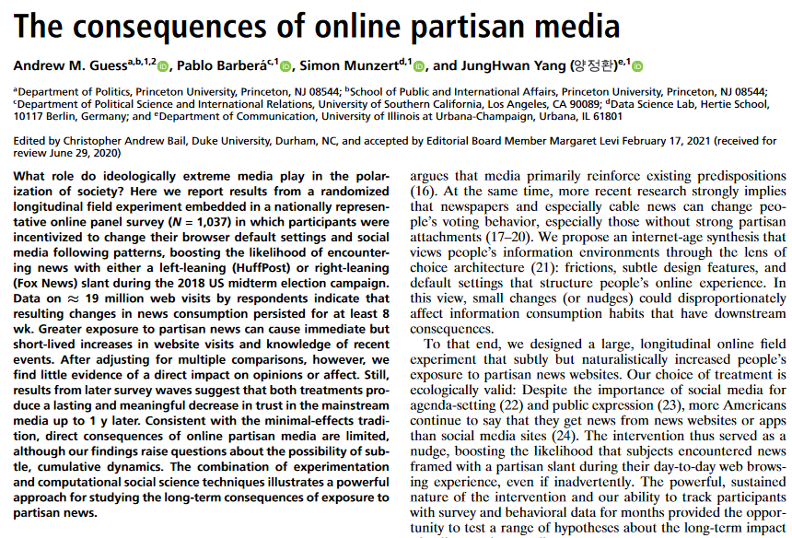
Metered data in past research
BACKGROUND
BACKGROUND
33 papers identified, 26 since 2019
Mostly substantive applications (24) in the fields of political science and communication and digital journalism research.
Published in outlets like PNAS, Nature, the American Political Science Review or the American Journal of Political Science.
Notes:
Another lit review identified 42 papers gathering web and/or device log data with approaches that cannot be defined as metered data.

Slide 8
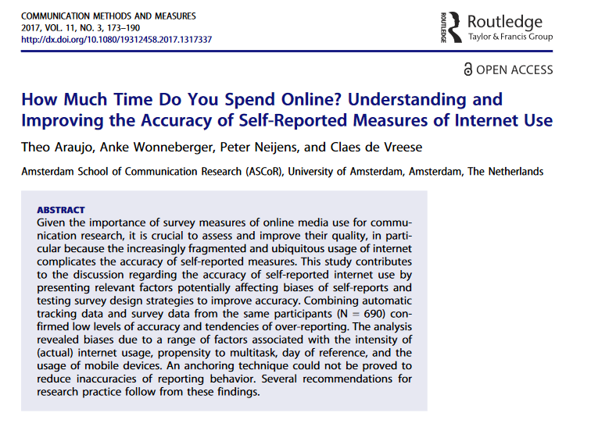
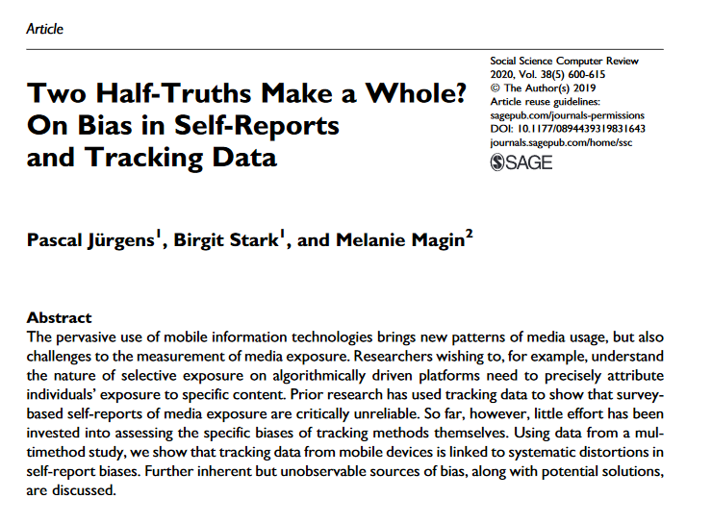
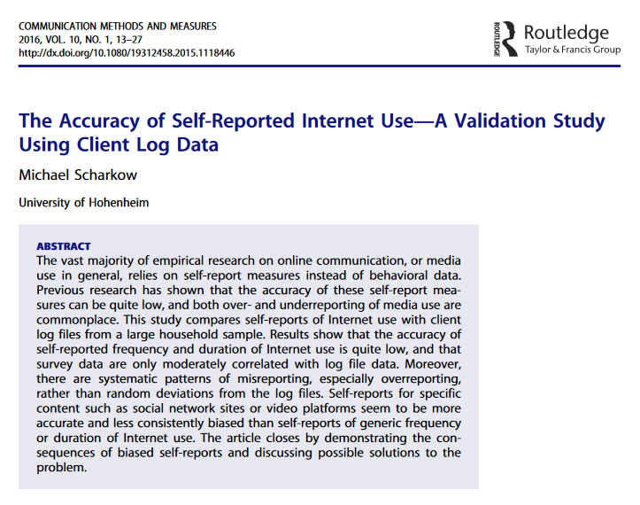
Metered data in past research
BACKGROUND
BACKGROUND
33 papers identified, 26 since 2019
Mostly substantive applications (24) in the fields of political science and communication and digital journalism research.
Published in outlets like PNAS, Nature, the American Political Science Review or the American Journal of Political Science.
Notes:
Another lit review identified 42 papers gathering web and/or device log data with approaches that cannot be defined as metered data.

Slide 9
Inferences for finite populations
BACKGROUND
Metered data can potentially suffer from different types of errors
Shared devices and observation of only part of the activity
60% of desktops, 40% of laptops and tablets, and 9% of smartphones shared to some degree(Revilla et al., 2017)
28% with the meter installed in all devices (Pew Research Center, 2020)
Technical issues and reactivity / social desirability bias (Jurgens et al., 2020; Toth and Trifonova, 2020)
Substantive conclusions vary depending on what is considered as a visit (3 seconds / 30 seconds / 120 seconds) (Mangold et al., 2021)
Notes:
Another lit review identified 42 papers gathering web and/or device log data with approaches that cannot be defined as metered data.

Slide 10
Inferences for finite populations
BACKGROUND
Metered data can potentially suffer from different types of errors
Shared devices and observation of only part of the activity
60% of desktops, 40% of laptops and tablets, and 9% of smartphones shared to some degree(Revilla et al., 2017)
28% with the meter installed in all devices (Pew Research Center, 2020)
Technical issues and reactivity / social desirability bias (Jurgens et al., 2020; Toth and Trifonova, 2020)
Substantive conclusions vary depending on what is considered as a visit (3 seconds / 30 seconds / 120 seconds) (Mangold et al., 2021)
Notes:
Another lit review identified 42 papers gathering web and/or device log data with approaches that cannot be defined as metered data.

Slide 11
Inferences for finite populations
BACKGROUND
Metered data can potentially suffer from different types of errors
Shared devices and observation of only part of the activity
60% of desktops, 40% of laptops and tablets, and 9% of smartphones shared to some degree(Revilla et al., 2017)
28% with the meter installed in all devices (Pew Research Center, 2020)
Technical issues and reactivity / social desirability bias (Jurgens et al., 2020; Toth and Trifonova, 2020)
Substantive conclusions vary depending on what is considered as a visit (3 seconds / 30 seconds / 120 seconds) (Mangold et al., 2021)
A systematic categorization and conceptualization of metered data errors
Not available
Notes:
Another lit review identified 42 papers gathering web and/or device log data with approaches that cannot be defined as metered data.

Slide 12
Main goals and contribution
FIRST PAPER
Total Error Framework for metered data
#1 Summarize the data collection and analysis process for metered data.
#2 Conceptualize and categorize all errors components (e.g. measurement errors) and causes (e.g. social desirability) that can occur when using metered data.

Slide 13
Main goals and contribution
FIRST PAPER
Total Error Framework for metered data
#1 Summarize the data collection and analysis process for metered data.
#2 Conceptualize and categorize all errors components (e.g. measurement errors) and causes (e.g. social desirability) that can occur when using metered data.
1) Choose the best design options for metered data.
2) Make better informed decisions while planning when and how to supplement or replace survey data with metered data.
3) Help assess research using metered data.

Slide 14
Main goals and contribution
FIRST PAPER
Total Error Framework for metered data
#1 Summarize the data collection and analysis process for metered data.
#2 Conceptualize and categorize all errors components (e.g. measurement errors) and causes (e.g. social desirability) that can occur when using metered data.
Bosch, O.J., and M. Revilla (2021). “When survey science met online tracking: presenting an error framework for metered data.” RECSM Working Papers Series, 62

Slide 15
Approach
FIRST PAPER
Adapting instead of reinventing
Follow approach by Amaya et al (2020) with their Total Error Framework for Big Data
7 error components of the TSE (Groves et al., 2009) as starting point:
Coverage errors, sampling errors, missing data errors, adjustment errors, specification errors, measurement errors and processing errors

Slide 16
Data collection and analysis process
RESULTS

Slide 17
Data collection and analysis process
RESULTS
Define concept of interest
Define concept of interest
Average hours of consumption of online political news

Slide 18
Data collection and analysis process
RESULTS
Define concept of interest
Define concept of interest
Average hours of consumption of online political news
Design measurement
Design measurement
Average time recorded of the visits to online political outlets’ URLs.

Slide 19
Data collection and analysis process
RESULTS
Define concept of interest
Define concept of interest
Average hours of consumption of online political news
Design measurement
Design measurement
Average time recorded of the visits to online political outlets’ URLs.
Develop/ choose the technology
Develop/ choose the technology
Proxy for IOS/ App for others

Slide 20
Data collection and analysis process
RESULTS
Define concept of interest
Define concept of interest
Define target inferential population
Define target inferential population
Average hours of consumption of online political news
People living in the UK older than 18
Design measurement
Design measurement
Average time recorded of the visits to online political outlets’ URLs.
Develop/ choose the technology
Develop/ choose the technology
Proxy for IOS/ App for others

Slide 21
Data collection and analysis process
RESULTS
Define concept of interest
Define concept of interest
Define target inferential population
Define target inferential population
Average hours of consumption of online political news
People living in the UK older than 18
Design measurement
Design measurement
Construct frame
Construct frame
Average time recorded of the visits to online political outlets’ URLs.
Postal Address Frame
Develop/ choose the technology
Develop/ choose the technology
Proxy for IOS/ App for others

Slide 22
Data collection and analysis process
RESULTS
Define concept of interest
Define concept of interest
Define target inferential population
Define target inferential population
Average hours of consumption of online political news
People living in the UK older than 18
Design measurement
Design measurement
Construct frame
Construct frame
Average time recorded of the visits to online political outlets’ URLs.
Postal Address Frame
Draw sample
Develop/ choose the technology
Draw sample
Develop/ choose the technology
Proxy for IOS/ App for others
Simple Random Sampling

Slide 23
Data collection and analysis process
RESULTS
Define concept of interest
Define concept of interest
Define target inferential population
Define target inferential population
Average hours of consumption of online political news
People living in the UK older than 18
Design measurement
Design measurement
Construct frame
Construct frame
Average time recorded of the visits to online political outlets’ URLs.
Postal Address Frame
Draw sample
Develop/ choose the technology
Draw sample
Develop/ choose the technology
Proxy for IOS/ App for others
Simple Random Sampling
Install the meter
Install the meter

Slide 24
Data collection and analysis process
RESULTS
Define concept of interest
Define concept of interest
Define target inferential population
Define target inferential population
Average hours of consumption of online political news
People living in the UK older than 18
Design measurement
Design measurement
Construct frame
Construct frame
Average time recorded of the visits to online political outlets’ URLs.
Postal Address Frame
Draw sample
Develop/ choose the technology
Draw sample
Develop/ choose the technology
Proxy for IOS/ App for others
Simple Random Sampling
Install the meter
Install the meter
Identify / generate data source
Identify / generate data source

Slide 25
Data collection and analysis process
RESULTS
Define concept of interest
Define concept of interest
Define target inferential population
Define target inferential population
Average hours of consumption of online political news
People living in the UK older than 18
Design measurement
Design measurement
Construct frame
Construct frame
Average time recorded of the visits to online political outlets’ URLs.
Postal Address Frame
Draw sample
Develop/ choose the technology
Draw sample
Develop/ choose the technology
Proxy for IOS/ App for others
Simple Random Sampling
Install the meter
Install the meter
Identify / generate data source
Identify / generate data source
Extract
Extract
Only information of news sites from UK
Transform
Transform
Code ideology of the content of articles
Load
Load
Load and store on server or device

Slide 26
Data collection and analysis process
RESULTS
Define concept of interest
Define concept of interest
Define target inferential population
Define target inferential population
Average hours of consumption of online political news
People living in the UK older than 18
Design measurement
Design measurement
Construct frame
Construct frame
Average time recorded of the visits to online political outlets’ URLs.
Postal Address Frame
Draw sample
Develop/ choose the technology
Draw sample
Develop/ choose the technology
Proxy for IOS/ App for others
Simple Random Sampling
Install the meter
Install the meter
Identify / generate data source
Identify / generate data source
Extract
Extract
Only information of news sites from UK
Transform
Transform
Code ideology of the content of articles
Load
Load
Load and store on server or device
Model
Model
Weight / Imputation

Slide 27
Data collection and analysis process
RESULTS
Define concept of interest
Define concept of interest
Define target inferential population
Define target inferential population
Average hours of consumption of online political news
People living in the UK older than 18
Design measurement
Design measurement
Construct frame
Construct frame
Average time recorded of the visits to online political outlets’ URLs.
Postal Address Frame
Draw sample
Develop/ choose the technology
Draw sample
Develop/ choose the technology
Proxy for IOS/ App for others
Simple Random Sampling
Install the meter
Install the meter
Identify / generate data source
Identify / generate data source
Extract
Extract
Only information of news sites from UK
Transform
Transform
Code ideology of the content of articles
Load
Load
Load and store on server or device
Model
Model
Weight / Imputation
Create estimates

Slide 28
Data collection and analysis process
RESULTS
Define concept of interest
Define target inferential population
Specification error
Design measurement
Construct frame
Coverage error
Develop/ choose the technology
Draw sample
Sampling error
Measurement error
Install the meter
Identify / generate data source
Missing data error
Extract
Measurement error
Processing error
Transform
Load
Model
Adjustment error
Create estimates

Slide 29
Error components and their causes
RESULTS
Error components | Specific error causes
Specification error | Measuring concepts from which not enough data is available Inferring attitudes Defining valid information
Measurement error | Non-trackable target Meter not installed Uninstalling the meter New non-tracked device Technology limitations Technology errors Hidden behaviours Shared device Social desirability Extraction error
Processing error | Coding error Aggregation at the domain level Data anonymization
Coverage error | Non-trackable individuals
Sampling error | Same error causes than for surveys
Missing data error | Noncontact Non-consent Non-trackable target Meter not installed Uninstalling the meter New non-tracked device Technology limitations Technology error Hidden behaviour Social desirability Extraction error
Adjustment error | Same error causes than for surveys

Slide 30
Error components and their causes
RESULTS
Error components | Specific error causes
Specification error | Measuring concepts from which not enough data is available Inferring attitudes Defining valid information
Measurement error | Non-trackable target Meter not installed Uninstalling the meter New non-tracked device Technology limitations Technology errors Hidden behaviours Shared device Social desirability Extraction error
Processing error | Coding error Aggregation at the domain level Data anonymization
Coverage error | Non-trackable individuals
Sampling error | Same error causes than for surveys
Missing data error | Noncontact Non-consent Non-trackable target Meter not installed Uninstalling the meter New non-tracked device Technology limitations Technology error Hidden behaviour Social desirability Extraction error
Adjustment error | Same error causes than for surveys
Most specific error causes on the side of measurement

Slide 31
Error components and their causes
RESULTS
Error components | Specific error causes
Specification error | Measuring concepts from which not enough data is available Inferring attitudes Defining valid information
Measurement error | Non-trackable target Meter not installed Uninstalling the meter New non-tracked device Technology limitations Technology errors Hidden behaviours Shared device Social desirability Extraction error
Processing error | Coding error Aggregation at the domain level Data anonymization
Coverage error | Non-trackable individuals
Sampling error | Same error causes than for surveys
Missing data error | Noncontact Non-consent Non-trackable target Meter not installed Uninstalling the meter New non-tracked device Technology limitations Technology error Hidden behaviour Social desirability Extraction error
Adjustment error | Same error causes than for surveys
Sampling and adjustment errors have no specific error causes

Slide 32
Practical recommendations
RESULTS
Clearly define what your tracked data is measuring beforehand

Slide 33
Practical recommendations
RESULTS
Clearly define what your tracked data is measuring beforehand
Concept: average hours of consumption of online political news
Measure: average time recorded of the visits to online political outlets’ URLs.

Slide 34
Practical recommendations
RESULTS
Clearly define what your tracked data is measuring beforehand
Concept: average hours of consumption of online political news
Measure: average time recorded of the visits to online political outlets’ URLs.
What is considered a visit?

Slide 35
Practical recommendations
RESULTS
Clearly define what your tracked data is measuring beforehand
Concept: average hours of consumption of online political news
Measure: average time recorded of the visits to online political outlets’ URLs.
What is considered a visit?
Which online outlets?

Slide 36
Practical recommendations
RESULTS
Clearly define what your tracked data is measuring beforehand
Concept: average hours of consumption of online political news
Measure: average time recorded of the visits to online political outlets’ URLs.
What is considered a visit?
Which online outlets?
Which URLs should be considered political?

Slide 37
Practical recommendations
RESULTS
Clearly define what your tracked data is measuring beforehand
Concept: average hours of consumption of online political news
Measure: average time recorded of the visits to online political outlets’ URLs.
What is considered a visit?
Which online outlets?
Which URLs should be considered political?
What time frame to use to compute an average?

Slide 38
Practical recommendations
RESULTS
Consider the impact of the chosen technologies on data quality

Slide 39
Practical recommendations
RESULTS
Consider the impact of the chosen technologies on data quality
Apps
Where?
Device
Devices
Not iOS
Continuous?
Yes
Types of data
URLs, Time, Device, Search terms, Incognito
Plug-in A
Where?
Browser
Devices
Only PC & MAC
Continuous?
Yes
Types of data
URLs, Time, Device, Search terms, Incognito, HTML
Plug-in B
Where?
Browser
Devices
Only PC & MAC
Continuous?
No
Types of data
URLs, Time, Device, Search terms, Incognito, HTML
Proxy
Where?
Network
Devices
All
Continuous?
Yes
Types of data
URLs, Time, Device, Search terms, Incognito, HTML

Slide 40
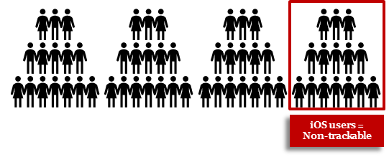
Practical recommendations
RESULTS
Consider the impact of the chosen technologies on data quality
Apps
Where?
Device
Devices
Not iOS
Continuous?
Yes
Types of data
URLs, Time, Device, Search terms, Incognito

Slide 41
Practical recommendations
RESULTS
Consider the impact of the chosen technologies on data quality
Apps
Where?
Device
Devices
Not iOS
Continuous?
Yes
Types of data
URLs, Time, Device, Search terms, Incognito

Slide 42
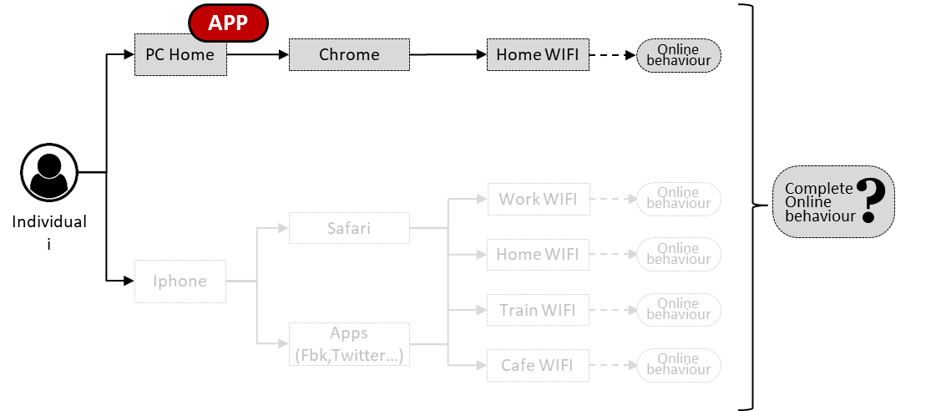
Practical recommendations
RESULTS
Explore strategies to increase the willingness of individuals to install the meter in all targets

Slide 43
Practical recommendations
RESULTS
Explore strategies to increase the willingness of individuals to install the meter in all targets
Tracking technologies present different installations processes.
Multiple tracking technologies might need to be installed for the same participant.
Targets (devices / browsers / networks used) are unknown.

Slide 44
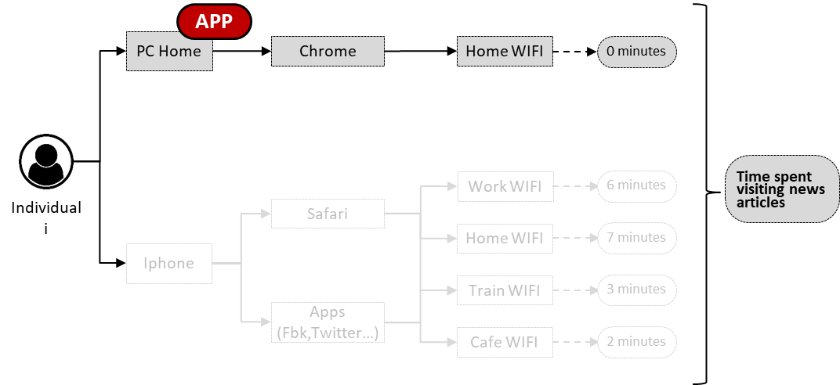
Practical recommendations
RESULTS
Define strategies to maximise the information available to identify missing data

Slide 45
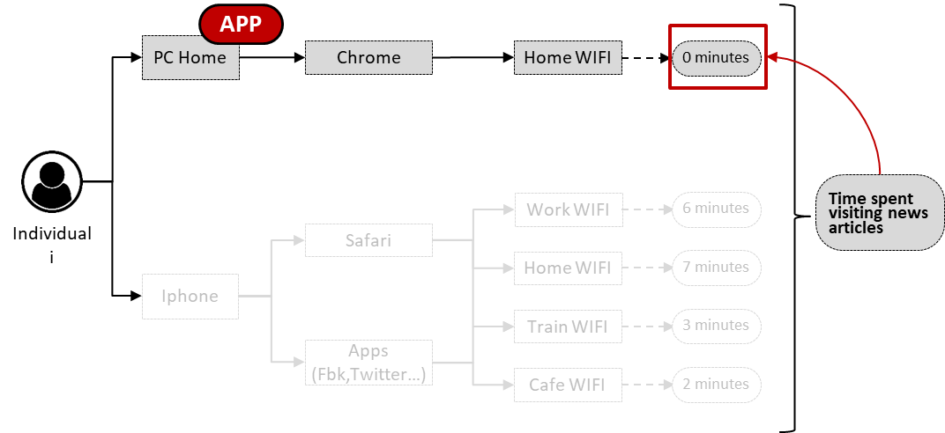
Practical recommendations
RESULTS
Define strategies to maximise the information available to identify missing data

Slide 46
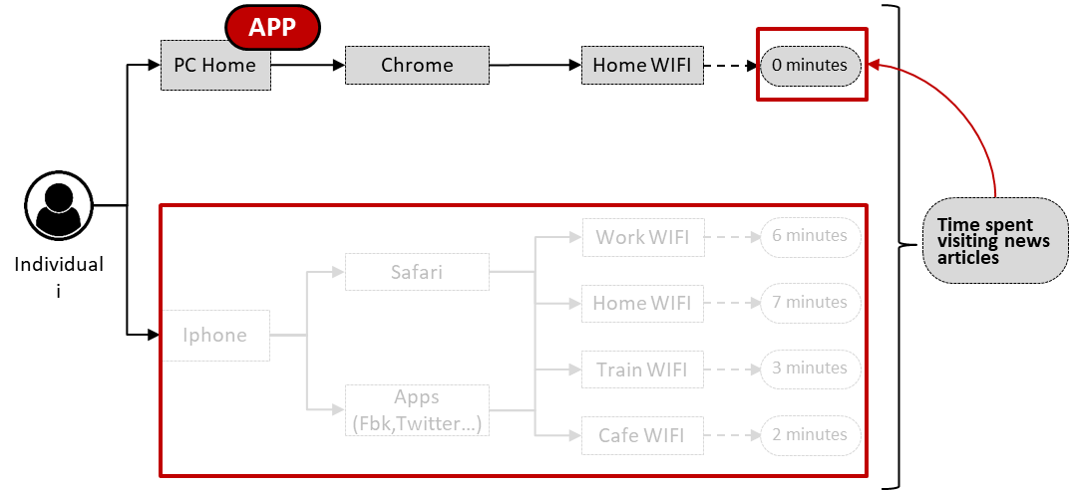
Practical recommendations
RESULTS
Define strategies to maximise the information available to identify missing data

Slide 47
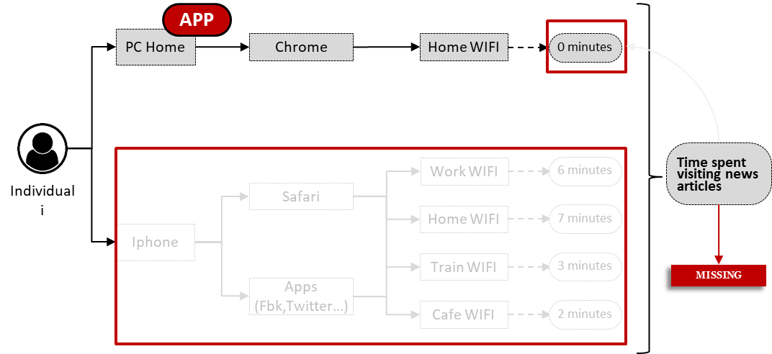
Practical recommendations
RESULTS
Define strategies to maximise the information available to identify missing data

Slide 48
Practical recommendations
RESULTS
Define strategies to maximise the information available to identify missing data

Slide 49
Limits
CONCLUSIONS
One specific definition of data quality.
Lack of previous empirical research.
Tracking technologies are constantly evolving.
Metered data errors are considered independently.
Take-home messages
Using metered data is complex and many decisions must be taken.
Reporting these decisions and conducting robustness checks is necessary.
More empirical research is needed.
This framework can help on all these aspects.

Slide 50
Thanks!
Questions?
Oriol J. Bosch
ORIOL J. BOSCH | THE LONDON SCHOOL OF ECONOMICS / RECSM-UPF
o.bosch-jover@lse.ac.uk
orioljbosch
https://orioljbosch.com/
This project has received funding from the European Research Council (ERC) under the European Union’s Horizon 2020 research and innovation programme (grant agreement No849165), PI: Melanie Revilla

