Slide 1
Are centrists even real? Combining survey self-reports and web tracking data to improve our understanding of left-right ideology.
o.bosch-jover@lse.ac.uk
orioljbosch
https://orioljbosch.com/
Oriol J. Bosch| Department of Methodology, LSE
Acknowledgements: I would like to thank Melanie Revilla for her always insightful comments, and Yuanmo He for his brilliant computational expertise.
Funding: This project has received funding from the European Research Council (ERC) under the European Unions Horizon 2020 research and innovation programme (grant agreement No 849165; PI: Melanie Revilla); the Spanish Ministry of Science and Innovation under the "R+D+i projects" programme (grant number PID2019-106867RB-I00 /AEI/10.13039/501100011033 (2020-2024), PI: Mariano Torcal); and the BBVA foundation under their grant scheme to scientific research teams in economy and digital society, 2019 (PI: Mariano Torcal).

Slide 2
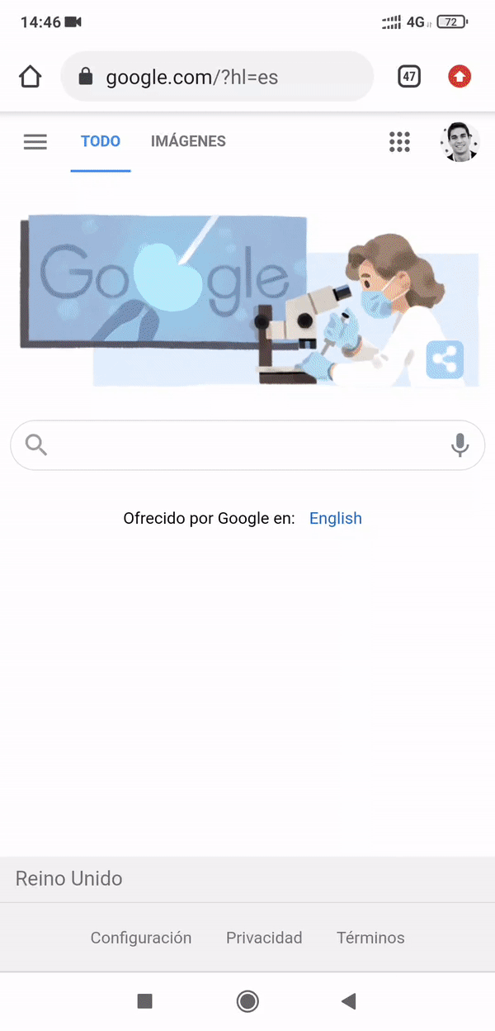
Can we measure ideology with web tracking data?
MEASURING IDEOLOGY
Direct observations of online behaviours using tracking solutions, or meters.
Group of tracking technologies (plug-ins, apps, proxies, etc)
Installed on participants devices
Collect traces left by participants when interacting with their devices online: URLs, apps visited, content that they saw…

Slide 3
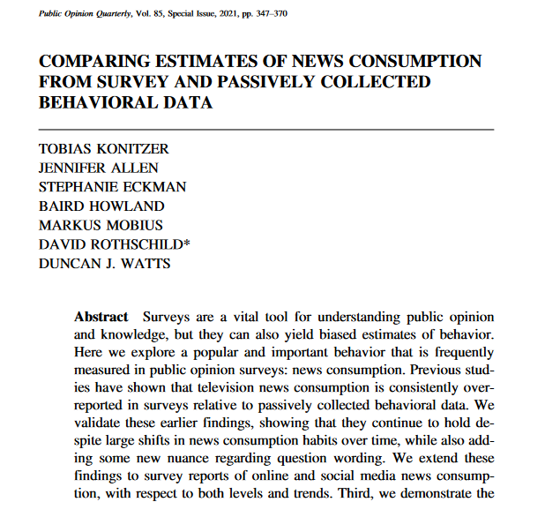
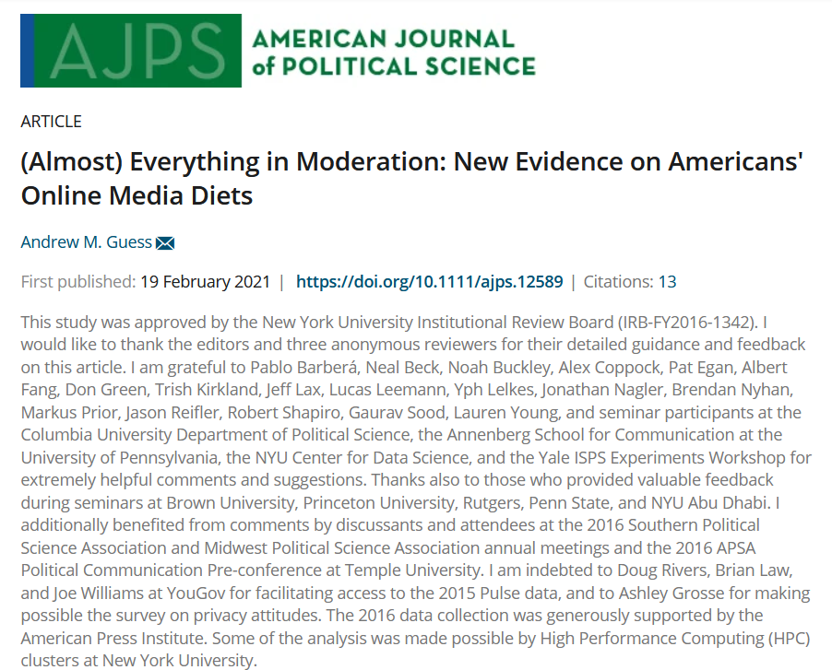
Web tracking data: a new source to measure ideology?
MEASURING IDEOLOGY
Web tracking data can be used to obtain “objective” measures of participants’ media diets

Slide 4
Web tracking data: a new source to measure ideology?
MEASURING IDEOLOGY
Web tracking data can be used to obtain “objective” measures of participants’ media diets
This might allow us to measure ideology

Slide 5
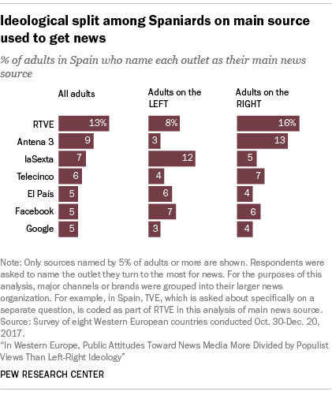
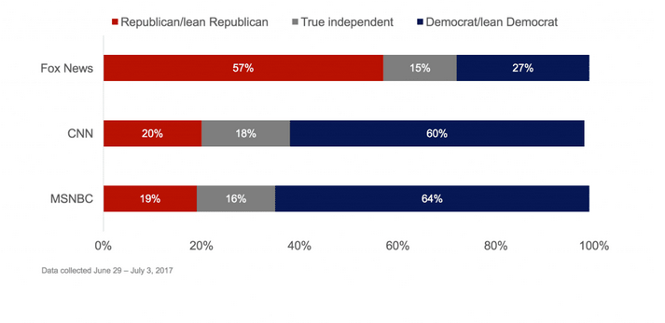
From observed media diets to ideology
MEASURING IDEOLOGY
We can assume that individuals prefer to read media outlets that they perceive to be “close” to them in the (latent) left-right dimension
https://www.surveymonkey.com/curiosity/cable-news-partisanship-drives-trust/
https://www.pewresearch.org/global/fact-sheet/news-media-and-political-attitudes-in-spain/

Slide 6
Why would we want to measure ideology with web tracking data?
MEASURING IDEOLOGY

Slide 7
Why would we want to measure ideology with web tracking data?
MEASURING IDEOLOGY
Supplement (online) behavioural data with attitudinal information without the need of self-reports (not always feasible)

Slide 8
Why would we want to measure ideology with web tracking data?
MEASURING IDEOLOGY
Supplement (online) behavioural data with attitudinal information without the need of self-reports (not always feasible)
Even if of lower quality than self-reports (my expectation), combining self-reports and web-tracking data could improve our understanding of the errors of self-reports, and the overall quality of the estimates we use

Slide 9
Why would we want to measure ideology with web tracking data?
MEASURING IDEOLOGY
Supplement (online) behavioural data with attitudinal information without the need of self-reports (not always feasible)
Even if of lower quality than self-reports (my expectation), combining self-reports and web-tracking data could improve our understanding of the errors of self-reports, and the overall quality of the estimates we use
Understand and quantify potential errors of self-reports: problems in the centre and the extremes
Create a new, hopefully, better measure of ideology

Slide 10
THIS STUDY

Slide 11
TRI-POL: the triangle of polarization
THIS STUDY
Three wave survey combined with web tracking data at the individual level (both PC and mobile data)
Netquest metered panels
Cross-quotas: gender, age, education and region
Sample size: 1,289 (Spain)
Spain, Portugal, Italy, Argentina and Chile

Slide 12
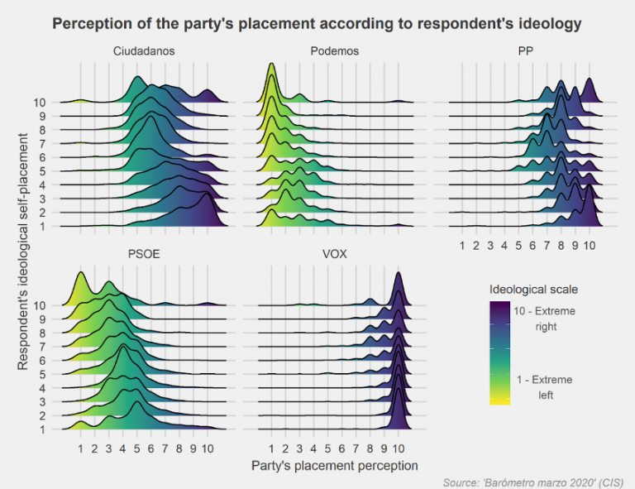
Case study for this presentation: Spain
THIS STUDY
The left-right dimension is very relevant in Spain
Spain has a highly partisan, pluralist media system
And a polarized multiparty system
https://blogs.lse.ac.uk/eurocrisispress/2020/06/26/polarization-coronavirus/

Slide 13
ESTIMATING IDEOLOGY WITH WEB TRACKING DATA

Slide 14
The underlying model
CREATING THE SCALE
An individual’s (i) decision to read a specific media outlet (j) is a function of:
The ideological distance between them and the outlet (d_{ij}).
Plus some user- and media- random effects (α_{i} an β_{j}), to account for differences in political interest and popularity of media.

Slide 15
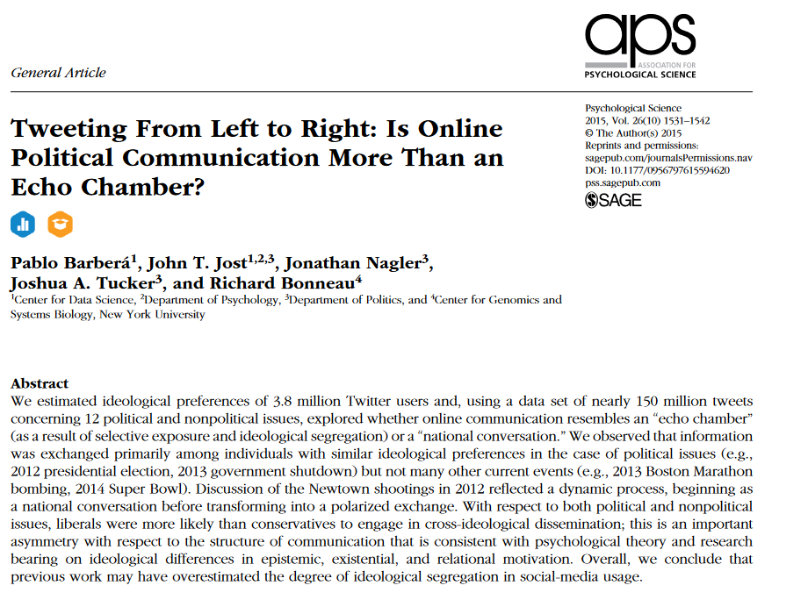
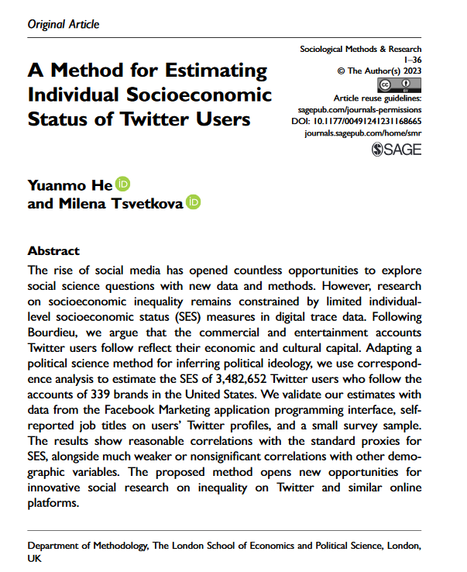
The underlying model
CREATING THE SCALE
This approach has already been used to measure the ideology and socioeconomic status of individuals based on what accounts they follow on Twitter

Slide 16
From model to estimates: Correspondence Analysis
CREATING THE SCALE
I adapt Pablo Barbera’s approach to measure ideology based on who users follow on Twitter, using Correspondence Analysis
Media outlets
Participants
Dimension 2
 | Oultet₁ | Outlet₂ | Outlet₃ | …
Participant₁ | 1 | 0 | 0
Participant₂ | 1 | 1 | 0
Participant₃ | 0 | 0 | 0
Participant₄ | 1 | 1 | 1
Participant₅ | 0 | 0 | 1
…
Dimension 1

Slide 17
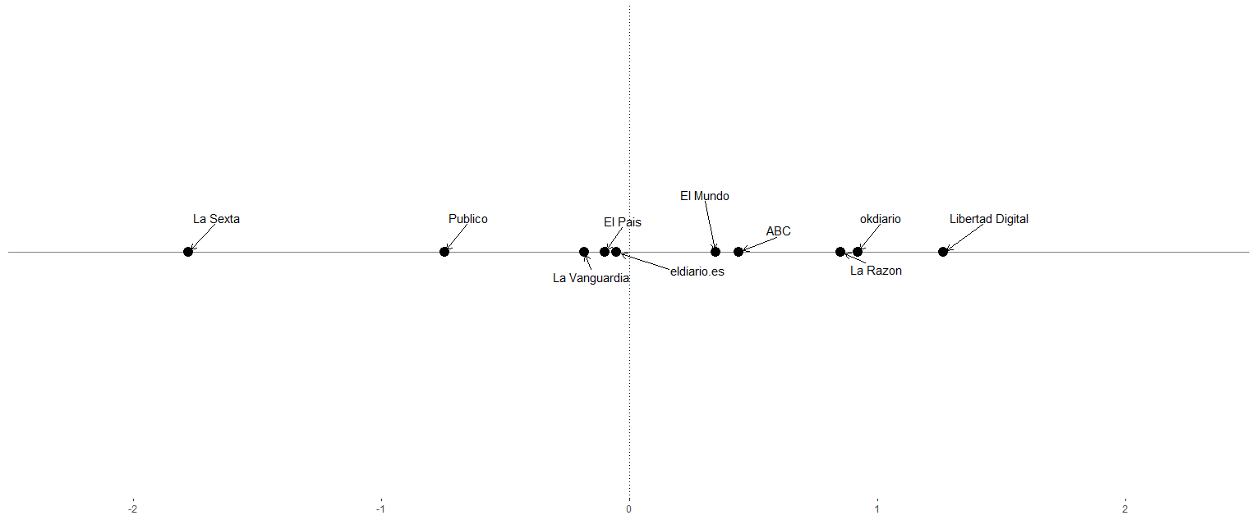
The ideology of media outlets
VALIDATING THE SCALE
Left space
Right space

Slide 18
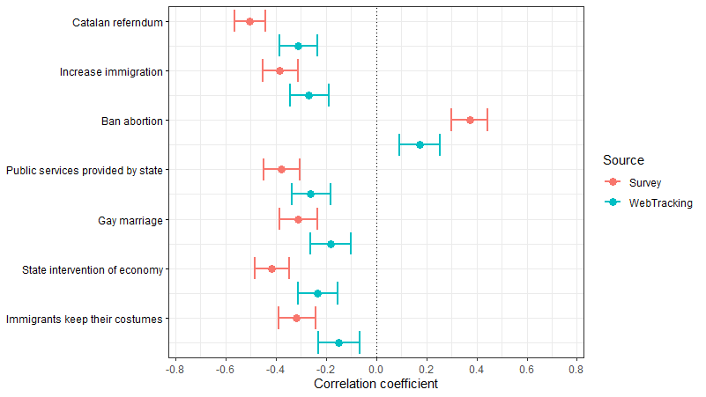
Predictive validity
VALIDATING THE SCALE
Political attitudes

Slide 19
HIDDEN MARKOV MODEL: WHAT CAN WE LEARN BY COMBINING BOTH ESTIMATES?

Slide 20
Hidden Markov Models to estimate the quality of both sources
HIDDEN MARKOV MODEL
Group of latent class models used to estimate and correct for measurement error in categorical, longitudinal data
Do not require any of data sources to be error-free
Surv₁
Surv₂
Surv₃
True score at wave i
Self-reported ideology at wave i
Ideo₁
Ideo₂
Ideo₃
WT₁
WT₂
WT₃
Web tracking-based ideology at wave i

Slide 21
Misclassification error (5 categories)
HIDDEN MARKOV MODEL
 | Hidden classes
 | Class 1 (Far-left) | Class 2 (Left) | Class 3 (Centre) | Class 4 (Right) | Class 5 (Far-right)
Survey
Far-left | .82 | .03 | .00 | .00 | .02
Left | .18 | .94 | .03 | .02 | .00
Centre | .00 | .02 | .87 | .02 | .00
Right | .00 | .02 | .09 | .94 | .09
Far-right | .00 | .00 | .01 | .02 | .89
Web tracking
Far-left | .01 | .01 | .00 | .00 | .00
Left | .55 | .47 | .31 | .23 | .19
Centre | .14 | .12 | .16 | .11 | .15
Right | .30 | .39 | .52 | .64 | .64
Far-right | .00 | .00 | .01 | .01 | .02

Slide 22
Misclassification error (5 categories)
HIDDEN MARKOV MODEL
 | Hidden classes
 | Class 1 (Far-left) | Class 2 (Left) | Class 3 (Centre) | Class 4 (Right) | Class 5 (Far-right)
Survey
Far-left | .82 | .03 | .00 | .00 | .02
Left | .18 | .94 | .03 | .02 | .00
Centre | .00 | .02 | .87 | .02 | .00
Right | .00 | .02 | .09 | .94 | .09
Far-right | .00 | .00 | .01 | .02 | .89
Web tracking
Far-left | .01 | .01 | .00 | .00 | .00
Left | .55 | .47 | .31 | .23 | .19
Centre | .14 | .12 | .16 | .11 | .15
Right | .30 | .39 | .52 | .64 | .64
Far-right | .00 | .00 | .01 | .01 | .02

Slide 23
Misclassification error (5 categories)
HIDDEN MARKOV MODEL
 | Hidden classes
 | Class 1 (Far-left) | Class 2 (Left) | Class 3 (Centre) | Class 4 (Right) | Class 5 (Far-right)
Survey
Far-left | .82 | .03 | .00 | .00 | .02
Left | .18 | .94 | .03 | .02 | .00
Centre | .00 | .02 | .87 | .02 | .00
Right | .00 | .02 | .09 | .94 | .09
Far-right | .00 | .00 | .01 | .02 | .89
Web tracking
Far-left | .01 | .01 | .00 | .00 | .00
Left | .55 | .47 | .31 | .23 | .19
Centre | .14 | .12 | .16 | .11 | .15
Right | .30 | .39 | .52 | .64 | .64
Far-right | .00 | .00 | .01 | .01 | .02

Slide 24
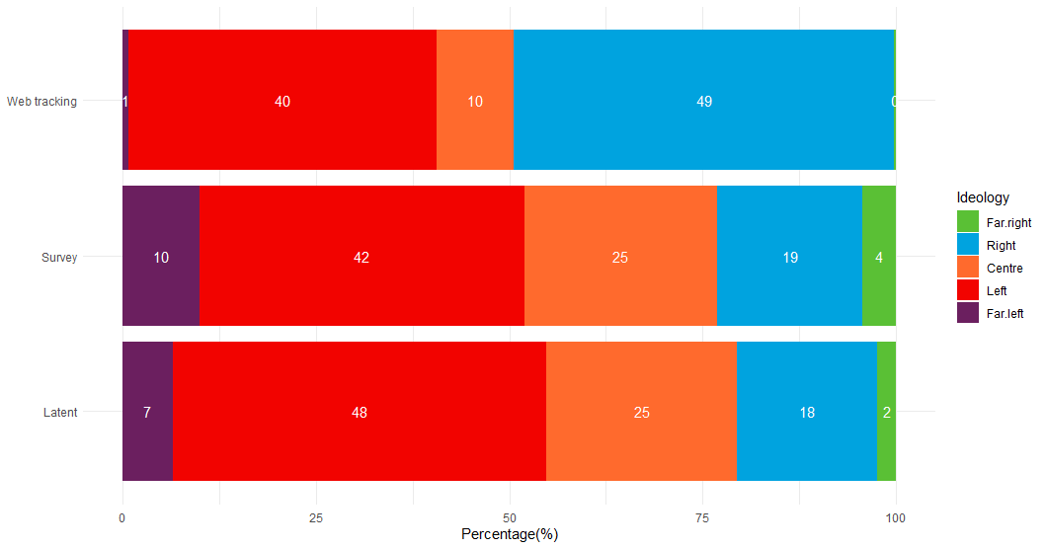
How do they compare to the latent “true” ideology?
HIDDEN MARKOV MODEL

Slide 25
CAN WE IMPROVE THE SELF-REPORT?

Slide 26
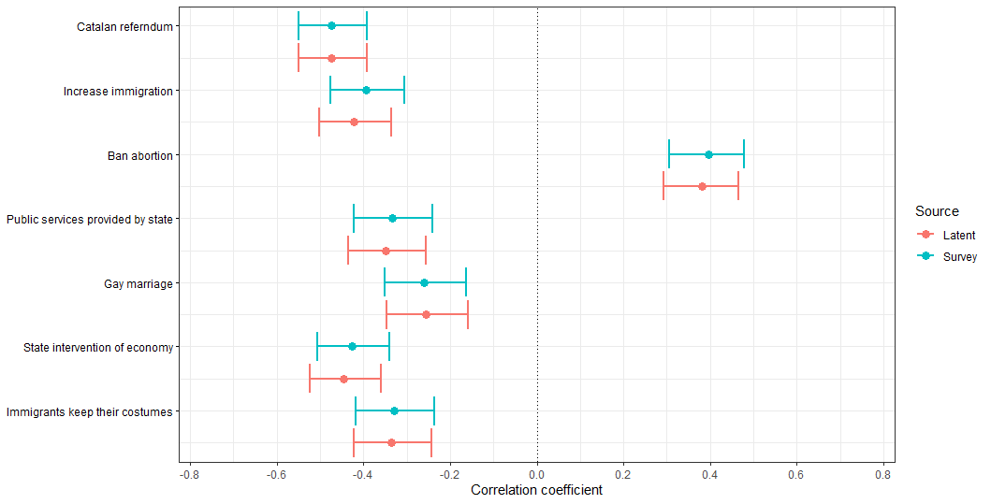
Predictive validity
CAN WE IMPROVE THE SELF-REPORT?
Political attitudes

Slide 27
CONCLUSIONS

Slide 28
Take-home messages
CONCLUSIONS
Promising approach to combine surveys and web tracking data
It is possible to create a measure of ideology using web tracking data, but is far from perfect!
Although survey self-reports do seem to have more problems identifying people on the extremes and the centre, the overall quality of the measure is very high
There might be avenues for improvement, but the results suggest that surveys do a very good job

Slide 29
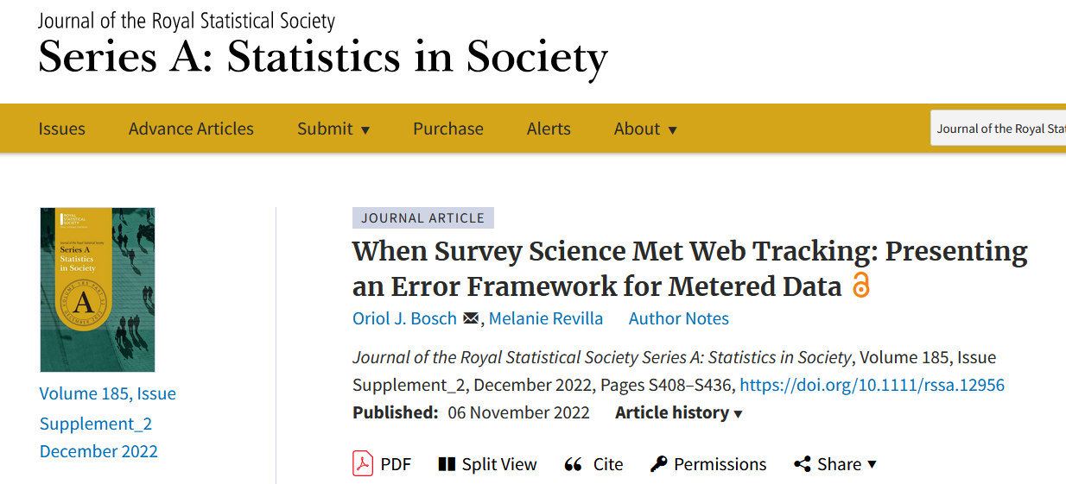
Next steps
CONCLUSIONS
Improve the model
Understand what we could do better with web-tracking data

Slide 30
Thanks!
Questions?
Oriol J. Bosch|Department of Methodology, LSE
ORIOL J. BOSCH | THE LONDON SCHOOL OF ECONOMICS / RECSM-UPF
o.bosch-jover@lse.ac.uk
orioljbosch
https://orioljbosch.com/

Slide 31
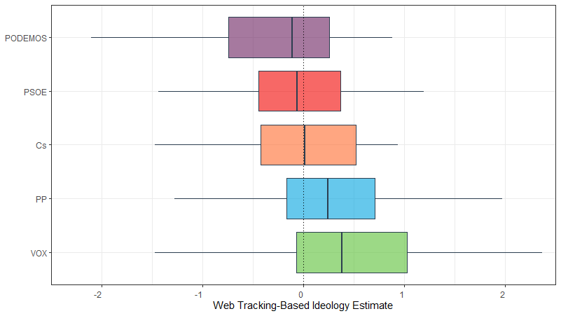
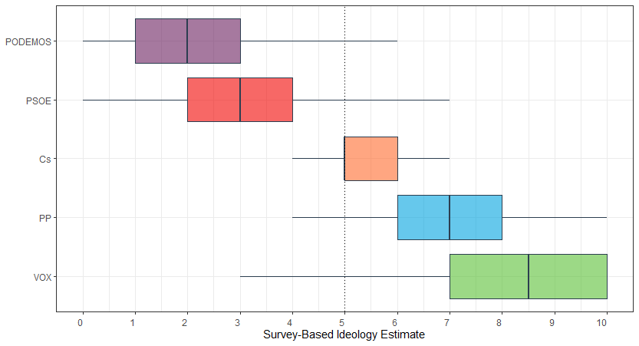
Self-reported and predicted ideology, by party proximity
VALIDATING THE SCALE

Slide 32
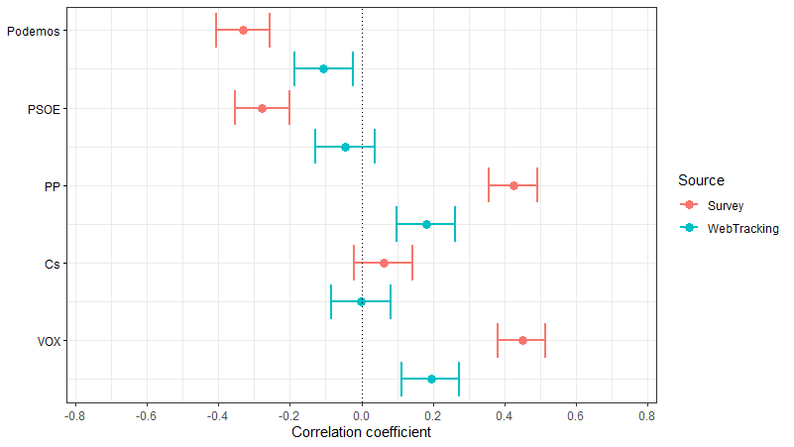
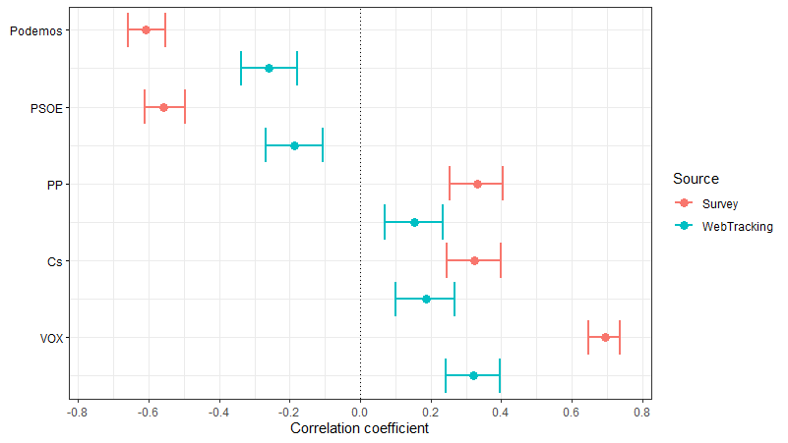
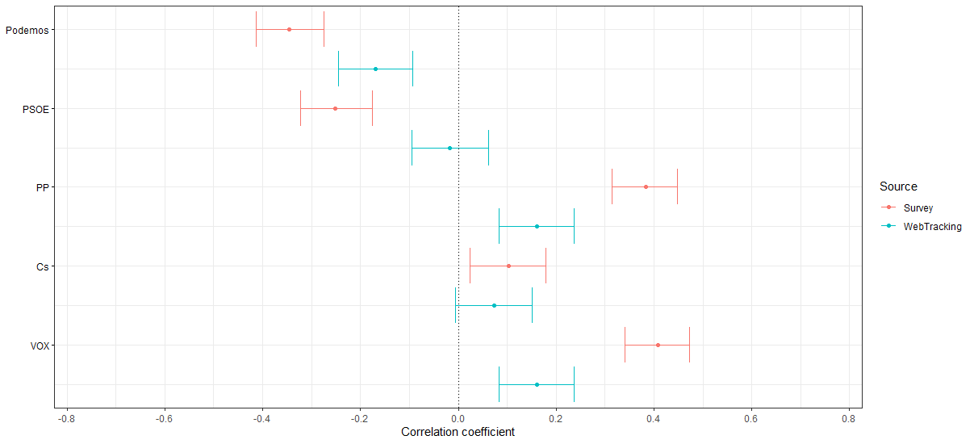
Predictive validity
VALIDATING THE SCALE
Voting intention
Attitudes towards candidates from…

Slide 33
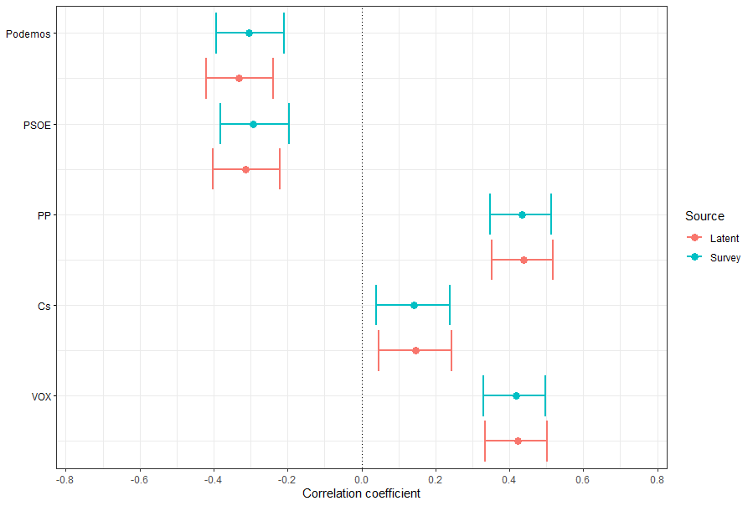
Predictive validity
CAN WE IMPROVE THE SELF-REPORT?
Voting intention

Slide 34
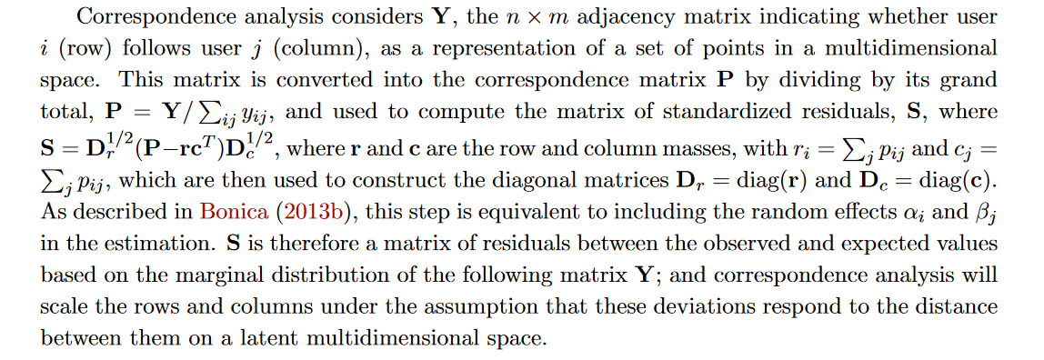
Correspondence Analysis
CAN WE IMPROVE THE SELF-REPORT?

