Slide 1




[169] Gendered Inequalities in the Labor Market: Which Policy Responses for Whom? 6/28/2023
11:00 AM to 12:45 PM - Room O-106
Gender Differences in Job Application Requirements: Do Women Demand More of Themselves than Men? A survey-based study of job-seeking behavior in Spain
Carlos Ochoa
carlos.ochoa@upf.edu
Clara Cortina
clara.cortina@upf.edu
M. José González
mjose.gonzalez@upf.edu
Dept. Political & Social Sciences
This project has received funding from the European Research Council (ERC) under the European Union’s Horizon 2020 research and innovation programme (grant agreement No849165), PI: Melanie Revilla.

Slide 2

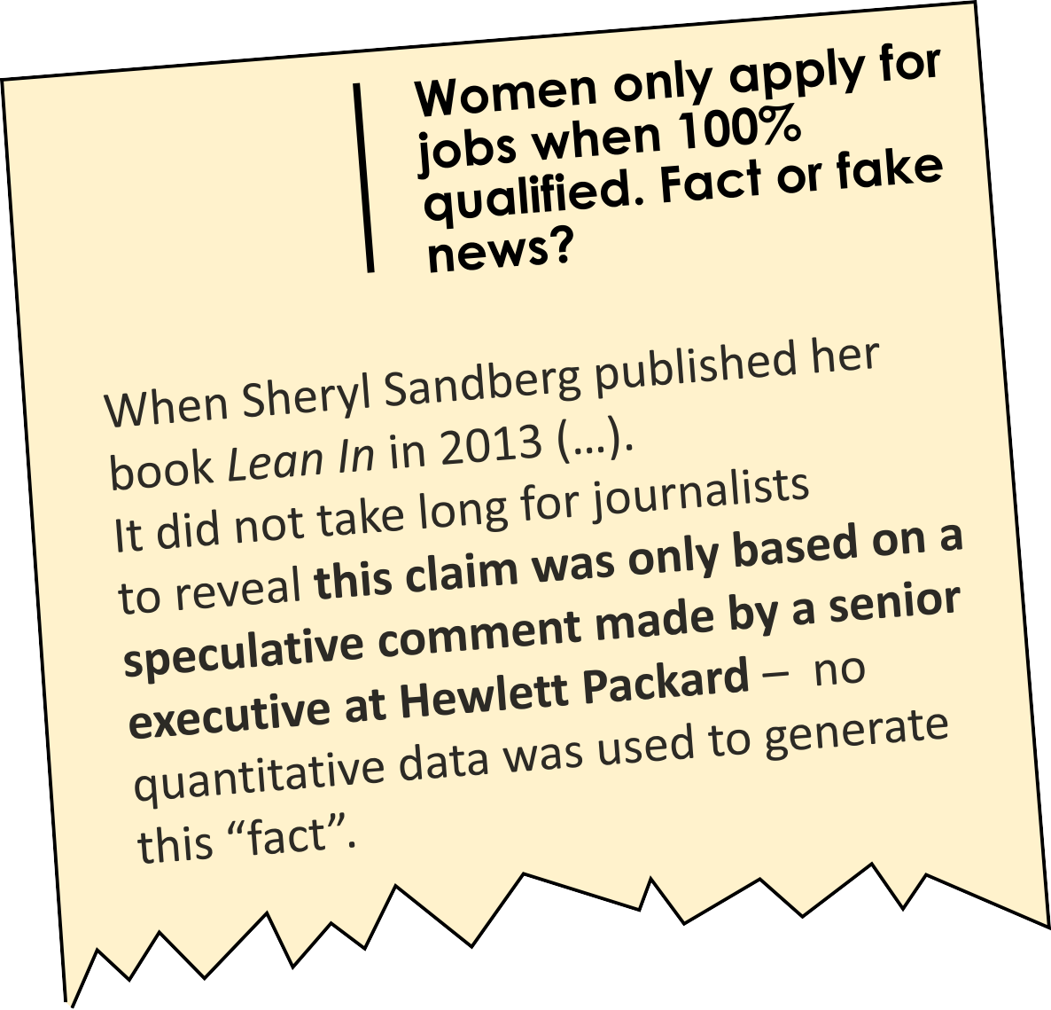
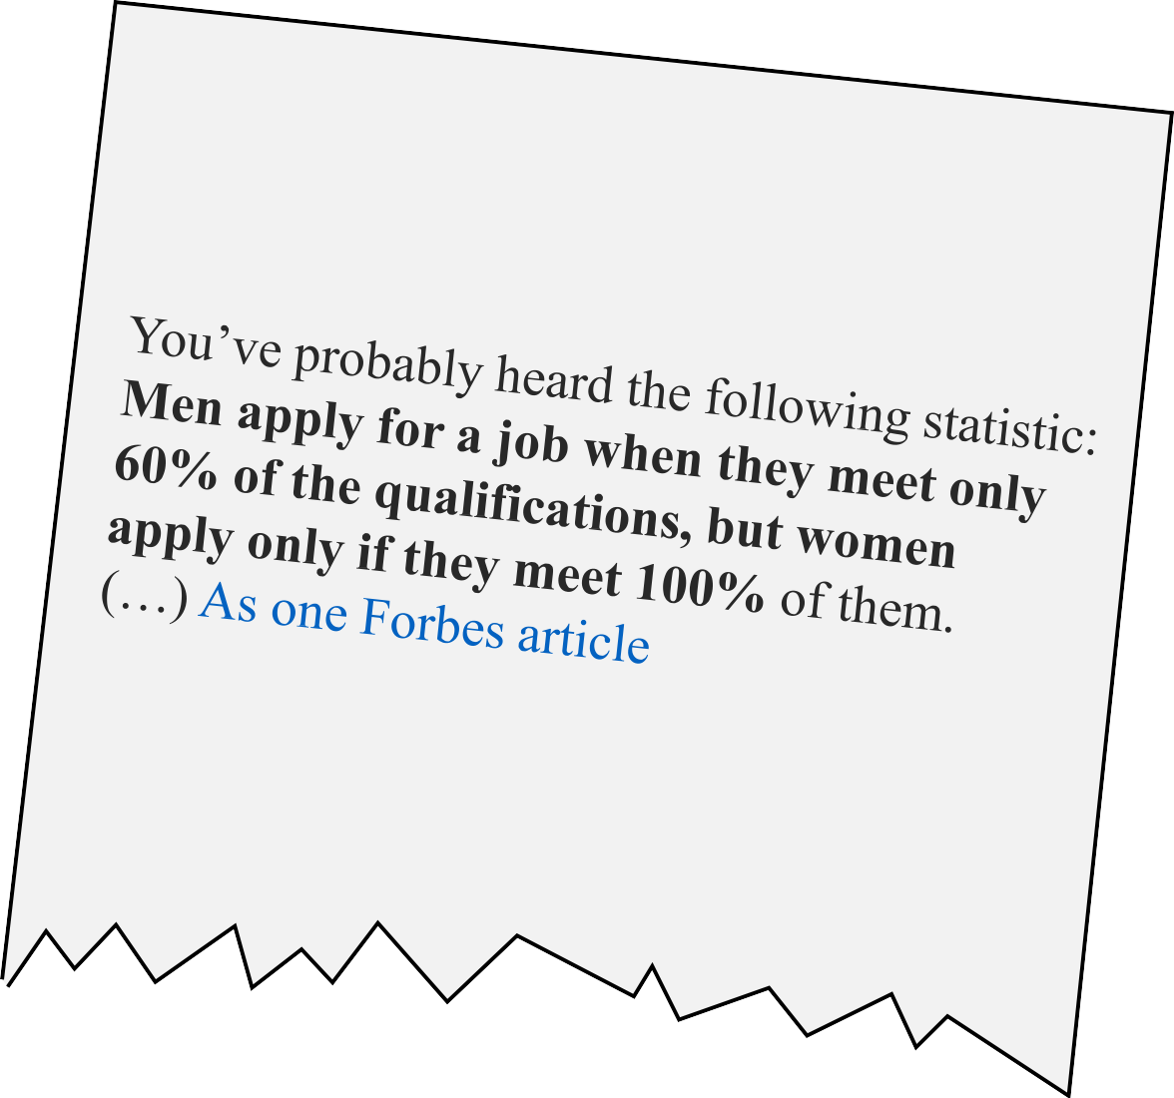



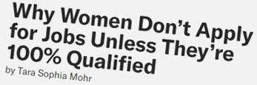
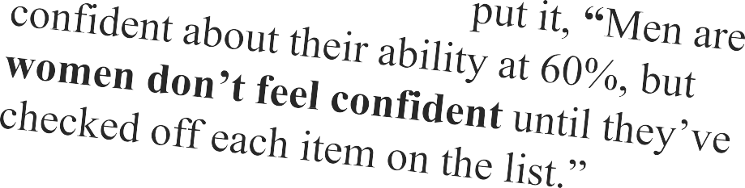

Motivation

Slide 3


Job searches are hard to research
Research in context
Research on job search, as most online events, is limited by the lack and/or inadequacy of available data.
Most existing research uses…
Survey data
Passive data
Individuals consent to be observed and do not play a role in the data collection (e.g., Linkedin.com reports).
Some opt-in online panels ask their members to install a “meter” and share their online activity.
Not affected by memory issues but…
Affected by other errors (Bosch and Revilla, 2022).
Cannot capture all objective data.
Cannot capture subjective data at all.
Affected by memory limitations
(Tourangeau, 2000) due to
Repetition
Low distinctiveness
Low emotional impact
Non-rehearsal
Short duration

Slide 4
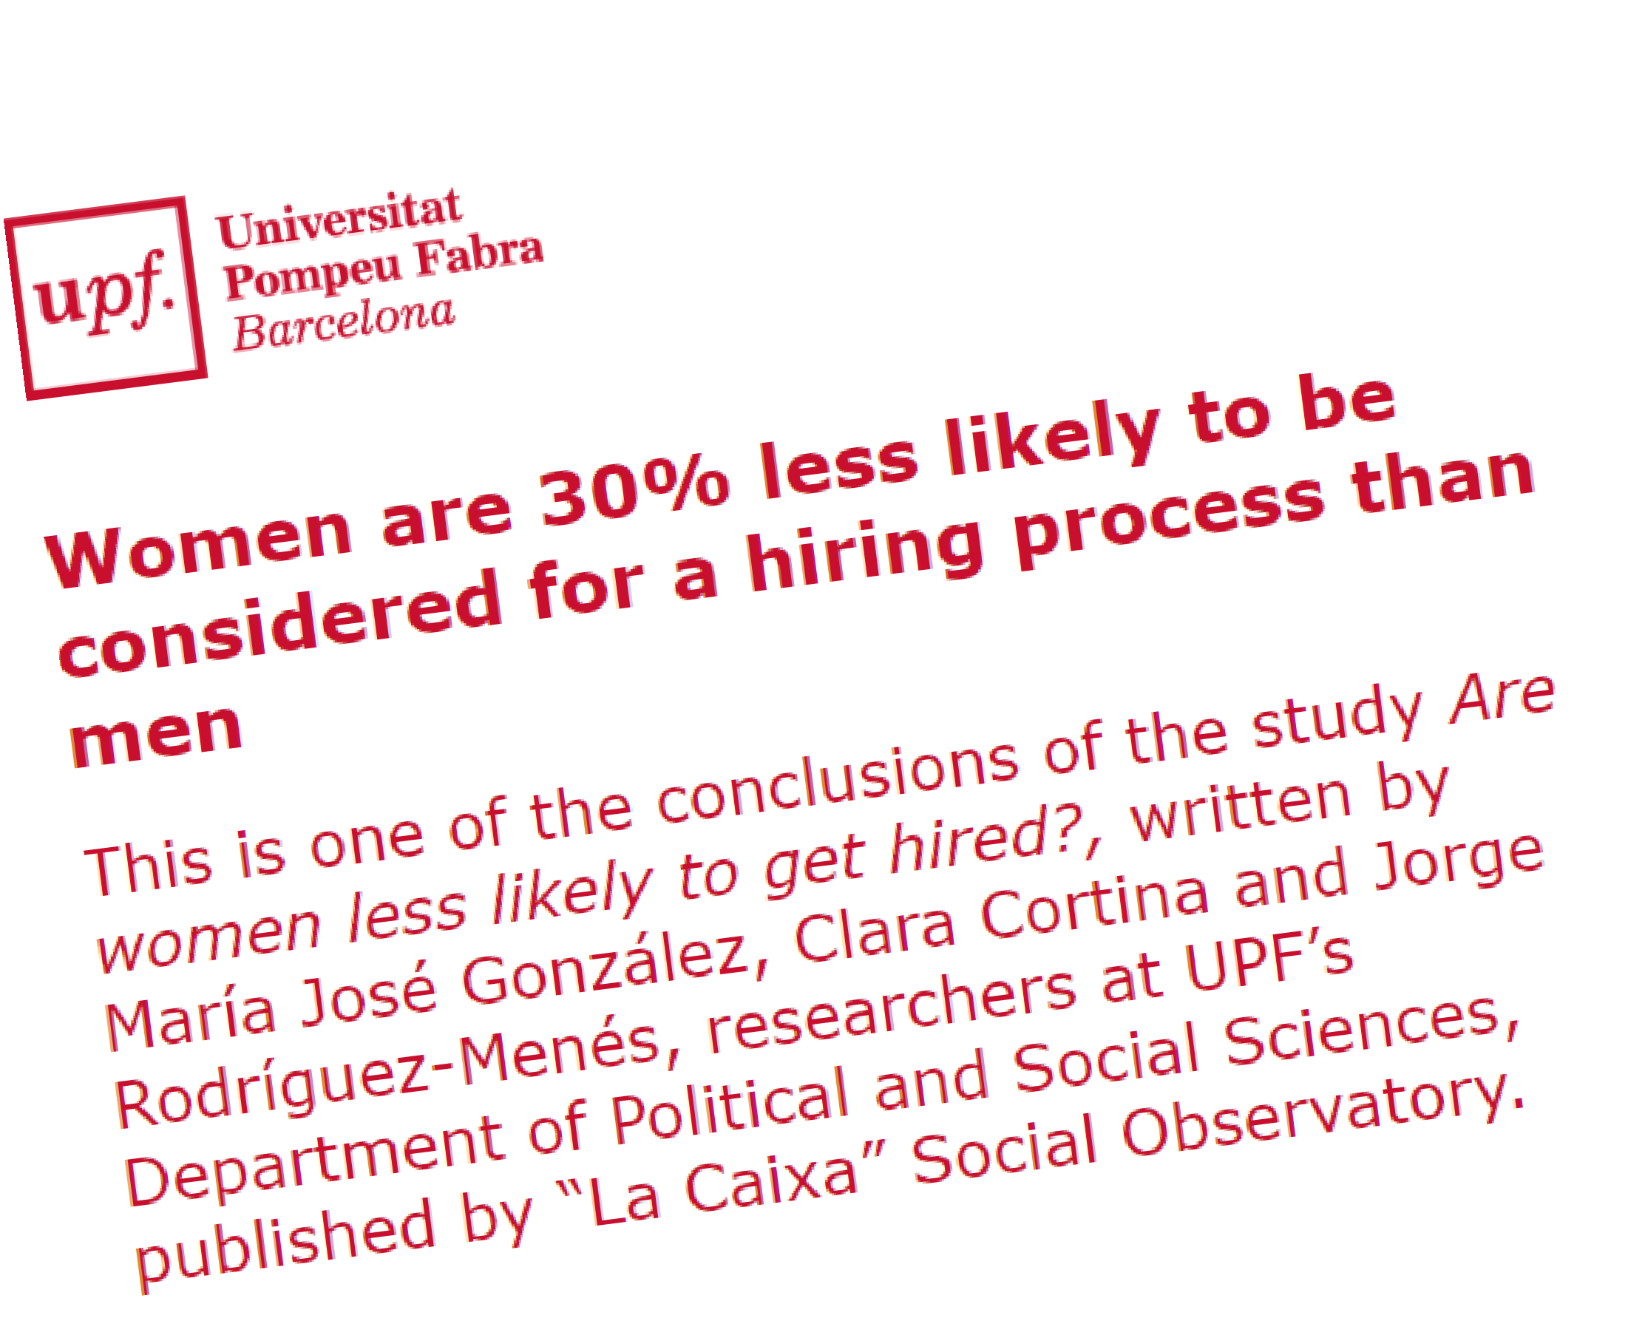
Experiments are not always possible
Experiments provide strong evidence to prove causal relationships, but cannot be used to research all the problems (i.e., ethical considerations, feasibility, cost…)

Slide 5
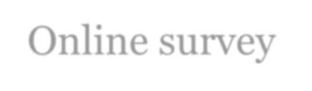

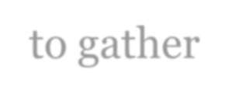

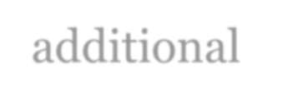

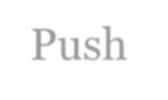
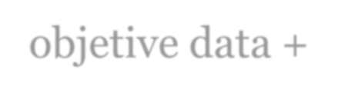
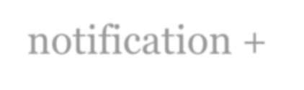
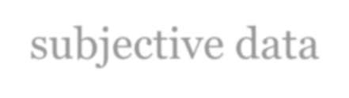
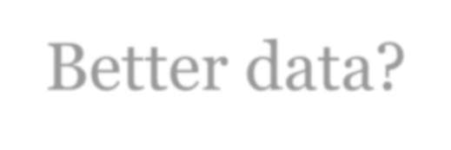
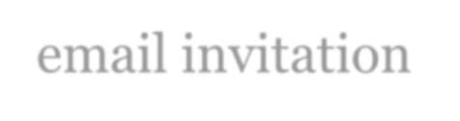
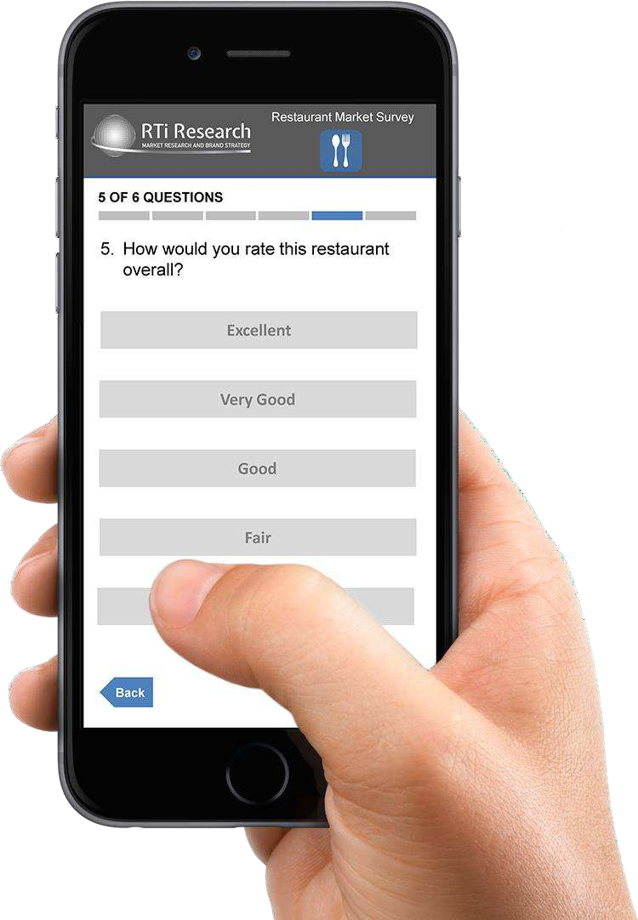
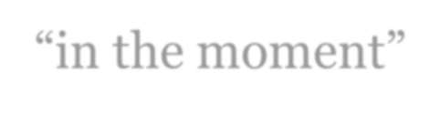
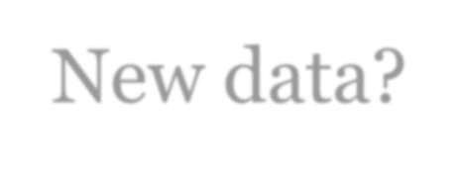
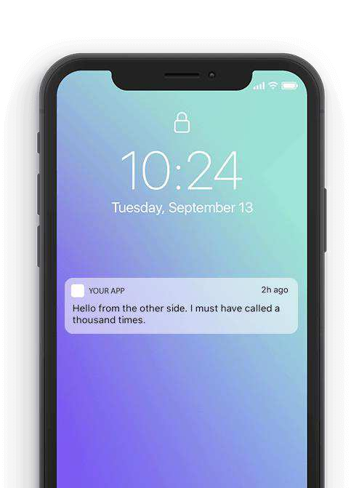
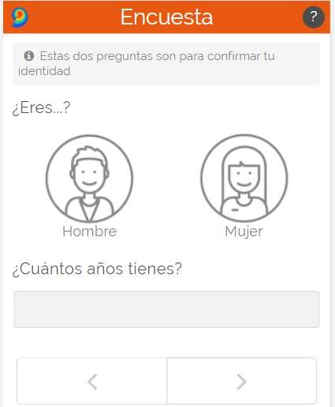
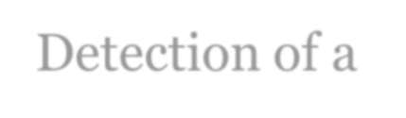

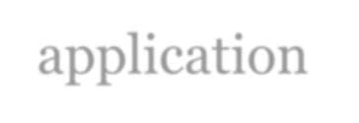

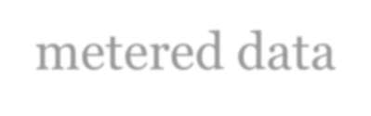
In-the-moment surveys: the best of both worlds…
Online survey to gather additional objetive data + subjective data
3
2
Push
notification + email invitation “in the moment”
Better data?
New data?
Detection of a job application through metered data
1

Slide 6
This research: methodological + substantive research
Researching a sample of job searchers, using both in-the-moment and conventional surveys, to answer these research questions:
How do in-the-moment surveys compare to conventional surveys?
How different groups of people decide to apply for a job?
RQ1. Levels of participation? RQ2. Evaluation of the experience? RQ3. Data quality?
RQ4. Different results?
Do females and males apply differently
when …
RQ1. … they do not meet the job
requirements?
RQ2. … the job do not meet their
expectations?

Slide 7

Specific research questions
Self-perception of the online job seeker:
To what extent do you believe your qualifications align with the requirements outlined in this job posting?
What are your expectations of being called for an interview or being hired for the job you applied for?

Slide 8

Background (1): Gender differences in applied-for jobs
It is challenging to establish a consensus in the literature due to the wide range of variables examined, different study populations (MBA students, online job search platforms, employment agencies, registration data), occupations, different methodologies (including online and lab experiments and small sample sizes) and case studies (Southern European countries systematically omitted!).

Slide 9
Background (2): scattered and mixed evidence
Fluchtmann, J., Glenny, A. M., Harmon, N., & Maibom, J. (2021) [women target jobs that pay lower wages; differences in beliefs, degree of (over)confidence or risk preferences; valuation of non-wage job characteristics; Danish employment agency]
Cortés, P., Pan, J., Pilossoph, L., Zafar, B., French, J., Paola, M., Araya, U., Winseck, K., & Lim, Z. H. (2020). [higher levels of risk aversion displayed by women and the higher levels of over-optimism displayed by men, US]
Nicks, L., Gesiarz, F., Valencia, L., Hardy, T., & Lohmann, J. (2022) [Online experiment (n = 10,468): only gender difference emerged among participants who were less qualified for the role, with no difference among more qualified participants; less qualified men’s greater self-perceptions in meeting the overall requirements than similarly qualified women, UK]
Barbulescu, R., & Bidwell, M. (2013).[ women’s preference for jobs with better anticipated work–life balance, their lower identification with stereotypically masculine jobs, and their lower expectations of job offer success in such stereotypically masculine jobs. Job searches of MBA students, US]
Hardies, K., Breesch, D., & Branson, J. (2013). [no evidence for a gender difference in overconfidence, Belgium]

Slide 10

Hypotheses
[Gender Socialization] Women may exhibit lower levels of confidence in their own abilities, potentially resulting in a higher inclination towards pessimism regarding their prospects of securing a job.
[Personality traits] Individuals who are more inclined to adhere to norms (social conformity) will conform strictly to the announced criteria, and individuals who score very high on self-efficacy are more likely to be optimistic about job requirements. Both personality traits will act as mediators in the job search.

Slide 11

Measures of Social Behavior and Personality
Social conformity: the tendency of individuals to change their attitudes, beliefs, and behaviors to align with those of a group or social norm (Mehrabian Conformity Scale, Mehrabian & Stefl, 1995)
Self-efficacy: a person's belief in their ability to achieve an outcome (Generalized Self-Efficacy Scale, Schwarzer and Jerusalem, 1995). Each item asks about the respondent's perception of their ability to overcome a problem or achieve a goal.
Both concepts use items measure scored on a 5-point Likert scale from (1) not at all true to (5) exactly true.

Slide 12
Method and data
Sample source: Opt-in online “metered” panel in Spain (Netquest). People that regularly participate in surveys and share their online behaviors in exchange of incentives.
In-the-moment group
Conventional group
Survey invitation sent 15 min after a job application is detected.
“Please, answer urgently!”
Length of interview < 10 minutes
70 questions about the job application + sociodemographics + personality traits.
N = 200?
An equivalent questionnaire asking for the last job application (if any) in the last 6 months.
N=200
198
130

Slide 13
Things are never as easy as they seem
The setting up of the project has been difficult.
1
2
3
4
Elaborating a complete list of job search websites.
jobtoday.com, Infojobs.net, indee.com, Linkedin.com/jobs,…
Identifying the exact URLs corresponding to confirmed job applications
(e.g., infojobs…).
https://api.jobtoday.com/v5/application/external/validation
Transforming such URLs into “regular expressions”.
jobtoday\.com\/\S*\/application
Reviewing regularly such URLs, since webpages evolve over time.
Several issues may cause the mistaken detections of job searches (both false
positives and false negatives)

Slide 14
Table 1: Descriptives of the analysis sample

Slide 15
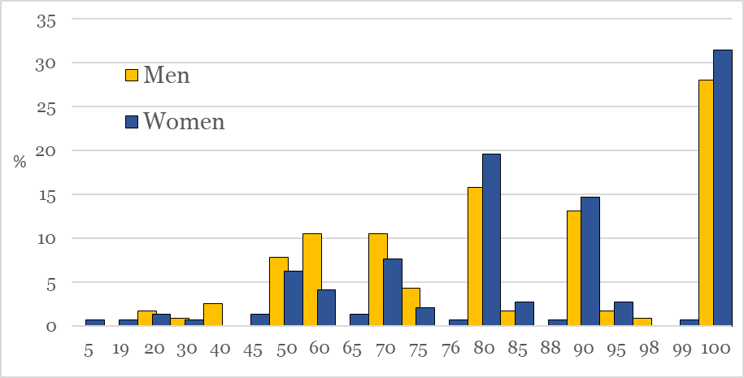
Descriptive
Figure 1: Distribution of responses by gender: “To what extent do you believe your qualifications align with the requirements outlined in this job posting?”
Rounding bias!
Sample: 333 individuals (16/06/2023)
71 don't remember or don't know; 5 persons are over 64 years old (to be deleted)
Final sample: 257 individuals

Slide 16
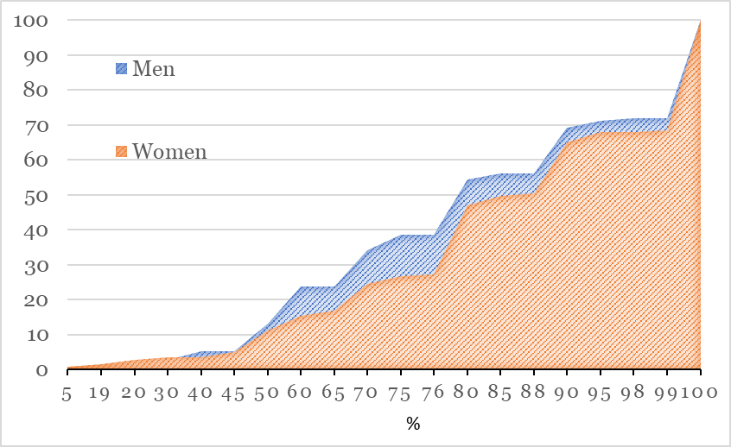
Descriptive
Figure 1: Cumulative distribution of responses by gender: “To what extent do you believe your qualifications align with the requirements outlined in this job posting?”

Slide 17
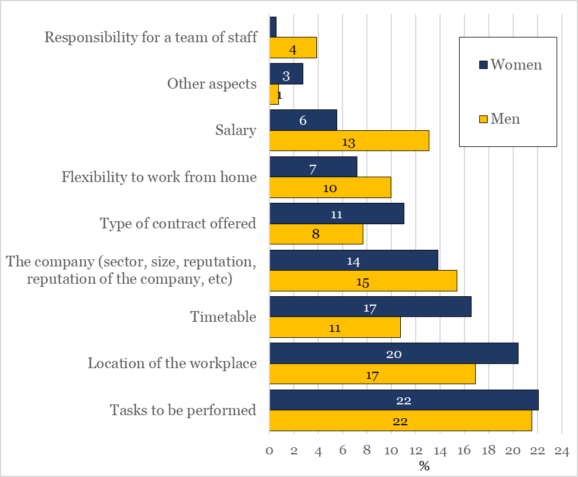
Figure 2. Distribution of responses by gender: “Indicate the three qualities that were most important to you in the application process”

Slide 18
Table 2. Linear Regression Analysis for Variables Predicting Self-Perceived Percentage of Requirements Met in Job Offer, 2023

Slide 19
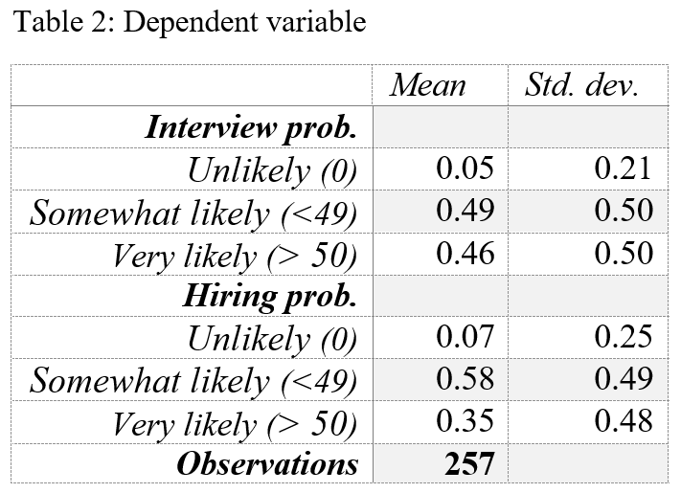
Table 3. Ordered Logistic Regression Analysis of the Variables that Predict the Self-perceived Likelihood of Being Interviewed or Hired, 2023

Slide 20
Conclusions
In line with previous studies there are significant gender differences in the aspects of jobs that are valued. Women tend to prioritize family-friendly work environments, shorter commutes, and shorter working hours, while men tend to prioritize salary.
There is no evidence of a '60% vs 100% rule’ (“Men apply for a job when they meet only 60% of the qualifications, but women apply only if they meet 100%.”): women do not set different thresholds for job applications than men. However, women have lower expectations than men that they will be called for an interview or hired, regardless of the level of match between the job offer and their skills.
Individuals experiencing heightened levels of despair, such as the unemployed, show notable behavioral differences and a tendency to pursue job opportunities even when they do not meet the required qualifications.
Higher conformity scores, indicating a tendency to strictly follow rules, were unexpectedly linked to a lower percentage of requirements met in job applications. Higher efficacy scores, reflecting a strong belief in one's abilities, were positively associated with meeting a higher percentage of requirements. This implies that individuals with greater self-confidence may perceive themselves as meeting more requirements, irrespective of gender.

