Slide 1
Track me but not really:
Device undercoverage and its consequences when tracking online behaviours.
ORIOL J. BOSCH | THE LONDON SCHOOL OF ECONOMICS / RECSM-UPF
This project has received funding from 1) the European Research Council (ERC) under the European Union’s Horizon 2020 research and innovation programme (grant agreement No849165), PI: Melanie Revilla; 2) Ministry of Economy and Competitiveness, State Programme for the Promotion of Scientific and Technical Research of Excellence (PID2019-106867RB-I00 /AEI/10.13039/501100011033 (2020-2024), PI: Mariano Torcal; 3) AYUDAS FUNDACIÓN BBVA A EQUIPOS DE INVESTIGACIÓN CIENTÍFICA EN ECONOMÍA Y SOCIEDAD DIGITAL 2019, PI: Mariano Torcal.

Slide 2
INTRODUCTION
Tracking online behaviours using a meter
Definition
A meter refers to a heterogeneous group of tracking technologies that allow sharing with the researchers, at least, information about the URLs of the web pages visited by the participants. The meter is willingly installed on participants devices.

Slide 3
INTRODUCTION
Tracking online behaviours using a meter
Definition
A meter refers to a heterogeneous group of tracking technologies that allow sharing with the researchers, at least, information about the URLs of the web pages visited by the participants. The meter is willingly installed on participants devices.
Resulting data: metered data

Slide 4
INTRODUCTION
Tracking online behaviours using a meter
Metered data can potentially suffer from different types of errors
Bosch, O.J., and M. Revilla (2021). “When survey science met online tracking: presenting an error framework for metered data.” RECSM Working Papers Series, 62

Slide 5
INTRODUCTION
Tracking online behaviours using a meter
Metered data can potentially suffer from different types of errors
Bosch, O.J., and M. Revilla (2021). “When survey science met online tracking: presenting an error framework for metered data.” RECSM Working Papers Series, 62
Our focus: problems of undercoverage

Slide 6
BACKGROUND
Full coverage
4G
Online behaviour
Safari
Work WIFI
Online behaviour
iPhone-Personal
Home WIFI
Online behaviour
Apps (Fbk,Twitter…)
Train WIFI
Online behaviour
Cafe WIFI
Online behaviour
Complete Online behaviour
PC Home
Chrome
Home WIFI
Online behaviour
Individual i
Work WIFI
Online behaviour
Safari
Home WIFI
Online behaviour
MacBook Work
Train WIFI
Online behaviour
Chrome
Cafe WIFI
Online behaviour

Slide 7
BACKGROUND
Full coverage
4G
Online behaviour
Safari
Work WIFI
Online behaviour
iPhone-Personal
Home WIFI
Online behaviour
Apps (Fbk,Twitter…)
Train WIFI
Online behaviour
Cafe WIFI
Online behaviour
Complete Online behaviour
APP
PC Home
Chrome
Home WIFI
Online behaviour
Individual i
Work WIFI
Online behaviour
Safari
Home WIFI
Online behaviour
MacBook Work
Train WIFI
Online behaviour
Chrome
Cafe WIFI
Online behaviour

Slide 8
BACKGROUND
Full coverage
4G
Online behaviour
Safari
Work WIFI
Online behaviour
iPhone-Personal
Home WIFI
Online behaviour
Apps (Fbk,Twitter…)
Train WIFI
Online behaviour
Cafe WIFI
Online behaviour
Complete Online behaviour
APP
PC Home
Chrome
Home WIFI
Online behaviour
Individual i
Work WIFI
Online behaviour
Safari
Home WIFI
Online behaviour
MacBook Work
Plug-in
Train WIFI
Online behaviour
Chrome
Cafe WIFI
Online behaviour

Slide 9
BACKGROUND
Full coverage
Proxy
4G
Online behaviour
Safari
Work WIFI
Online behaviour
iPhone-Personal
Home WIFI
Online behaviour
Apps (Fbk,Twitter…)
Train WIFI
Online behaviour
Cafe WIFI
Online behaviour
Complete Online behaviour
APP
PC Home
Chrome
Home WIFI
Online behaviour
Individual i
Work WIFI
Online behaviour
Safari
Home WIFI
Online behaviour
MacBook Work
Plug-in
Train WIFI
Online behaviour
Chrome
Cafe WIFI
Online behaviour

Slide 10
BACKGROUND
Undercoverage
Undercoverage can prevent tracking the complete online behavior.
Different levels of undercoverage.
Device: at least one device used by a participant is not tracked
Browser: at least one web-browser used by a participant is not tracked
In-app: the behaviours happening inside apps are not tracked.
Network: at least one network from which a participant connect to the Internet is not tracked

Slide 11
BACKGROUND
Undercoverage
Proxy
4G
Online behaviour
Safari
Work WIFI
Online behaviour
iPhone-Personal
Home WIFI
Online behaviour
Apps (Fbk,Twitter…)
Train WIFI
Online behaviour
Cafe WIFI
Online behaviour
Complete Online behaviour
PC Home
Chrome
Home WIFI
Online behaviour
Individual i
Work WIFI
Online behaviour
Safari
Home WIFI
Online behaviour
MacBook Work
Plug-in
Train WIFI
Online behaviour
Chrome
Cafe WIFI
Online behaviour

Slide 12
BACKGROUND
Undercoverage
Proxy
4G
Online behaviour
Safari
Work WIFI
Online behaviour
iPhone-Personal
Home WIFI
Online behaviour
Apps (Fbk,Twitter…)
Train WIFI
Online behaviour
Cafe WIFI
Online behaviour
?
Complete Online behaviour
PC Home
Chrome
Home WIFI
Online behaviour
Individual i
Work WIFI
Online behaviour
Safari
Home WIFI
Online behaviour
MacBook Work
Plug-in
Train WIFI
Online behaviour
Chrome
Cafe WIFI
Online behaviour

Slide 13
BACKGROUND
Undercoverage
57%
meter installed in only one device.
Netquest (Spain)
(Revilla, Ochoa and Loewe, 2017)
4%
used only one device to access the Internet.
28%
fully covered.
Ipsos Knowledge Panel (USA)
(Pew Research Center, 2020)

Slide 14
THIS STUDY
Main goals
#1 Assess prevalence of device, browser and in-app undercoverage
Who is fully covered?
How does undercoverage look like?
What drives undercoverage?
#2 Investigate how to deal with the consequences of undercoverage.

Slide 15
THIS STUDY
Data
Data from TRI-POL project
Data collection planned for the end of this spring
Surveys, metered data and paradata
Netquest metered panels
Italy, Portugal and Spain
Questionnaire about polarization, political trust and political communication
Focus on 6 questions asked to assess undercoverage and its consequences
Survey information is combined with device paradata and metered data

Slide 16
THIS STUDY
Assess prevalence (of device, browser and in-app undercoverage)
Combining survey and paradata

Slide 17
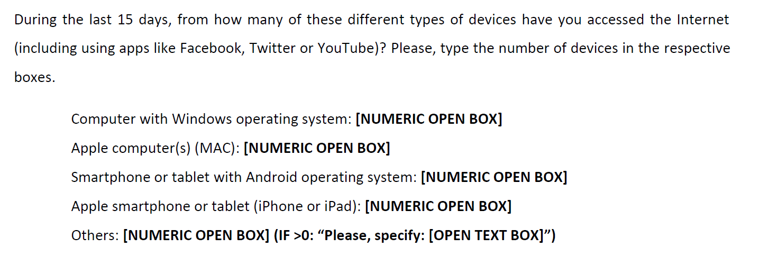
THIS STUDY
Assess prevalence (of device, browser and in-app undercoverage)
Combining survey and paradata

Slide 18
THIS STUDY
Assess prevalence (of device, browser and in-app undercoverage)
Combining survey and paradata

Slide 19
THIS STUDY
Assess prevalence (of device, browser and in-app undercoverage)
Combining survey and paradata

Slide 20
THIS STUDY
Assess prevalence (of device, browser and in-app undercoverage)
Combining survey and paradata
Compare this information with device paradata: Information about all the devices and browsers in which they are tracked .

Slide 21
THIS STUDY
Assess prevalence (of device, browser and in-app undercoverage)
What can we get from this?
We can estimate the undercoverage at different levels:
% fully covered;
% fully covered for device/browser/in-app;
% with 1, 2, 3, … n devices/browsers not covered;
% with type of device (e.g. iPhone) or browser (e.g. Safari) not covered.
We can investigate the characteristics of those partially covered.

Slide 22
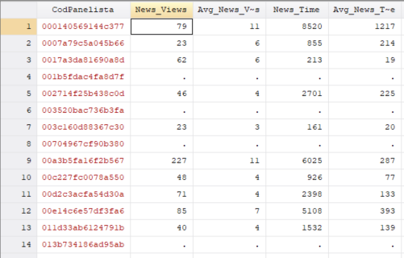
THIS STUDY
How to deal with the consequences of undercoverage
How should we consider a lack of behaviour?

Slide 23
THIS STUDY
How to deal with the consequences of undercoverage
How should we consider a lack of behaviour?

Slide 24
THIS STUDY
How to deal with the consequences of undercoverage
How should we consider a lack of behaviour?
0 minute visiting news outlets?
Missing information?

Slide 25
THIS STUDY
How to deal with the consequences of undercoverage
Better identifying real lack of behaviour and missings
For those completely covered, we can be quite certain that a lack of behaviour should be considered as 0.
For those partially undercovered, it is still not clear what to do.

Slide 26
THIS STUDY
How to deal with the consequences of undercoverage
Better identifying real lack of behaviour and missings
For those completely covered, we can be quite certain that a lack of behaviour should be considered as 0.
For those partially undercovered, it is still not clear what to do
We need more data

Slide 27
THIS STUDY
How to deal with the consequences of undercoverage
We (still) need more data

Slide 28
THIS STUDY
How to deal with the consequences of undercoverage
We (still) need more data
If the person did not use another device or browser to visit the pages/apps of interest -> undercoverage does not affect this measure
If the person did use another device or browser to visit the pages/apps of interest -> undercoverage affects this measure

Slide 29
THIS STUDY
How to deal with the consequences of undercoverage
We (still) need more data
If the person did not use another device or browser to visit the pages/apps of interest -> undercoverage does not affect this measure
If the person did use another device or browser to visit the pages/apps of interest -> undercoverage affects this measure
Most likely cannot be done for every web page/app of interest

Slide 30
CONCLUSIONS
Take-home messages
Undercoverage might be common and problematic
Evidence suggests that a high proportion suffers from device undercoverage.
More research is needed to understand the extent of this.
Although undercoverage con potentially bias metered data measures, no research has been conducted.
Identifying when a lack of behaviour is real or a product of undercoverage is key
Confounding both phenomena can inflate measurement and missing data errors.
Gathering information is necessary to both correct for this issue and be transparent about the quality of the sample.

Slide 31
Thank you
Questions?
ORIOL J. BOSCH | THE LONDON SCHOOL OF ECONOMICS / RECSM-UPF
o.bosch-jover@lse.ac.uk
orioljbosch
https://orioljbosch.com/

